Slide 1
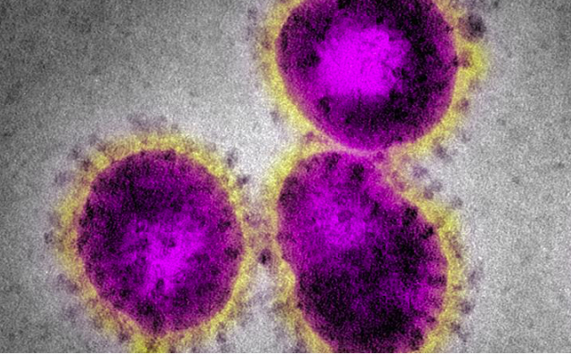
Epidemiology 101 Basic reproductive rate of infection (similar to R₀) (does one infection result in one new infection?) Threshold host population size/density.

Slide 2
Human populations are an epidemic waiting to happen. World-wide epidemic = pandemic. If we humans cannot find the willpower to control our own population, microbes will evolve to do it for us in ways that won’t be much fun. Ebola Coronavirus

Slide 3
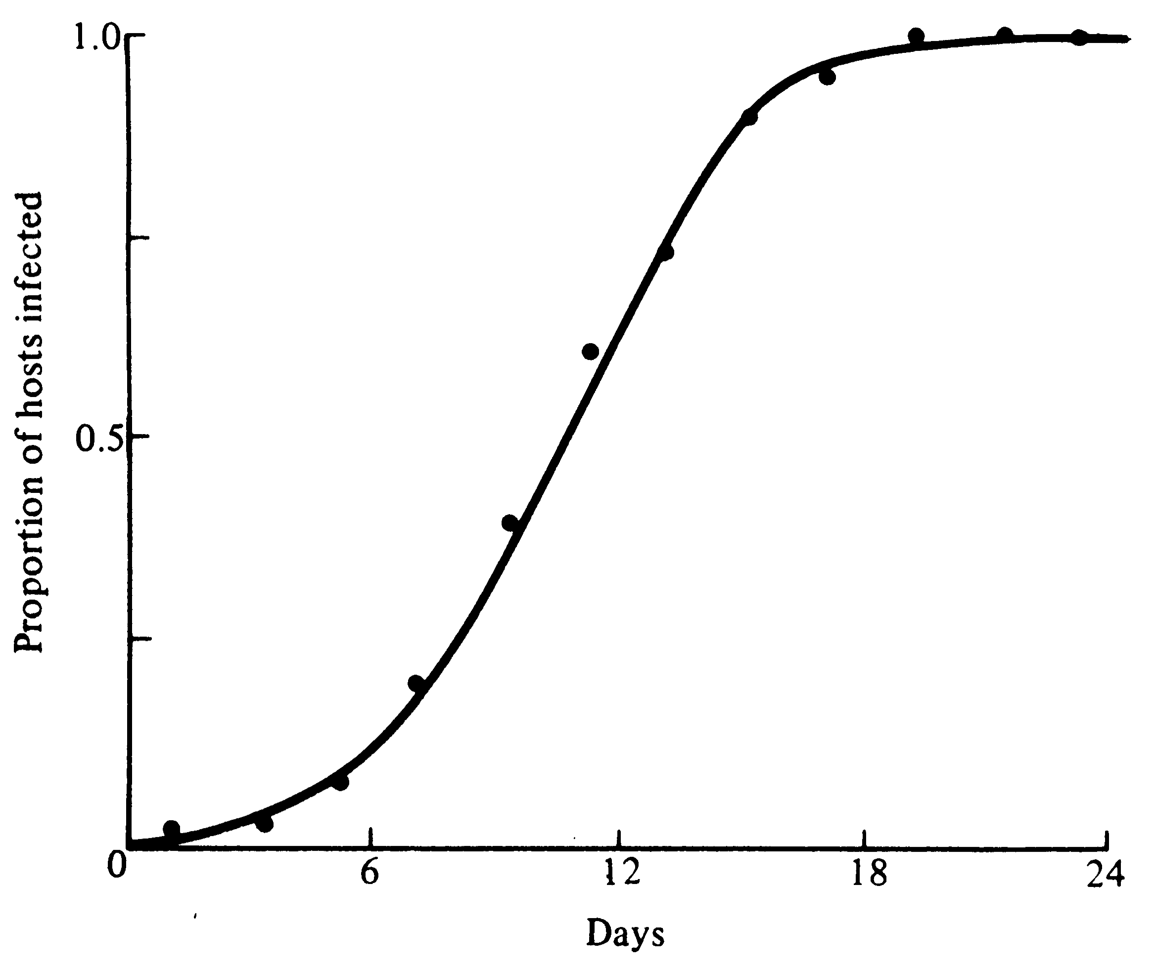
Sigmoidal time course of an epidemic without resistance
S = Susceptible
I = Infected
β = Rate of Transmission
Everyone Infected At High Densities
dI /dt = β IS dS/dt = – β IS
←Maximal Rate of Spread at Intermediate Densities (Fauci’s Peak)
←J-shaped Exponential Growth at Low Densities

Slide 4
