Slide 1
Overpopulation drives most of our problems
Our Afterlives
Future
Generations

Slide 2
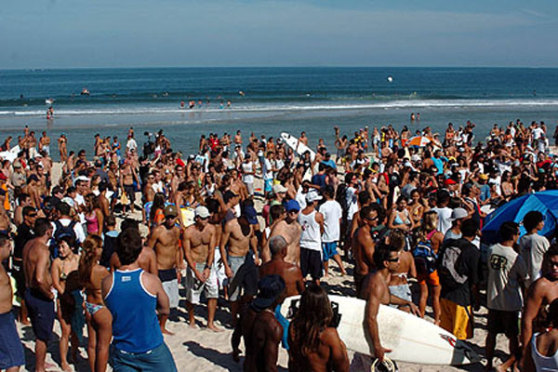
Overpopulation drives most of our problems.
Most people are in denial and will not even
say this politically incorrect word!

Slide 3
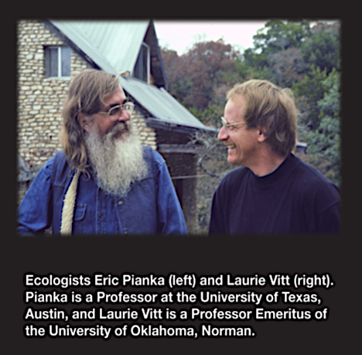
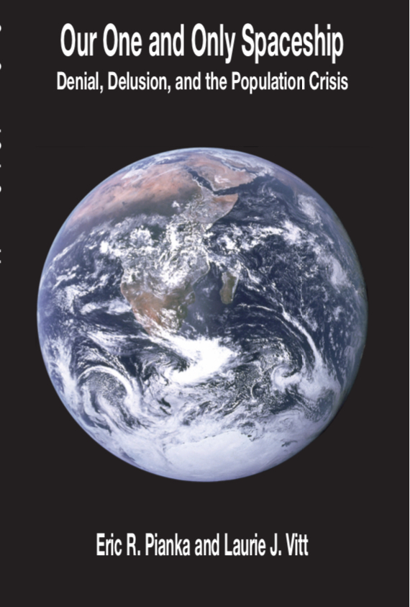

Slide 4
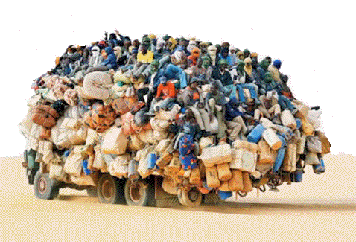
7.7 Billion
of us,
locked
in massive
denial about
overpopulation
The Haber-Bosch Nitrogen-Fixation
Process allowed humans to explode
(Food leads Population)

Slide 5
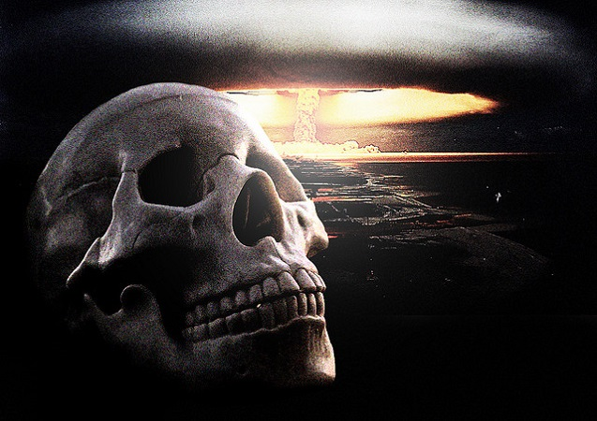
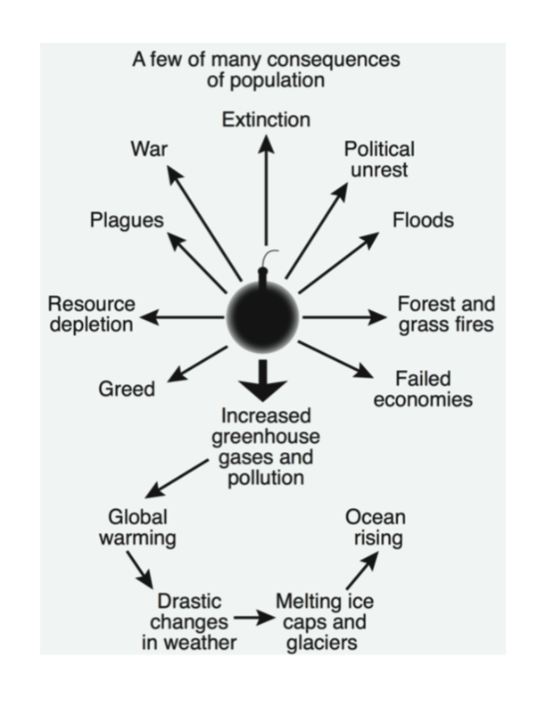
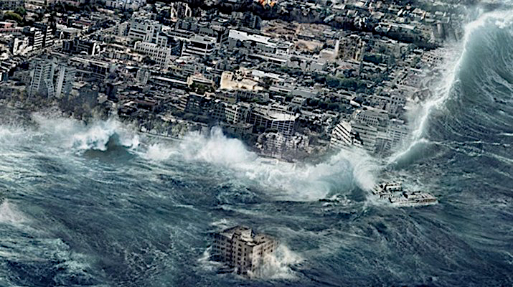
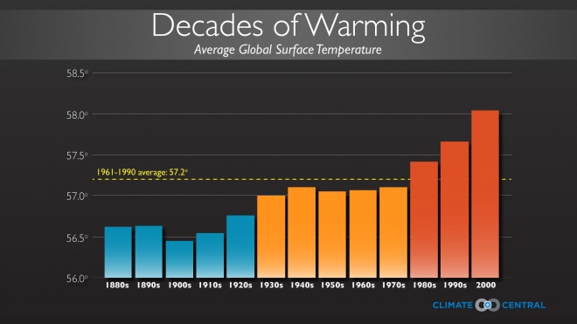
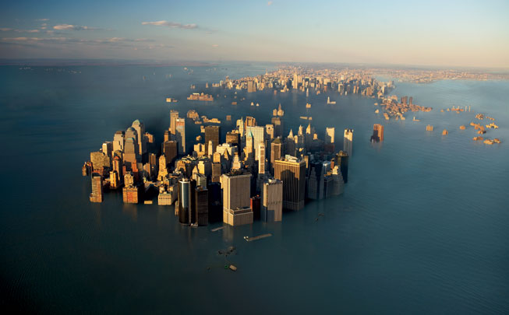
Coastal Cities
Inundated
Nuclear War
Flooding

Slide 6
Fossil fuel is our energy slave. It’s too cheap, one gallon
will move a one-ton car 30-50 miles (for as measly $2-3
dollars – just imagine having to push your car that far!)

Slide 7
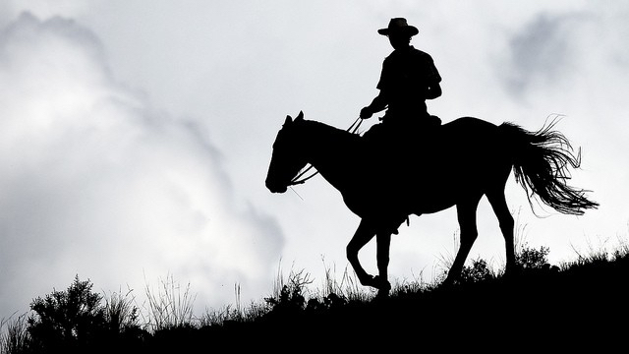

One horsepower = Energy of Ten Strong Men
One 500 hp Muscle Car = Energy of Five Thousand Men
Thousands of Muscle Cars = Energy of Millions of Men
We’ve got to get out of internal combustion vehicles!

Slide 8
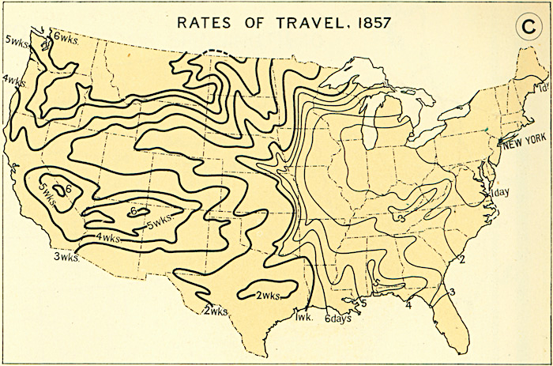
Before the railroads reached west,
time was measured in riding days

Slide 9
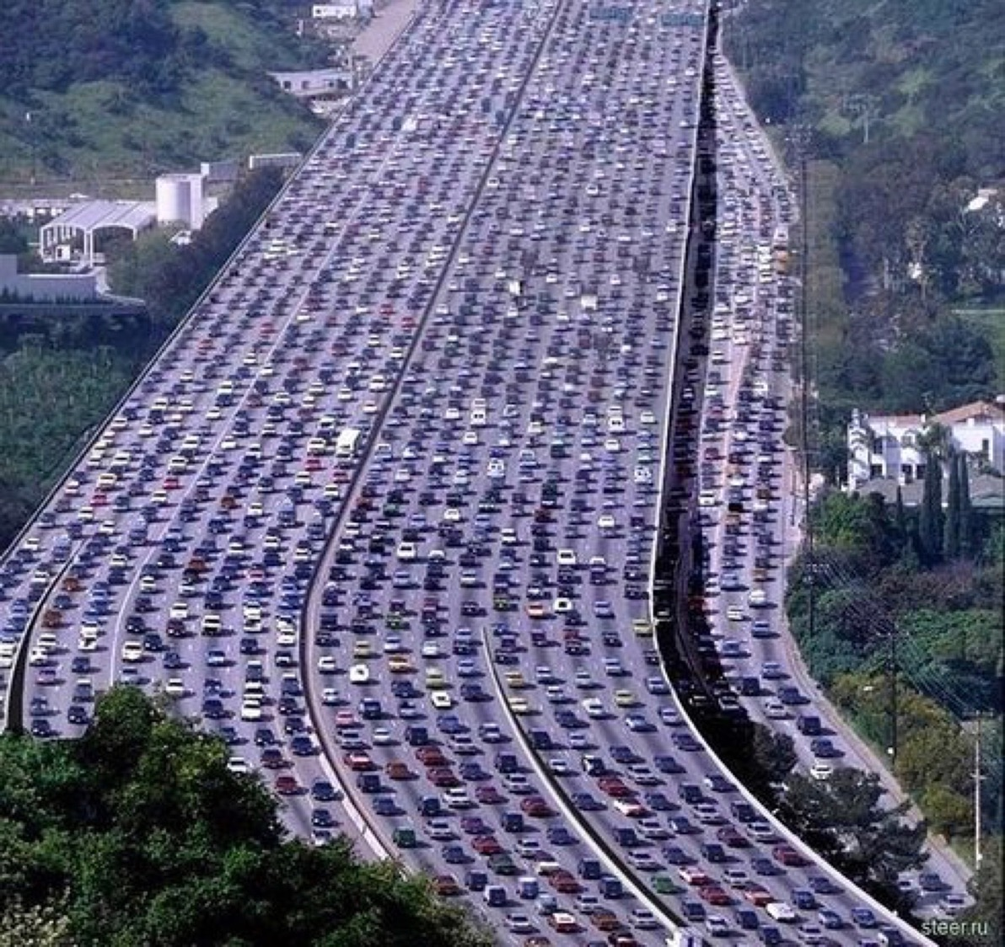
Freeway outside Houston
Energy of Millions of Men
Spewing out carbon
dioxide, going nowhere,
but headed for oblivion

Slide 10
Per Capita Energy Consumption times Population = Global Warming

Slide 11
Solar Panels are only a Short-term “Solution”
We must reduce per-capita energy consumption & Population

Slide 12
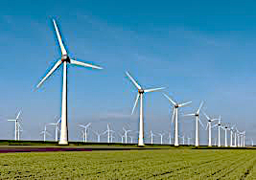
EROI = Energy return on investment
Must reduce energy consumption and population
Wind Turbines won’t “solve” our “energy shortage”

Slide 13
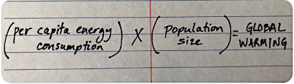
The so-called “Green New Deal” fatally ignores
overpopulation and offers only symptomatic
short-term relief from global warming. It is a
mere fantasy, a delusionary hopeless pipe dream.
We must reduce both per capita energy
consumption and population growth!

Slide 14
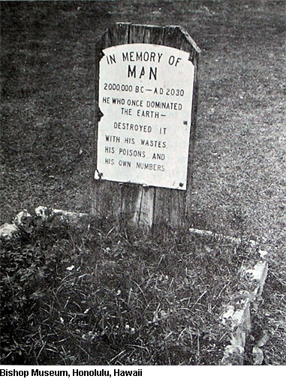
Man did not have forever to harness the forces of the
sun and stars. The Sun was an elderly light, long past
the turbulent heat of youth, and would some day join
the senile class of once-luminiferous bodies. In some
incredibly remote time a chance collision might blow
it up again into incandescent gas and start a new local
cosmic cycle, but of man there would be no trace. In
Balfours's terms, he “will go down into the pit, and all
his thoughts will perish. The uneasy consciousness,
which in this obscure corner has for a brief space
broken the contented silence of the universe, will be at
rest. Matter will know itself no longer. ‘Imperishable
monuments’ and ‘immortal deeds,’ death itself, and
love stronger than death, will be as though they had
never been. Nor will anything that IS be better or be
worse for all that labour, genius, devotion and suffering
of man have striven through countless generations to
effect.” Homer Smith, 1951. Man and His Gods. Earl of Balfour, 1895. Foundations of Belief.

Slide 15
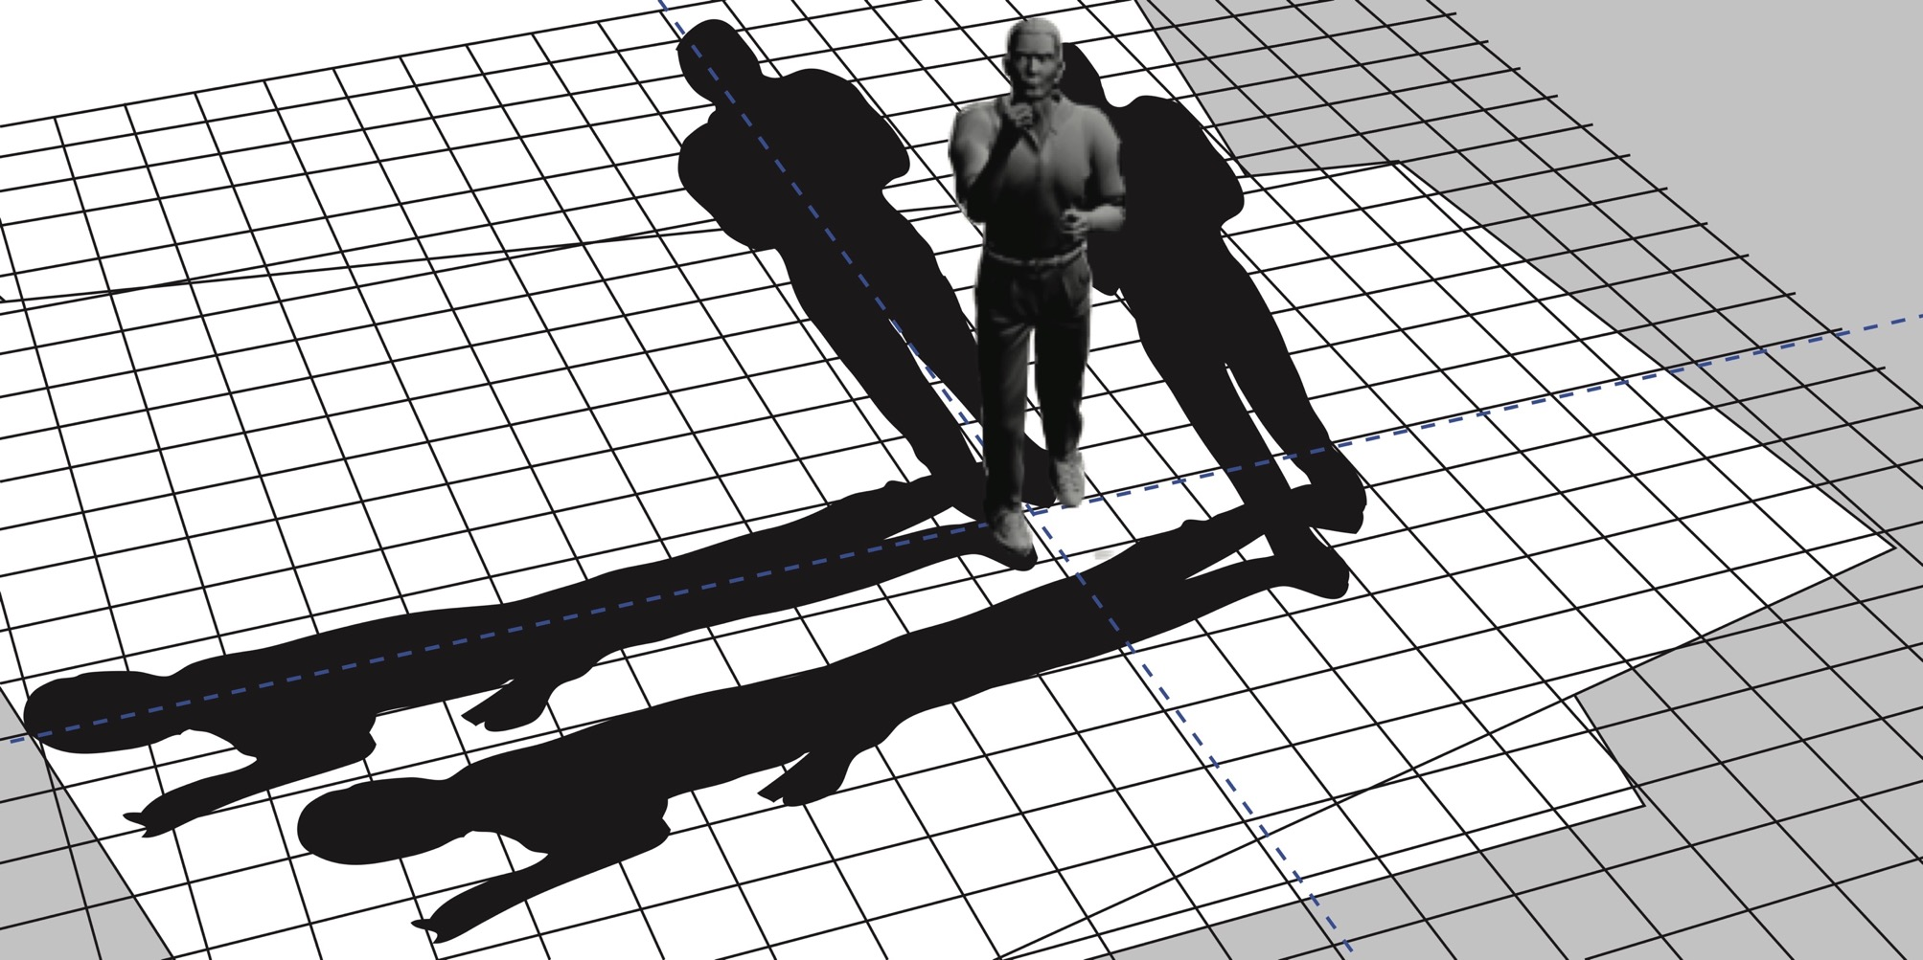
The future is coming up on us very fast.

Slide 16
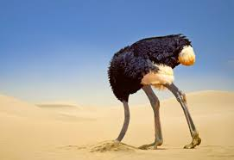
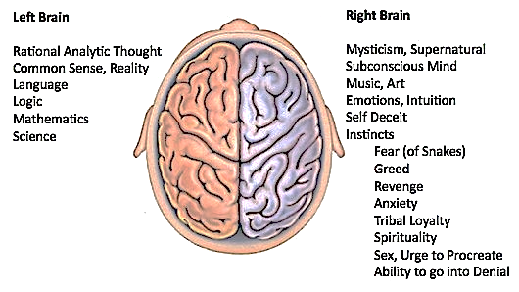
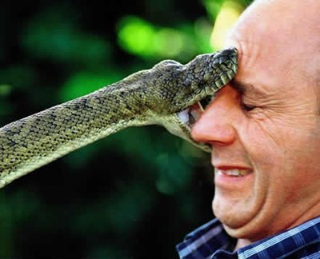
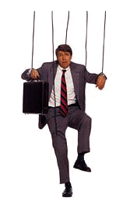

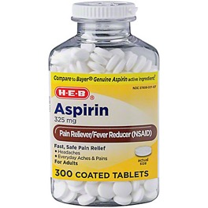
Denial
Denial
Broca’s Area
Fear
Natural Selection is
Our Puppet Master
Take an Aspirin
and call in the
morning
Music
Emotions

Slide 17

Message in a Bottle: hope that
someone will read it & get message
Message in a Bottle: hope that
someone will read it & get message
Oreskes
Conway

Slide 18
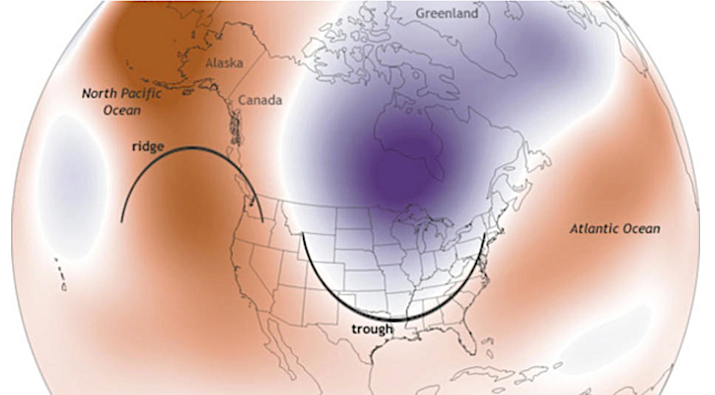
Wobbling Polar Jet Stream: Ridges and Troughs

Slide 19
Unburnable Fossil Fuels
(National Geographic)
Paris Agreement: Stay under 2°C

Slide 20
Antarctic Ice Melt

Slide 21
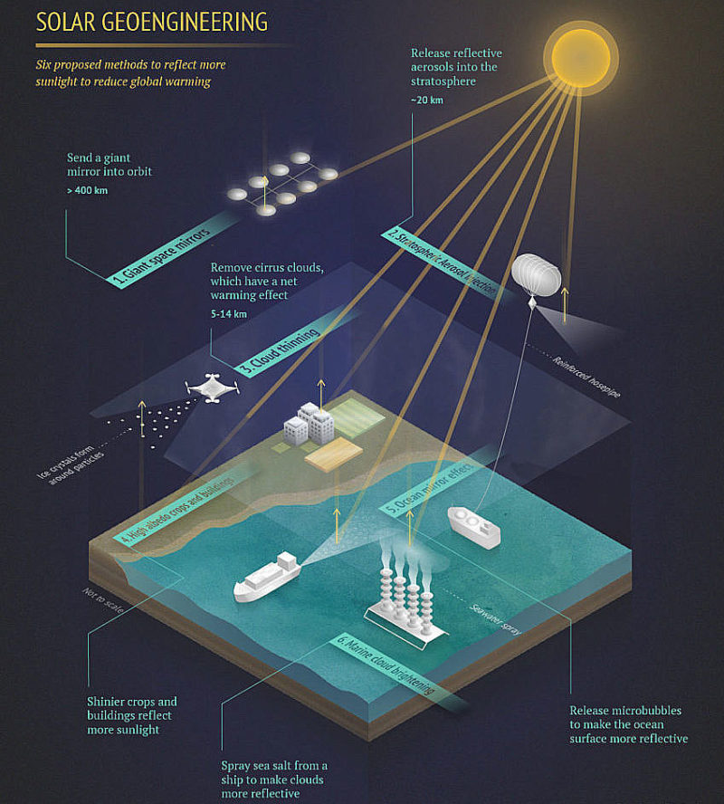
GeoEngineering will lead to climate wars
Release reflective aerosols into
Stratosphere ~20 km
Put a giant space mirror into orbit
>400km
Cloud thinning --remove cirrus clouds
5-14 km
High albedo crops and buildings
Ocean reflection effects
Marine cloud brightening
All offer only short-term relief
Wagner, G. and M. L. Weitzman. (2015).
Climate Shock. Princeton University Press.

Slide 22
What you can do personally about climate change and global warming: Do not drive, walk, use public transport, or ride a bicycle If you must drive, get out of Hummers, pickup trucks, and SUVs Shorten trips, drive as infrequently as possible. Lobby politicians and government to reduce CO₂ and methane emissions and get the USA back into the Paris global climate change agreement Oppose Coal Mining and Oil Pipelines Do Not Vote for deluded Politicians who 'think' climate change is a "hoax" Vote for Politicians who do THINK and CARE about environment Support green renewable energy wherever possible (only works in the short-term) Don't make babies - adopt unwanted children, reduce juvenile delinquency, crime

Slide 23
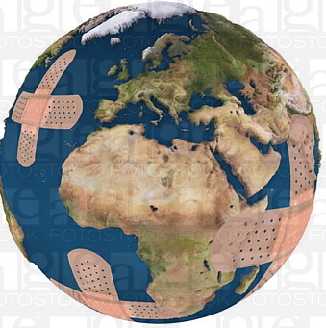
It is perilous to continue to ignore overpopulation, the cause of almost all of our many problems. Because people are in denial, they ignore the underlying cause, and merely try to treat its many symptoms over the
short term. We must face reality and take better care of our one and only spaceship!

