Slide 1
Second Exam
Mean = 69.15
SD = 14.28
N = 75
Range 34-96
V
|
|
|
Mean
|
|
|
|
F D’s C- C C+ B’s A- A
4 8 13 20 8 14 6 2

Slide 2
Direct versus Indirect Interactions
Exploitation vs. Interference competition
Apparent Competition
Competitive Mutualism
Facilitation
Food Chain Mutualism
Trophic Cascades (top-down, bottom up)
Bumble Bees & Britain’s Naval Prowess
Complex Population Interactions (Colwell’s Plant-Pollinator System)
Mutualisms, Ants, Bioluminescence
Euglossine bees and orchids
Heliconius butterflies (larval nitrogen reserves)
Cattle Egret Commensalism
Gause’s Paramecium competition lab experiments
Park’s Tribolium Lab Experiments
Lecture # 20
9 April 2020

Slide 3
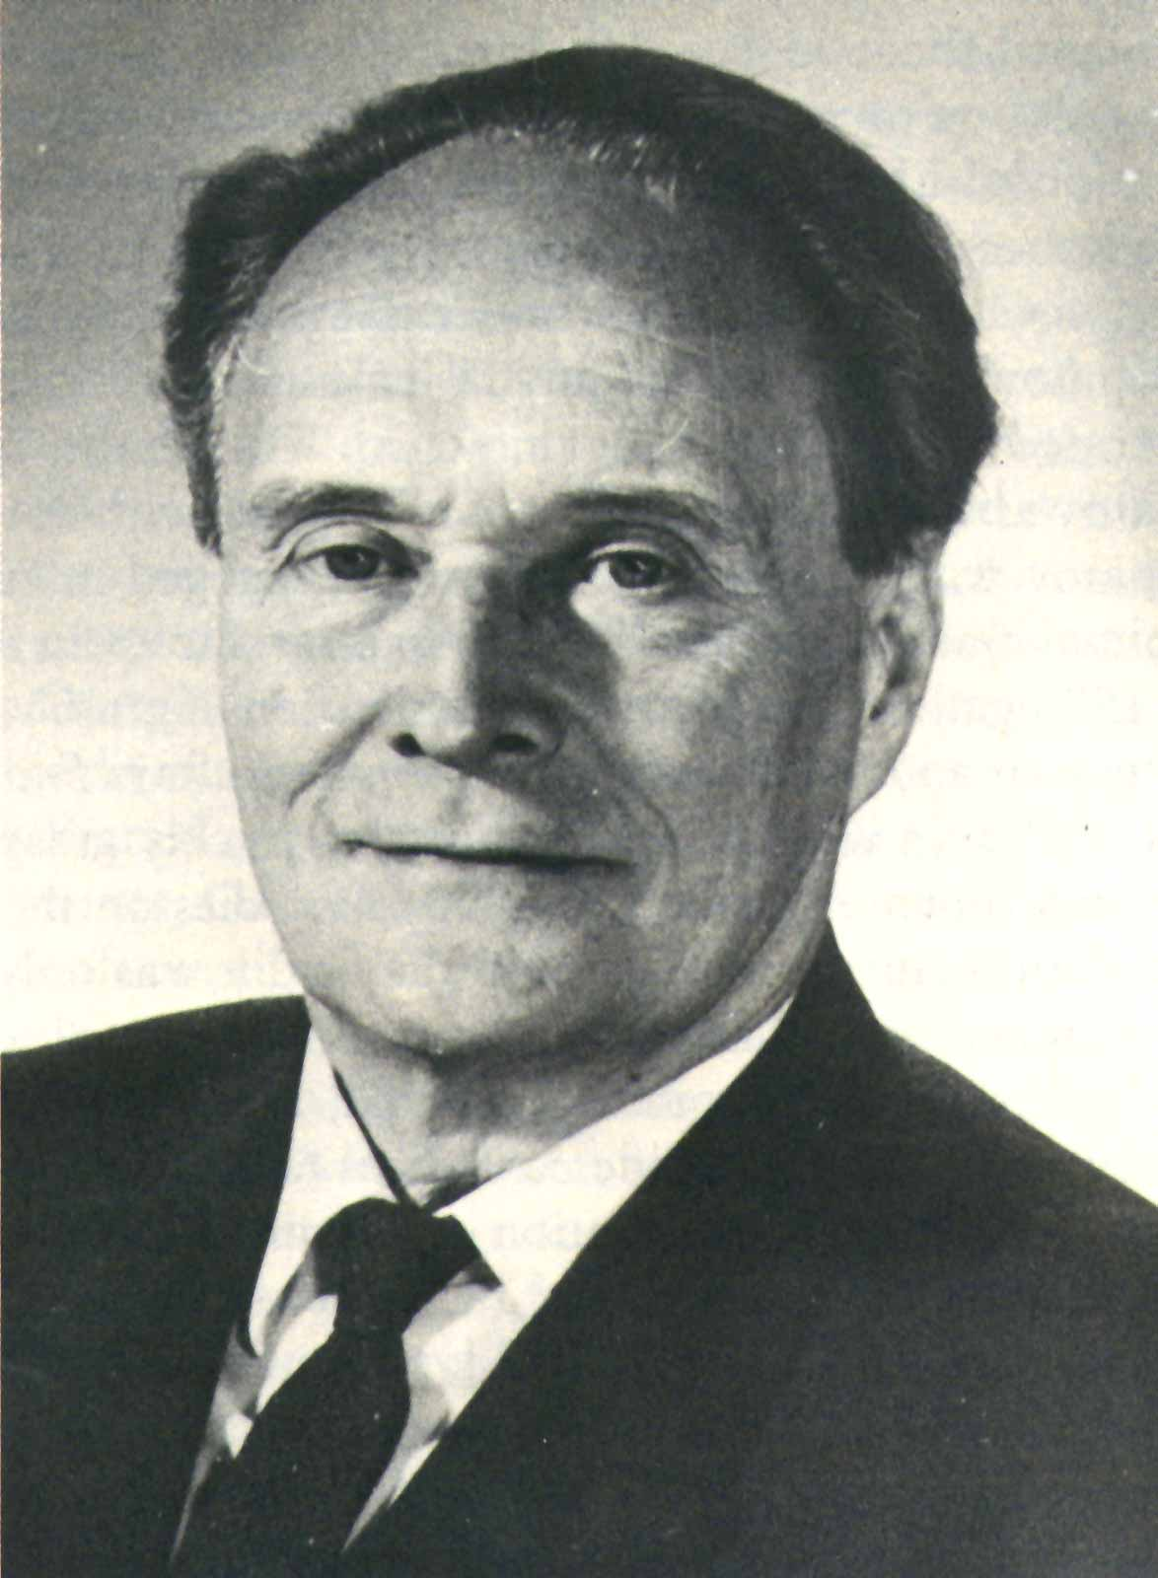
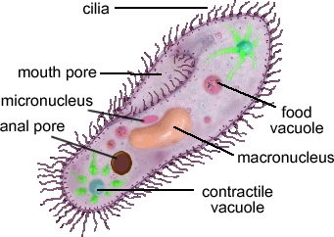
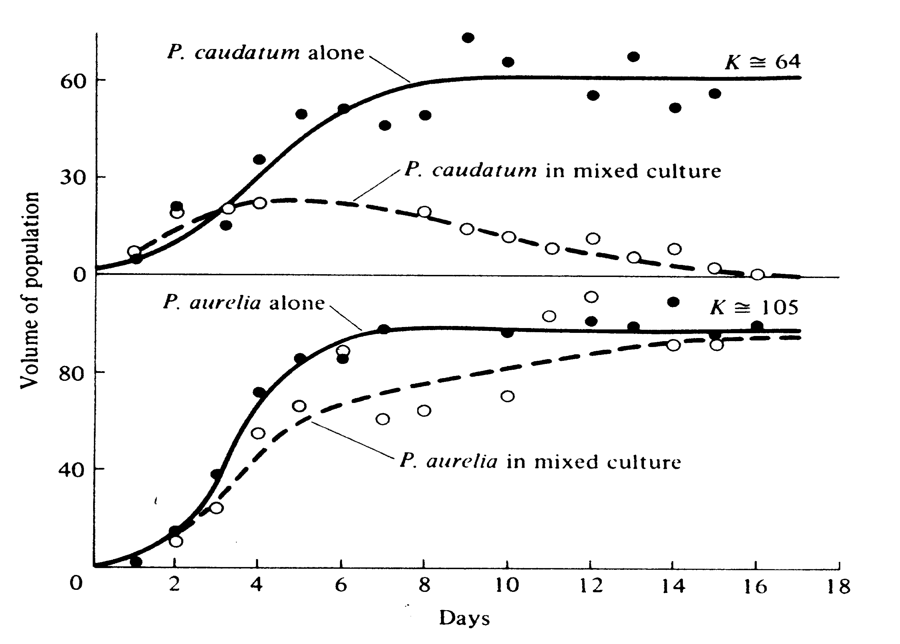
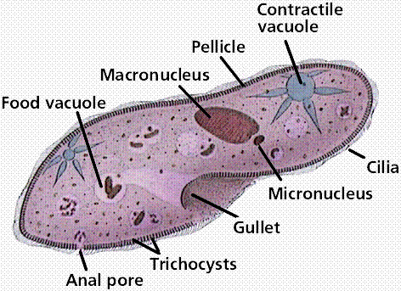
Competitive Exclusion
Georgii F. Gause

Slide 4
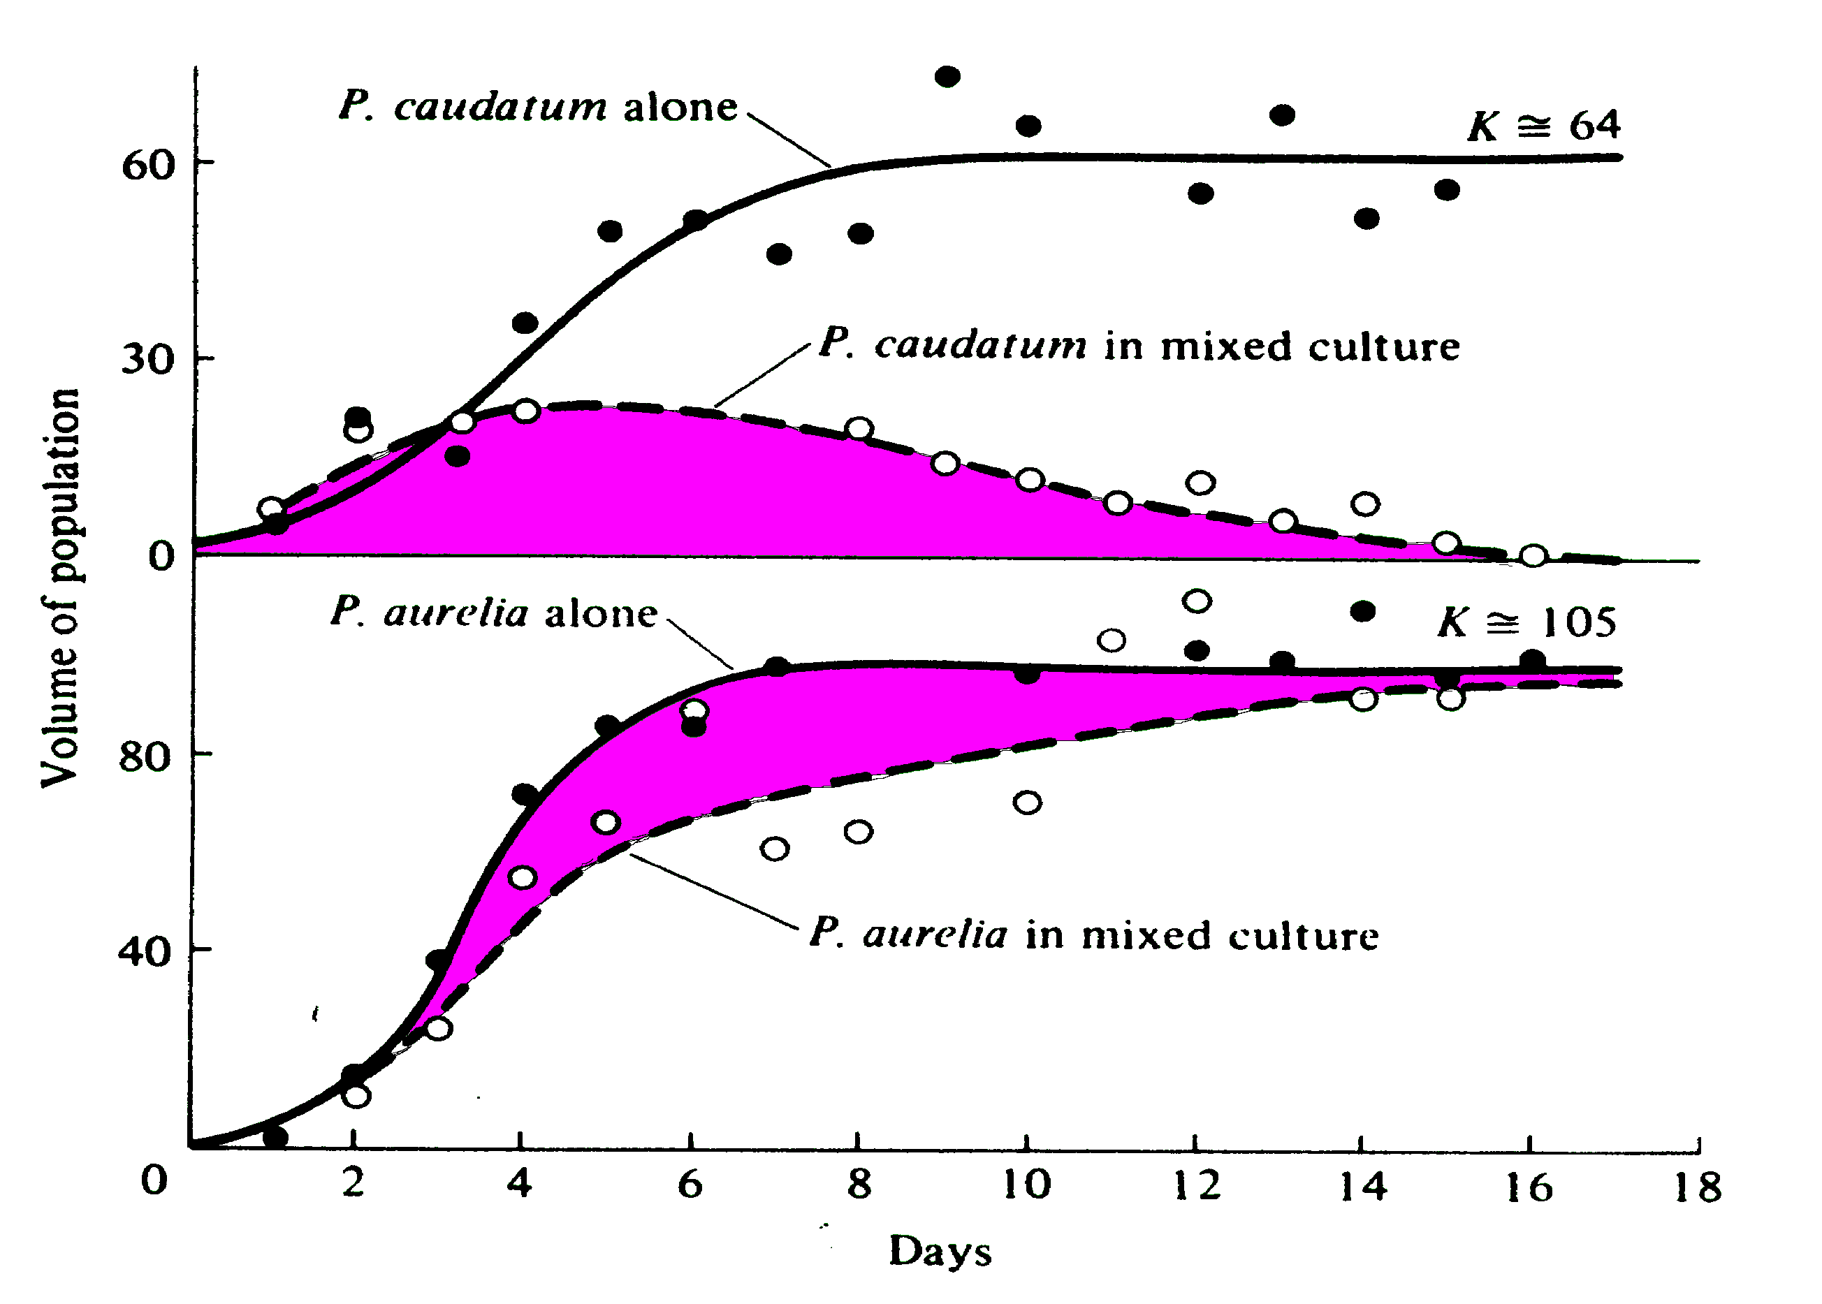
Competitive Exclusion
Georgii F. Gause

Slide 5
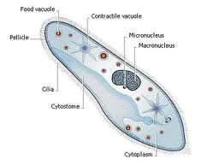
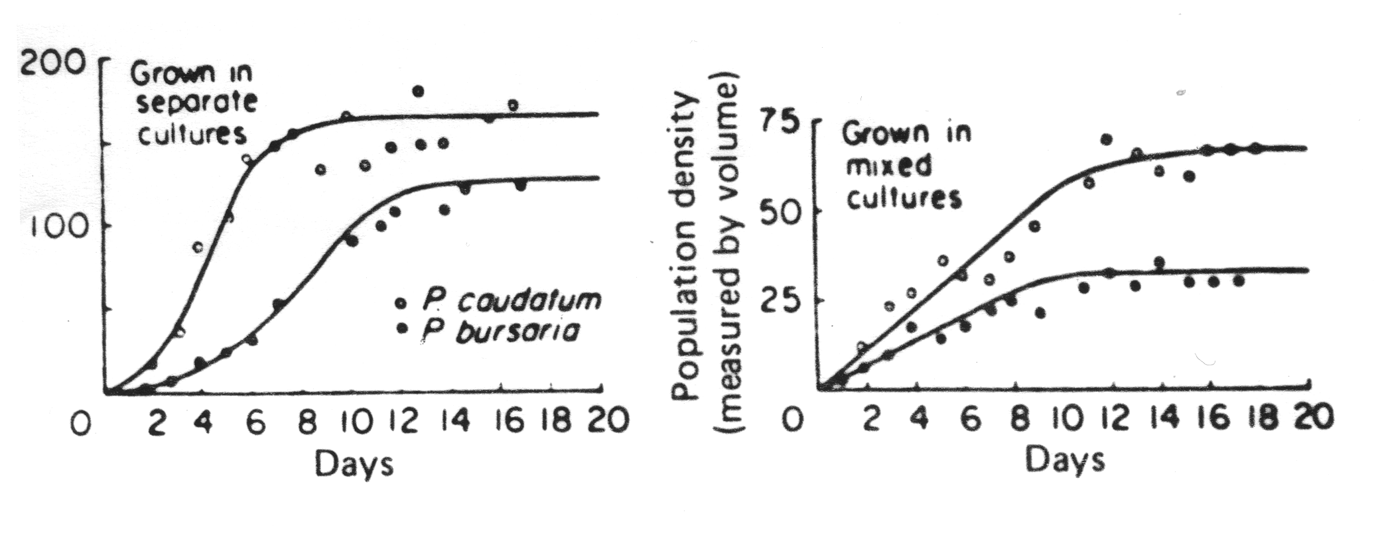
Coexistence of
two species of
Paramecium
G. F. Gause

Slide 6
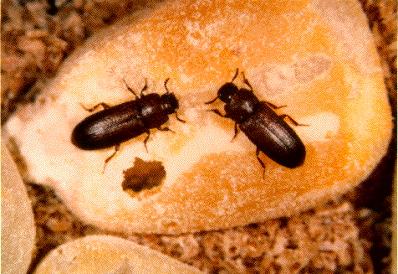
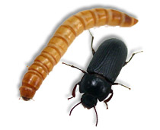
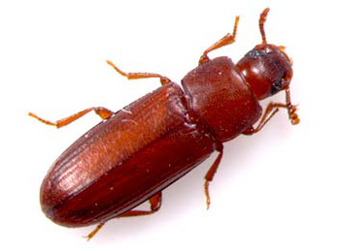
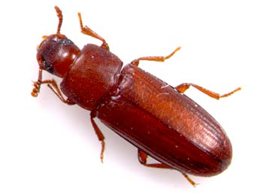
Outcome of Competition Between Two Species of Flour Beetles
_______________________________________________________________________________
Relative
Temp. Humidity Single Species
(°C) (%) Climate Numbers Mixed Species (% wins) confusum castaneum
_______________________________________________________________________________
34 70 Hot-Moist confusum = castaneum 0 100
34 30 Hot-Dry confusum > castaneum 90 10
29 70 Warm-Moist confusum < castaneum 14 86
29 30 Warm-Dry confusum > castaneum 87 13
24 70 Cold-Moist confusum <castaneum 71 29
24 30 Cold-Dry confusum >castaneum 100 0
_______________________________________________________________________________

Slide 7
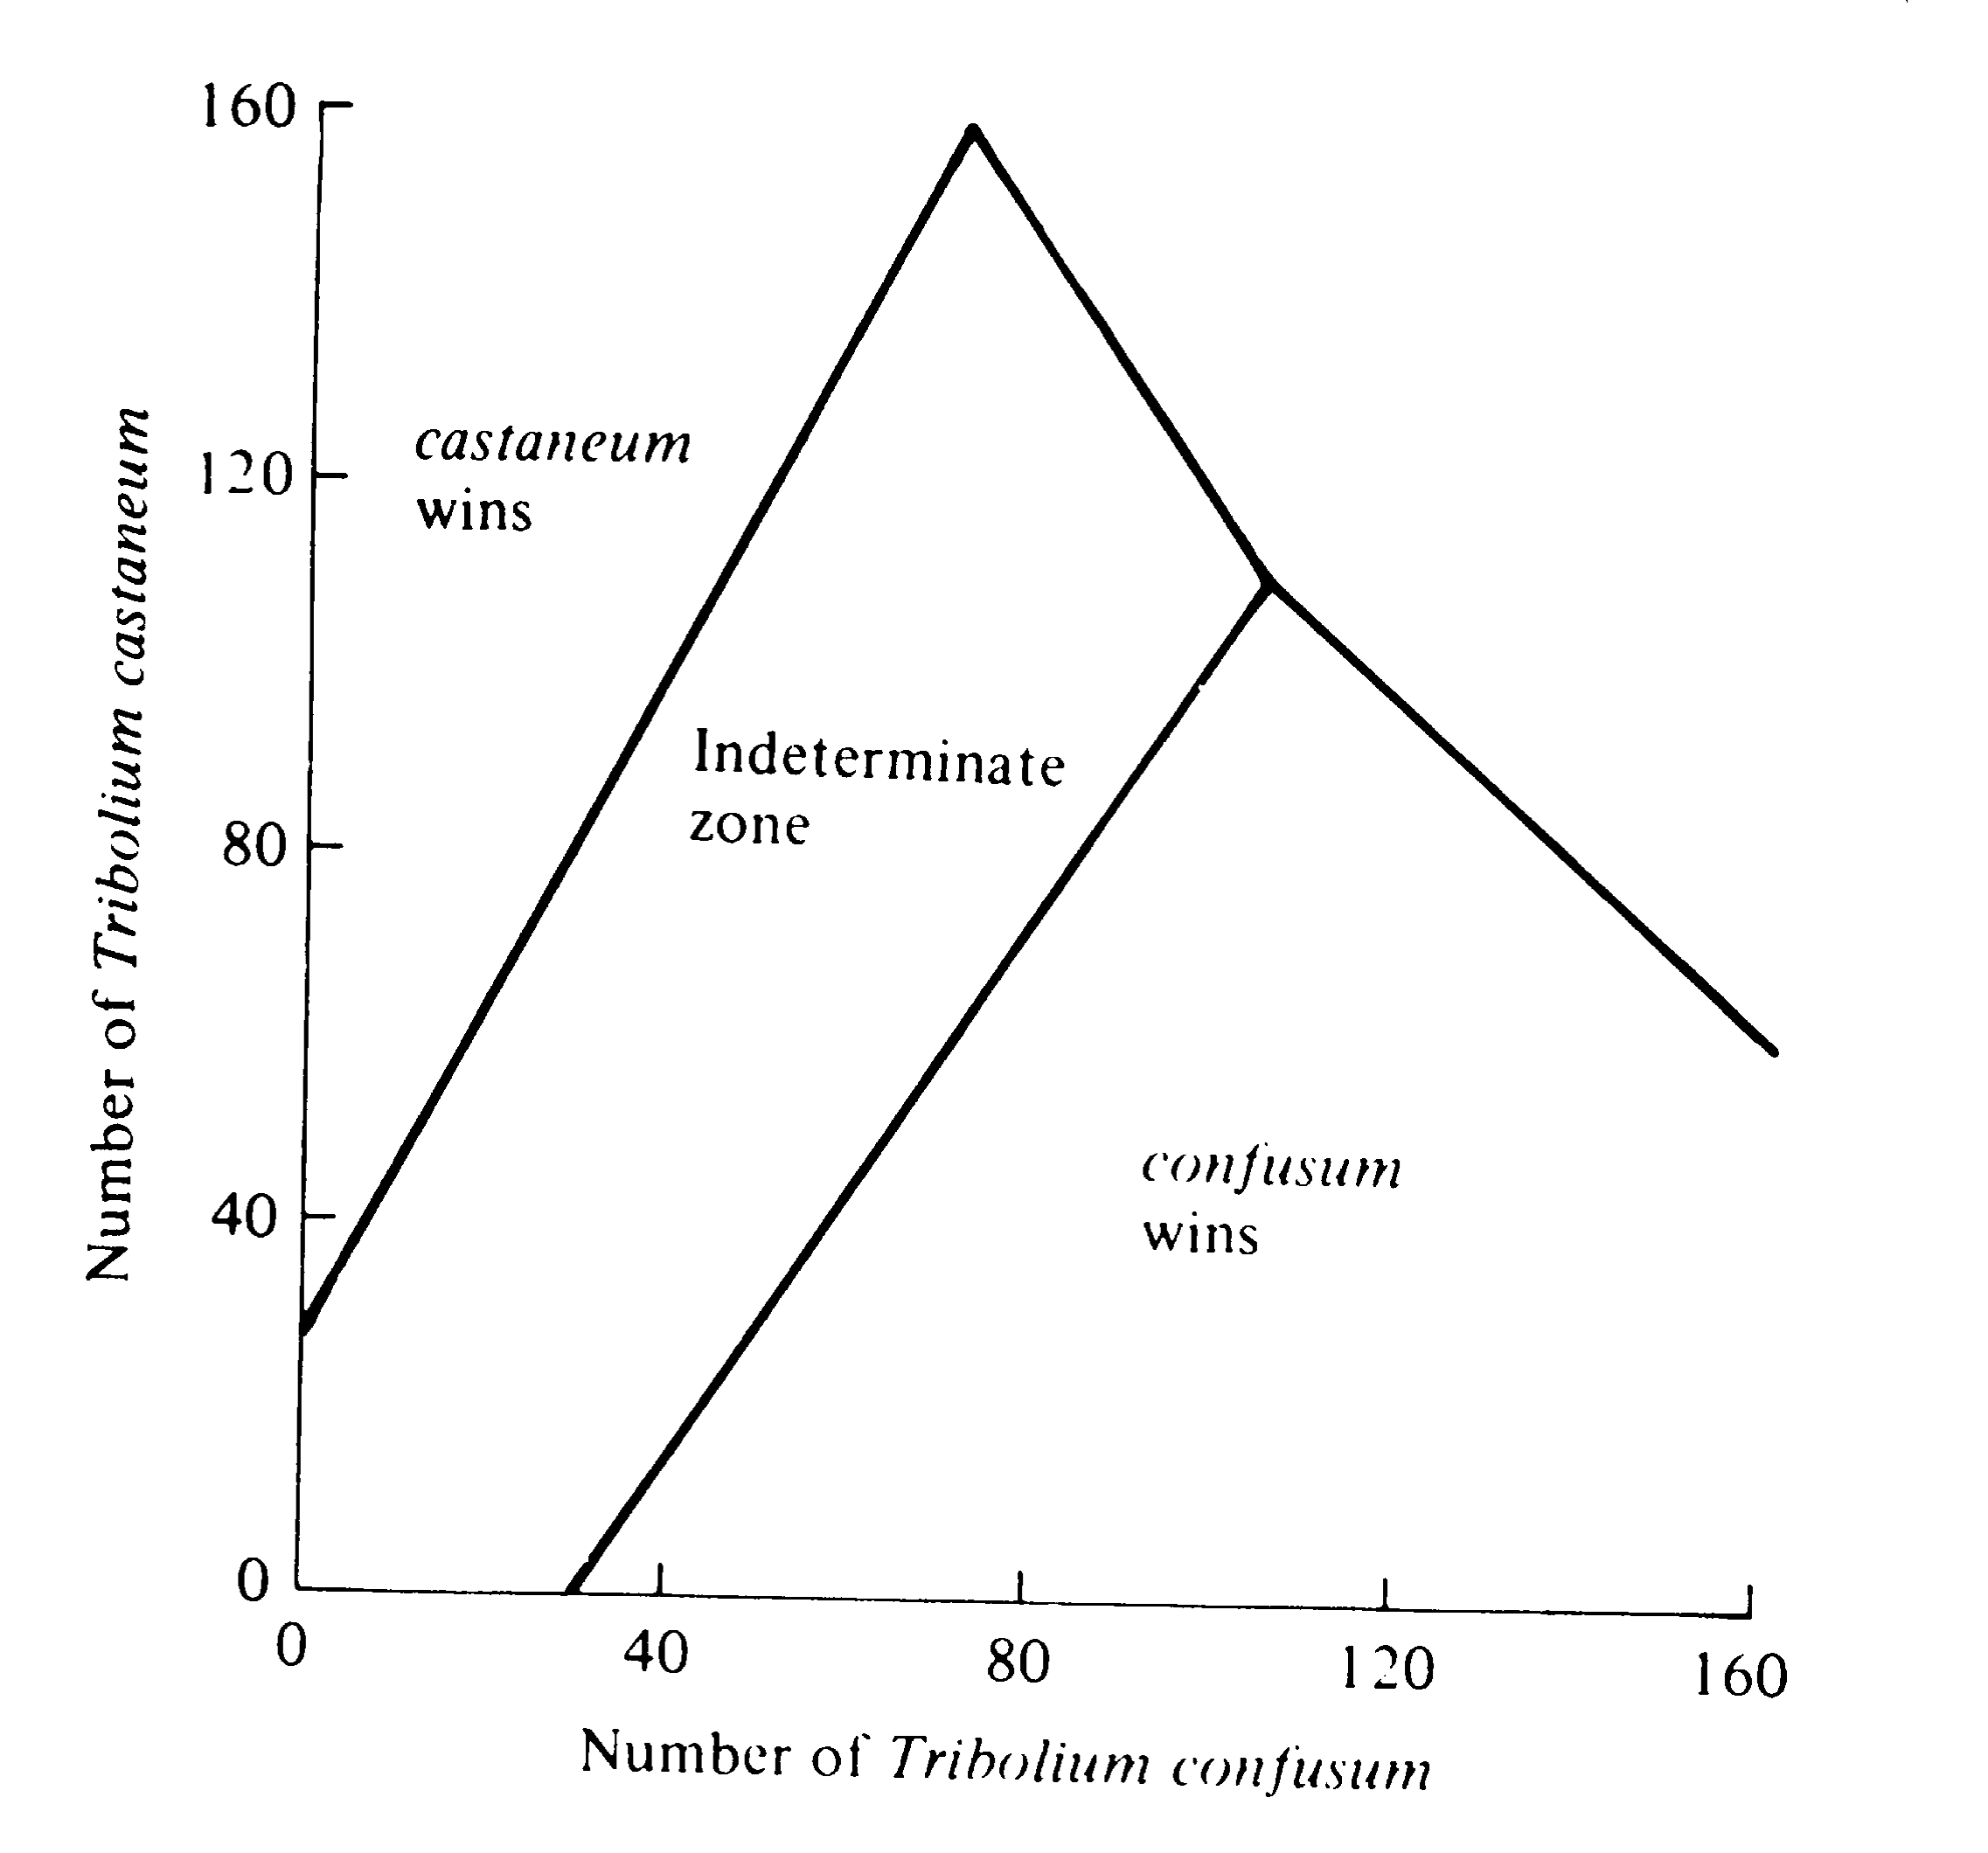
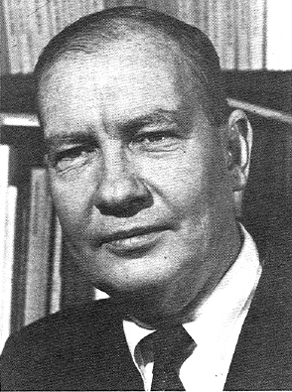
”
”
Thomas Park

Slide 8
Recall the Verhulst-Pearl Logistic Equation
dN/dt = rN [(K – N)/K] = rN {1– (N/K)}
dN/dt = rN – rN (N/K) = rN – {(rN²)/K}
dN/dt = 0 when [(K – N)/K] = 0
[(K – N)/K] = 0 when N = K
dN/dt = rN – (r/K)N²

Slide 9
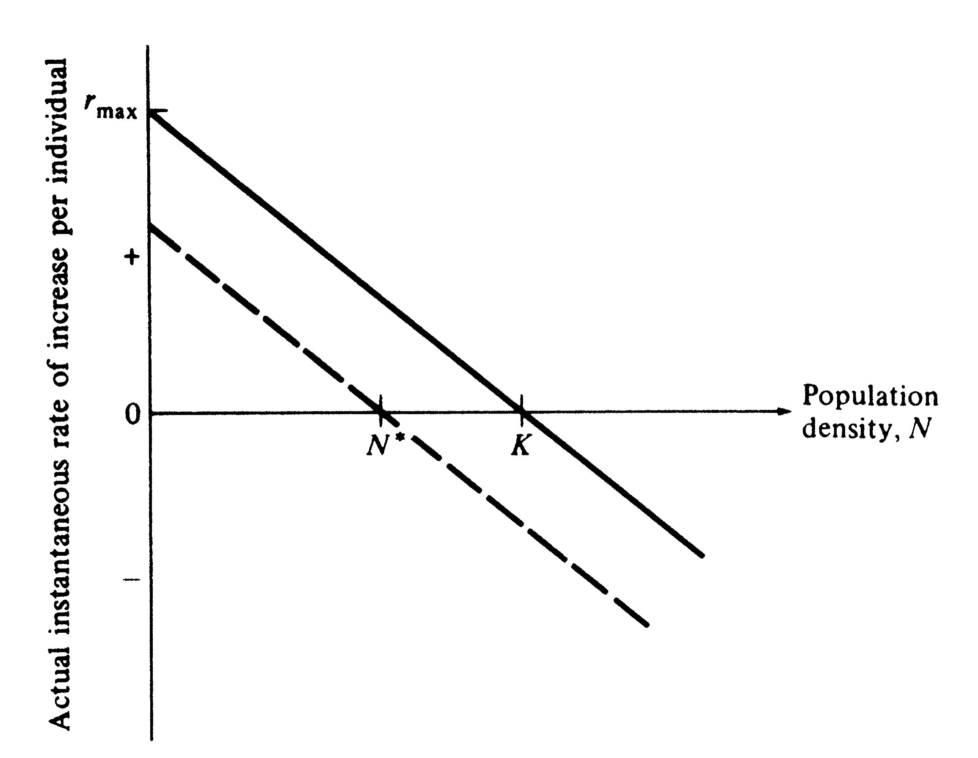
Inhibitory effect of each individual
on its own population growth is 1/K
Assumes linear response to crowding,
instant response (no lag),
r and K are fixed constants
V
r_{N}
V
N

Slide 10
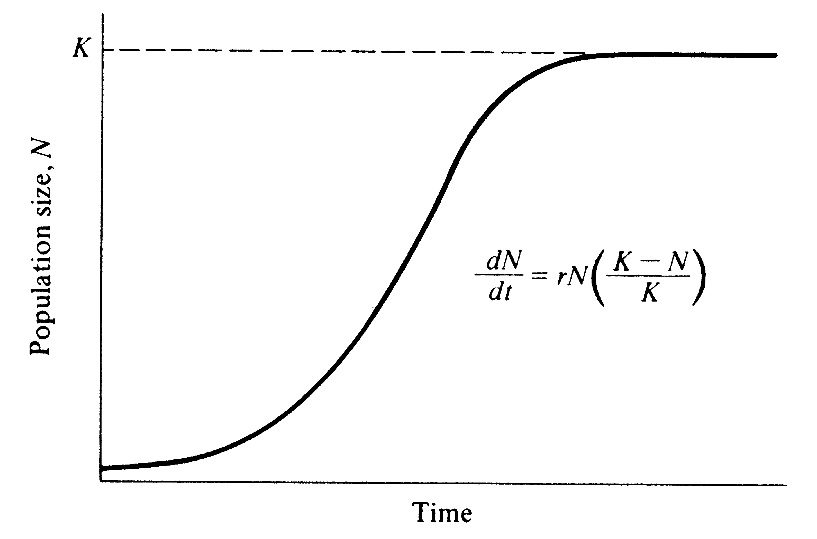
S - shaped sigmoidal population growth
Verhulst-Pearl Logistic
dN
dt
= maximal
K
2
O.

Slide 11
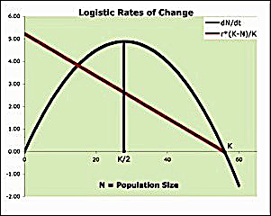
Sigmoidal population growth

Slide 12
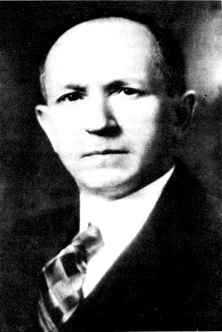
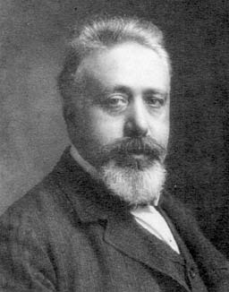
Lotka-Volterra
Competition Equations competition coefficient α_{ij} = per capita competitive effect of one individual of species j on the rate of increase of species i dN₁ /dt = r₁ N₁ ({K₁ – N₁ – α₁₂ N₂ }/K₁) dN₂ /dt = r₂ N₂ ({K₂ – N₂ – α₂₁ N₁ }/K₂)
Isoclines:
(K₁ – N₁ – α₁₂ N₂ )/K₁ = 0 when N₁ = K₁ – α₁₂ N₂
(K₂ – N₂ – α₂₁ N₁ )/K₂ = 0 when N₂ = K₂ – α₂₁ N₁
Alfred Lotka Vito Volterra

Slide 13
Intercepts:
N₁ = K₁ – α₁₂ N₂
if N₂ = K₁ / α_{12,} then N₁ = 0
N₂ = K₂ – α₂₁ N₁
if N₁ = K₂ / α_{21,} then N₂ = 0

Slide 14
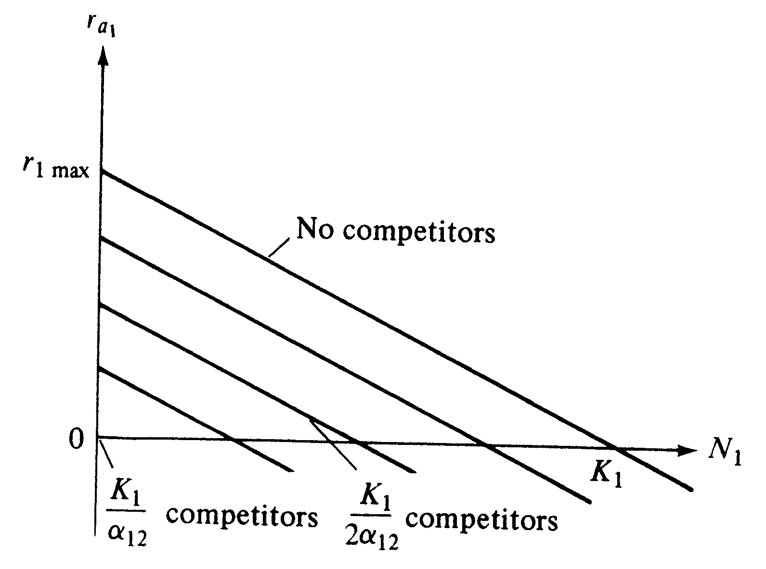

Slide 15
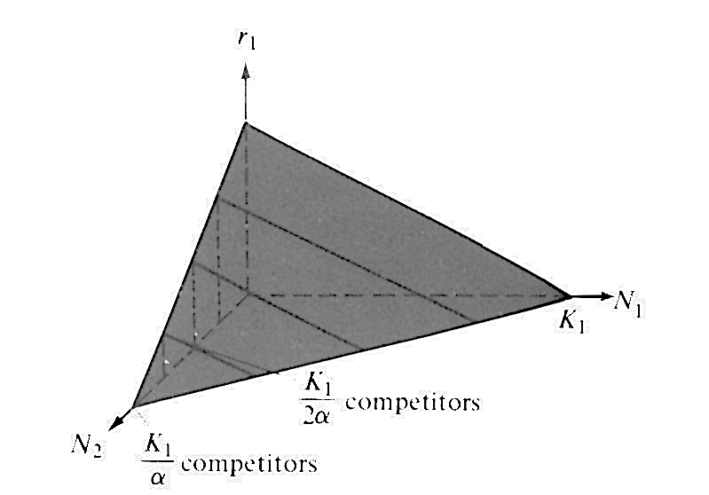
No competitors
/
/
competitors
\
2α
competitors

Slide 16
No competitors
/
/
competitors
\
2α
competitors

Slide 17
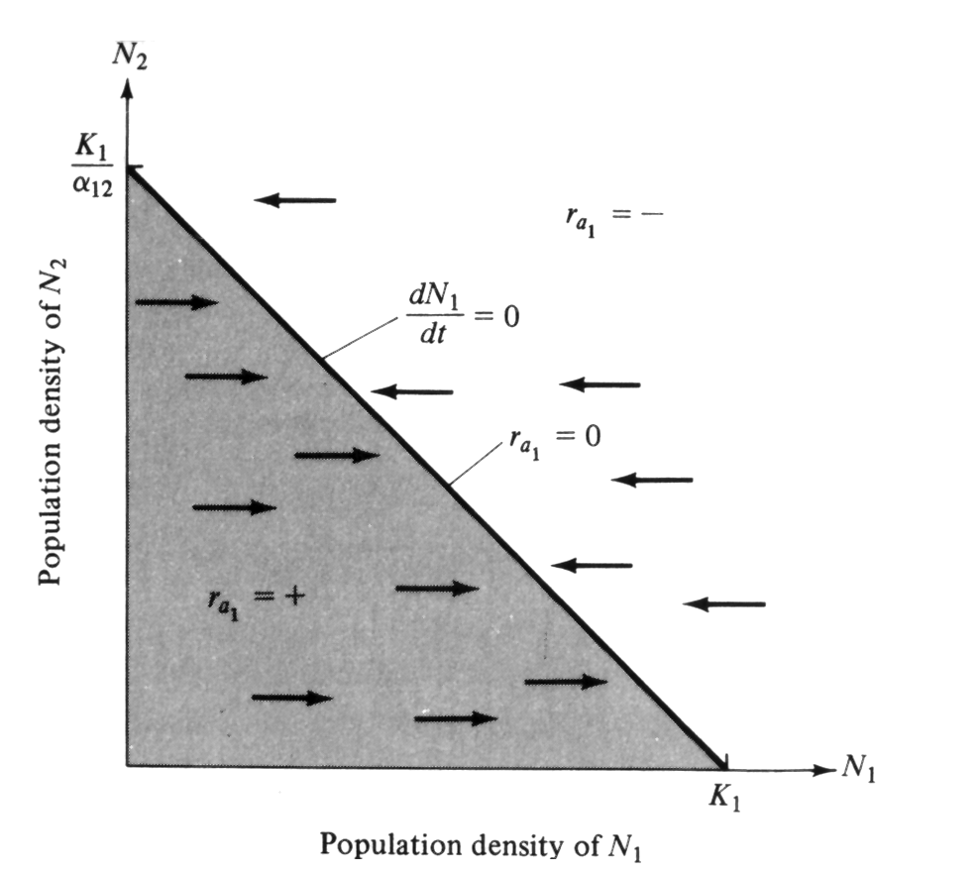
Zero isocline for species 1
N₁* = K₁ – α₁₂ N₂

Slide 18
Four Possible Cases of Competition
Under the Lotka–Volterra
Competition Equations
_____________________________________________________________________
Species 1 can contain Species 1 cannot contain
Species 2 (K₂/α₂₁ < K ₁) Species 2 (K₂/α₂₁ > K ₁)
_____________________________________________________________________
Species 2 can contain Case 3: Either species Case 2: Species 2
Species 1 (K₁/α₁₂ < K₂) can win always wins
_____________________________________________________________________
Species 2 cannot contain Case 1: Species 1 Case 4: Neither species
Species 1 (K₁/α₁₂ > K₂) always wins can contain the other; stable coexistence
_____________________________________________________________________
Vito Volterra
Alfred Lotka

Slide 19
Interspecific Competition leads to Niche Diversification
Two types of Interspecific Competition:
Exploitation competition is indirect, occurs when a resource is in short supply by resource depression
Interference competition is direct and occurs via antagonistic encounters such as interspecific territoriality or production of toxins

Slide 20
Lotka-Volterra
Competition Equations competition coefficient α_{ij} = per capita competitive effect of one individual of species j on the rate of increase of species i dN₁ /dt = r₁ N₁ ({K₁ – N₁ – α₁₂ N₂ }/K₁) dN₂ /dt = r₂ N₂ ({K₂ – N₂ – α₂₁ N₁ }/K₂)
Solve for Isoclines by setting dN/dt‘s equal to zero:
(K₁ – N₁ – α₁₂ N₂ )/K₁ = 0 when N₁ = K₁ – α₁₂ N₂
(K₂ – N₂ – α₂₁ N₁ )/K₂ = 0 when N₂ = K₂ – α₂₁ N₁
Alfred Lotka Vito Volterra

Slide 21
Lotka-Volterra
Competition Equations competition coefficient α_{ij} = per capita competitive effect of one individual of species j on the rate of increase of species I
N₁ x N₁ = Self Damping
N₁ x N₂ = Interspecific Contacts dN₁ /dt = r₁ N₁ ({K₁ – N₁ – α₁₂ N₂ }/K₁) dN₂ /dt = r₂ N₂ ({K₂ – N₂ – α₂₁ N₁ }/K₂)
Solve for Isoclines by setting dN/dt‘s equal to zero:
(K₁ – N₁ – α₁₂ N₂ )/K₁ = 0 when N₁ = K₁ – α₁₂ N₂
(K₂ – N₂ – α₂₁ N₁ )/K₂ = 0 when N₂ = K₂ – α₂₁ N₁
Alfred Lotka Vito Volterra

Slide 22
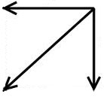
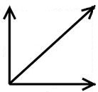
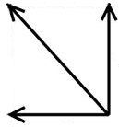
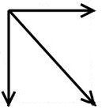
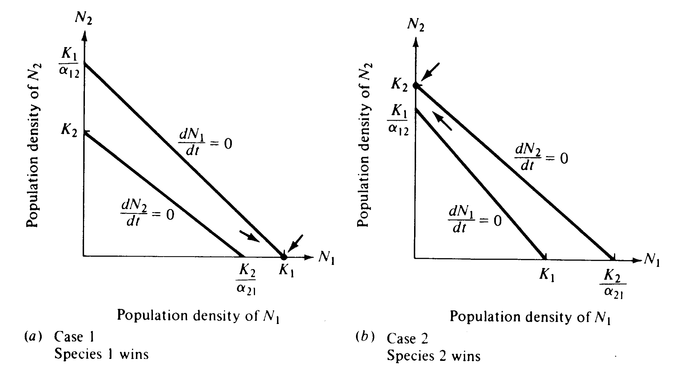
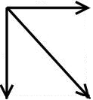
Resultant Vectors
O
O

Slide 23
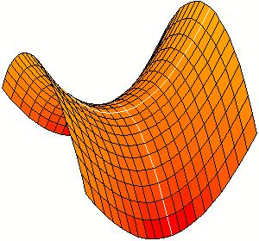
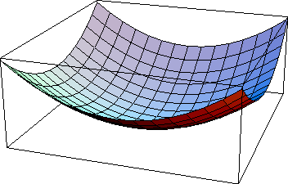
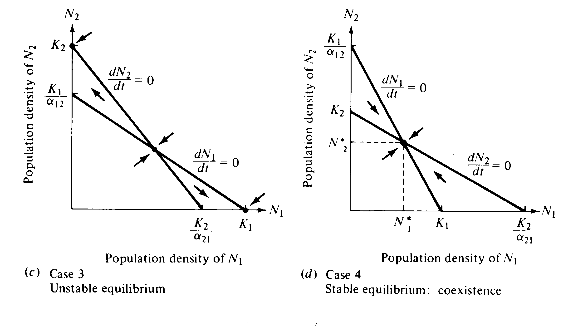
Saddle Point
Point Attractor
O
O
O

Slide 24
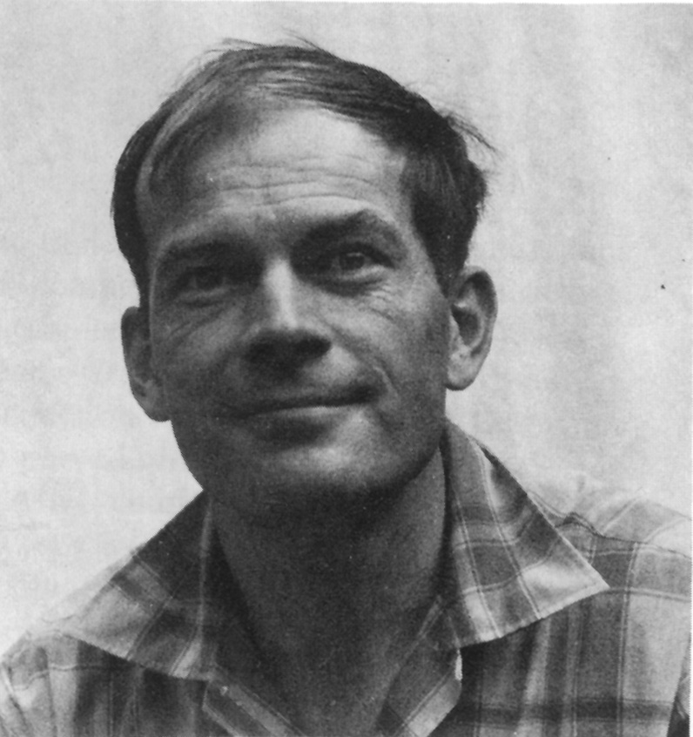
Lotka-Volterra Competition Equations for n species (i = 1, n): dN_{i} /dt = r_{i}N_{i} ({K_{i} – N_{i} – Σ α_{ij} N_{j}}/K_{i})
N_{i}* = K_{i} – Σ α_{ij} N_{j} where the summation is over j from 1 to n, excluding i
Diffuse Competition
Σ α_{ij} N_{j}
Robert H. MacArthur

Slide 25
Lotka-Volterra Competition Equations for 3 species: dN₁ /dt = r₁ N₁ ({K₁ – N₁ – α₁₂ N₂ – α₁₃ N₃ }/K₁) dN₂ /dt = r₂ N₂ ({K₂ – N₂ – α₂₁ N₁ – α₂₃ N₃ }/K₂) dN₃ /dt = r₃ N₃ ({K₃ – N₃ – α₃₁ N₁ – α₃₂ N₂ }/K₃)
Isoclines: dN/dt = 0 {curly brackets, above}
(K₁ – N₁ – α₁₂ N₂ – α₁₃ N₃ ) = 0 when N₁ = K₁ – α₁₂ N₂ – α₁₃ N₃
(K₂ – N₂ – α₂₁ N₁ – α₂₃ N₃ ) = 0 when N₂ = K₂ – α₂₁ N₁ – α₂₃ N₃
(K₃ – N₃ – α₃₁ N₁ – α₃₂ N₂ ) = 0 when N₃ = K₃ – α₃₁ N₁ – α₃₂ N₂

Slide 26
Lotka-Volterra Competition Equations for n species
(i = 1, n): dN_{i} /dt = r_{i}N_{i} ({K_{i} – N_{i} – Σ α_{ij} N_{j}}/K_{i})
N_{i}* = K_{i} – Σ α_{ij} N_{j} where the summation is over j from 1 to n, excluding i
Diffuse Competition Σ α_{ij} N_{j}

Slide 27
Alpha matrix of competition coefficients
α₁₁ α₁₂ α_{13 . . .} α_{1n}
α₂₁ α₂₂ α_{23 . . .} α_{2n}
α₃₁ α₃₂ α_{33 . . .} α_{3n}
. . . . . . .
. . . . . . .
α_{n1} α_{n2} α_{n3 . . .} α_{nn}
Self damping elements on the diagonal α_{ii} equal 1.

Slide 28
Mutualism Equations (pp. 234-235, Chapter 11)
dN₁ /dt = r₁ N₁ ({X₁ – N₁ + α₁₂ N₂ }/X₁)
dN₂ /dt = r₂ N₂ ({X₂ – N₂ + α₂₁ N₁ }/X₂)
(X₁ – N₁ + α₁₂ N₂ )/X₁ = 0 when N₁ = X₁ + α₁₂ N₂
(X₂ – N₂ + α₂₁ N₁ )/X₂ = 0 when N₂ = X₂ + α₂₁ N₁
If X₁ and X₂ are positive and α₁₂ and α₂₁ are chosen so that isoclines cross,
a stable joint equilibrium exists.
Intraspecific self damping must be stronger than interspecific positive mutualistic effects.

Slide 29
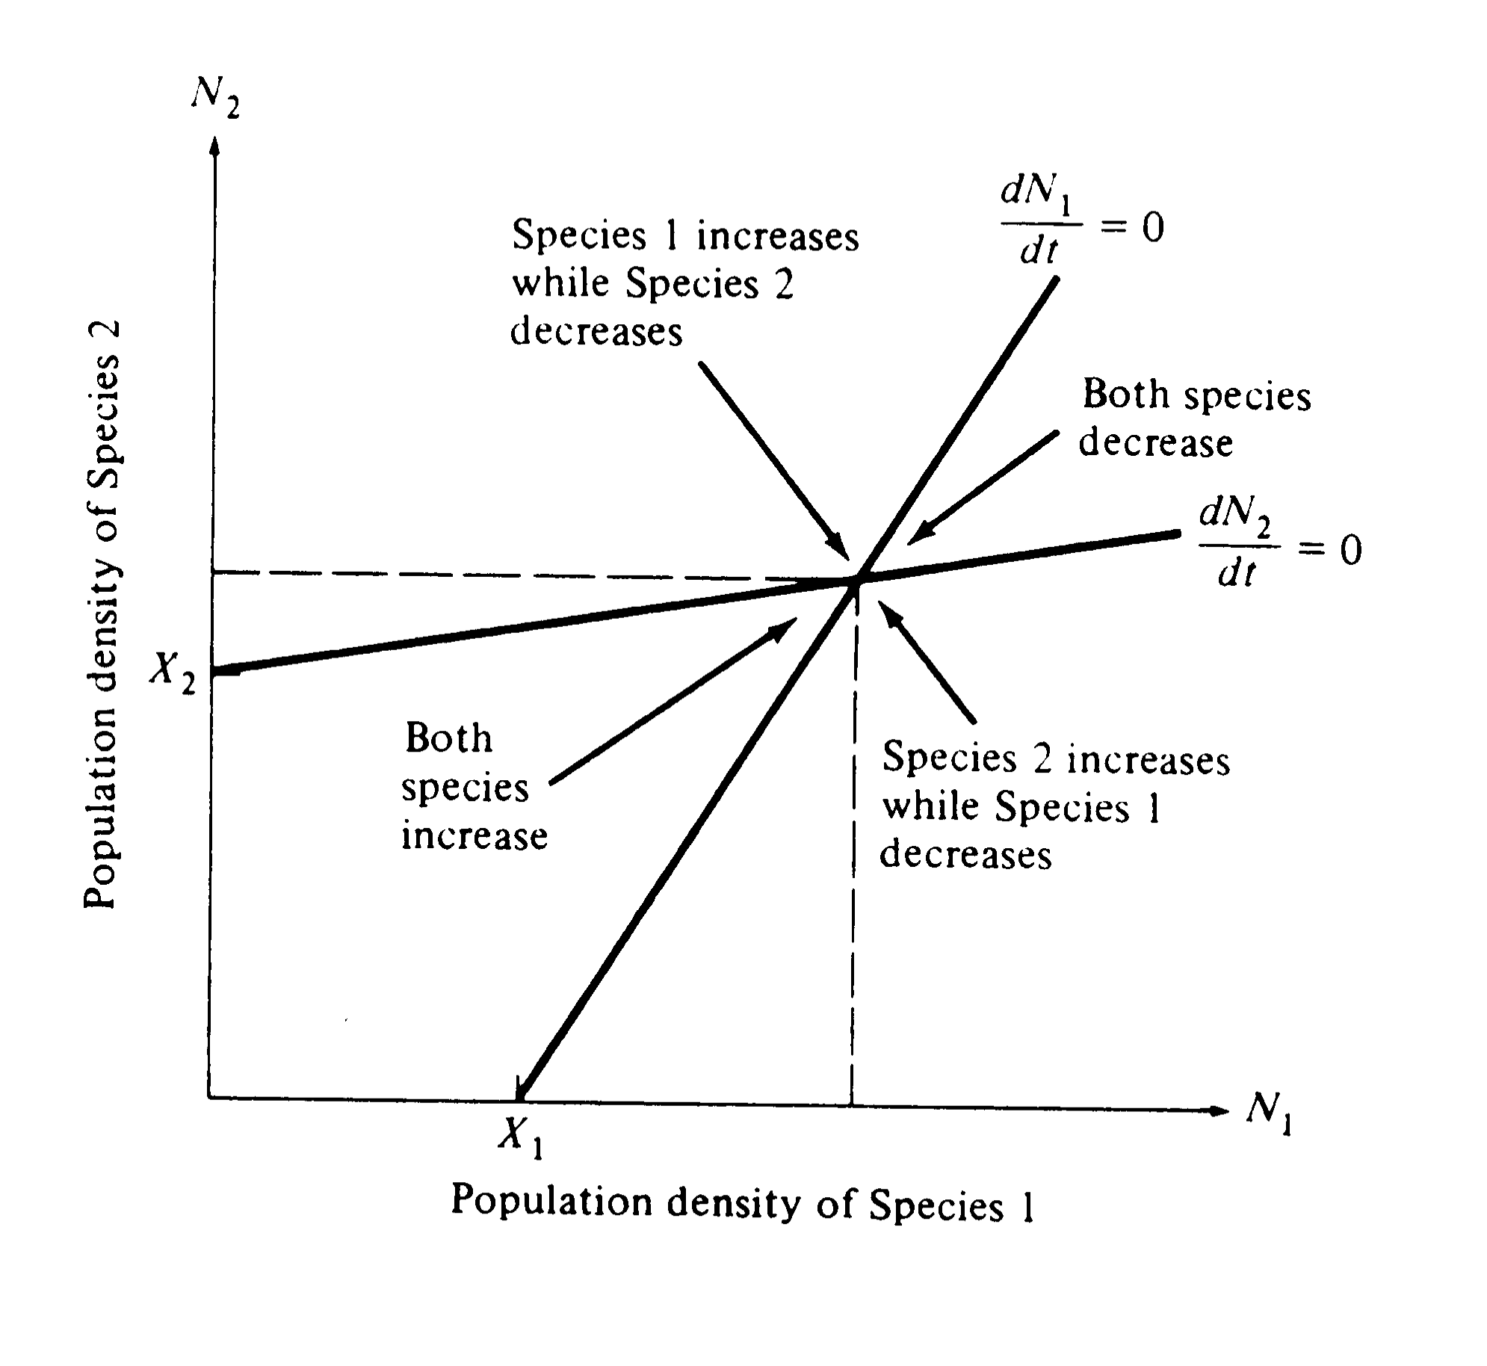
N₂*
O
N₁*

Slide 30
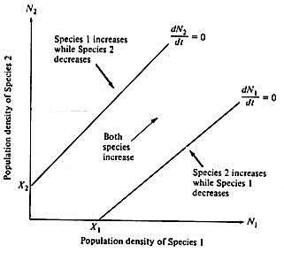
v

Slide 31
Evidence of Competition in Nature often circumstantial
1. Resource partitioning among closely-related sympatric congeneric species
(food, place, and time niches)
Complementarity of niche dimensions
2. Character displacement, Hutchinsonian ratios
3. Incomplete biotas: niche shifts
4. Taxonomic composition of communities

Slide 32
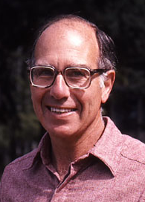
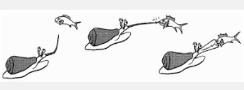


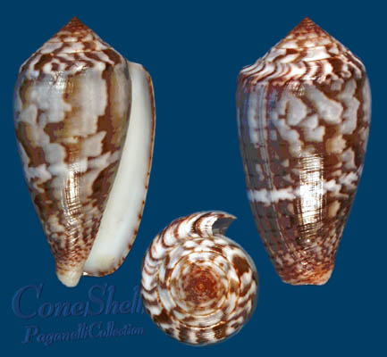
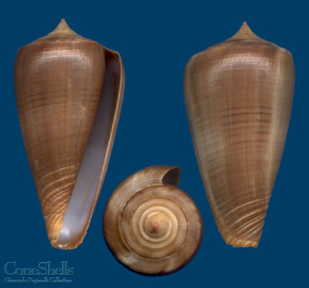
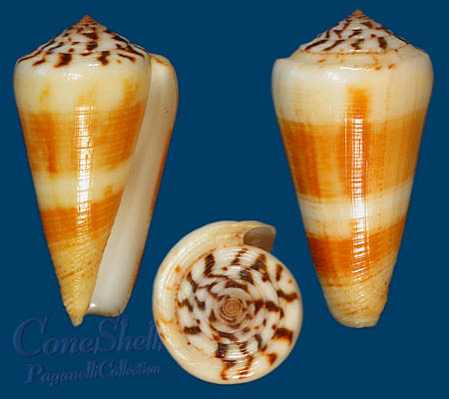
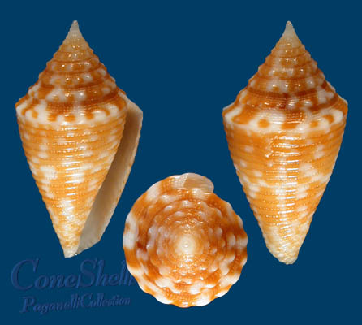
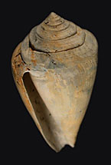
Resource Matrix (m x n)
Major Foods (Percentages) of Eight Species of
Cone Shells, Conus, on Subtidal Reefs in Hawaii
_____________________________________________________________
Gastro- Entero- Tere- Other
Species pods pneusts Nereids Eunicea belids Polychaetes
______________________________________________________________
flavidus 4 64 32
lividus 61 12 14 13
pennaceus 100
abbreviatus 100
ebraeus 15 82 3
sponsalis 46 50 4 4
rattus 23 77
imperialis 27 73
______________________________________________________________
Alan J. Kohn
Radula

Slide 33
Resource Matrix (m x n)
Major Foods (Percentages) of Eight Species of
Cone Shells, Conus, on Subtidal Reefs in Hawaii
_____________________________________________________________
Gastro- Entero- Tere- Other
Species pods pneusts Nereids Eunicea belids Polychaetes
______________________________________________________________
flavidus 4 64 32
lividus 61 12 14 13
pennaceus 100
abbreviatus 100
ebraeus 15 82 3
sponsalis 46 50 4 4
rattus 23 77
imperialis 27 73
______________________________________________________________
Alan J. Kohn
Radula

Slide 34
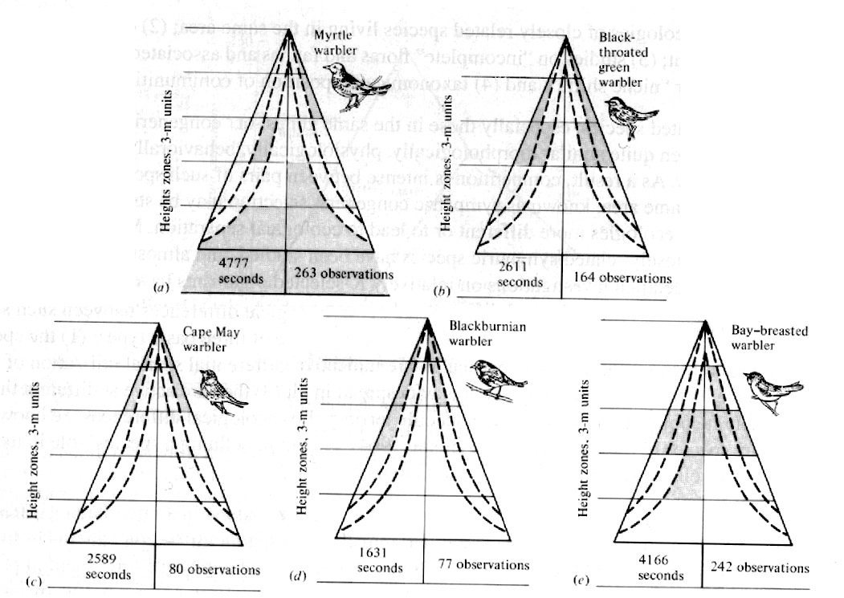
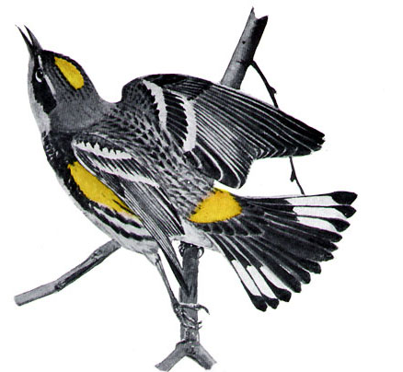


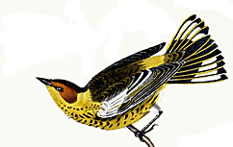
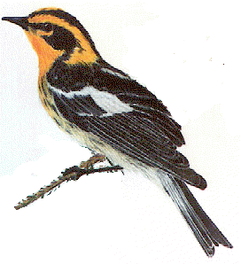
MacArthur’s Warblers (Dendroica)
Robert H. MacArthur

Slide 35
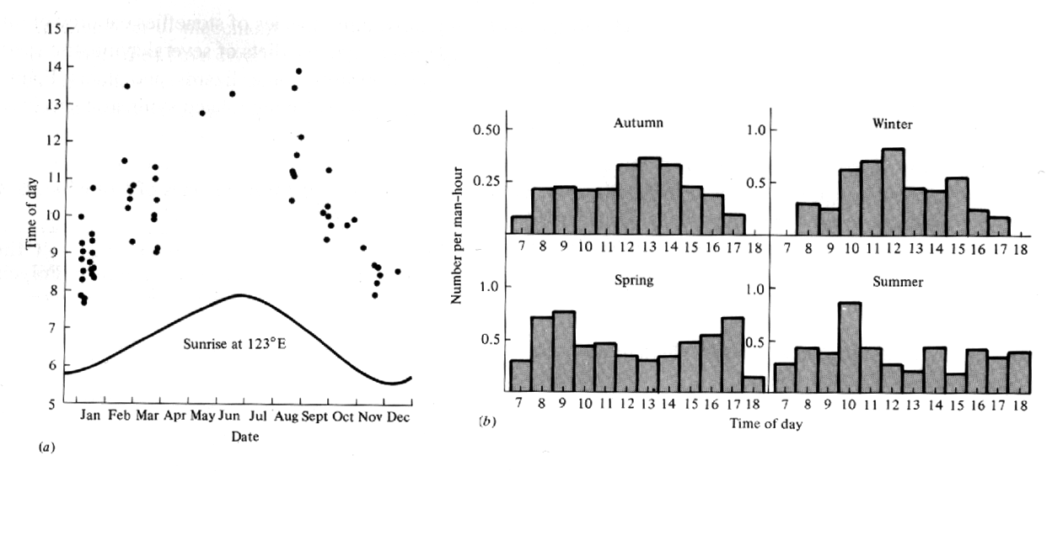
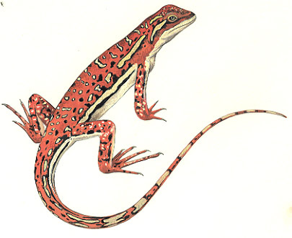
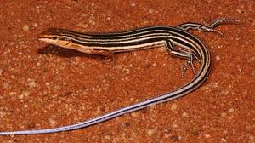
Time of Activity Seasonal changes in activity times
Ctenotus calurus Ctenophorus isolepis

Slide 36
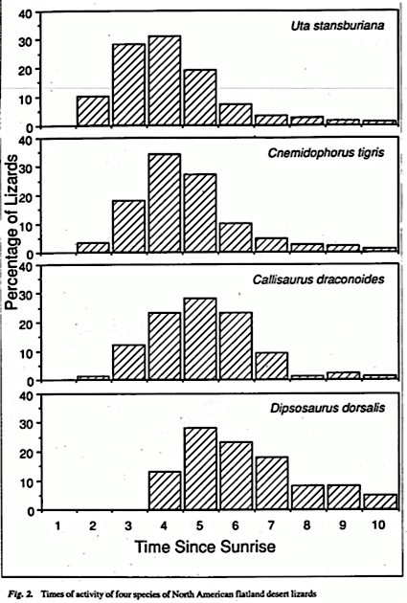
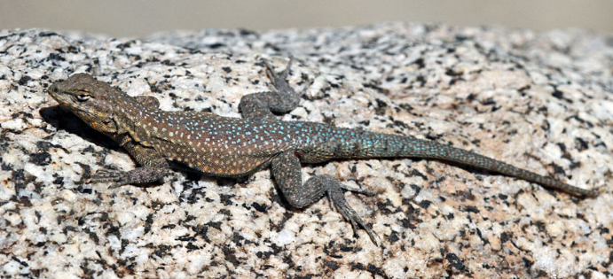
35.3 ºC
26.1 ºC
39.5 ºC
27.1 ºC
39.1 ºC
29.1 ºC
40.0 ºC
31.2 ºC

Slide 37

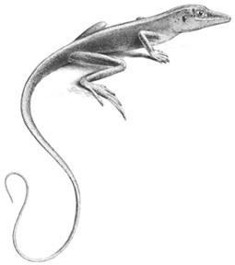


Complementarity of Niche Dimensions, page 276
Anolis
Thomas W. Schoener

Slide 38




Slide 39

Prey size versus predator size
Comb-eared
Ctenotus Skinks
Hawks

Slide 40

Galápagos Finches
Woodpecker
Finches
Cocos Isand

Slide 41





Slide 42



Galápagos Finches
Peter R. Grant
David Lack
“Darwin’s
Finches”

Slide 43



Slide 44


Slide 45


Slide 46


Slide 47






Character Displacement in Hydrobia mud snails
in Denmark (Thomas Fenchel)
Snail shell length, mm

Slide 48




Corixid Water Boatman
G. E. Hutchinson

Slide 49

Hutchinsonian Ratios

Slide 50


Hutchinsonian Ratios
Henry S. Horn
Bob May

Slide 51

Hutchinsonian Ratios
Henry S. Horn
Bob May
Recorders

Slide 52

Wind Instruments

Slide 53


Slide 54





Kitchen
Knives

Slide 55






Kitchen Pots

Slide 56







Tricycles

Slide 57




Bikes

Slide 58




Hutchinsonian ratios among short wing Accipiter hawks
Sharp-shinned
Thomas W. Schoener
Cooper’s
Goshawk

Slide 59





Slide 60
Hutchinsonian ratios among Australian Varanus lizards

