Slide 1
A Brief History and the Biological Impacts of Atomic Energy

Slide 2
First a Review:
What is it?

Slide 3
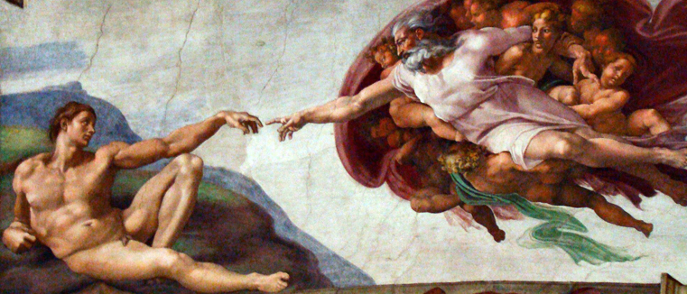
First a Review:
What is it?

Slide 4
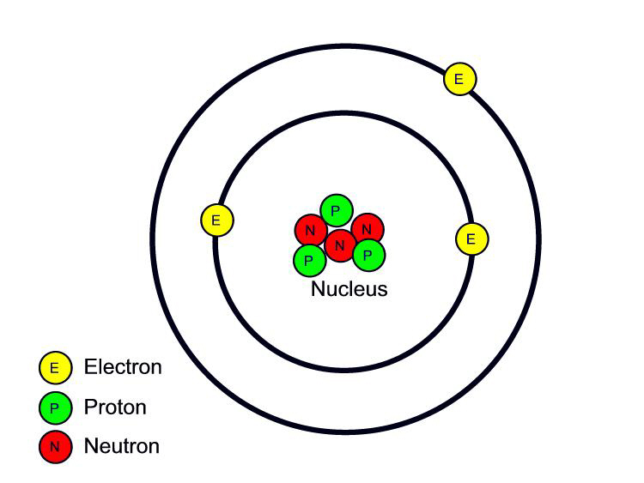
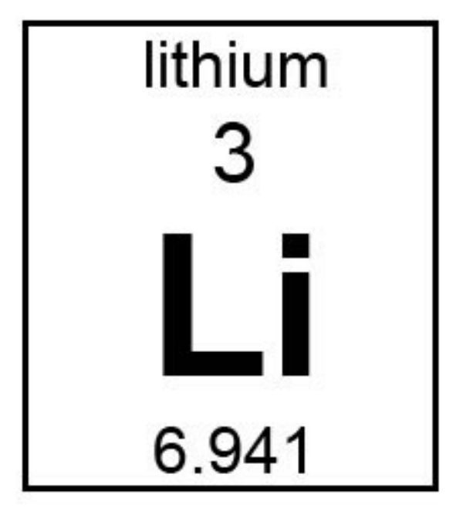
Parts of an atom
Element Name
Atomic Number
(#Protons)
Symbol
Atomic Mass = Protons + Neutrons
( # neutrons based on average of relative isotope abundance)

Slide 5
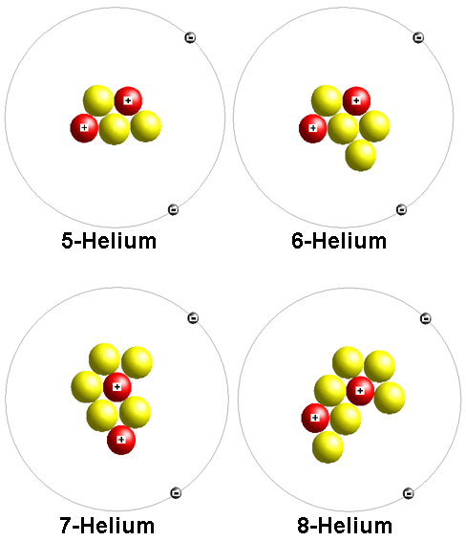
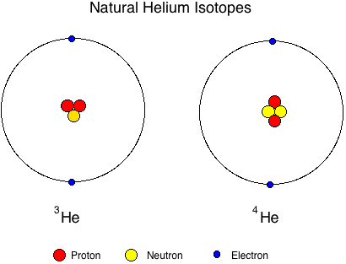
Isotope: A variant of a particular an element which differs by number of neutrons. All isotopes of a given element have the same number of protons.
0.0002% stable
99.9998% stable

Slide 6
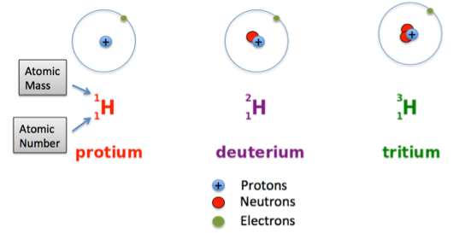
Hydrogen is unlike other elements
99.98% stable
0.02% stable
Trace stable

Slide 7
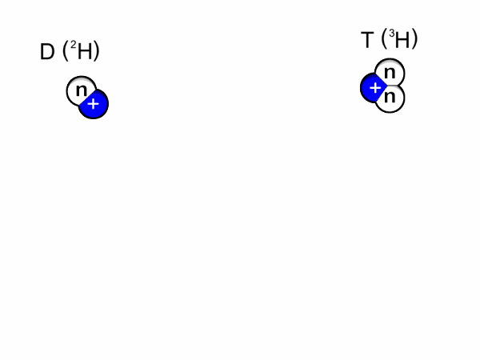
Nuclear Fusion Deuterium(²H) + Tritium(³H) ➟ Helium(⁴He) 3.5 MeV
(NEW-Kleer fuse-UN)

Slide 8
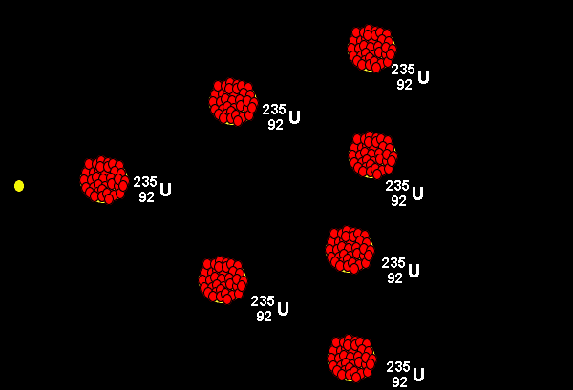
Nuclear Fission (NEW-Kleer fish-UHN)
Uranium(²³⁵U) + Neutron(¹n) ➟
Barium(¹⁴⁰Ba) + Krypton(⁹³Kr) + 3Neutrons(¹n) + ~200 MeV

Slide 9
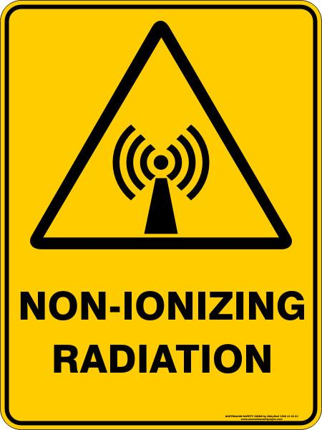
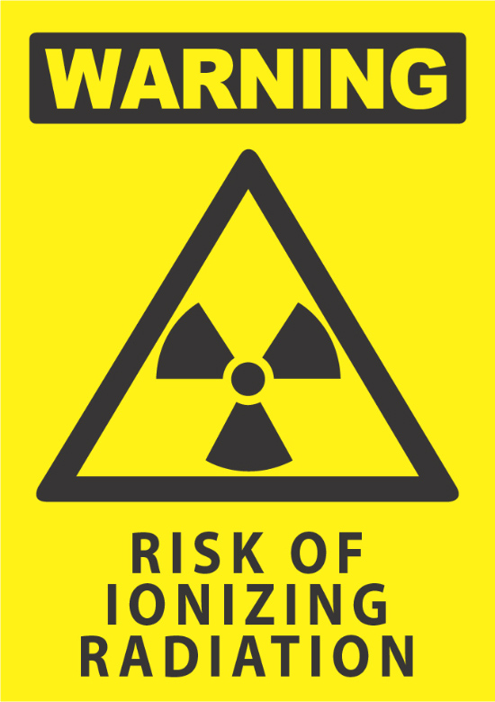
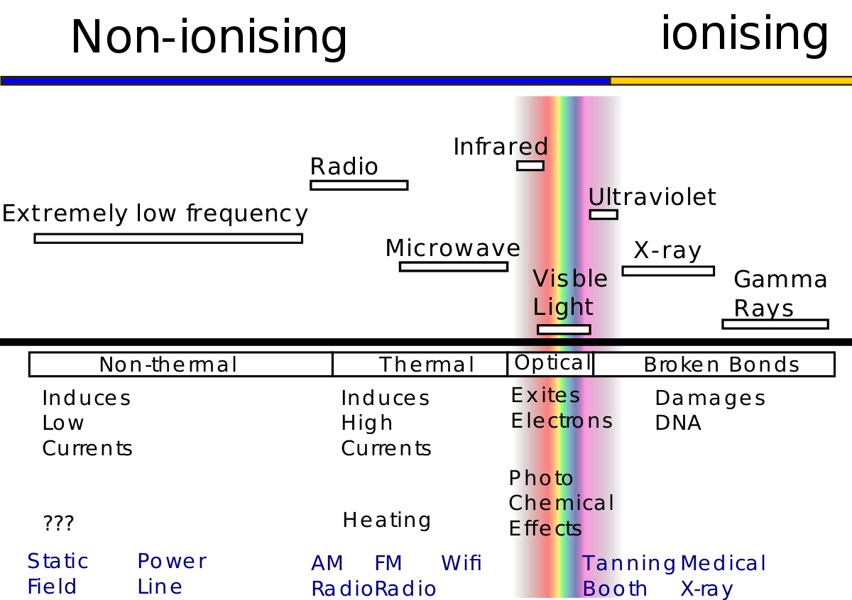
Radiation! emission or transmission of energy in the form of waves or particles

Slide 10
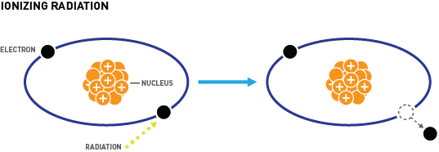
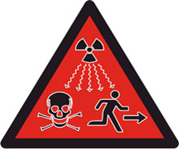
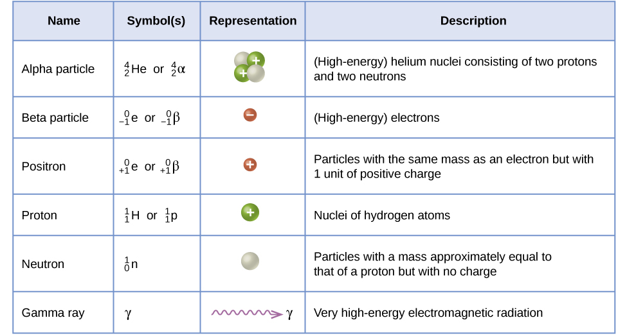
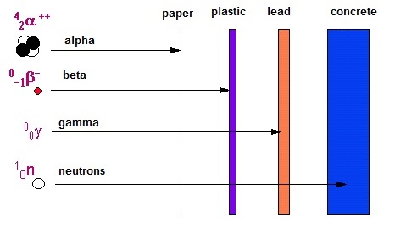
Ionising radiation:
Radiation that carries enough energy to
liberate electrons from atoms thereby ionizing them.

Slide 11
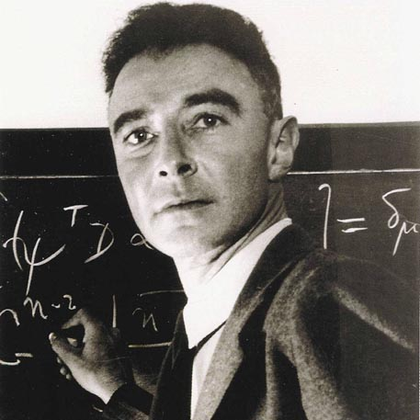
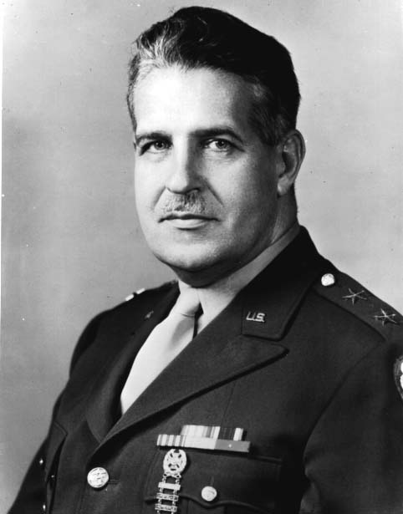
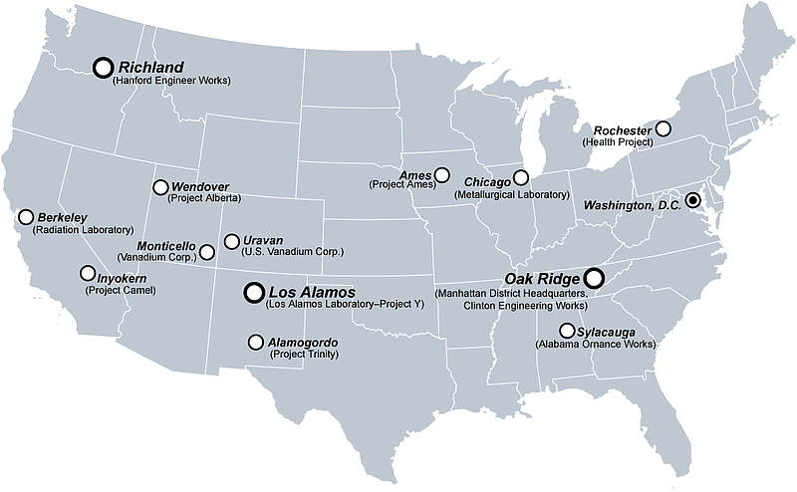
The Manhattan Project
The genesis of modern atomic power
Robert Oppenheimer
Leslie Groves
Eventually, the Manhattan Project employed more than 130,000 people and cost nearly US$ 2 billion (equivalent to US$ 23 billion in 2007 dollars).

Slide 12
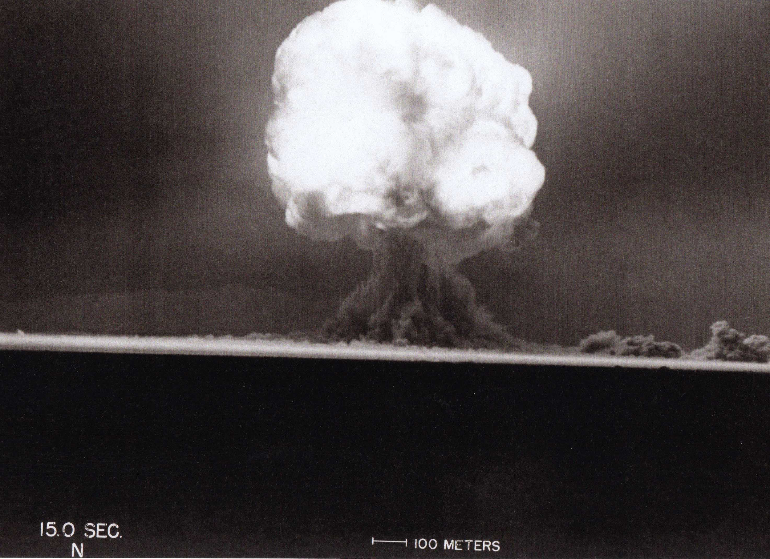
The Bomb.
Trinity shot:
5:29 a.m.
July 16, 1945
Yeild: 20 kt

Slide 13
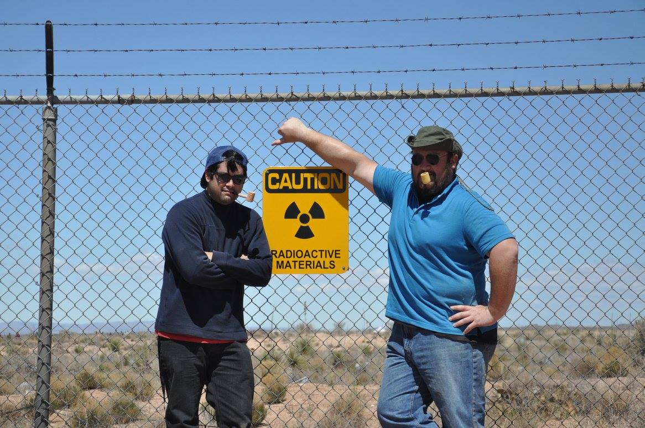
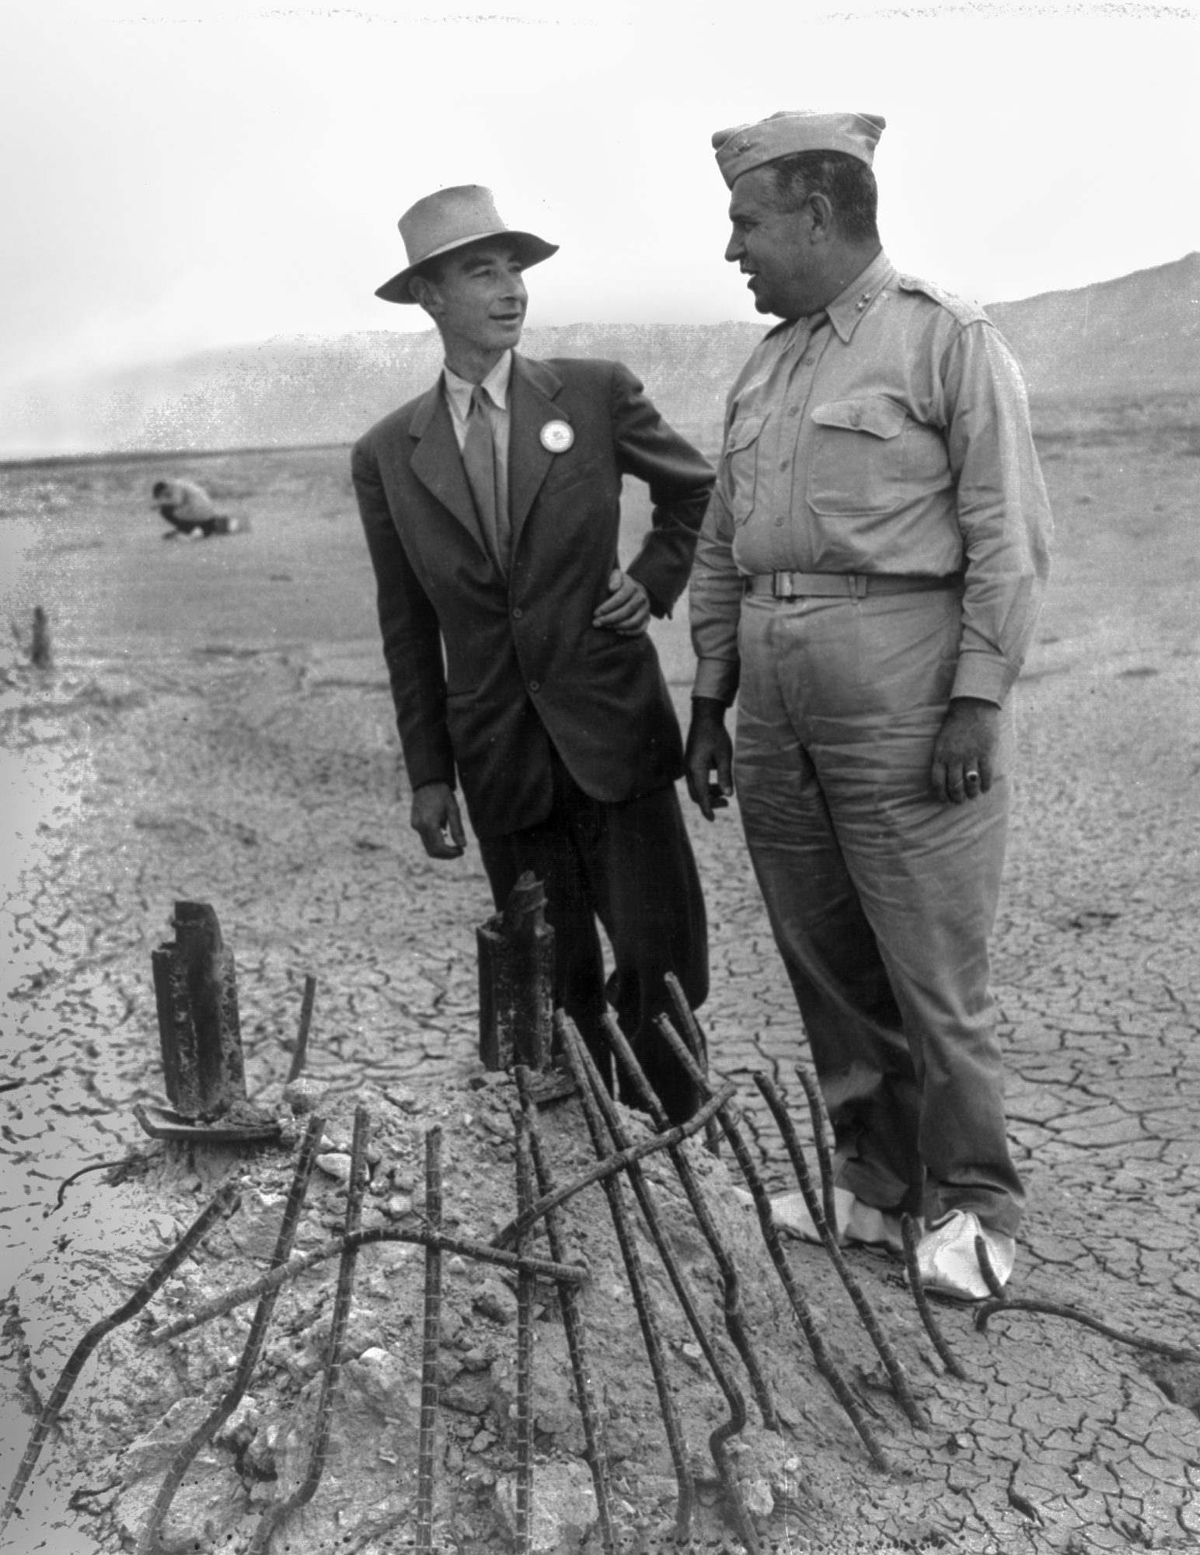
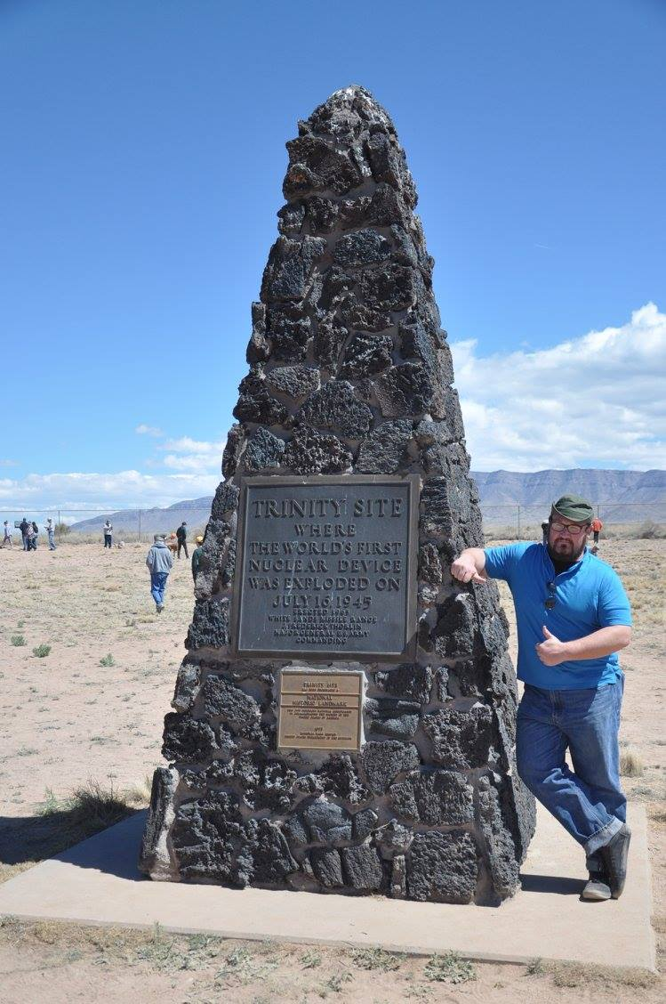

Slide 14
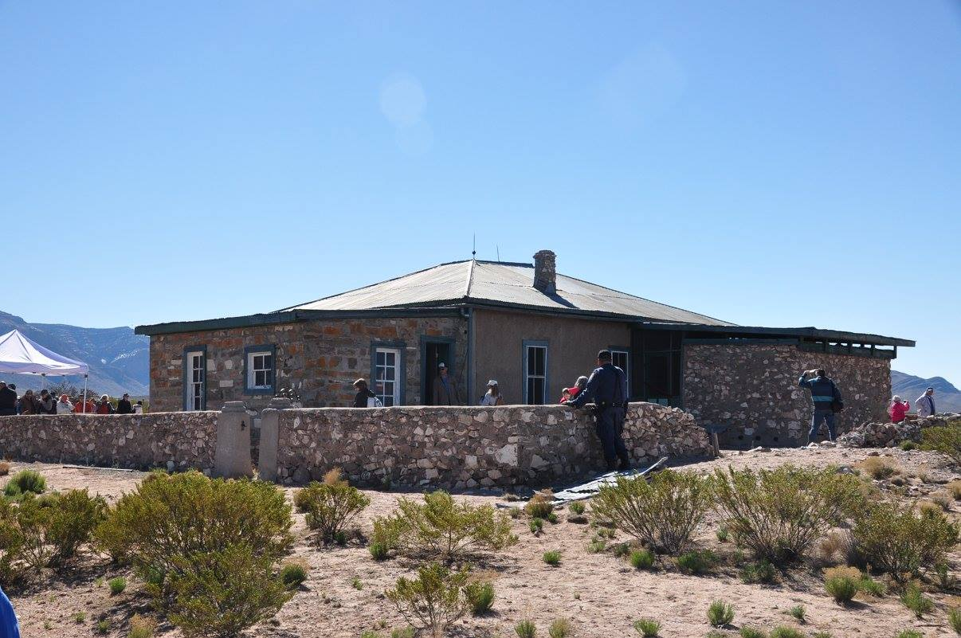
Trinity site: McDonald Ranch House
This is where the uranium core of the bomb was assembled prior to the test. Only two miles from ground zero

Slide 15
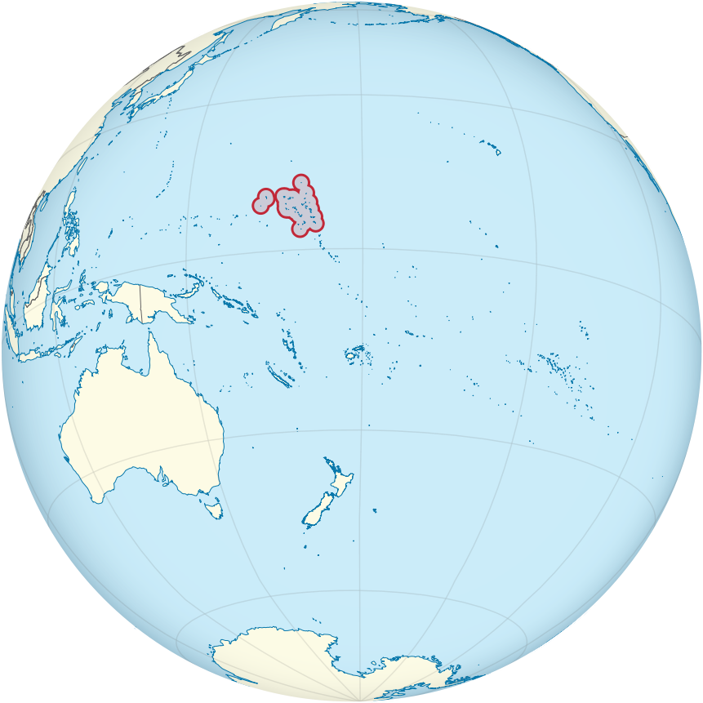
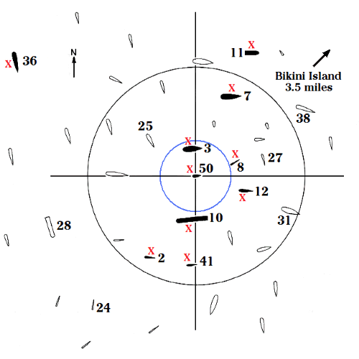
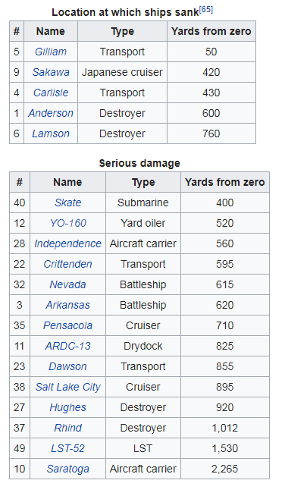
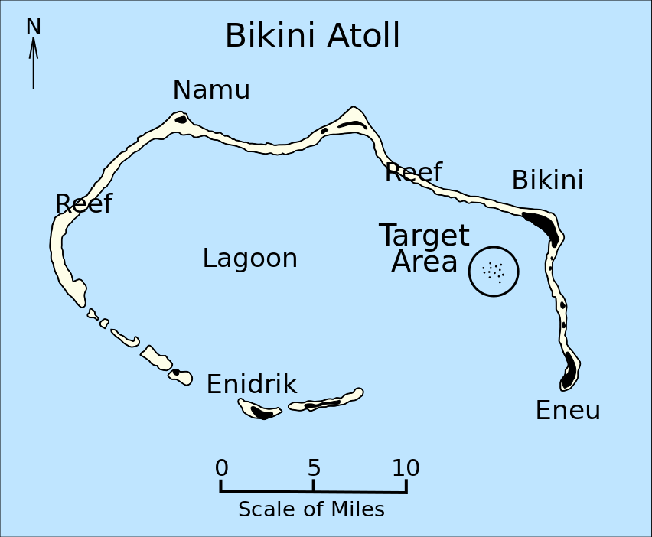

Slide 16
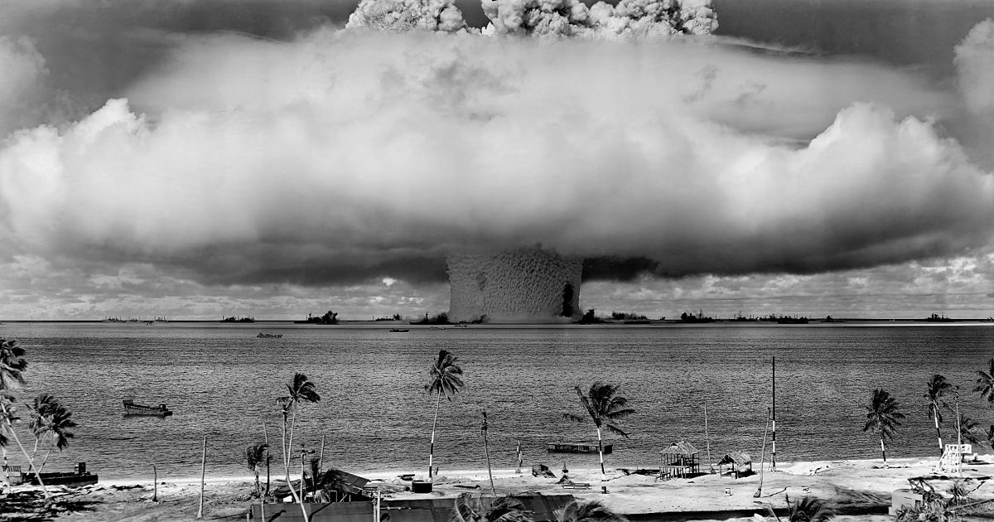

Slide 17
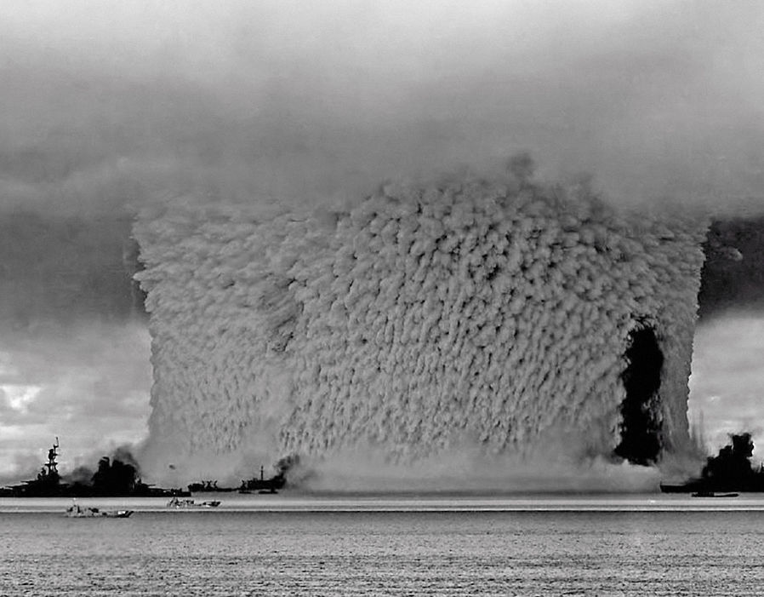

Slide 18
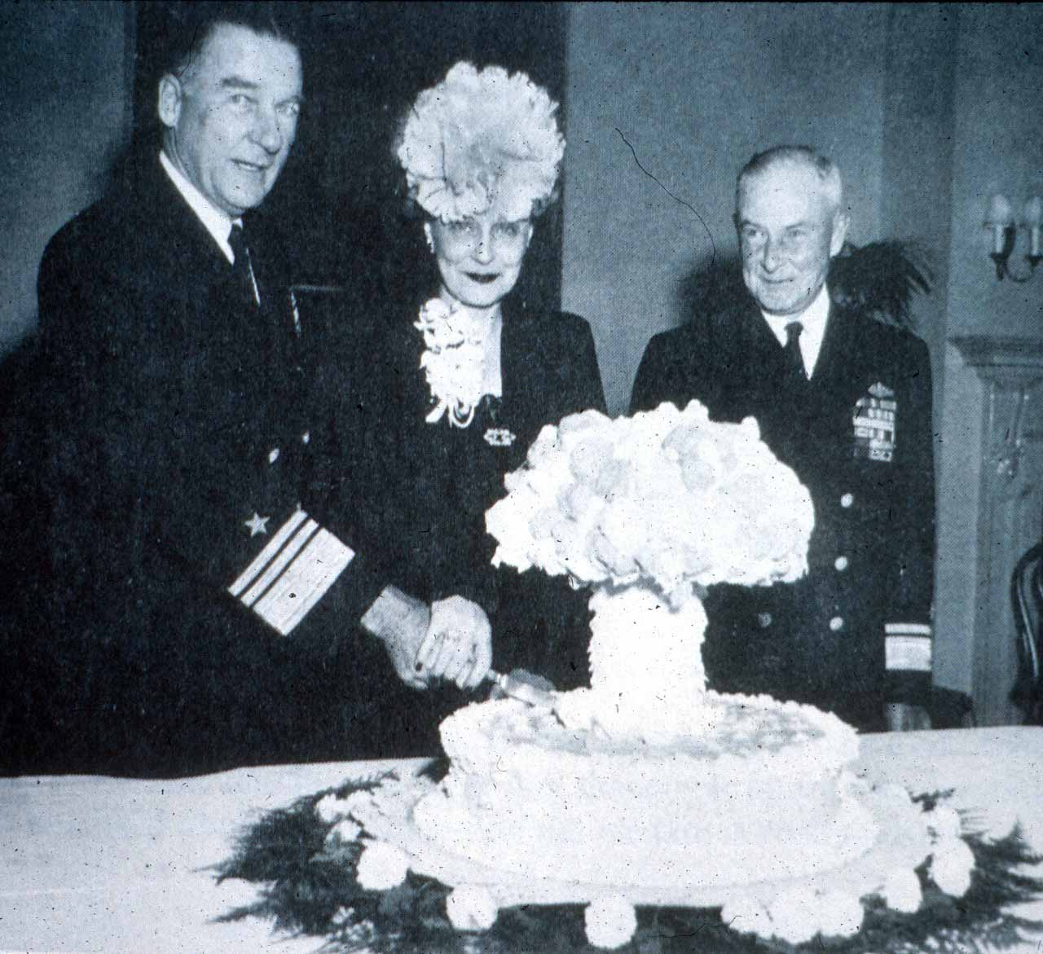

Slide 19
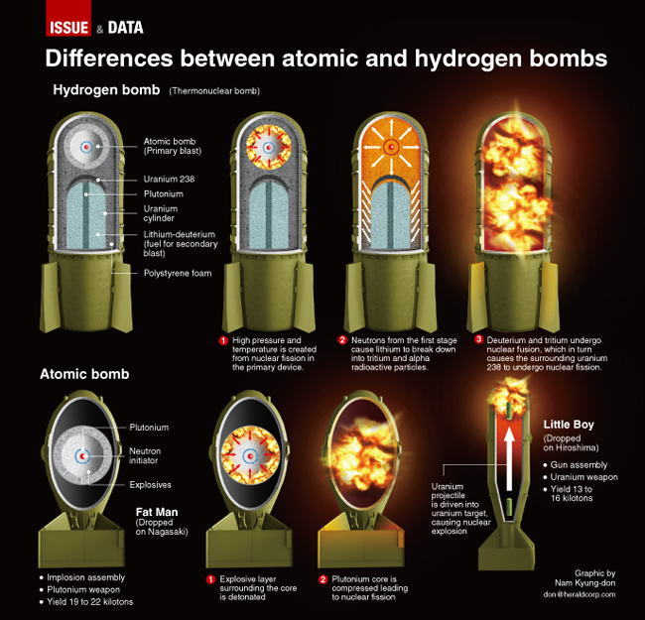

Slide 20
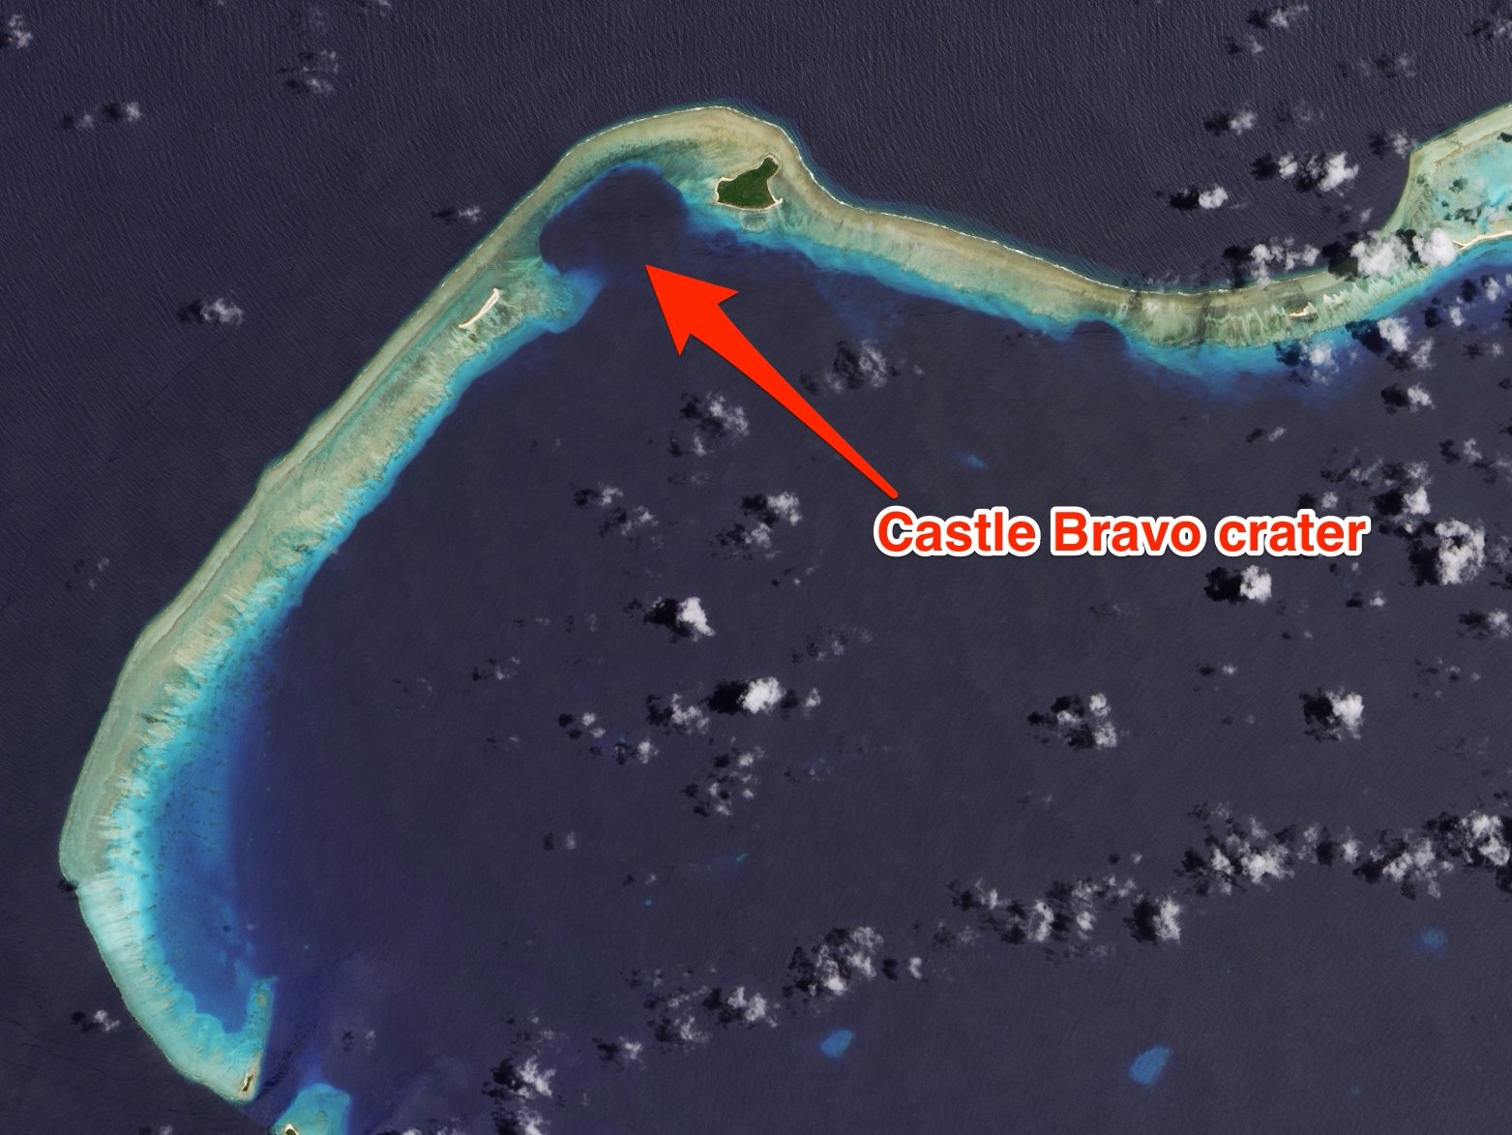

Slide 21
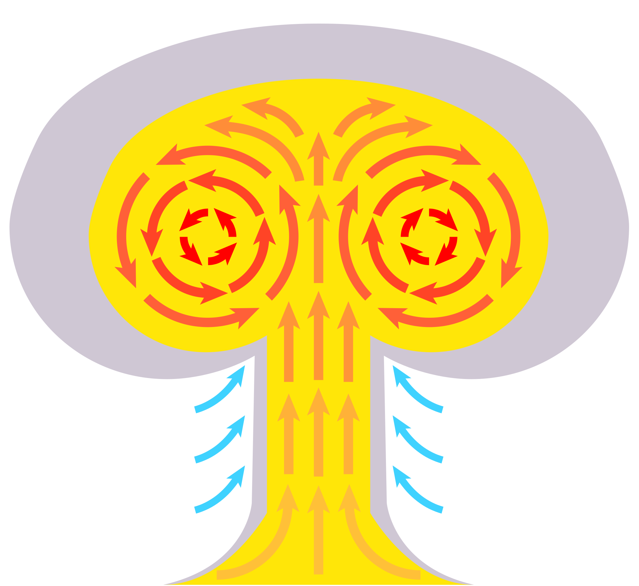
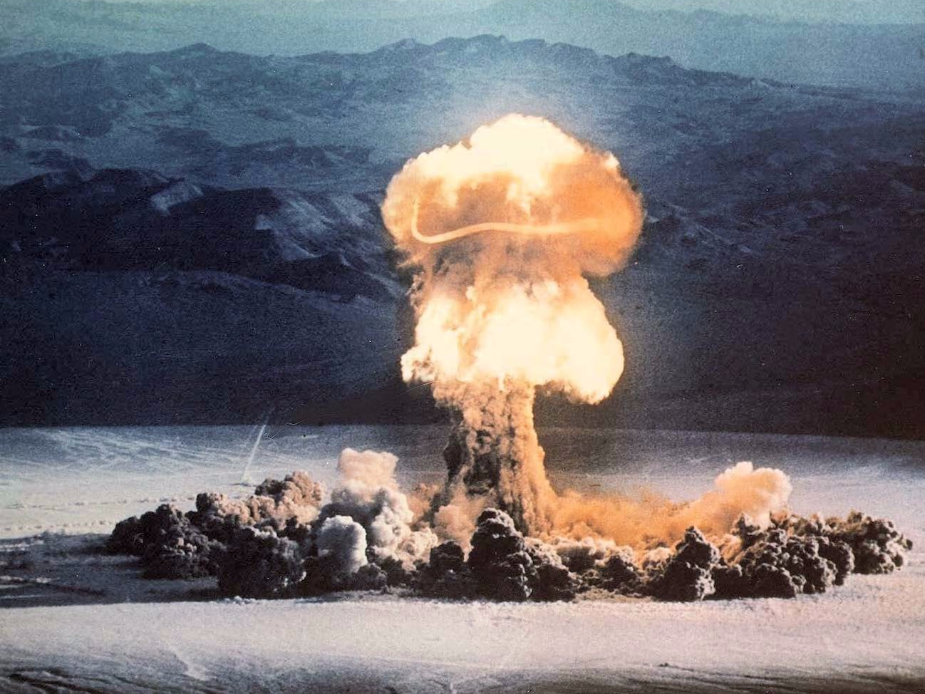
Nuclear Fallout

Slide 22
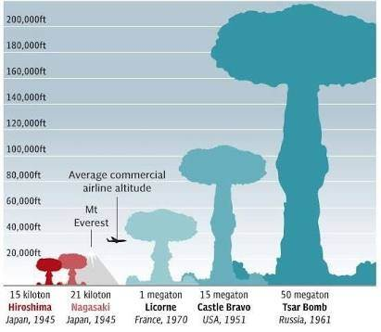
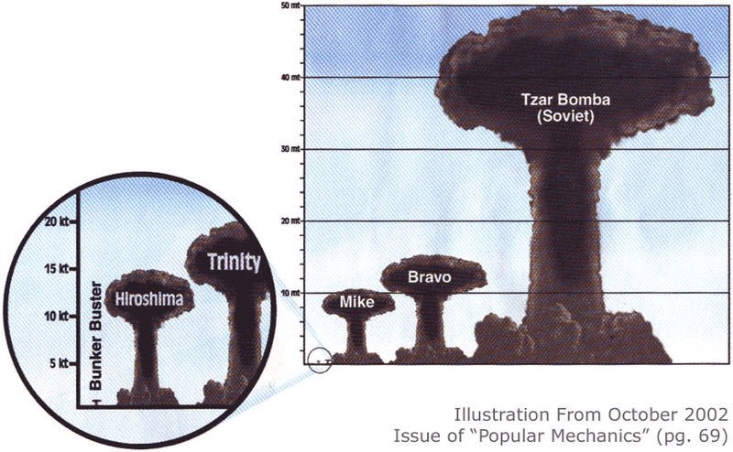

Slide 23
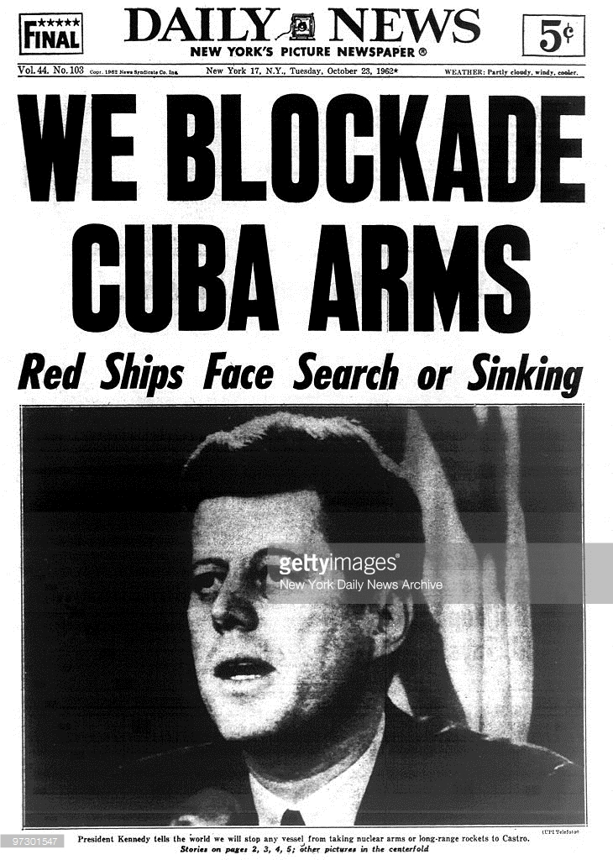
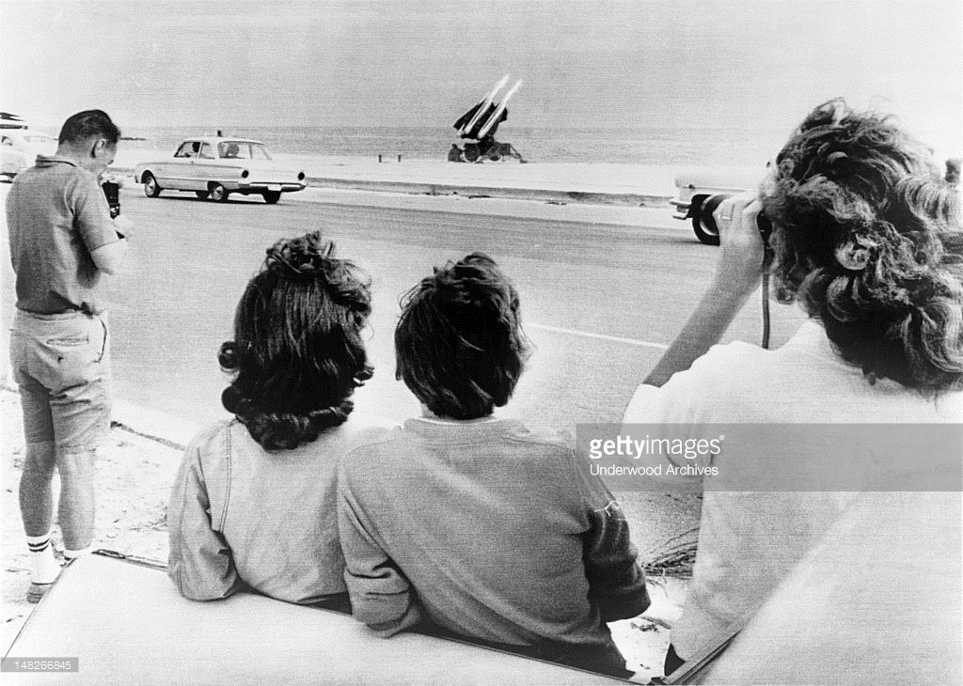
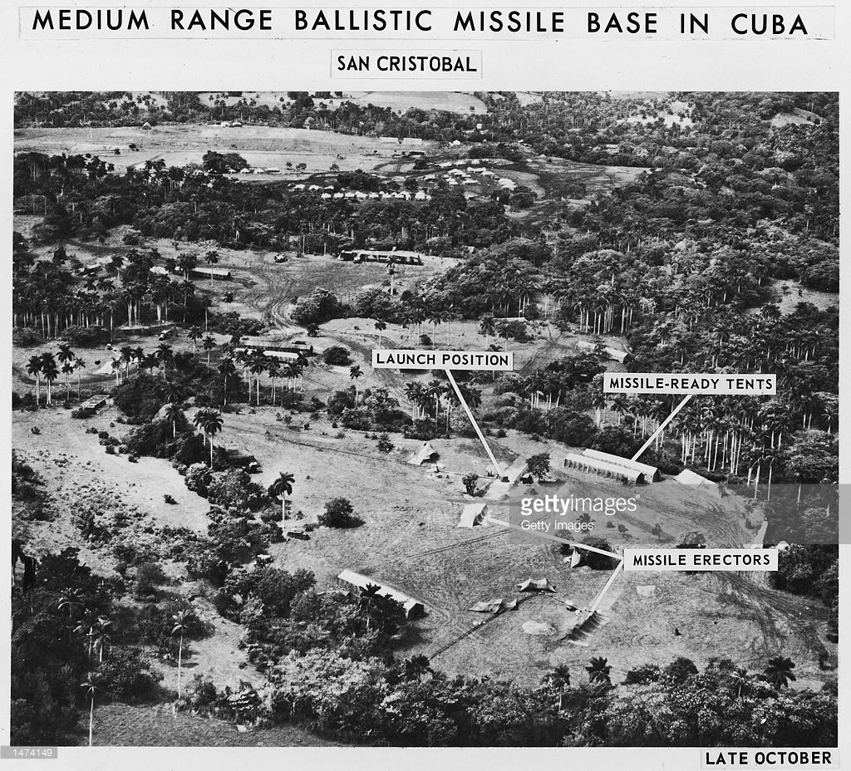
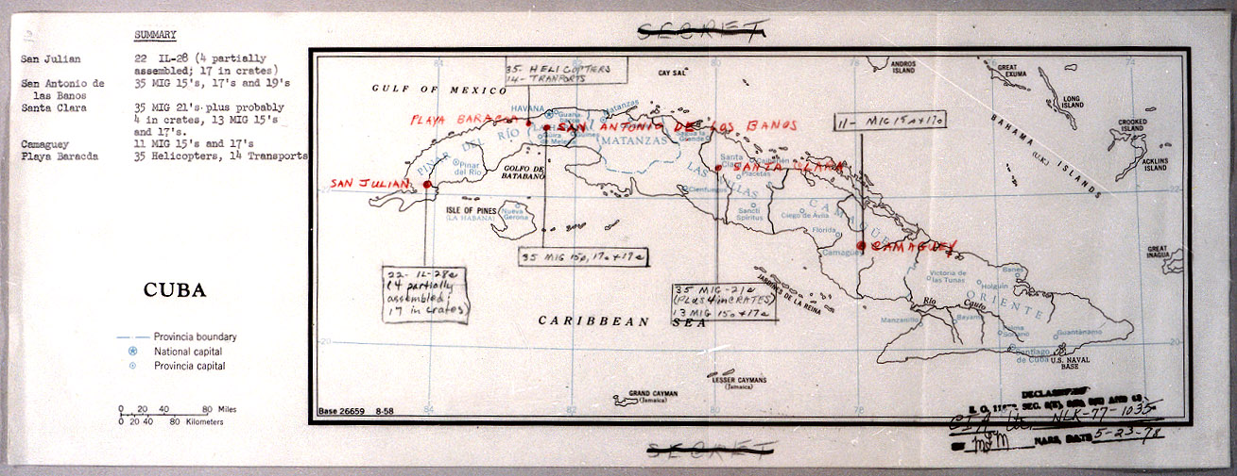
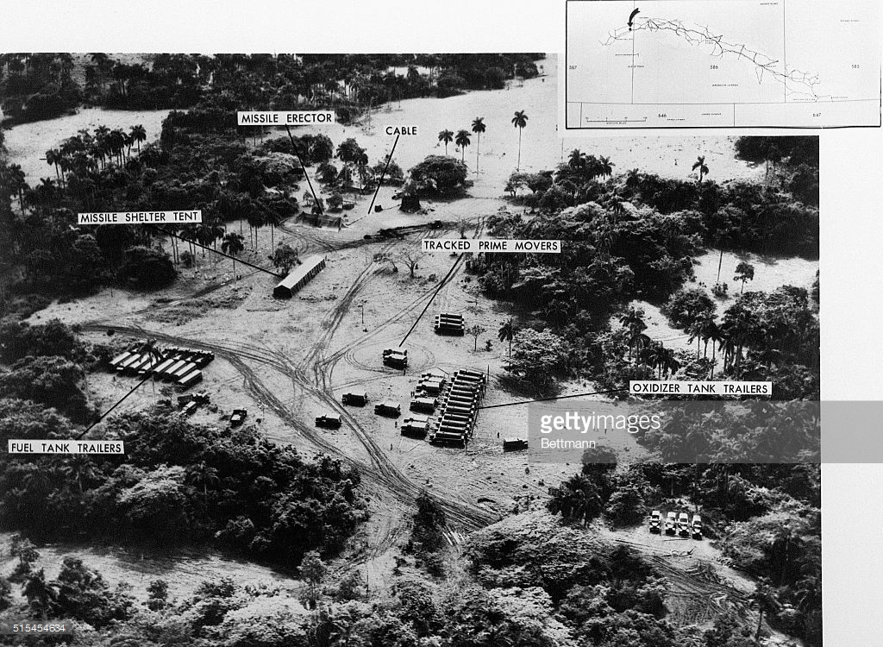

Slide 24
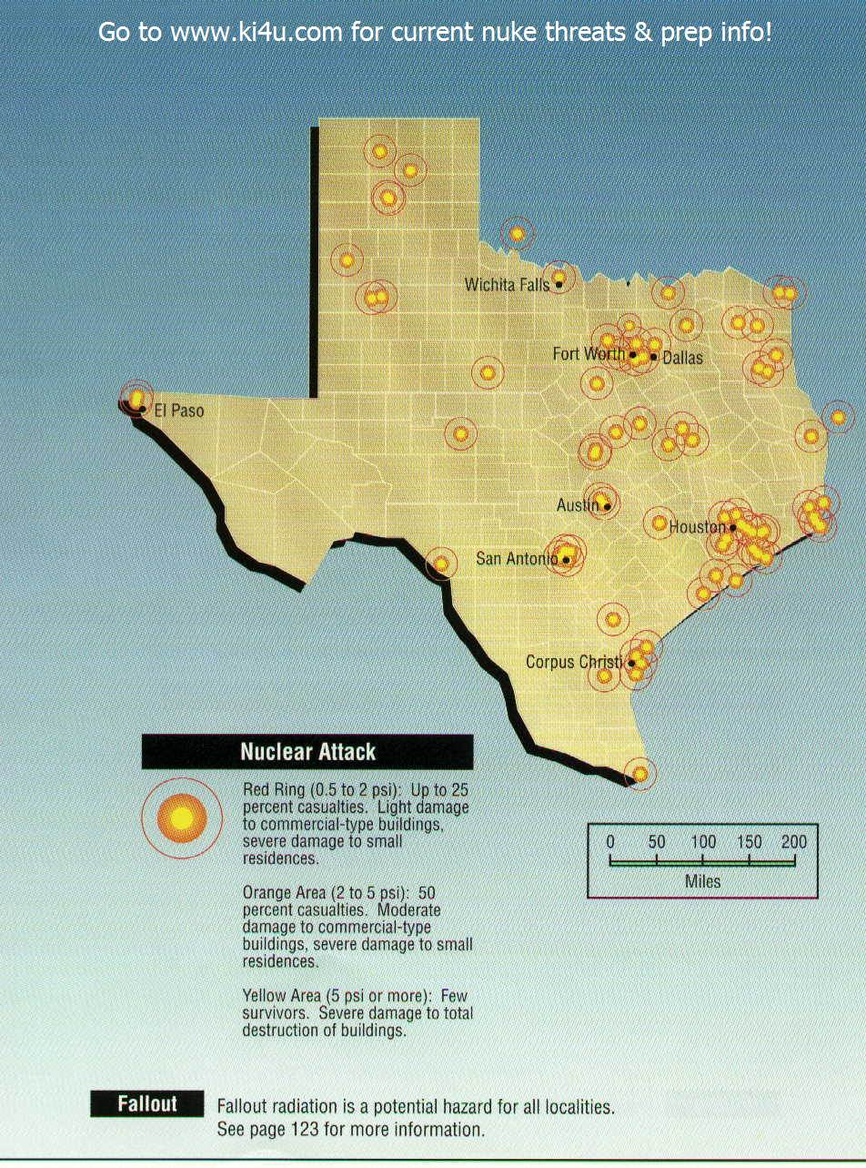
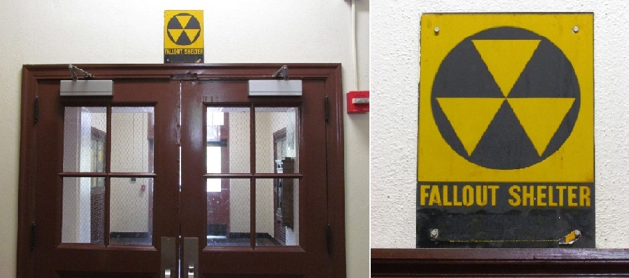
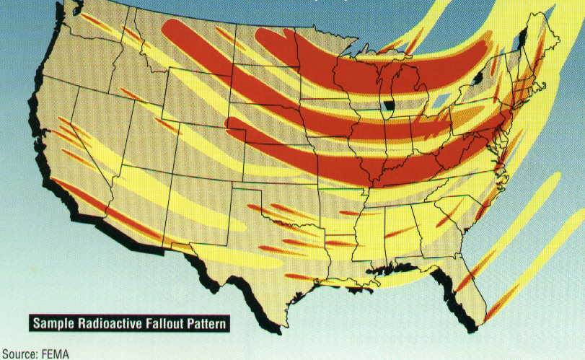

Slide 26
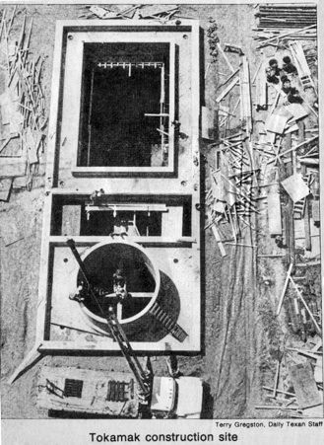
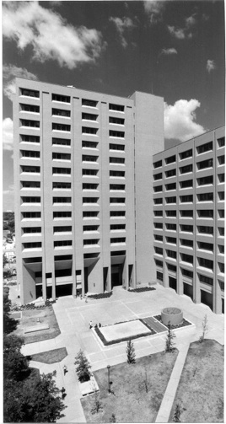
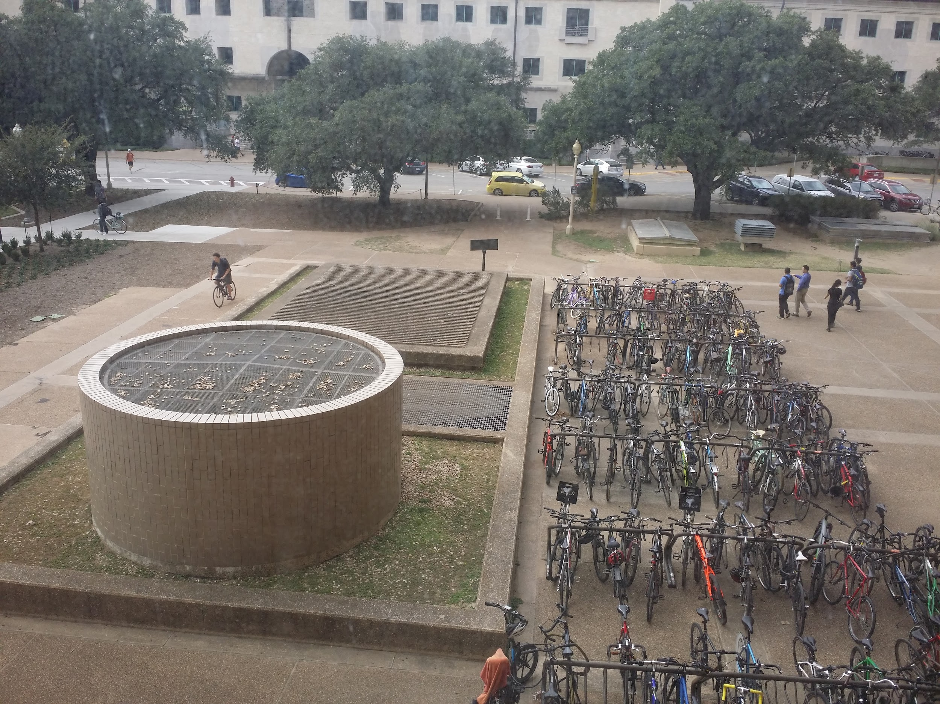
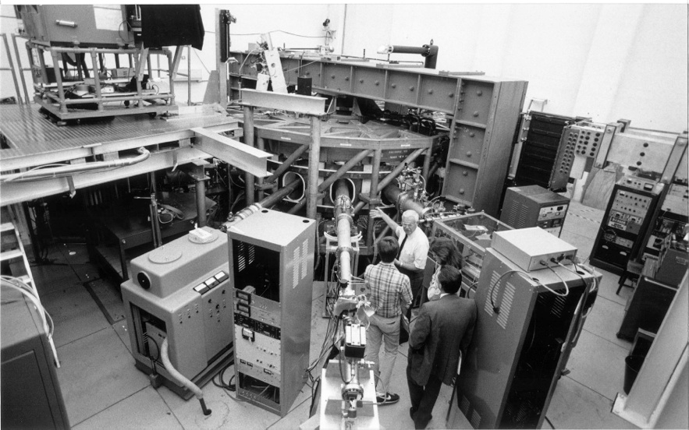
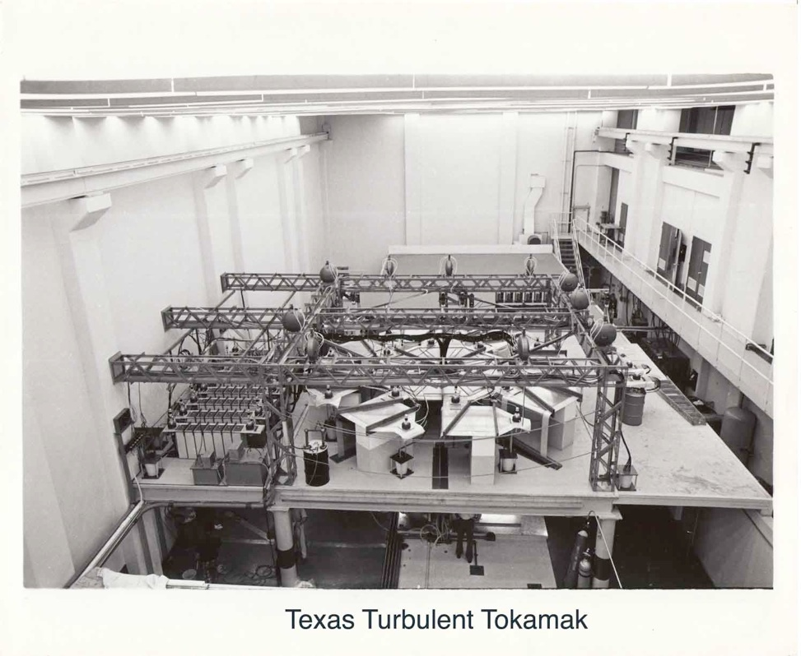
UT’s Fusion Tokamak Reactor

Slide 27
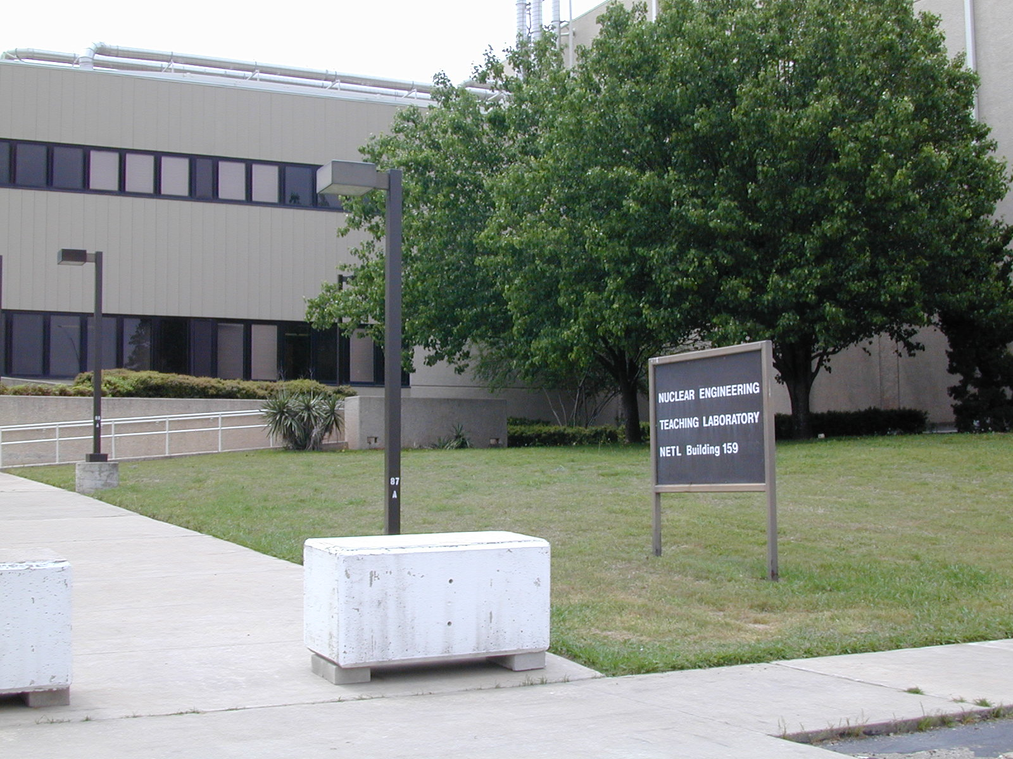
UT’s Fission TRIGA Reactor
The NETL reactor, designed by General Atomics, is a TRIGA Mark II nuclear research reactor. The NETL is the newest of the current fleet of U.S. university reactors. The NETL reactor has in-core irradiation facilities and five beam ports. The reactor is capable of steady-state operation at power levels up to 1 MW or pulsing mode operation where powers as high as 1500 MW are achieved for about 10 msec.

Slide 28
Upshot-Knothole, Grable (25May 1953)
W-9: 15 kiloton yeild

