Slide 1
Lotka-Volterra Predation Equations: N₁ N₂ = Contacts two coefficients of predation, p₁ and p₂ plus r₁ and d₂ dN₁ /dt = r₁ N₁ – p₁ N₁ N₂ dN₂ /dt = p₂ N₁ N₂ – d₂ N₂ No self damping N² terms (no density dependence) dN₁ /dt = 0 when r₁ = p₁ N₂ or N₂ = r₁ / p₁ dN₂ /dt = 0 when p₂ N₁ = d₂ or N₁ = d₂ / p₂ Gause’s Paramecia x Didinium Experiments Neutral Stability Limit Cycle Predator destabilizing, Prey Refuges Functional and Numerical Responses
23rd Lecture
21 April 2020

Slide 2
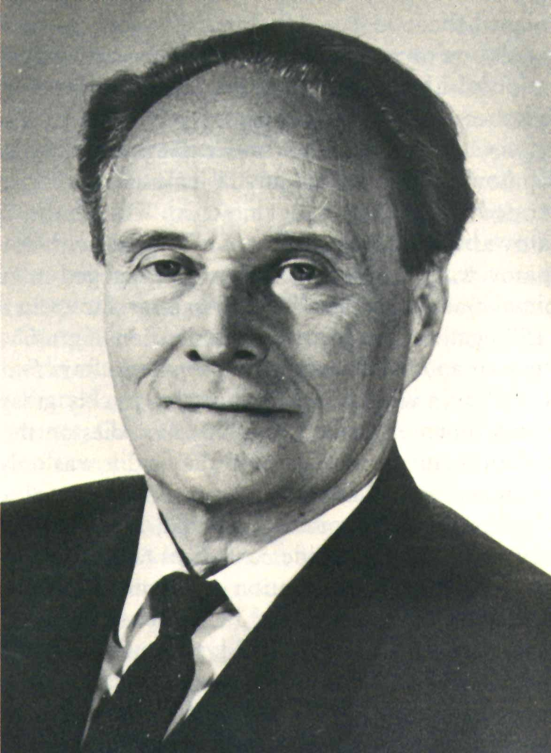
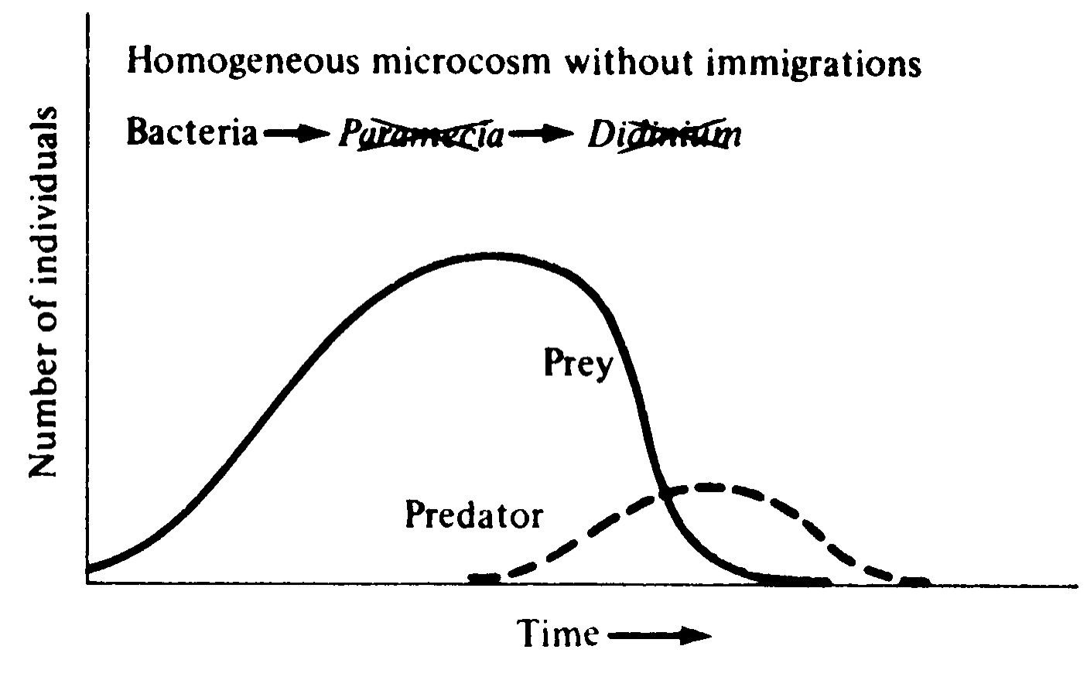
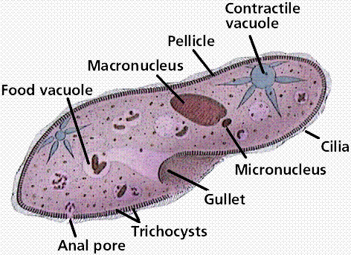
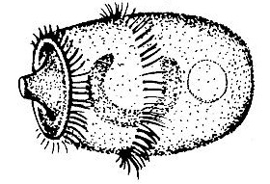
Predator-Prey Experiments
Georgy F. Gause
Ciliated Protozoans
Didinium

Slide 3
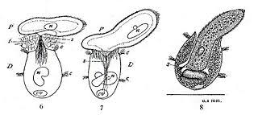

Slide 4
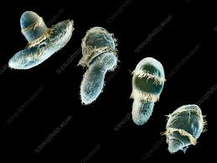

Slide 5
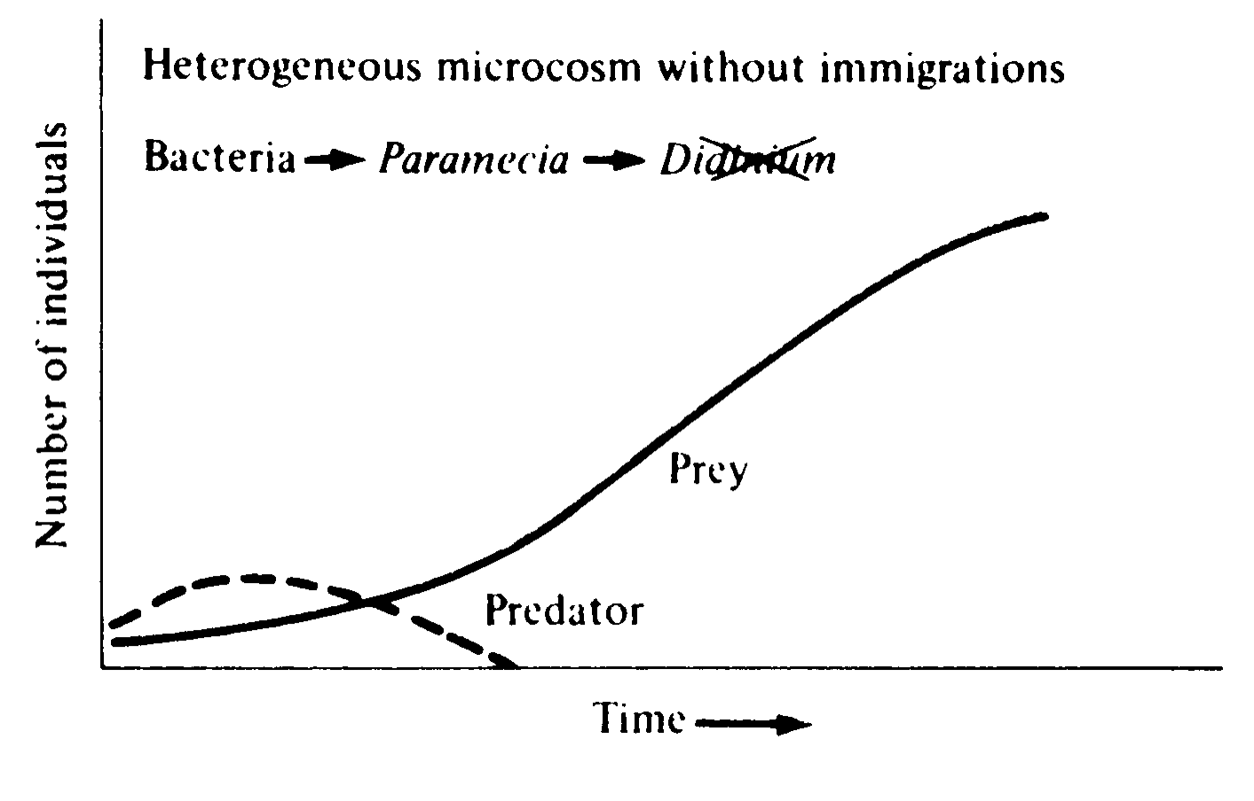
Predator-Prey Experiments
Georgy F. Gause
Didinium
Paramecium

Slide 6
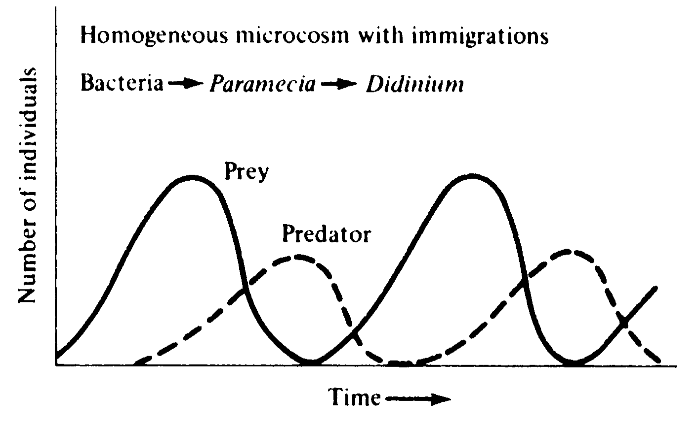
Predator-Prey Experiments
Georgy F. Gause

Slide 7
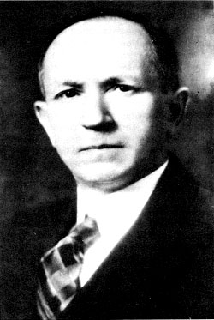
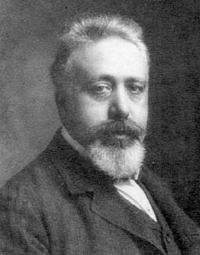
Lotka-Volterra Predation Equations N₁ N₂ = Contacts coefficients of predation, p₁ and p₂ dN₁ /dt = r₁ N₁ – p₁ N₁ N₂ dN₂ /dt = p₂ N₁ N₂ – d₂ N₂ No self damping (no density dependence) dN₁ /dt = 0 when r₁ = p₁ N₂ or N₂ = r₁ / p₁ dN₂ /dt = 0 when p₂ N₁ = d₂ or N₁ = d₂ / p₂
Alfred J. Lotka
Vito Volterra

Slide 8
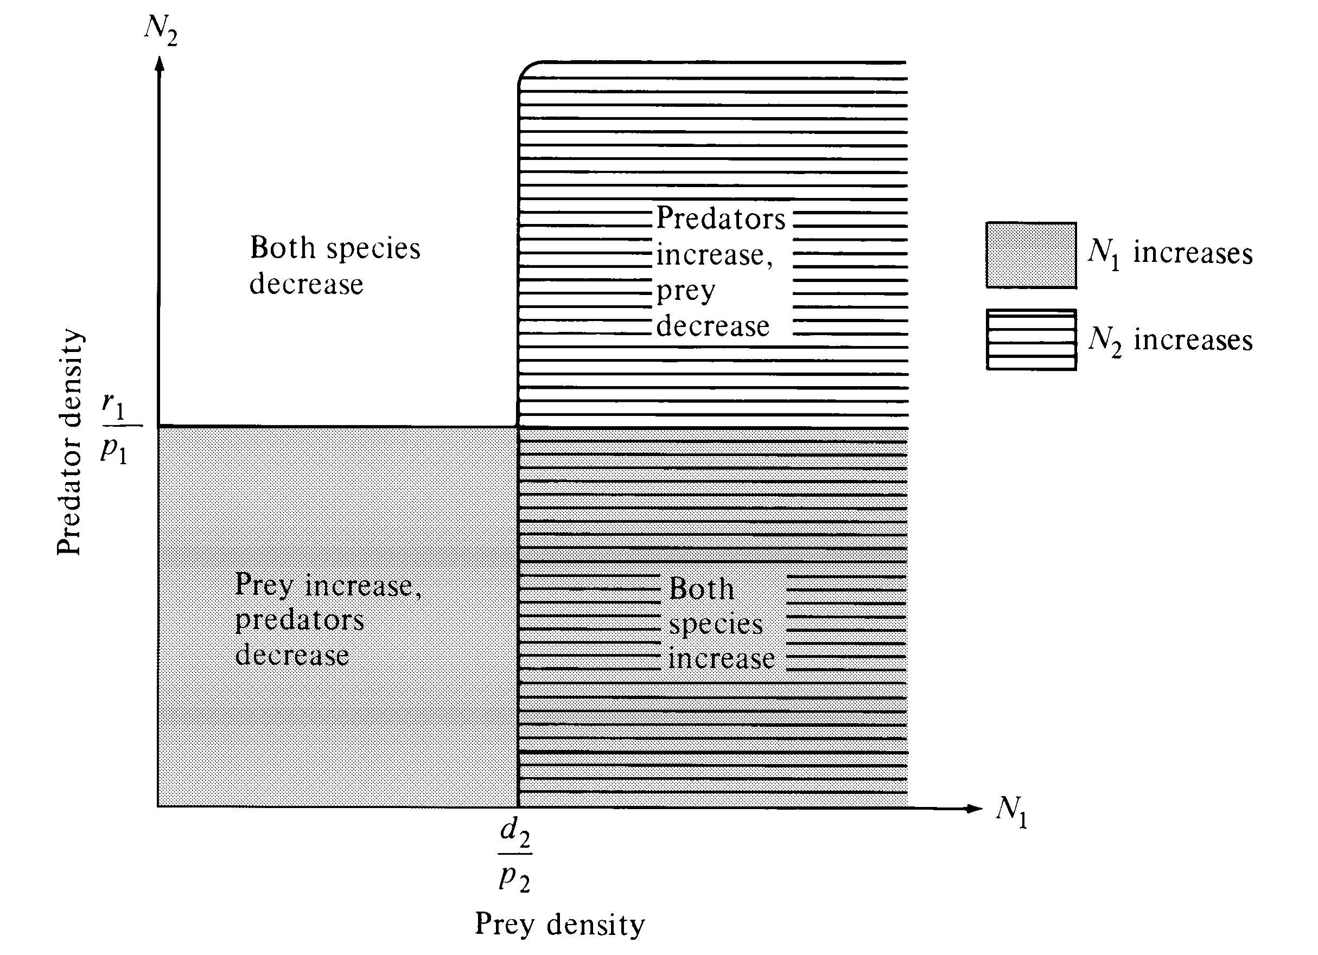
Neutral Stability
(Vectors spiral
in closed loops)

Slide 9
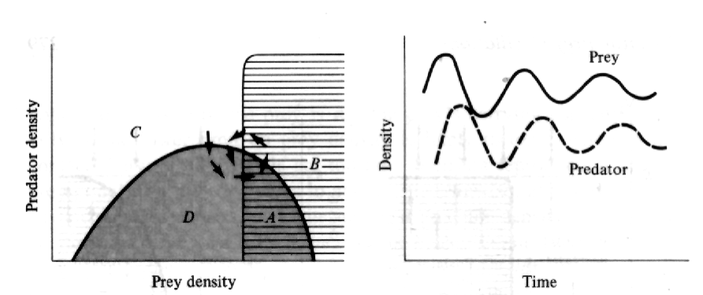
o
Prey self damping
o
dN₁ /dt = r₁ N₁ – p₁ N₁ N₂ – r₁ K₁/N₁² dN₂ /dt = p₂ N₁ N₂ – d₂ N₂
o
r₁/K₁
dN₁ /dt = 0 → r₁ = p₁ N₂ or N₁* = – r₁ K₁/ N₁
dN₂ /dt = 0 → p₂ N₁ = d₂ or N₁* = d₂
Vectors spiral
inwards
(Damped
Oscillations)

Slide 10
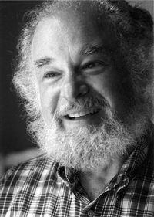
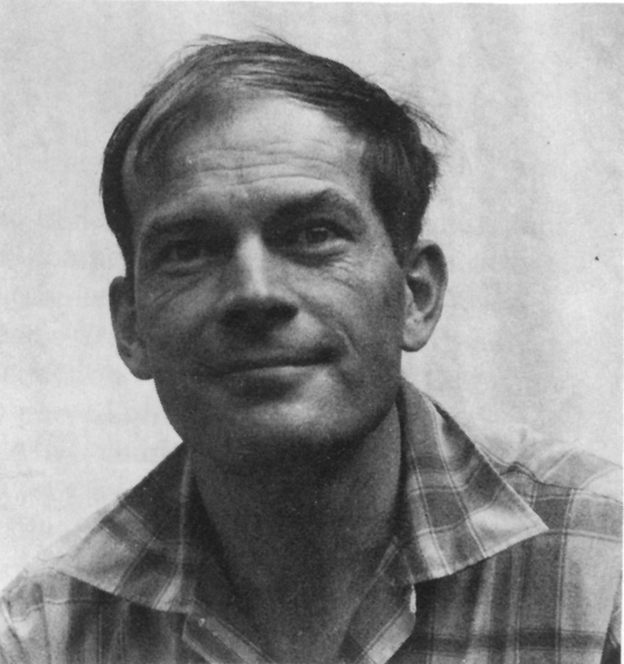
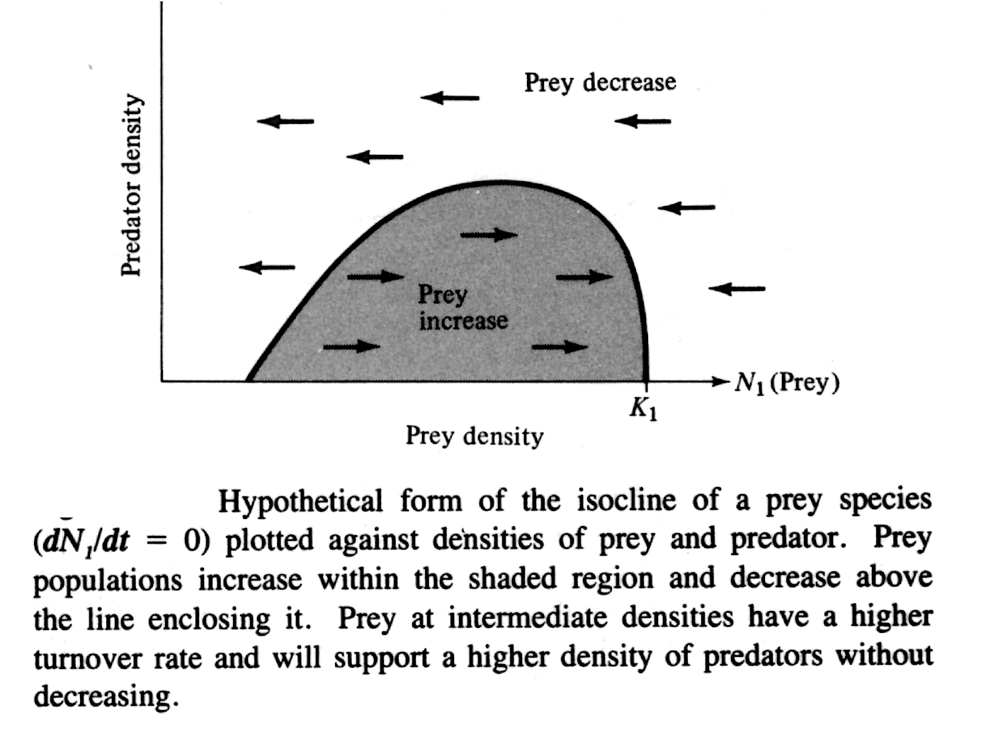
Why the prey isocline has a hump
Mike Rosenzweig
Robert MacArthur
Optimal Yield

Slide 11
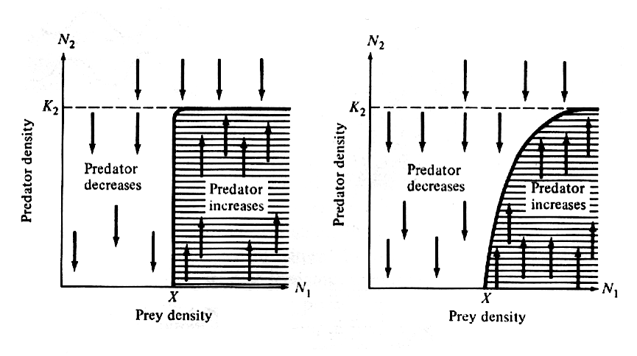
Predator isoclines
Mike Rosenzweig
Robert MacArthur

Slide 12
Superimposed prey and predator isoclines
<—Mike Rosenzweig
Robert MacArthur —>
Moderately efficient predator
Neutral stability — Vectors form a closed ellipse.
Amplitude of oscillations remains constant.

Slide 13
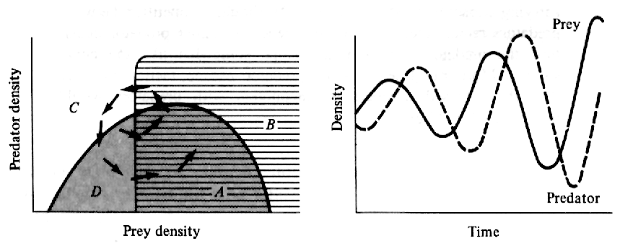
Superimposed prey and predator isoclines
<—Mike Rosenzweig
Robert MacArthur —>
Unstable — extremely efficient predator
Vectors spiral outwards until a Limit Cycle is reached

Slide 14
Superimposed prey and predator isoclines
<—Mike Rosenzweig
Robert MacArthur —>
Damped Oscillations — inefficient predator
Vectors spiral inwards to stable equilibrium point

Slide 15
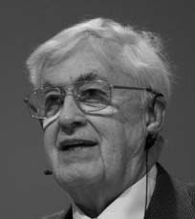
Functional response = rate at which
Individual predators capture and eat
more prey per unit time as prey density
increases
C. S. Holling

Slide 16
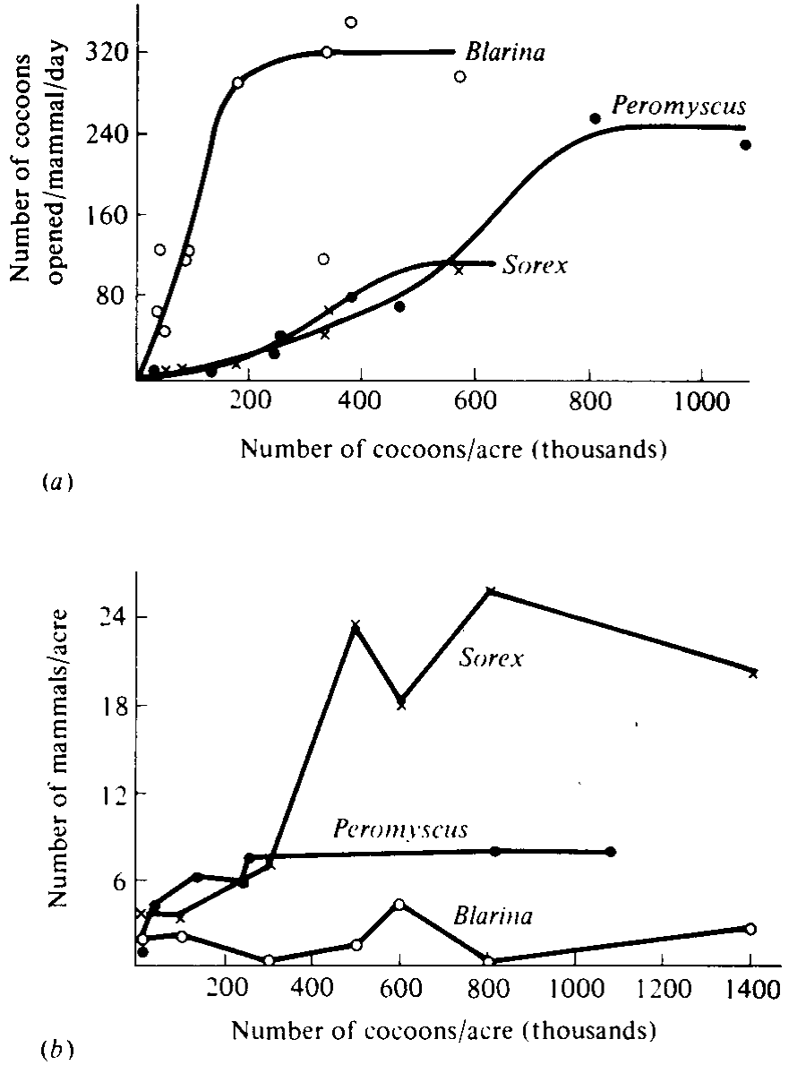
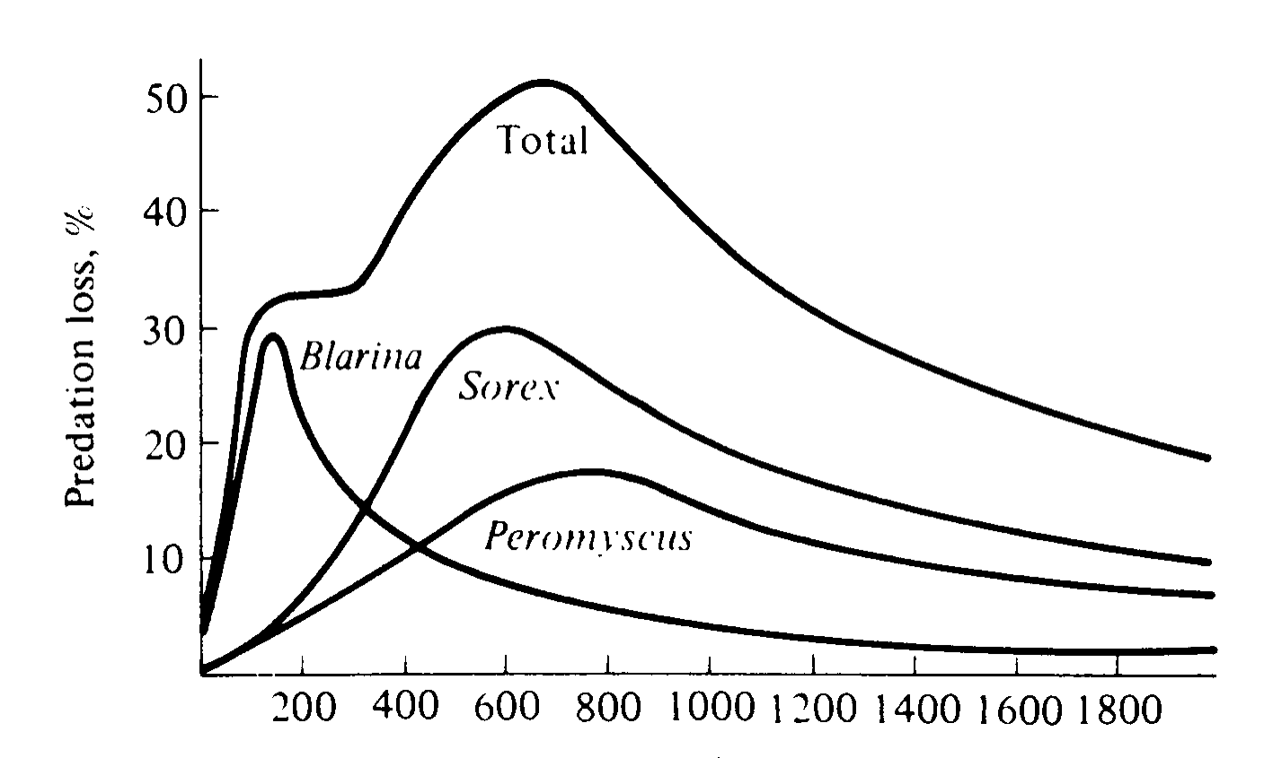
Numerical response = increased prey density raises the predator’s population size and a greater number of predators consume
An increased number of prey

Slide 17
Gause’s Paramecia x Didinium Experiments Lotka-Volterra Predation Equations: N₁ N₂ = Contacts two coefficients of predation, p₁ and p₂ plus r₁ and d₂ dN₁ /dt = r₁ N₁ – p₁ N₁ N₂ dN₂ /dt = p₂ N₁ N₂ – d₂ N₂ No self damping N² terms (no density dependence) dN₁ /dt = 0 when r₁ = p₁ N₂ or N₂ = r₁ / p₁ dN₂ /dt = 0 when p₂ N₁ = d₂ or N₁ = d₂ / p₂ Neutral Stability, Limit Cycle Predator destabilizing, Prey Refuges Functional and Numerical Responses

Slide 18
Adding Prey self-damping stabilizes
Prey-Predator isocline analyses
Predator efficiency, Prey escape ability
Prey refuges, coevolutionary race
Predators usually destabilizing
Predator Switching, frequency dependence, stabilizes

Slide 19
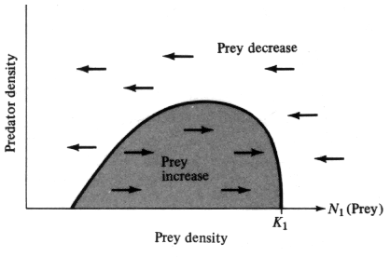
Prey Isocline Hump
Efficient Predator —> unstable
Inefficient Predator —> stable
Predator Switching, frequency dependence, stabilizes
“Prudent” Predation and Optimal Yield
Feeding territories
Consequence of senescence

Slide 20
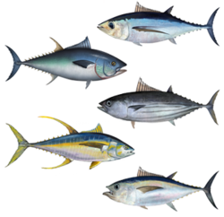
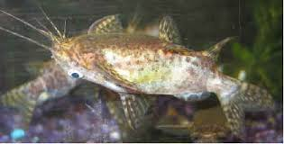
Predator Escape Tactics Aspect Diversity Cryptic coloration (countershading) Disruptive coloration Flash coloration Eyespots, head mimicry Warning (aposematic) coloration Alarm signals Hawk alarm calls Selfish callers Plant secondary chemicals
Upside-Down Catfish

Slide 21
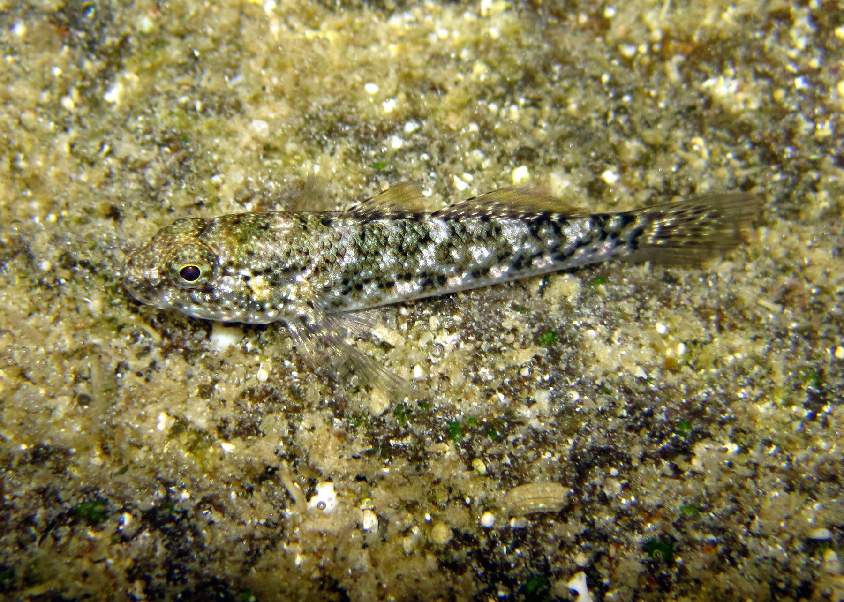
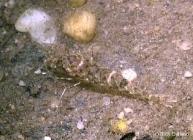
Aspect Diversity
in Tide Pools
Cottid Fish <—
Shrimp —>
Secondary Chemical
Defenses of Plants

Slide 22
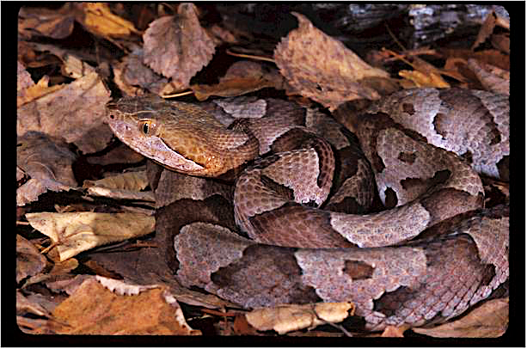

Slide 23
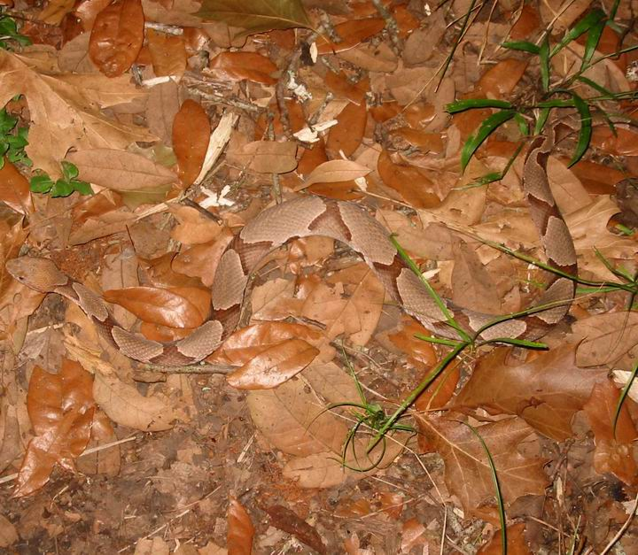

Slide 25
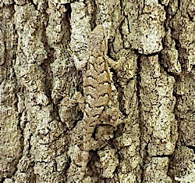
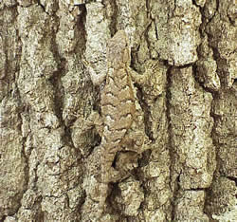

Slide 26
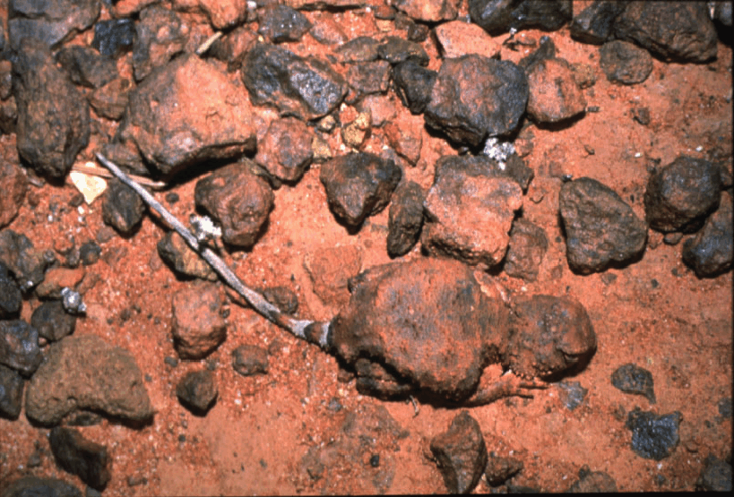
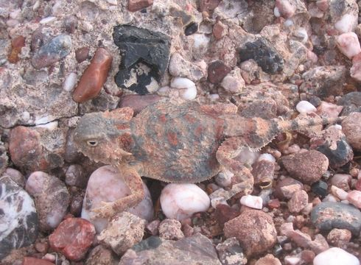
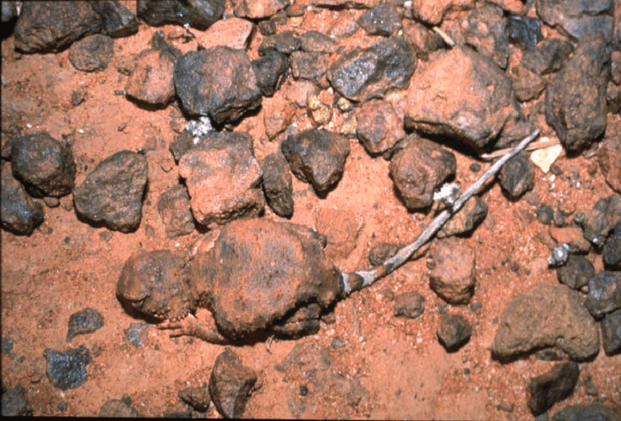
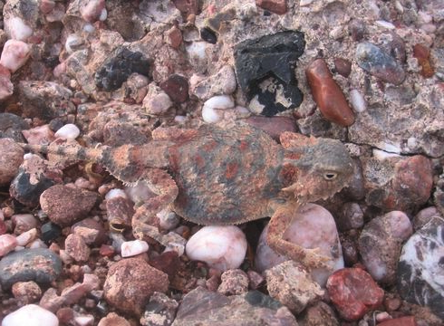

Slide 27
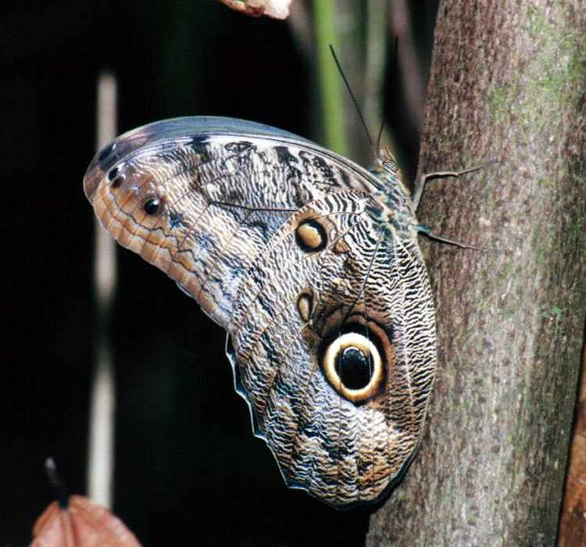
Calligo owl butterfly

Slide 28
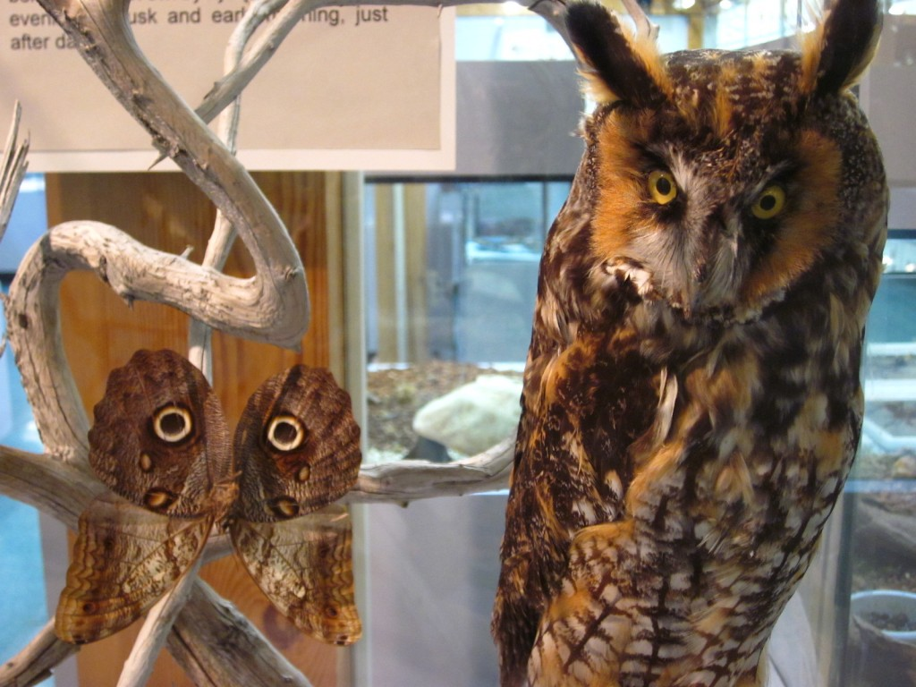

Slide 29
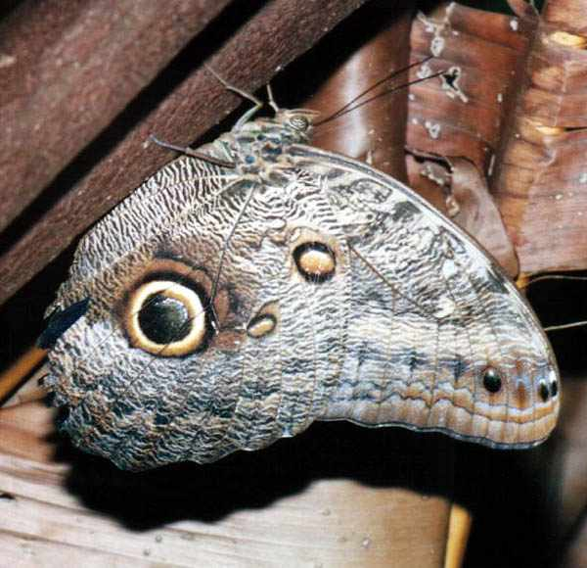

Slide 31
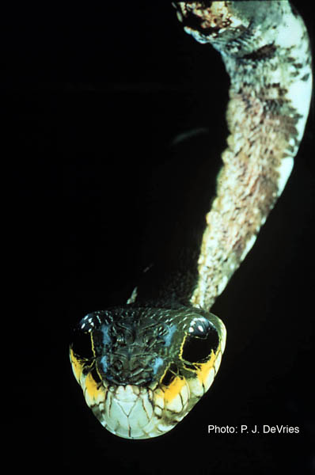
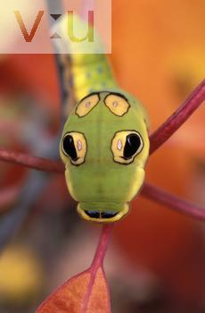
Head Mimicry
Papilio caterpillar
Pit Viper caterpillar
DeVries Snake head

Slide 32
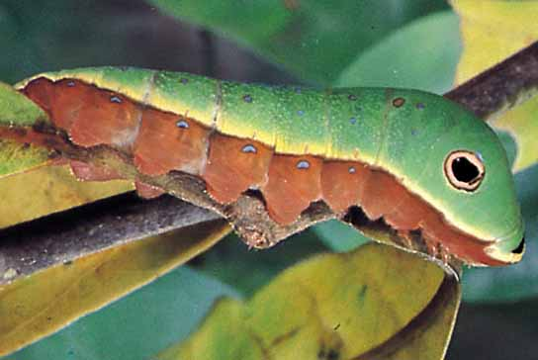

Slide 33
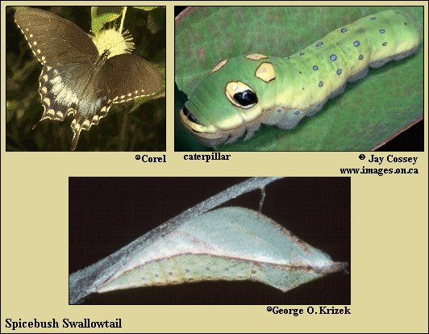

Slide 34
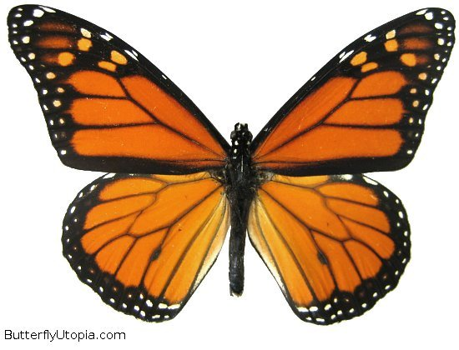
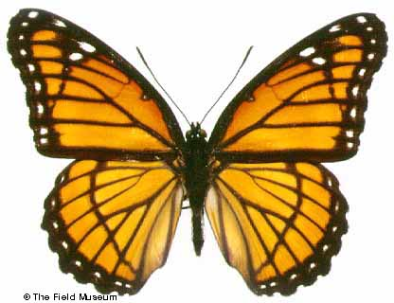
Batesian Mimicry
Viceroy
(Mimic)
Monarch
(Model)

Slide 35
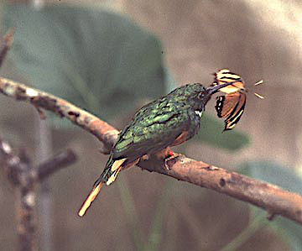
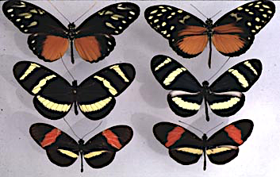
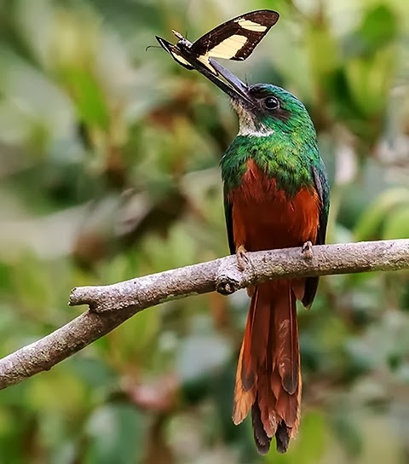
Rufous-tailed Jacamar
Galbula ruficauda

Slide 36
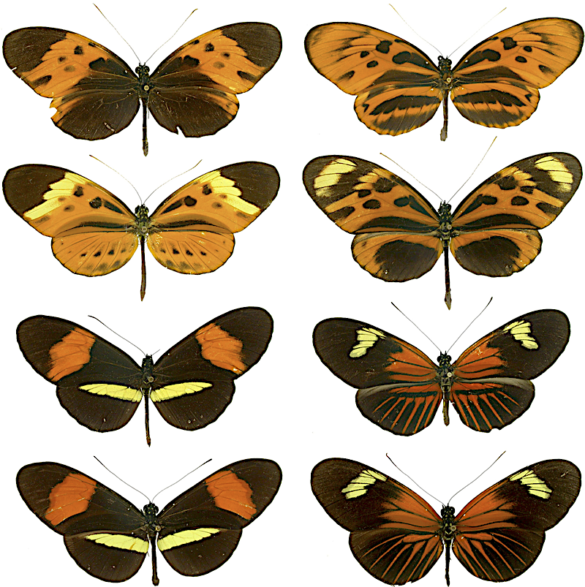

Slide 37
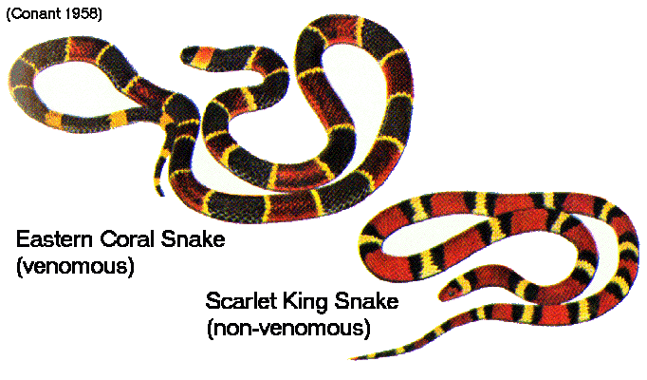
Batesian Mimicry

Slide 38
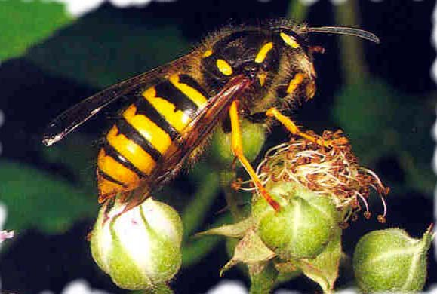
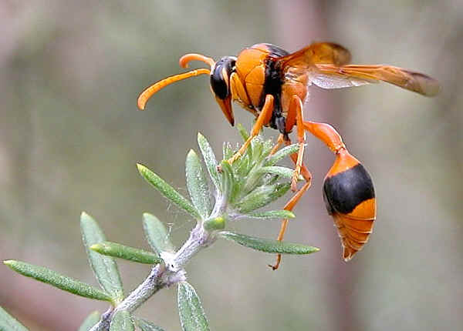
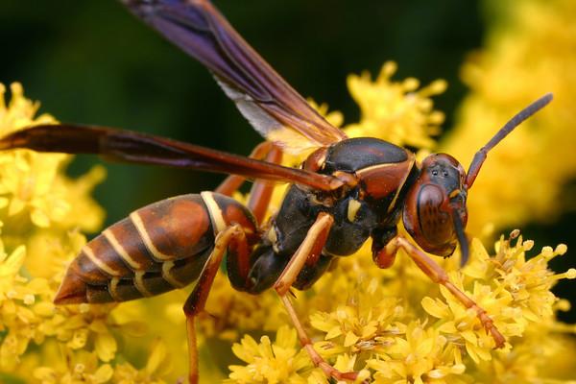
Mullerian Mimicry

Slide 39
Batesian Mimicry

Slide 40
Aposematic (“stay away”) Warning coloration

Slide 41
Dendrobatid Frogs
Aposematic (“stay away”) Warning coloration

Slide 42
Parasitism > Commensalism > Mutualism (+, –) < (+, 0) < (+, +) Host-Altered Behavior Evolution of Virulence Biological Control

Slide 43
Parasitism

Slide 44
HIV
Virions

Slide 45
1. Physiological dependence on host most parasites are highly specialized many have complex life cycles with intermediate and final hosts challenge: how to infect new hosts? 2. Higher reproductive potential than host (high fecundity necessary for dispersal) 3. Parasites can kill highly infected hosts but typically do not — allow host to live 4. Infection produces an overdispersed distribution of parasites among hosts

Slide 46
Parasite Examples Assassin bugs (Triatoma) Chagas’ disease, Malaria, Zika Virus Tapeworms (Cestodes) Cholera (Shigella) transmission via dysentery Toilet seats, elevator buttons, shopping carts... Molecular mimicry “eclipsed antigens” resemble host antigens hence do not elicit formation of host antibodies Major Histocompatibility Complex (MHC) Trypanosoma shed coats, change antigens Filariasis Elephantiasis (blocked lymph nodes, nematode worms carried by mosquitos)

Slide 48
Assassin bugs (Triatoma), contact, blood sucking, Chagas’s Disease
Triatoma

Slide 50
Microbiome, antibiotics, Germs R us, appendix =“bomb shelter”
Challenges facing Parasites, hosts as islands, how to infect new ones?
Host specificity, high fecundities, exploitation of vectors (mosquitoes)
Intermediate and final hosts, host altered behavior (rabies, etc.)
Assassin bugs (Triatoma), contact, blood sucking, Chagas’s Disease Malaria (Plasmodium), fever
Tapeworms (Cestodes), Nematodes (roundworms)
Cholera (Shigella) transmission via dysentery, water borne
Toilet seats, elevator buttons, door knobs, shopping carts...etc.
Getting into and out of a public restroom safely
Molecular mimicry: “eclipsed antigens” resemble host antigens hence do not elicit formation of host antibodies Major Histocompatibility Complex (MHC), identity of self, immune response
Trypanosoma shed coats, change antigens Filariasis Elephantiasis (lymph nodes blocked by nematodes carried by mosquitoes)
Botflies
Dracunculus medinensis, caduceus symbol of medicine

Slide 51
Evolution of Virulence (benign parasites allow hosts to live)
Host altered behavior Rabies virus — rabid animals bite, passes on virus to new host
Lancet fluke Trematode Dicrocoelium dentriticum Cercaria —> Metacercariae encyst on ant’s brain Sheep ingest an ant and get infected Starlings, Pill bugs, and Acanthocephalans Ducks, Amphipods, and Acanthocephalans STDs ——> increased sexual activity?
Ectoparasites (fleas, ticks, lice), endoparasites
Social parasites (thievery, brood parasitism)
Parasitoids: Ichneumonid wasps ————>
Microparasites —> macroparasites —> parasitoids —> predator spectrum
and many correlates thereof, such as relative sizes, rates of increase,
number of parasites per host, virulence, stability, and ability to
regulate lower trophic level

Slide 52
Botfly

Slide 53
Botfly
Botfly larva

Slide 56
Filariasis Elephantiasis
(blocked lymph nodes, nematode worms
carried by mosquitos)

Slide 57
Filariasis Elephantiasis
(blocked lymph nodes, nematode worms
carried by mosquitos)
Zika Virus

Slide 59
Nematode (Roundworm) Dracunculus medinensis

Slide 63
Dracunculus medinensis

Slide 66
Nephrurus laevissimus

Slide 68
Host Altered Behavior Rabies virus — rabid animals bite Lancet fluke Trematode Dicrocoelium dentriticum Cercaria —> Metacercariae encyst on ant’s brain Sheep ingest an ant and get infected Starlings, Pill bugs, and Acanthocephalans Ducks, Amphipods, and Acanthocephalans STDs —> increased sexual activity?

Slide 70
Ebola zaire
Ebola reston
Crisis in a Hot Zone. CDC Biohazard Level 4
Nancy Jax. Modes of transmission: airborne,
waterborne, food, contact, intermediate hosts.

Slide 71
Ectoparasites, endoparasites
Social parasites: Brood Parasitism
Parasite–Predator spectrum
Microparasites: Viruses, Bacteria
Macroparasites: “Worms” Cestodes
Parasitoids: Ichneumonid wasps ——>
Predators
Mode of transmission & virulence

Slide 72
__________________________________________________________________

Slide 73
Common Pathways For Transmission of Parasites
______________________________________________________
Food or Water Contamination
roundworm, amoebae, cryptosporidium, Giardia ——>
Vector Bourne
mosquito - canine heartworm, filaria, malaria
flea - canine tapeworm
housefly - amoebic cysts
sand fly - leishmaniasis
Sexual Contact
Trichomonas, Giardia, amoebae, HIV
Inhalation of Contaminated Dust or Air
pinworm, Toxoplasma gondii ———>
Skin Penetration
rabies, hookworms, schistosomes, strongyloides
_____________________________________________________________

Slide 74
Parasitism > Commensalism > Mutualism (+, –) < (+, 0) < (+, +) Host-Altered Behavior Evolution of Virulence Biological Control

Slide 75
Robert Buckman
Human Wildlife: The
Life that Lives on Us.
Johns Hopkins Univ.
Press
100 trillion cells, but only 10 trillion
are human cells. Most of the other
90 trillion are bacteria, with a few
other parasites, fungi, and other
creatures. Shown here is an eyebrow
mite, Demodex folliculorum, which
burrow into eyebrow follicles (those
are three of their rear ends stickling
out of a human eyebrow follicle).

Slide 76
1/10th mm
Dermatophagoides
farinae
Dust Mite

Slide 78
Oryctolagus cunniculus
Biological Control

Slide 79
Oryctolagus cunniculus
Swag man
Thomas Austin

Slide 83
Rabbit Proof Fence

Slide 88
Rabbit Proof Fence

Slide 89
Brazilian cottontail rabbit Sylvilagus brasilensis
carried a benign myxoma virus which, when
injected into an Oryctolagus cunniculus hare
caused cancers that quickly killed the rabbits.
Released in 1951, epidemic killed 99.9% of bunnies
but, rabbits being rabbits, bred like bunnies, and
soon there were as many as ever. Second epidemic
only killed 70% and the third only 50%. Resistent
Rabbits evolved, but so did the virus — as it was
spreading through the rabbit population, the virus
evolved reduced virulence.

Slide 92
Opuntia Prickly Pear Cactus and Cactoblastis Moth

Slide 98
Cane Toad

Slide 105
Cane
Toads

Slide 107
Asian Toad, Duttaphrynus melanostictus

Slide 108
Epidemiology Basic reproductive rate of infection (does one infection result in one new infection?) Threshold host population size

Slide 109
Sigmoidal time course of an epidemic
dI /dt = b IS dS/dt = – b IS

Slide 110
Darwinian Medicine don’t just treat symptoms identify host defenses fever and inflammation iron additives Vitamin C and cancer Antibiotic resistant strains Application of an evolutionary approach to medical treatment

Slide 111
Methicillin-resistant Staphylococcus aureus (MRSA)

Slide 112
Darwinian Medicine don’t treat symptoms host response or parasite manipulation? fever and inflammation iron additives Vitamin C and cancer Antibiotic resistant strains Application of an evolutionary approach to medical treatment
R. M. Nesse
G. C. Williams

Slide 114
Coevolution Joint evolution of two (or more) taxa that have close ecological relationships but do not exchange genes, and in which reciprocal selective pressures operate to make the evolution of either taxon partially dependent on the evolution of the other

Slide 115
Modes of transmission airborne waterborne food contact intermediate hosts

Slide 116
Enterobius
Pinworms
(Parasites
on Primates)

Slide 117
Parallel phylogenies
Brooks and Glen 1982
Enterobius species
Primate hosts

Slide 118
Drosophila pachea and senita cactus.
Danaid butterflies use polyuridine alkaloids as chemical precursors for synthesis of pheromones used in attracting mates.
An arginine mimic, l-canavavine, present in many legumes,
ruins protein structure in most insects.
However, a bruchid beetle has evolved metabolic machinery
that enable it to use plants containing canavanine.

Slide 119
Wild ginger, Asarum caudatum, in western Washington are
polymorphic for growth rate, seed production, and palatabililty to
a native slug, (Cates 1975).
Where slugs are uncommon, plants allocate more energy to
growth and seed production and less to production of antiherbivore
chemicals. In habitats with lots of slugs, less palatable plants have
a fitness advantage — even though they grow more slowly, they
Lose less photosynthetic tissue to slug herbivory.

Slide 120
Some of the Suggested Correlates of Plant Apparency
___________________________________________________________________________
Apparent Plants Unapparent Plants
___________________________________________________________________________
Common or conspicuous Rare or ephemeral
Woody perennials Herbaceous annuals Paul Feeny
Long leaf life span Short-lived leaves
Slow growing, competitive species Faster growing, often fugitive species
Late stages of succession, climax Early stages of succession, second growth
Bound to be found by herbivores Protected from herbivores by escape in
(cannot escape in time and space) time and space (but still encountered by
wide-ranging generalized herbivores)
Produce more expensive quantitative Produce inexpensive qualitative chemical
(broad-based) antiherbivore defenses defenses (poisons or toxins) to discourage
(tough leaves, thorns, tannins) generalized herbivores
Quantitative defenses constitute Qualitative defenses may be broken down
effective ecological barriers to her- over evolutionary time by coevolution of
bivores, although perhaps only a weak appropriate detoxification mechanisms in
evolutionary barrier unless supple- herbivores (host plant-specific herbivore
mented with qualitative defenses species result)
___________________________________________________________________________

Slide 121
Daniel Janzen

Slide 122
Pine squirrels (Tamiasciurus) and
coniferous food trees (Smith 1970)
Squirrels are very effective seed predators, stockpile cones
Trees reduce squirrel effectiveness in many different ways:
Cones difficult for squirrels to reach, open, or carry
Putting fewer seeds in each cone (fake cones without any seeds)
Increasing thickness of seed coats (seeds harder to harvest)
Putting less energy into each seed (smaller seeds)
Shedding seeds from cones early, before young squirrels forage
Periodic cone crop failures decimate squirrel populations
Individual trees out of synchrony would set fewer seeds and thus
be selected against.

