Slide 1
Third Exam Thursday 7th May 2020
Chapters 11-15, 17-18 plus 8 readings
Energy
Money
Land
Food
Water
Sewage
Solutions
Space Travel
27th Lecture
30 April 2020
Final Exam: Wednesday 13th May 2-5 pm

Slide 2
Latitudinal gradients in species diversity
Tropical tree species diversity
Seeding rings
Nutrient mosaic
Circular networks
Disturbance (epiphyte loads)
Connectance and number of species
Sea otters as keystone species, alternative stable states
Types of stability
Constancy = variability
Inertia = resistance
Elasticity = resilience (Lyapunov stability)
Amplitude (domain of attraction)
Cyclic stability (neutral stability, limit cycles, strange attractors)
Trajectory stability (succession)
Traditional ecological wisdom: diversity begats stability
May’s challenge using random model systems
Real systems not constructed randomly

Slide 3
Types of Stability Point Attractors <——> Repellers Domains of Attraction, Multiple Stable States Local Stability <——> Global Stability Types of Stability 1. Persistence 2. Constancy = variability 3. Resistance = inertia 4. Resilience = elasticity (rate of return, Lyapunov stability) 5. Amplitude stability (Domain of attraction) 6. Cyclic stability, neutral stability, limit cycles, strange attractors 7. Trajectory stability

Slide 4
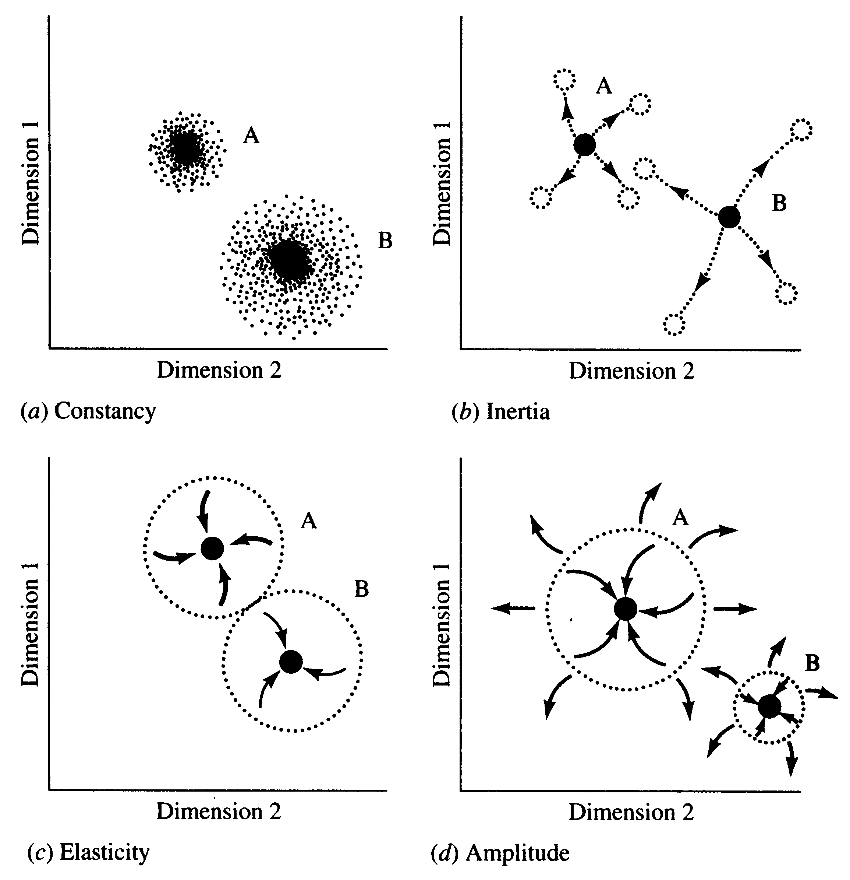

Slide 5
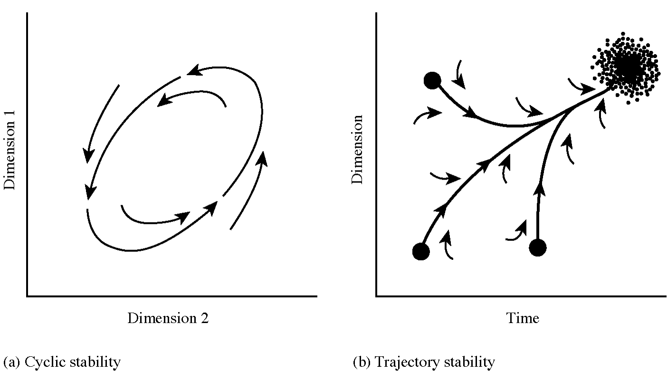
Limit Cycle
Succession

Slide 6
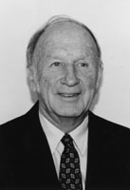
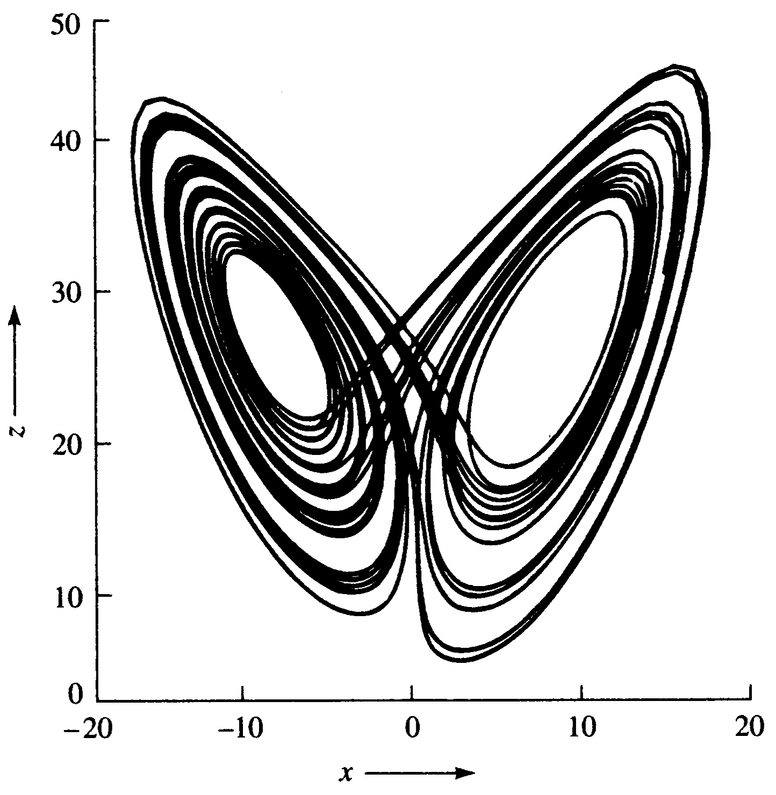
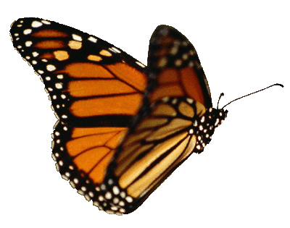
Edward Lorenz
Strange
Attractor
Butterfly Effect

Slide 7
LORENZ ATTRACTOR
This is the system in which chaos in the context of dissipative
dynamical systems was first discovered. The equations approximate
temporal variations in the temperature gradient of a fluid, such as the
atmosphere, heated from below. Typically the equations are written as
dx/dt = a(y - x)
dy/dt = bx - y - xz
dz/dt = yz – cz
where z(t) describes the temperature gradient. Provided that the
parameter, c, the so-called "Rayleigh number," is large enough, the
Lorenz system exhibits chaos and sensitivity to initial conditions --
hence Lorenz' conclusion that the weather is inherently unpredictable.
A typical chaotic trajectory has a c value of 8/3. The coordinate axes,
which have been suppressed to make for a cleaner image, are the three
state variables, x, y and z.

Slide 8
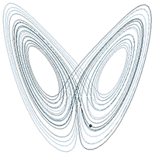
attractor

Slide 9
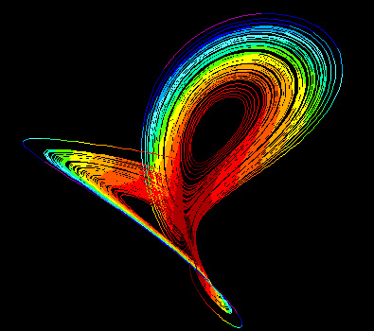
Lorenz strange attractor
Colors reflect variations in
velocity on the attractor with
red indicating the slowest
speeds and violet the fastest.

Slide 10
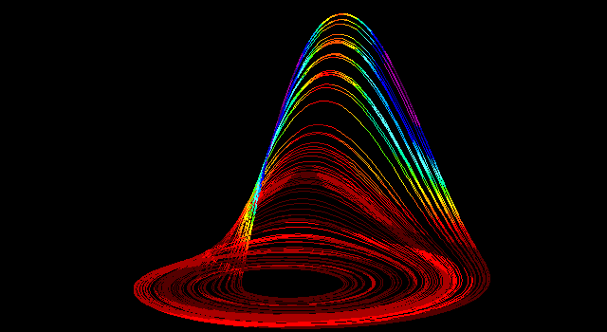
Rossler strange attractor

Slide 11
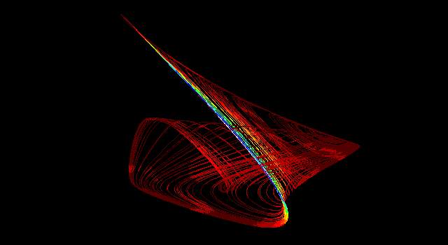
Gilpin strange attractor

Slide 12
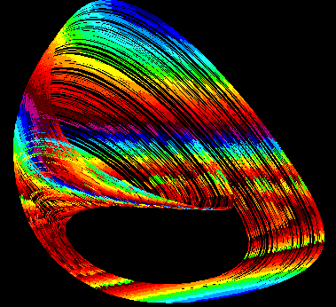
3 species food chain

Slide 13
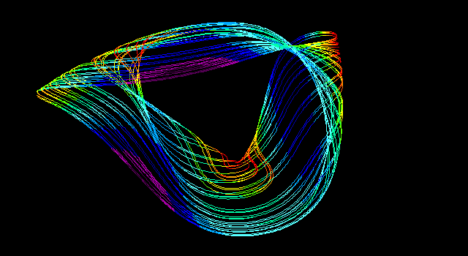

Slide 14
Generalized Lotka-Volterra Equations:
dN_{i}/dt = N_{i} (b_{i} + Σ a_{ij} N_{j})
Jacobian Matrix
Partial Derivatives: ∂N_{i} / ∂N_{j ,} ∂N_{j} / ∂N_{i}
Sensitivity of species i to changes in density of species j
when all other species are held constant
Sensitivity of species j to changes in density of species i
when all other species are held constant

Slide 15
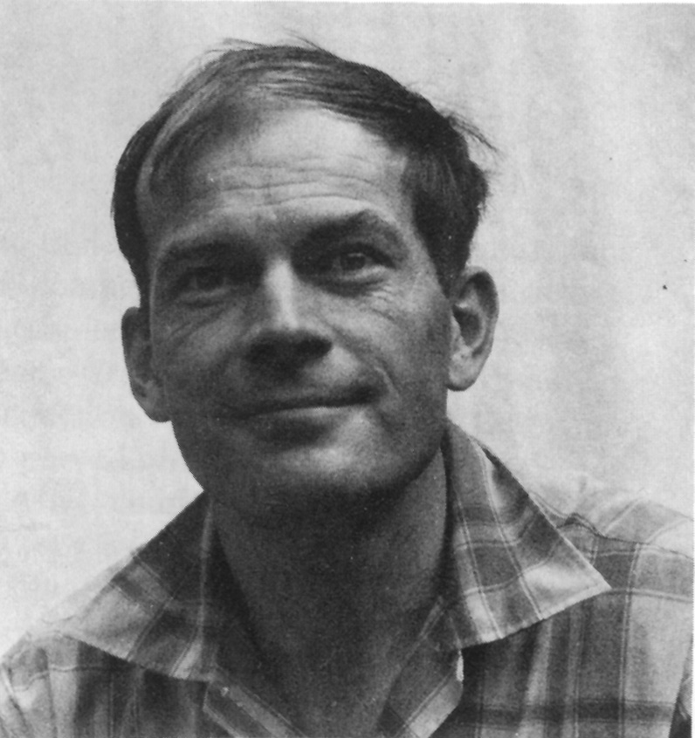
Traditional Ecological Wisdom:
Diversity begats Stability
MacArthur’s idea
Stability of an ecosystem should increase with both the number of different trophic links between species and with the equitability of energy flow up various food chains
Robert MacArthur

Slide 16
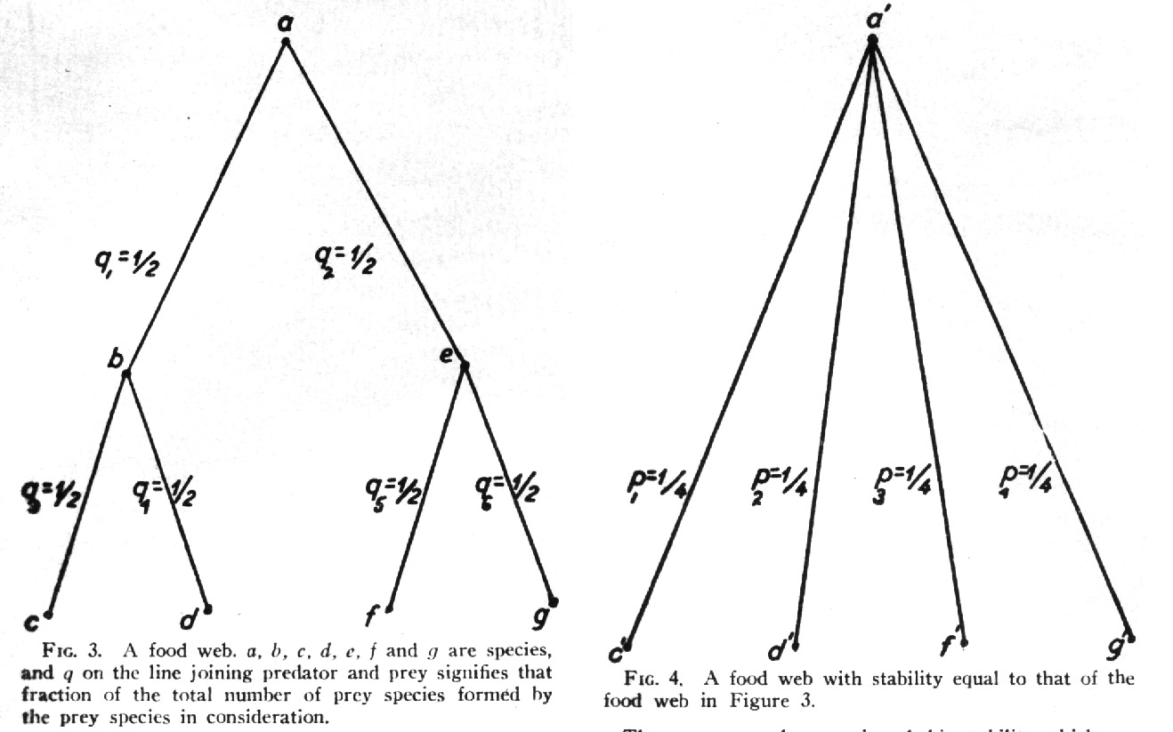
Robert MacArthur

Slide 17
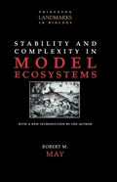
Robert May challenged
conventional ecological
thinking and asserted that complex ecological systems
were likely to be less stable
than simpler systems
May analyzed sets of randomly assembled model ecosystems. Jacobian matrices were assembled as follows: diagonal elements were defined as – 1. All other interaction terms were equally likely to be + or – (chosen from a uniform random distribution ranging from +1 to –1). Thus 25% of interactions were mutualisms, 25% were direct interspecific competitors and 50% were prey-predator or parasite-host interactions. Not known for any real ecological system!

Slide 18
May varied three aspects of community complexity:
Number of species
(dimensionality of the Jacobian matrix)
2. Average absolute magnitude of elements
(interaction strength)
Proportion of elements that were non-zero
(connectance)
Major Conclusion: Complex random systems
are LESS stable than simpler systems

Slide 19
Real communities are far from random in construction, but must obey various constraints.
Can be no more than 5-7 trophic levels, food chain loops are disallowed, must be at least one producer in every ecosystem, etc.
Astronomically large numbers of random systems : for only 40 species, there are 10⁷⁶⁴ possible networks
of which only about 10⁵⁰⁰ are biologically reasonable — realistic systems are so sparse that random sampling is unlikely to find them. For just a 20 species network, if one million hypothetical networks were generated on a computer every second for ten years, among the resulting 31.5¹³ random systems produced, there is a 95% expectation of never encountering even one realistic ecological system!

Slide 20
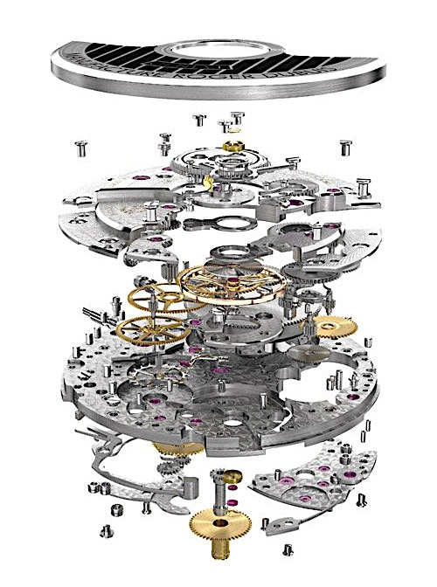
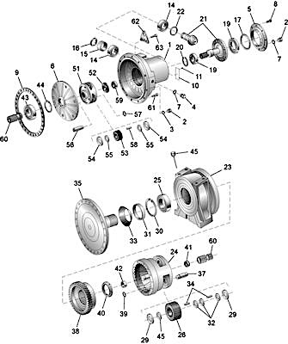
Gearbox: Exploded View

Slide 21
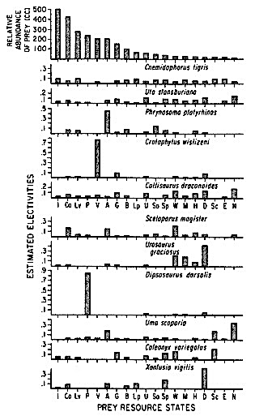
North America

Slide 22
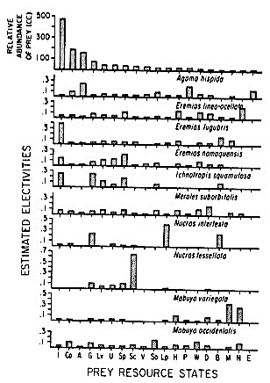
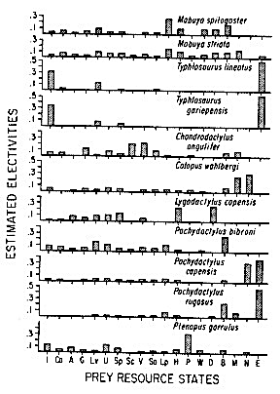
Kalahari

Slide 23
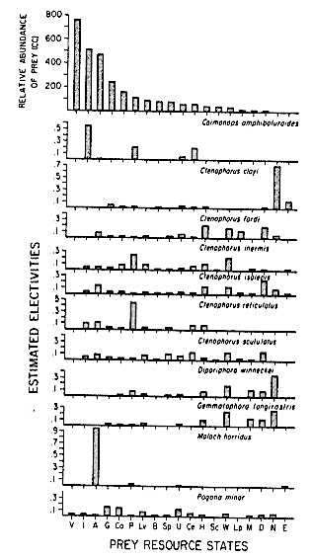
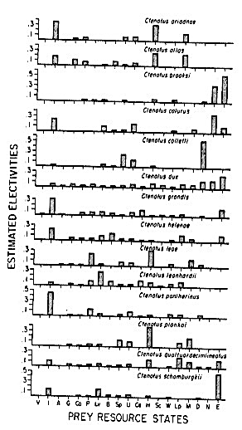
Australia

Slide 24
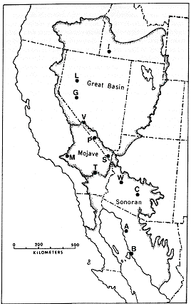
North America
12 study sites
4-5 ubiquitous species
Replace each “resident” species with 11 “aliens”
from other sites
11 x 12 x 5 = 660 comparisons
N_{i}* = K_{i} – Σ α_{ij} N_{j}

Slide 25
“Aliens” versus “residents” comparisons – Pseudo-communities
In North America plus the Kalahari plus Australia, for 30 study areas and 20 prey categories, residents outperformed aliens in 1871 out of 3014 such “experiments” (62%).
For 10 Kalahari sites, 46 prey categories, residents outperformed aliens in 810 out of 1056 cases (76.7%).
In 2 sites in Australia, 200+ prey, residents outperformed aliens in 39 of 52 possible substitutions (75%).

Slide 26
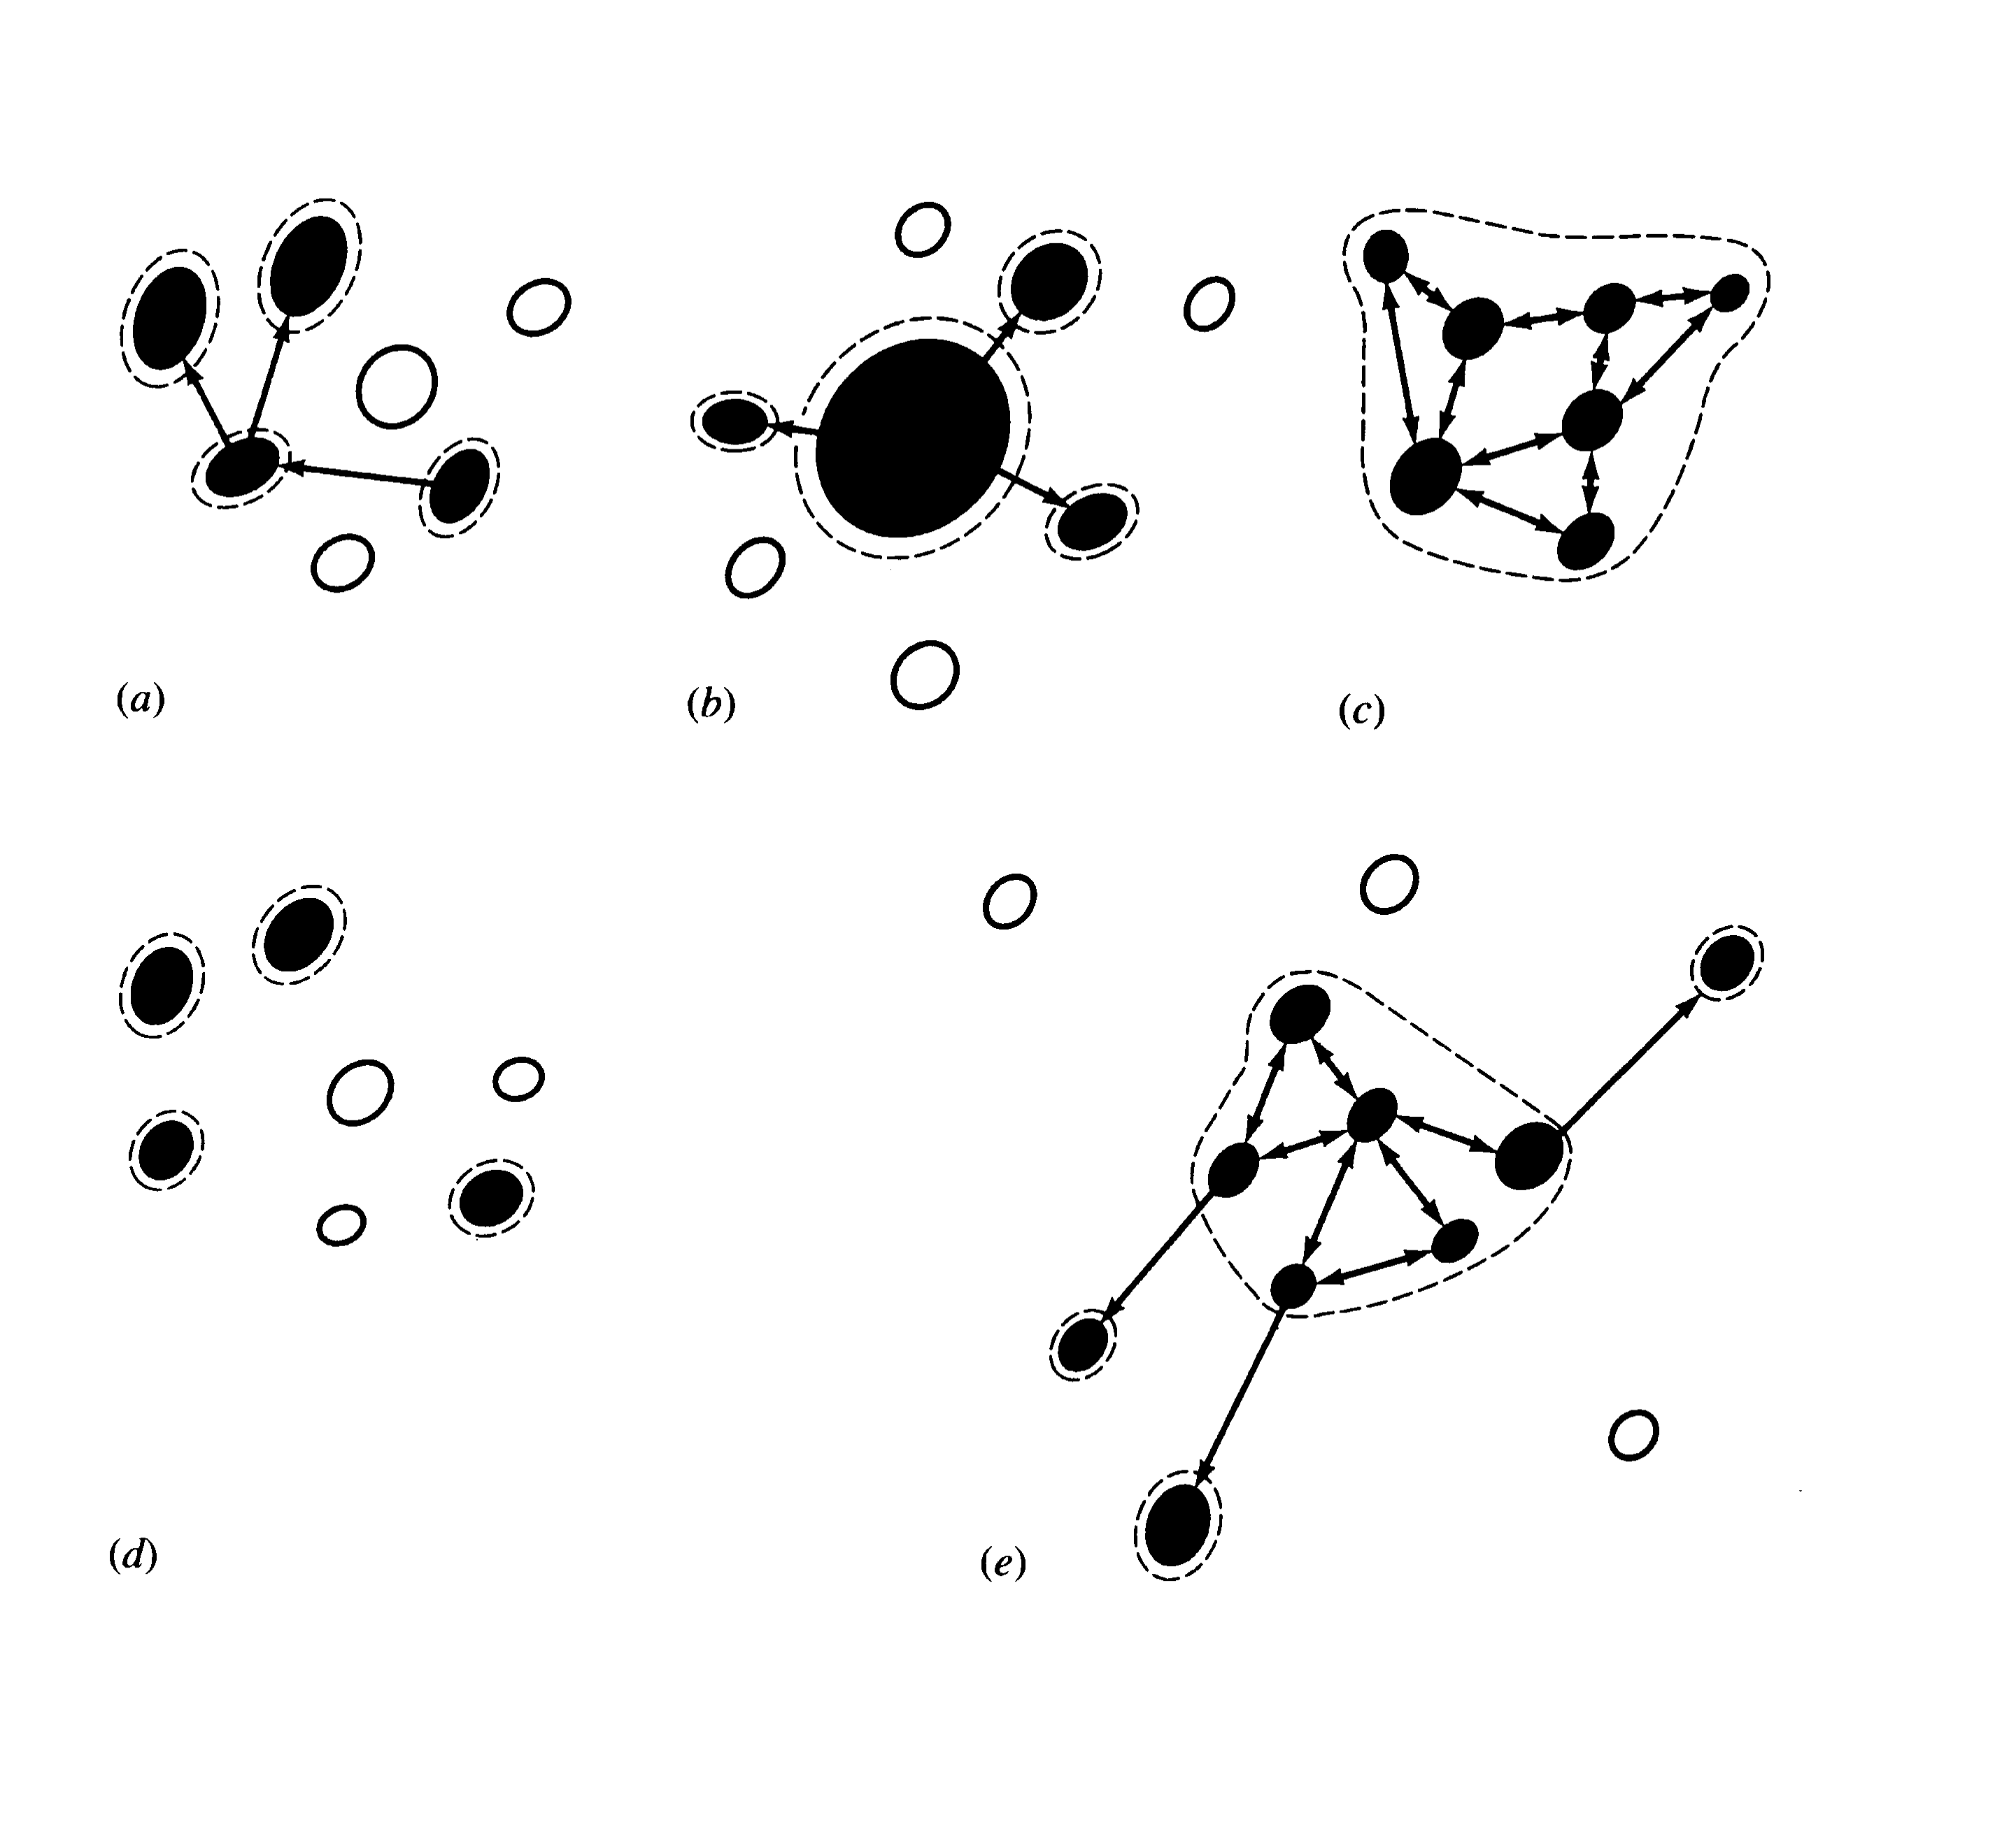
Different types of Metapopulations (Source, Sinks)

Slide 27
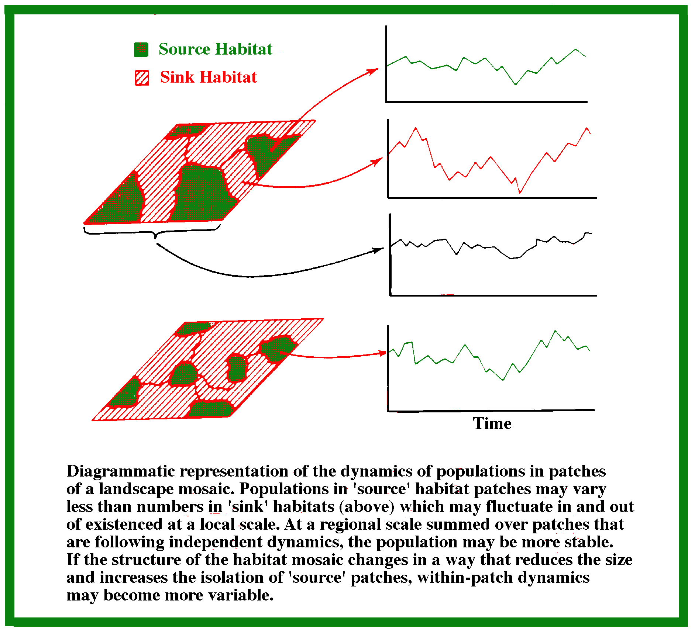

Slide 28
Types of stability
Constancy = variability
Inertia = resistance
Elasticity = resilience (Lyapunov ‘Yapunov’ stability)
Amplitude (domain of attraction)
Cyclic stability (neutral stability, limit cycles, strange attractors)
Trajectory stability (succession)
Traditional ecological wisdom: diversity begats stability
May’s challenge using random model systems
Real systems not constructed randomly

Slide 29
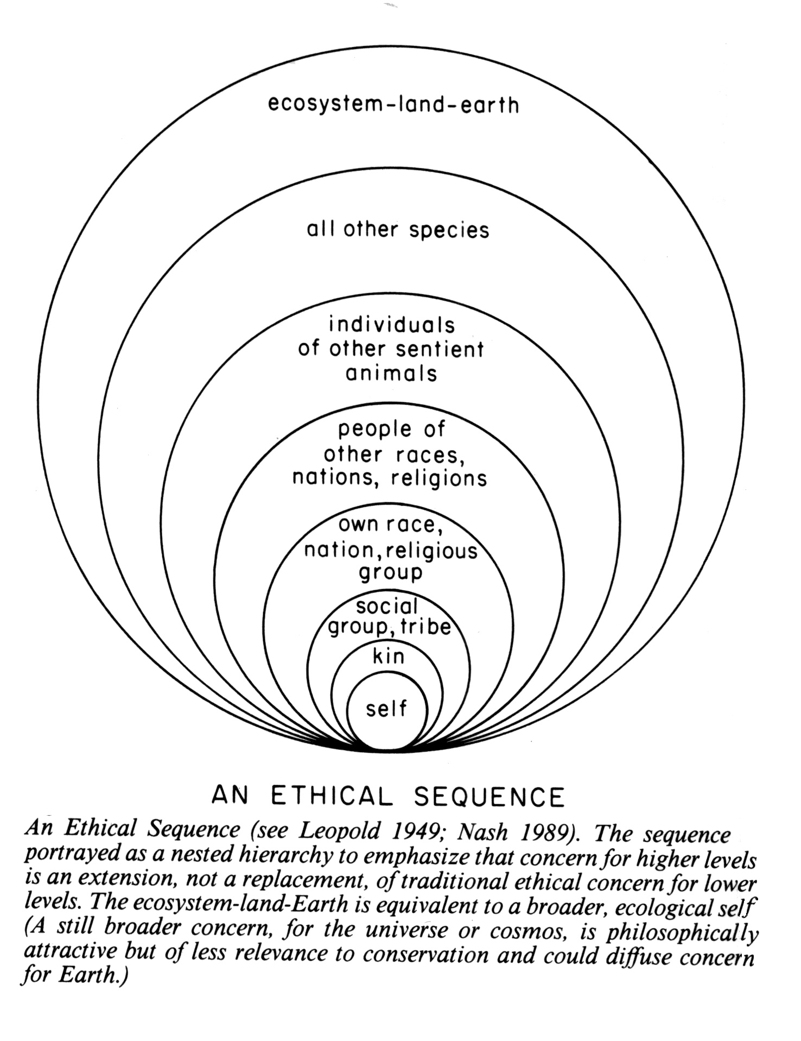
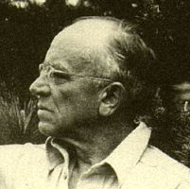
Aldo
Leopold:
“A land ethic changes
the role of Homo sapiens from conqueror of the
land community to plain
member and citizen of
it. It implies respect for
his fellow-members and
also respect for the
community as such.”

Slide 30
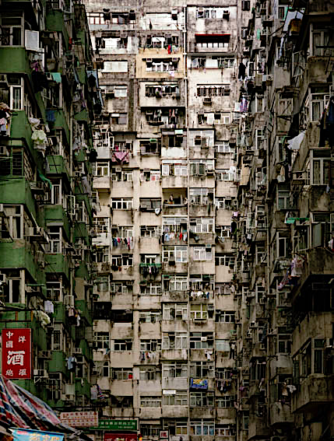
Overpopulation

Slide 31
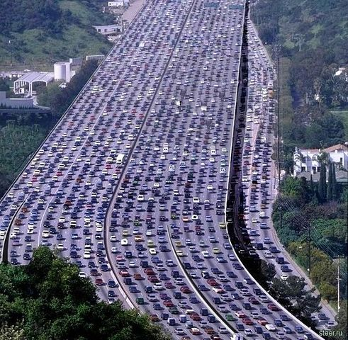
Fossil Fuel
Consumption

Slide 32
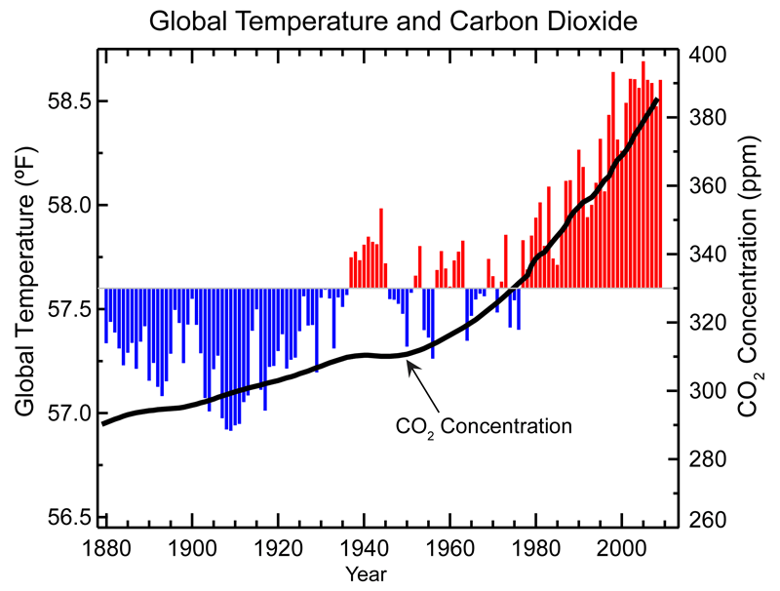
Greenhouse Gases:
Climate Change
Global Warming

Slide 33
Global Warming

Slide 34
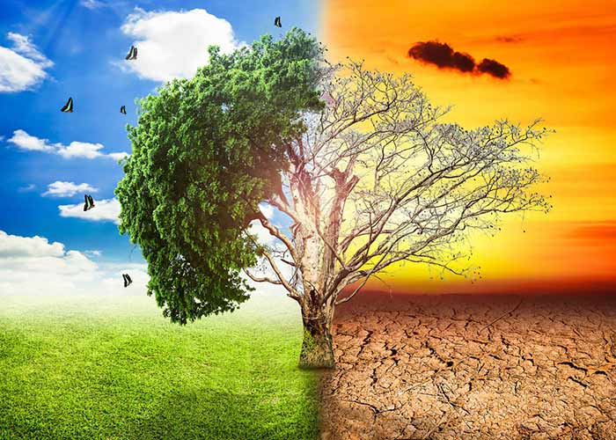
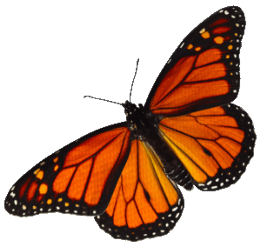
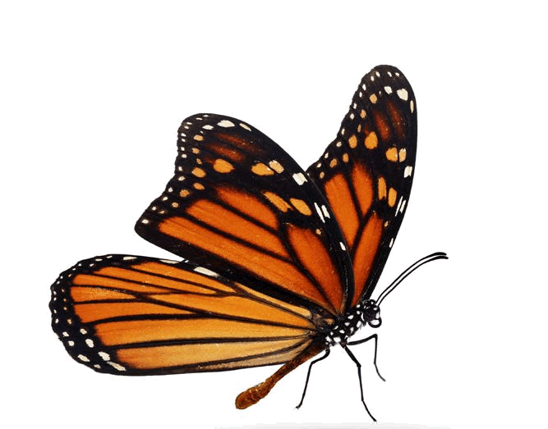
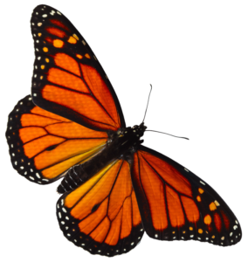
Global Warming

Slide 35
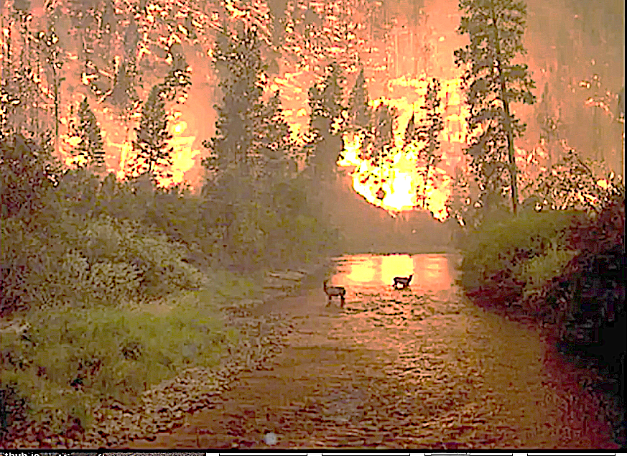
Fires

Slide 36
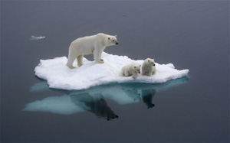
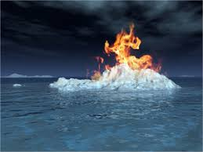
Melting Ice
Methane Release
Burning Clathrates

Slide 37
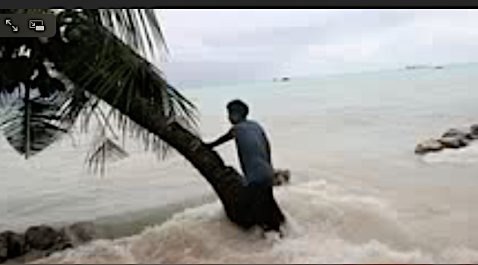
Rising Sea Levels -- Floods

Slide 38
Kiribati

Slide 39
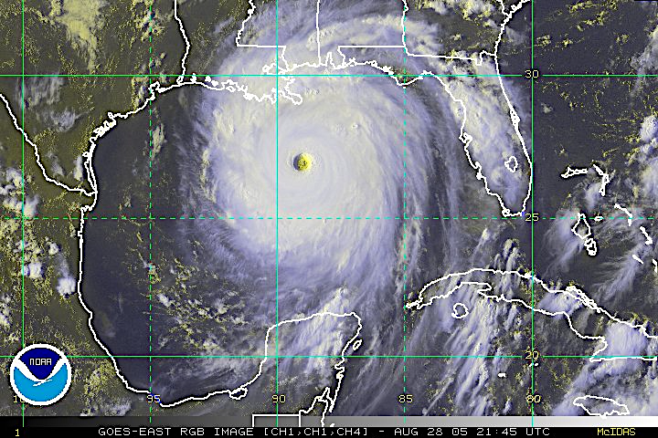
Hurricanes:
Katrina

Slide 40
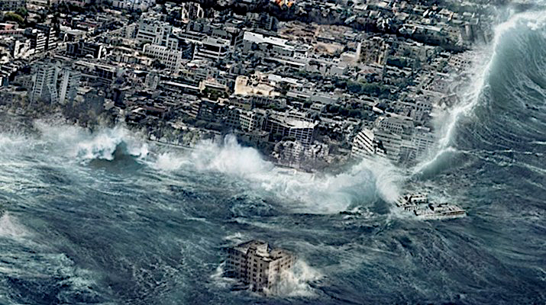
Coastal Cities
Inundated

Slide 41
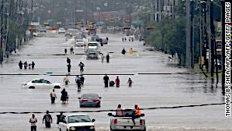
Flooding

Slide 42
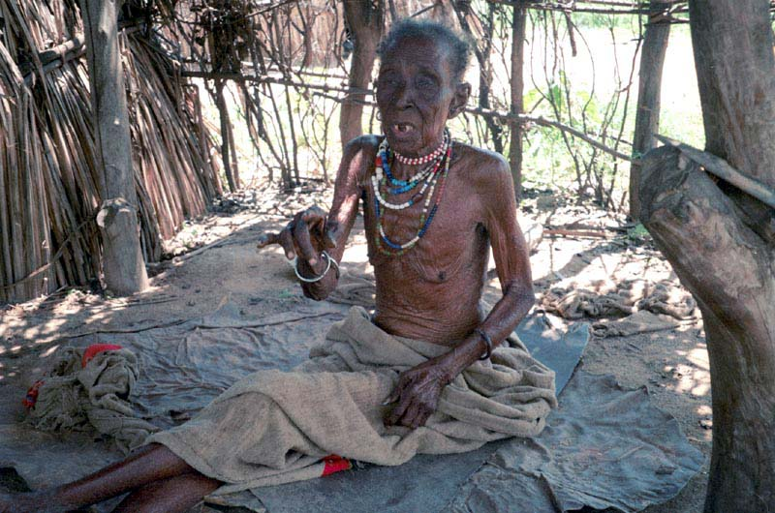
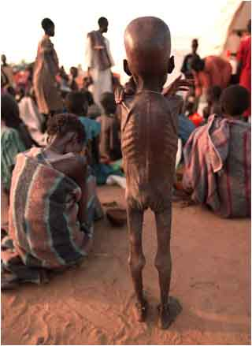
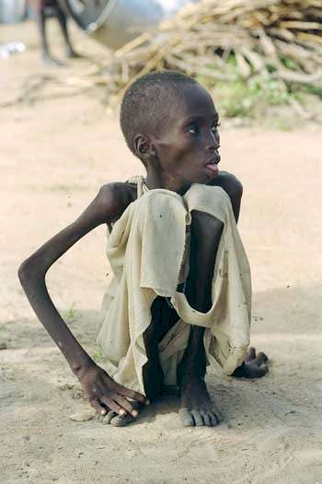
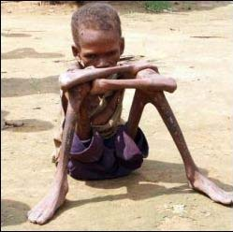
Famines

Slide 43
Nuclear War

Slide 45
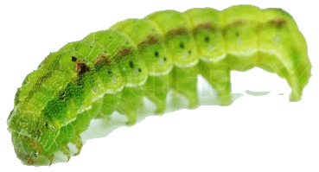
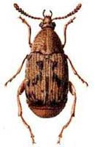
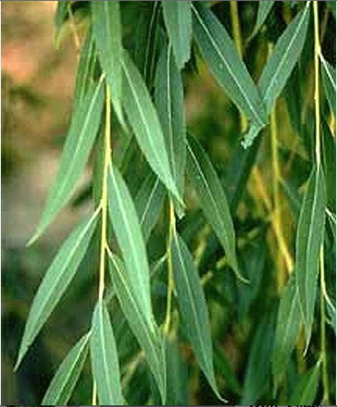
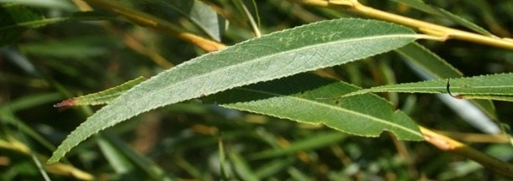
No facts, only interpretations: “Sunrise” = Spinup = Spindawn
Selective thinking, use classical Darwinian natural selection
Avoid homicidal males, ages 15 to 40-ish
Don’t trust politicians (self deceit, better liars)
Don’t trust anybody, not even your mate (cuckoldry, promiscuity)
Wash your hands and keep them away from your face!
Remember how to get into and out of a public toilet
Host-altered behavior: STDs —> increased sexual activity?
Eat green and brown bugs and caterpillars, not red or yellow ones
Soak acorns before eating, save tannin water for tanning hides
Remember you can make soap by boiling animal fat and ashes
Chew on willow for pain relief (salicyclic acid)
Don’t stand still around a big monitor lizard — if one starts to run up
your back, don’t reach around to get it off, just lay down on your belly
Knock centipedes off in the direction they are moving

Slide 46
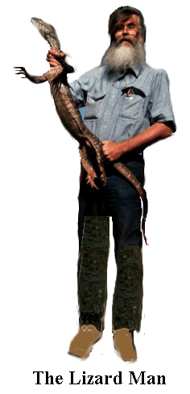
50+years at UT, Taught dozens
of ecology and evolution classes
Wrote classic textbook
Taught many thousand undergrads
and hundreds of graduate students
World authority on the ecology of
desert lizards on three continents
North America, Africa, & Australia

