Slide 1
First Exam Thursday 20 February 2020
Covers Chapters 1-4, 6-7 plus Chapter 16
and first 9 lectures, 5 discussions, plus 8 Readings:
Scientific Methods
Natural Selection
On Human Nature
Our Hunter-Gatherer Heritage
Evolution of Uncaring Humanoids
Global Warming
Population Growth
Evolution’s Problem Gamblers
Lecture # 7
11 February 2020

Slide 2
Greenhouse effect, gases, global warming
Carbon dioxide, methane, climate change, global warming
Wobbling Polar Jet Stream: Ridges and Troughs
Watch “TempFast.mov” 128 years go by in one minute!
Ice ages, agriculture, deforestation, the “Long Summer”
Ocean temperatures, sea level rise, melting ice caps, sliding glaciers
Milankovitch Cycles, Ice ages, “Long Summer”
“Matter will know itself no longer.” (Balfour 1895)
Due to increased CO₂, plants now contain fewer minerals and protein
but more sugar:
http://www.politico.com/agenda/story/2017/09/13/food-nutrients-carbon-dioxide-000511
Watch “Methane Emergency”: https://www.youtube.com/watch?v=ATIm8Ov1Fks

Slide 3
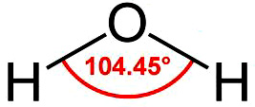
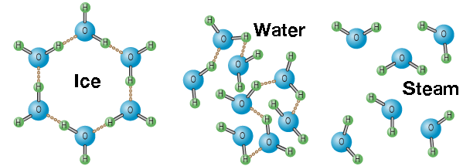
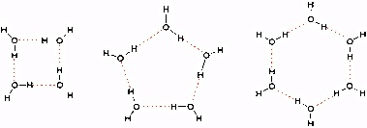
Meterology
Climate versus Weather
Sun, Wind, Water
Oceans/Atmosphere
Temperature
Precipitation (rain, snow)
Hydrologic Cycle
Watch “Earth‘s Water Cycle” Greenhouse Effect
Thermal Equator
Local Perturbations
Milankovitch Cycles
Clathrates, Methane Hydrate

Slide 4
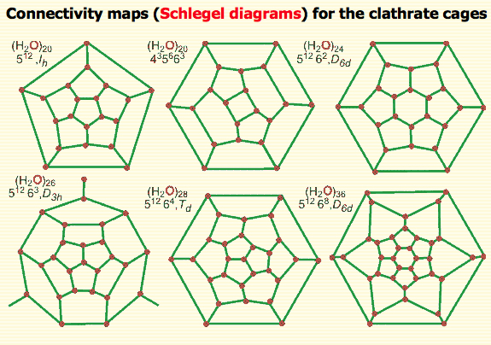
Clathrate Cages

Slide 5
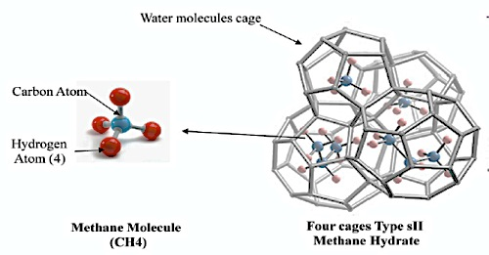
+
Bipolar Molecule
Methane Hydrate

Slide 6
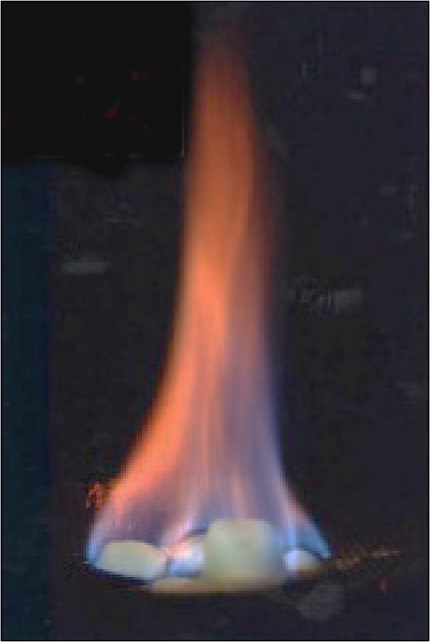
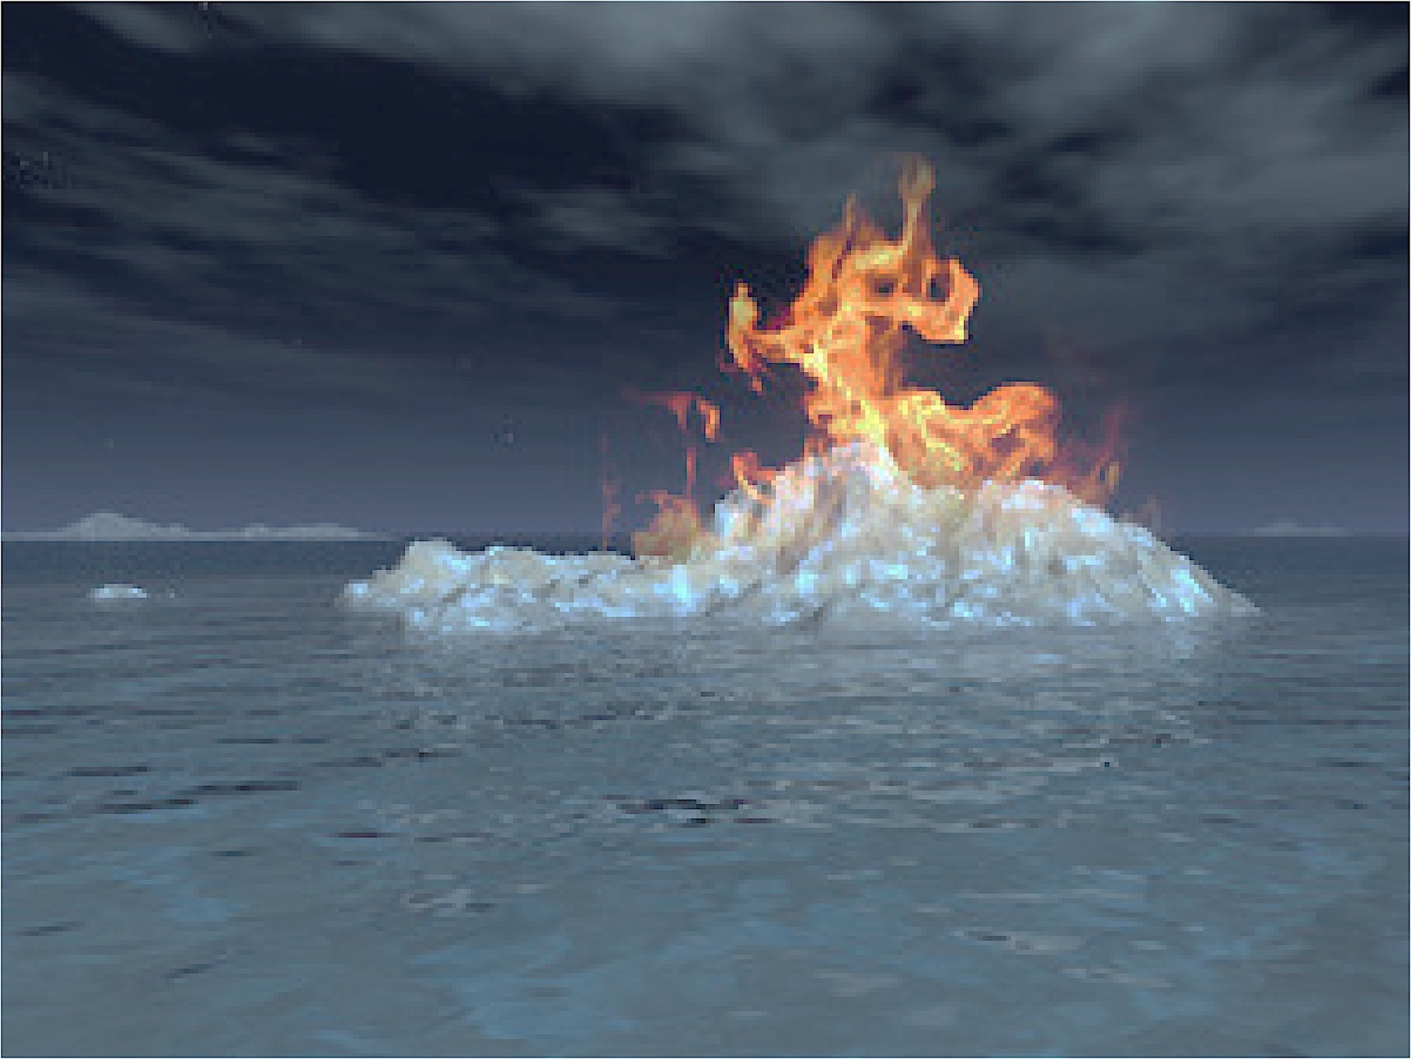
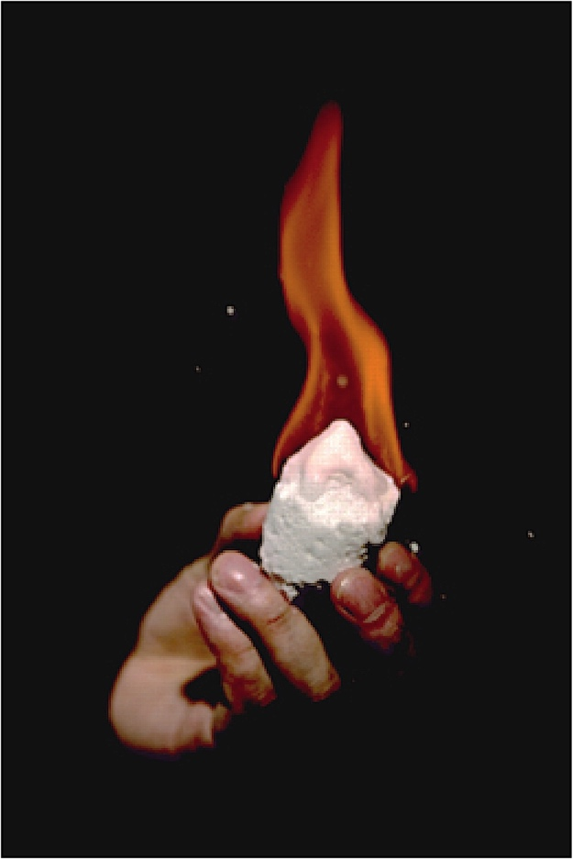
Methane Hydrate
CH₄ + O₂ → CO₂ + H₂O + Heat

Slide 7
Watch NASA’s “Earth‘s Water Cycle”

Slide 8
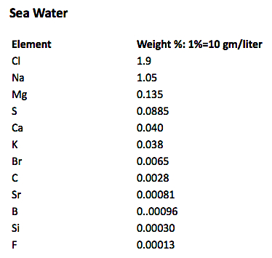

Slide 9
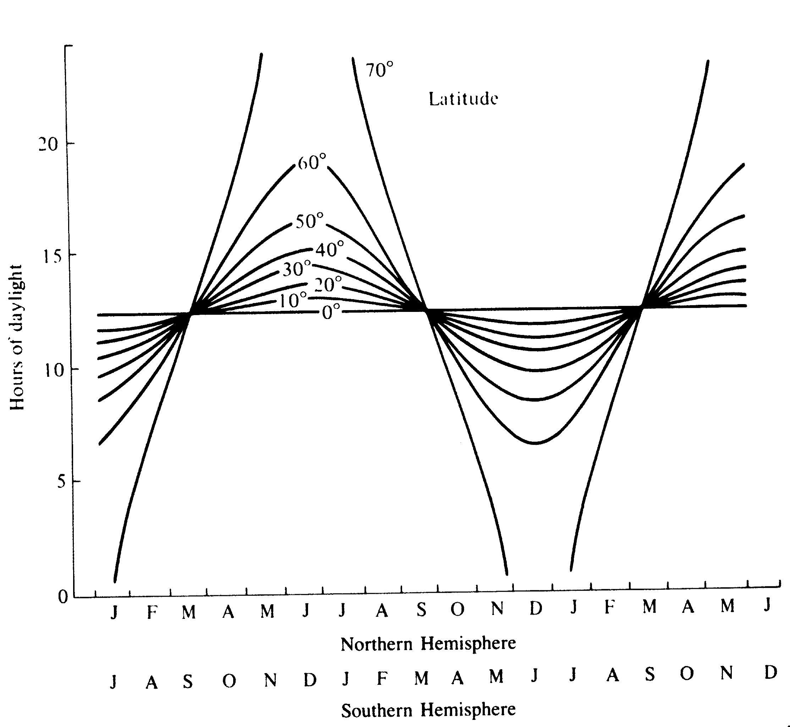
Daylength (Photoperiod) changes seasonally, but differently at different latitudes — no change in daylength at equator

Slide 10
Average Annual Temperature (°C) at Different Latitudes
___________________________________________________________
Latitude Year January July Range
___________________________________________________________
90°N –22.7 –41.1 –1.1 40.0
80°N –18.3 –32.2 2.0 34.2
70°N –10.7 –26.3 7.3 33.6
60°N –1.1 –16.1 14.1 30.2
50°N 5.8 –7.1 18.1 25.2
40°N 14.1 5.0 24.0 19.0
30°N 20.4 14.5 27.3 12.8
20°N 25.3 21.8 28.0 6.2
10°N 26.7 25.8 27.2 1.4
Equator 26.2 26.4 25.6 0.8
10°S 25.3 26.3 23.9 2.4
20°S 22.9 25.4 20.0 5.4
30°S 16.6 21.9 14.7 7.2
40°S 11.9 15.6 9.0 6.6
50°S 5.8 8.1 3.4 4.7
60°S –3.4 2.1 –9.1 11.2
70°S –13.6 –3.5 –23.0 19.5
80°S –27.0 –10.8 –39.5 28.7
90°S –33.1 –13.5 –47.8 34.3

Slide 11
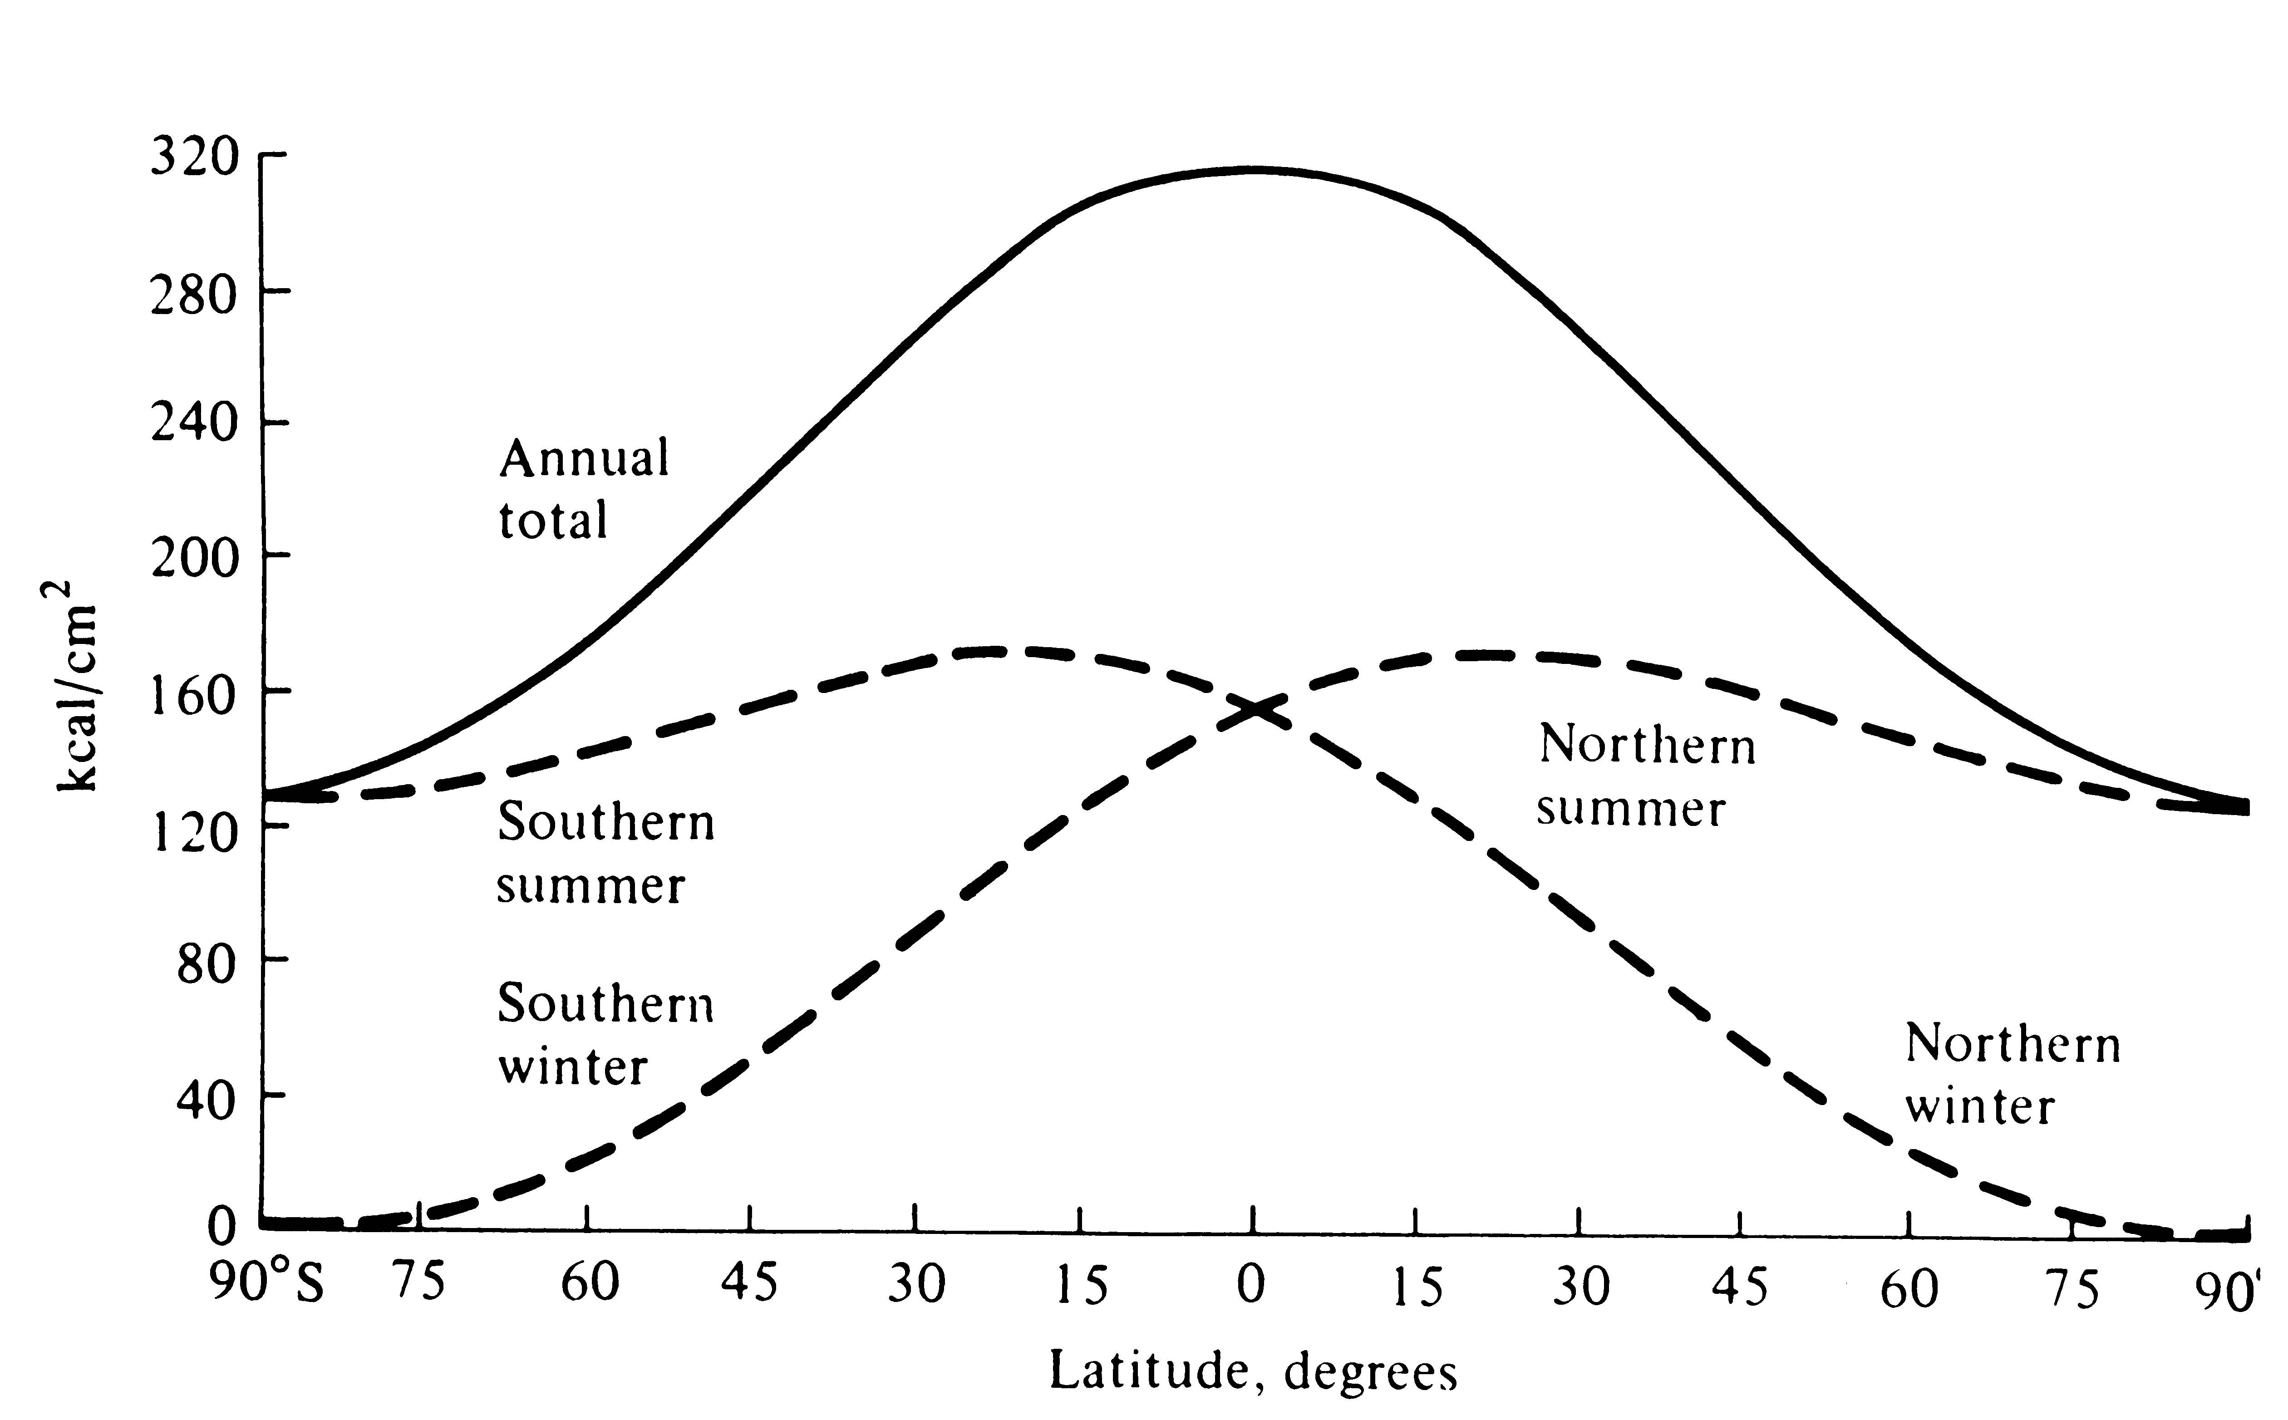
Heat Energy intercepting Earth’s Surface at various Latitudes

Slide 12
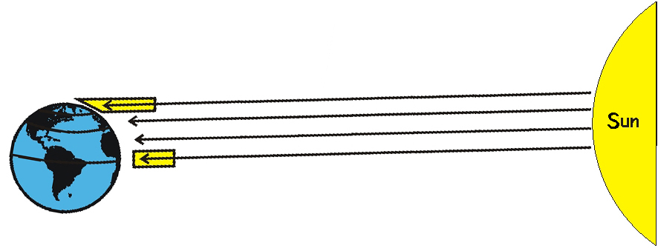
Heat Energy intercepting Earth’s Surface at various Latitudes

Slide 13
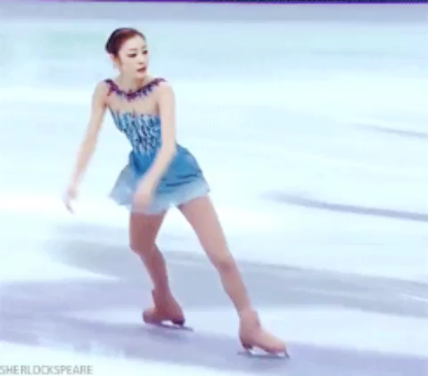
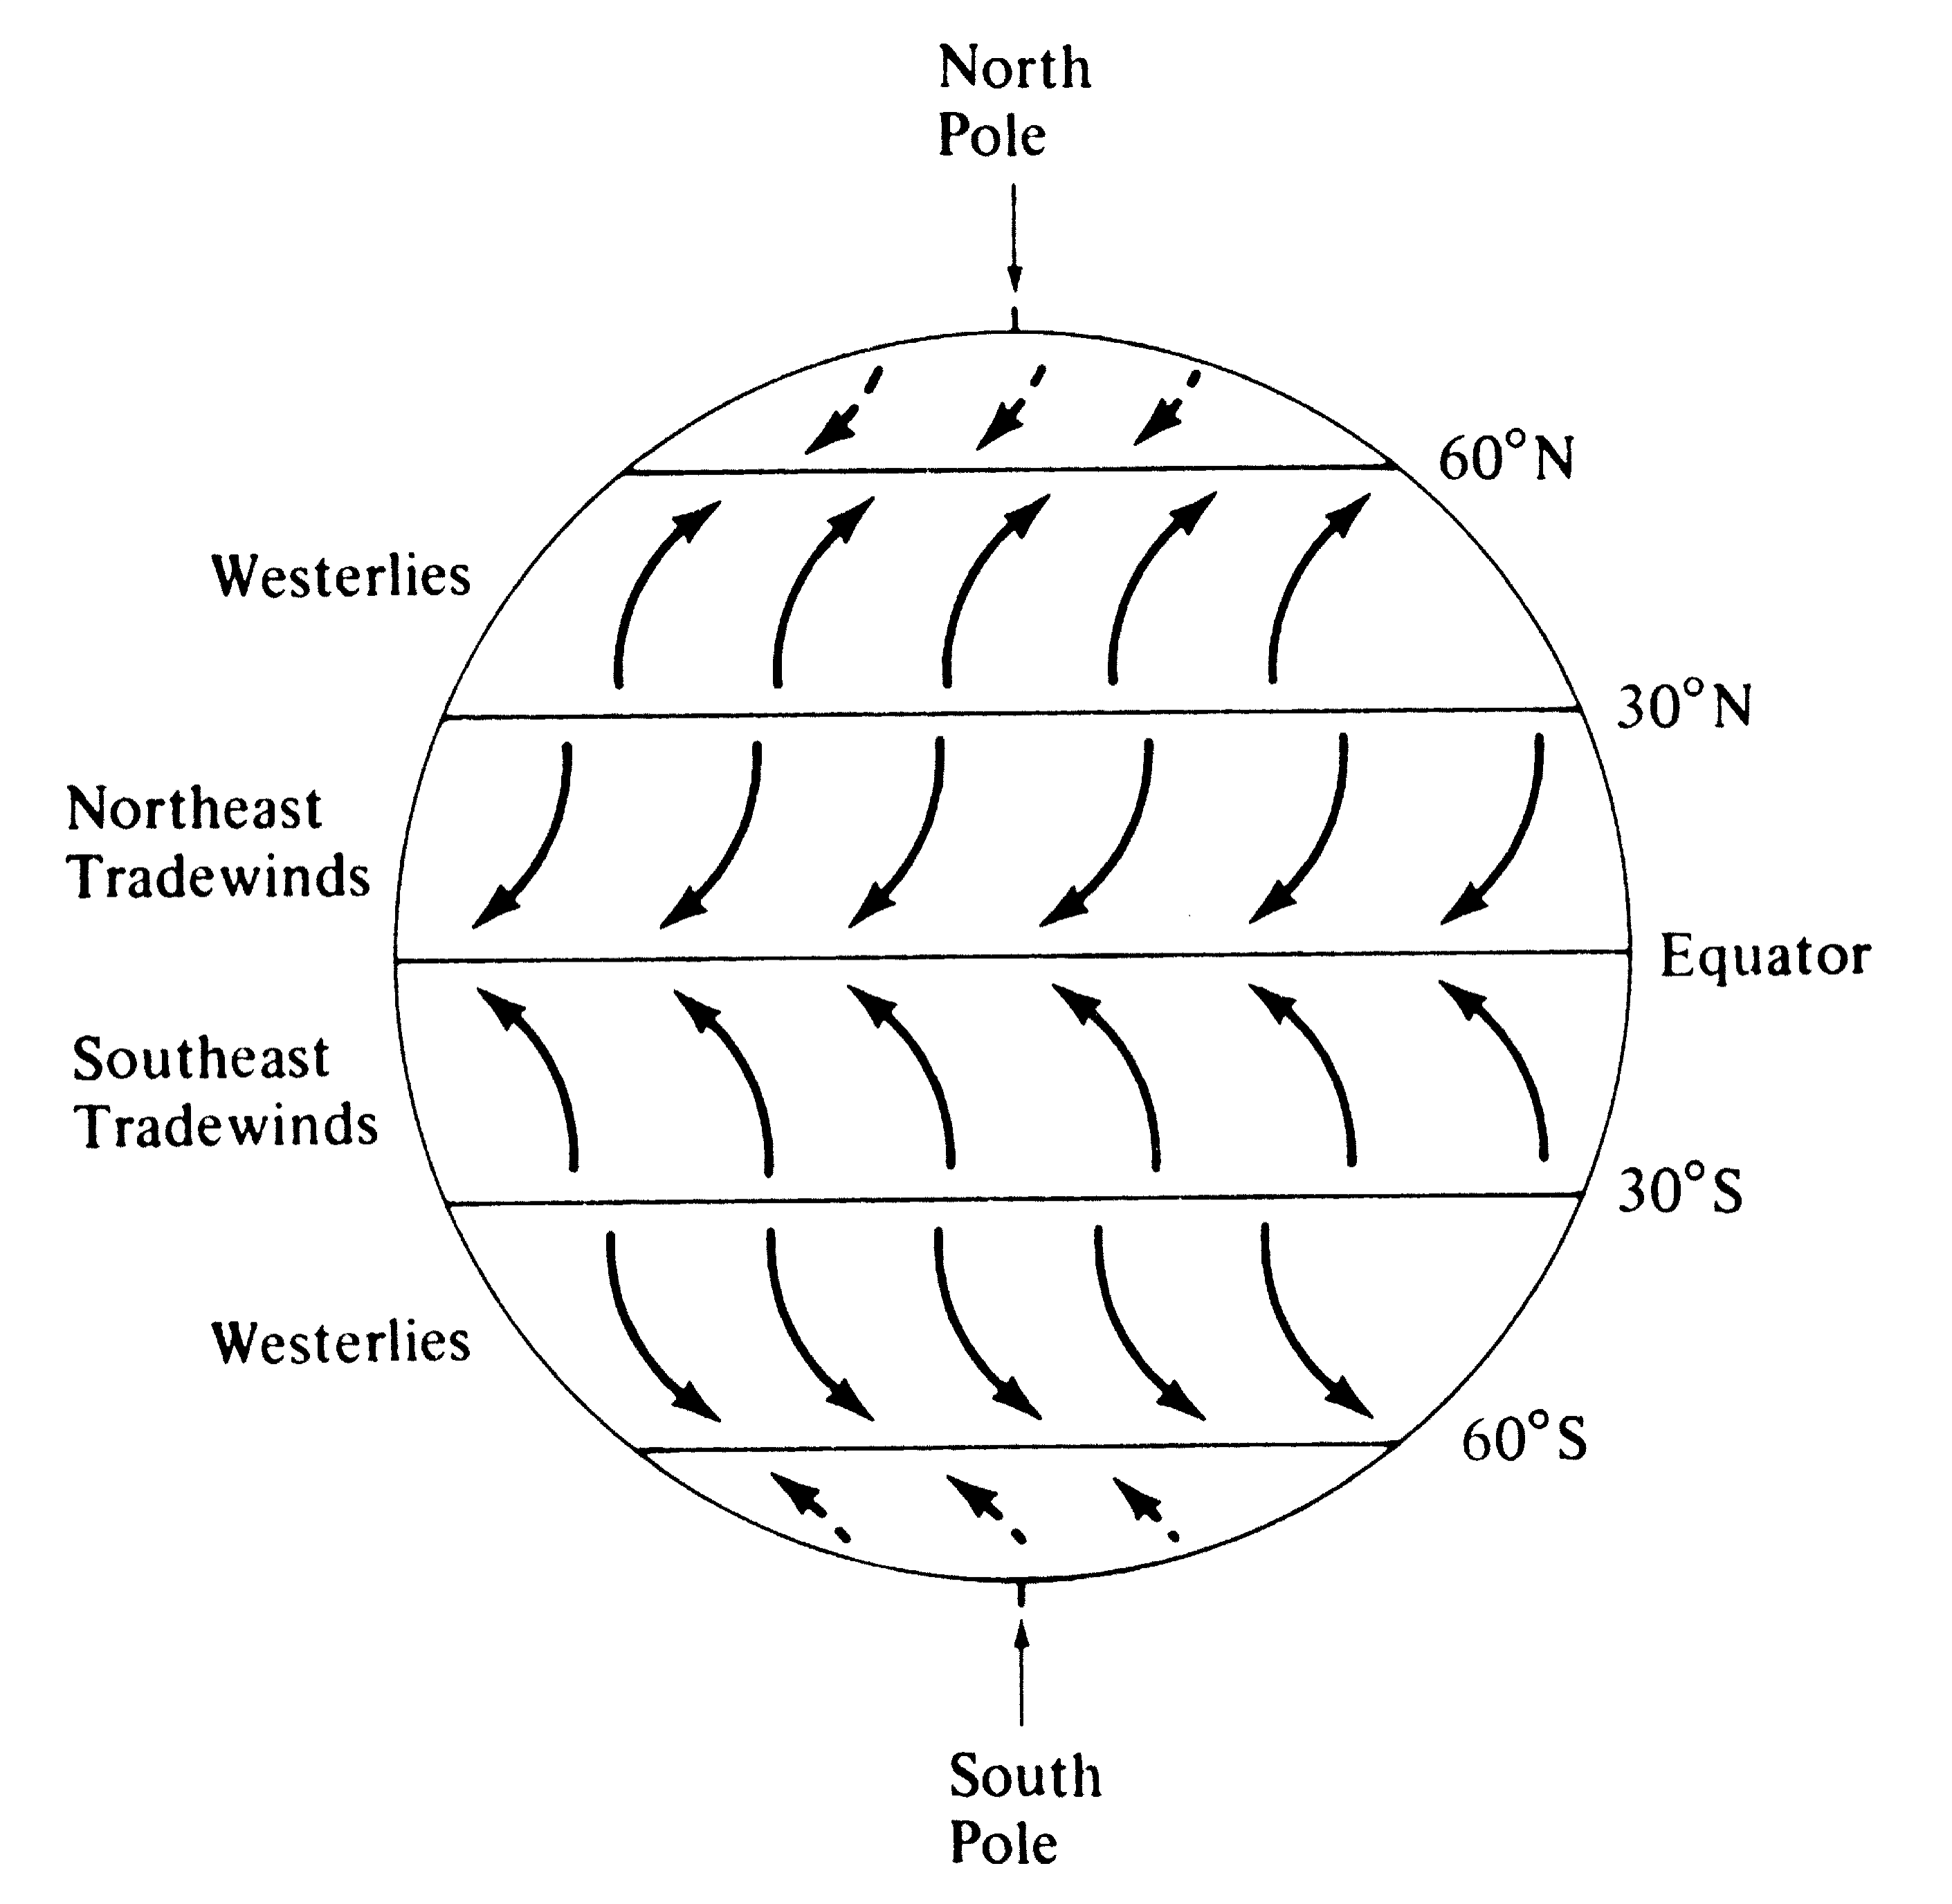
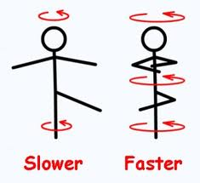
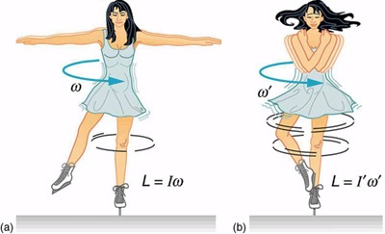
Coriolis Force

Slide 14
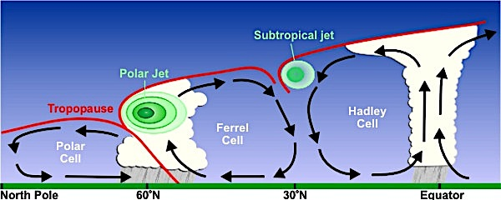
Meridional Circulation Patterns
Atmospheric Cells, Jet Streams,
Adiabatic Cooling and Warming,
Horse Latitudes, Thermal Equator

Slide 15
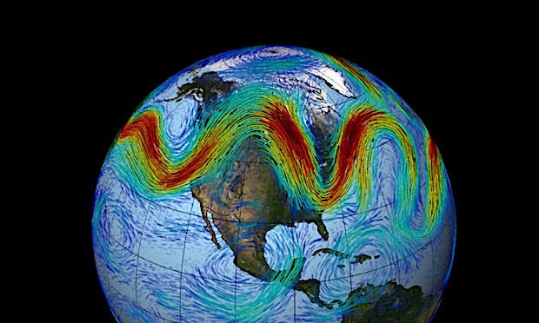
Wobbling Polar Jet Stream

Slide 16
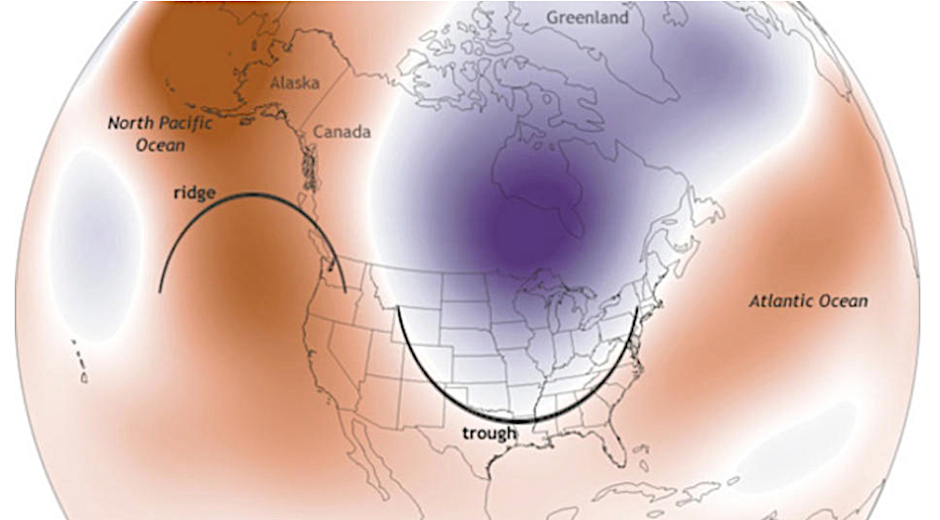
Wobbling Polar Jet Stream

Slide 17
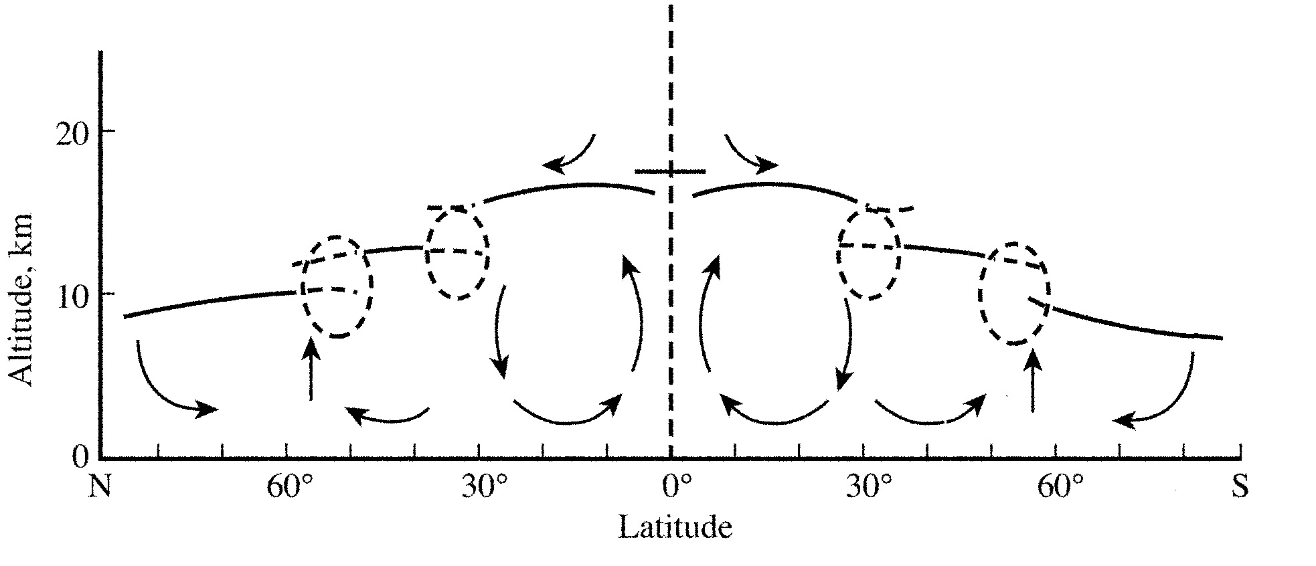
Thermal
Equator
Subtropical Jet
Subtropical Jet
Polar Jet
Polar Jet
Meridional Circulation Patterns
Atmospheric Cells, Jet Streams,
Adiabatic Cooling and Warming,
Horse Latitudes, Thermal Equator

Slide 18
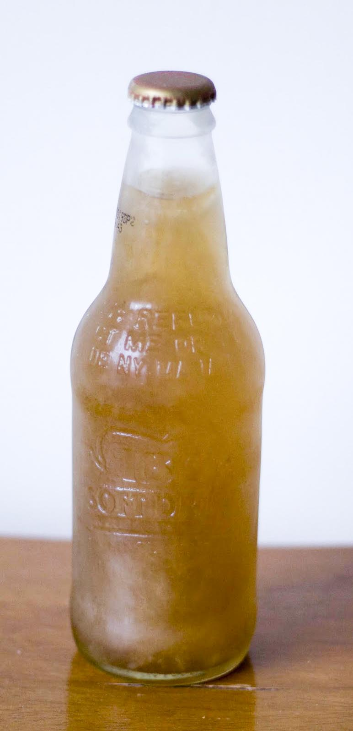
Thermal
Equator
Subtropical Jet
Subtropical Jet
Polar Jet
Polar Jet
Meridional Circulation Patterns
Atmospheric Cells, Jet Streams,
Adiabatic Cooling and Warming,
Horse Latitudes, Thermal Equator

Slide 19
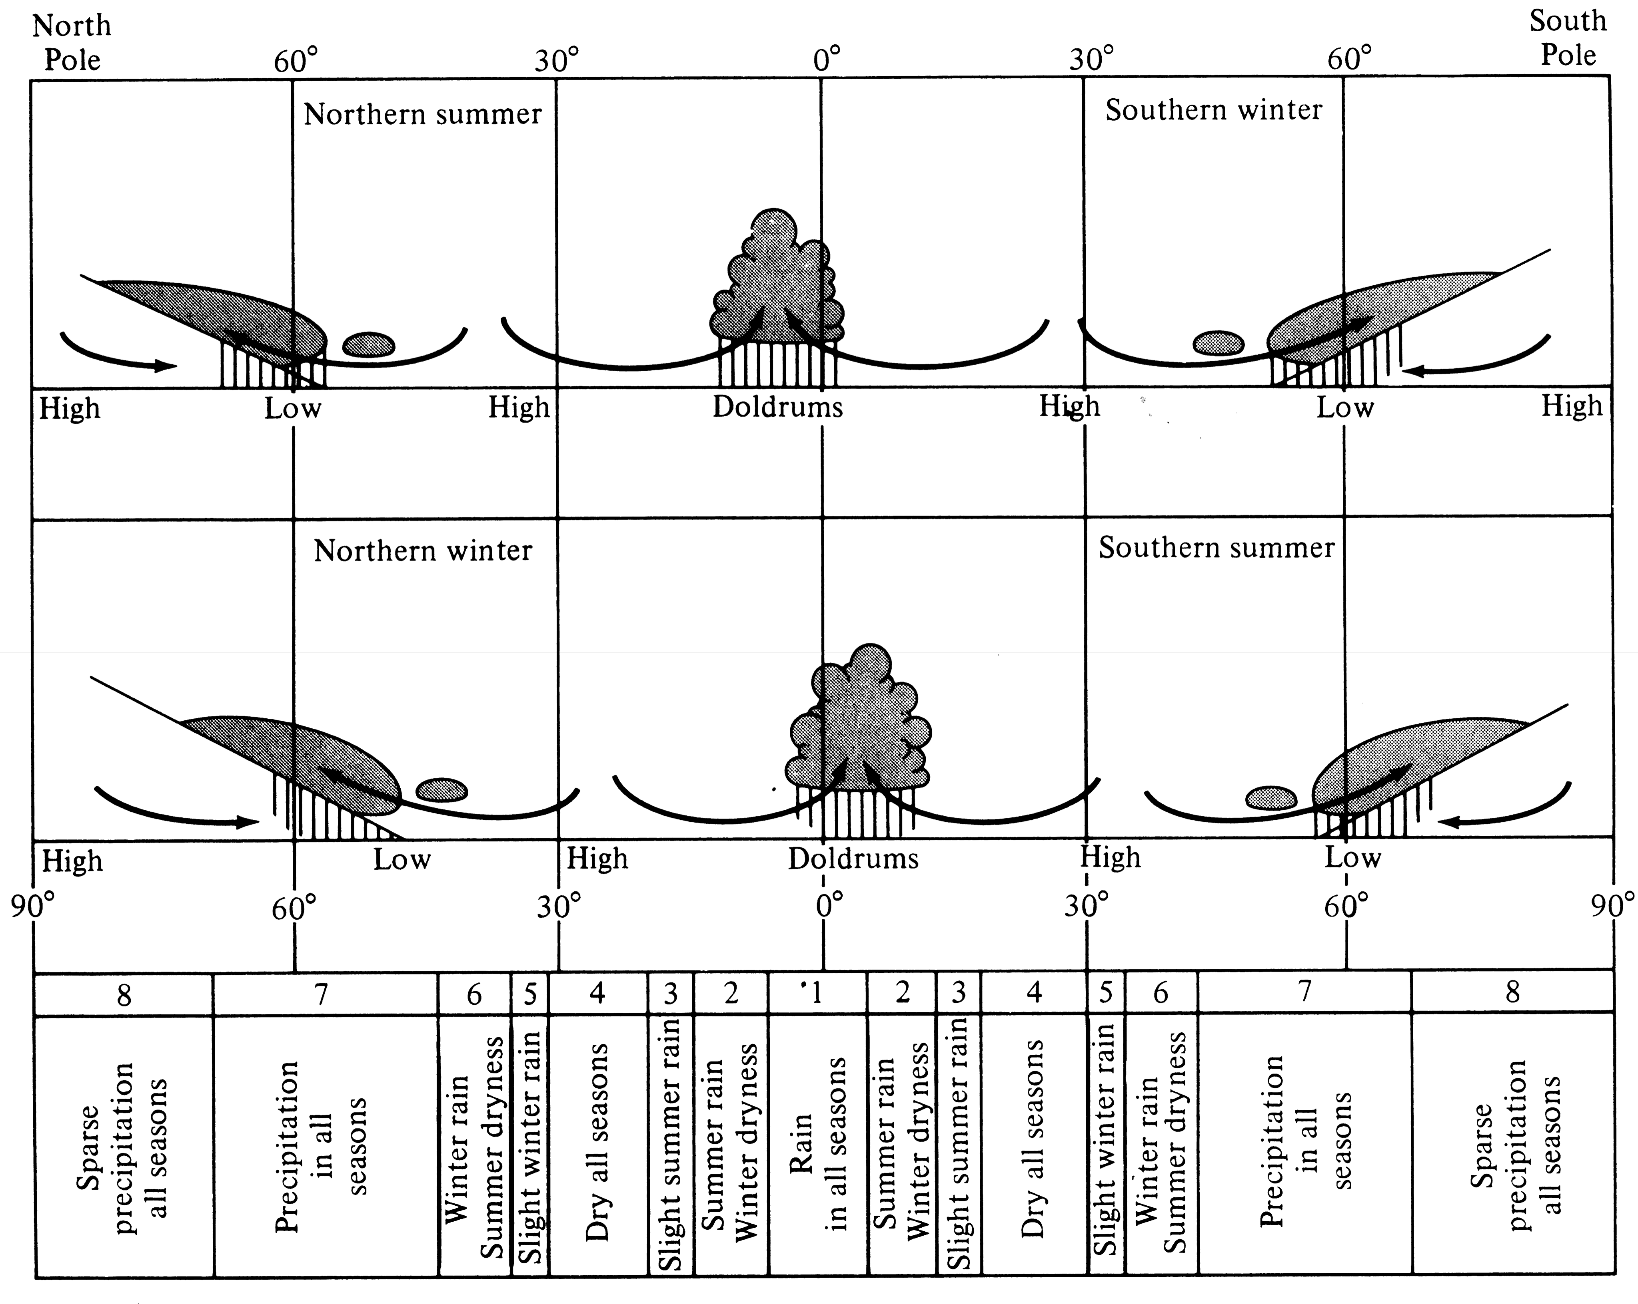

Slide 20
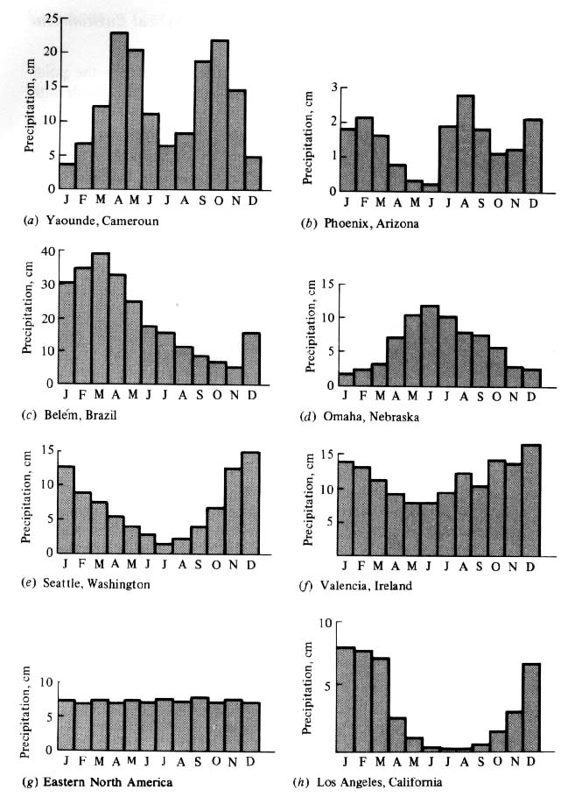
Annual
March of
Average
Monthly
Precipitation
(seasonal
Patterns of
Precipitation)

Slide 21
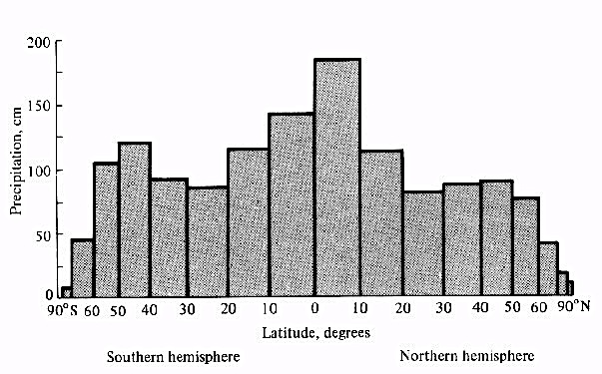
Latitudinal Belts of Average Annual Precipitation

Slide 22
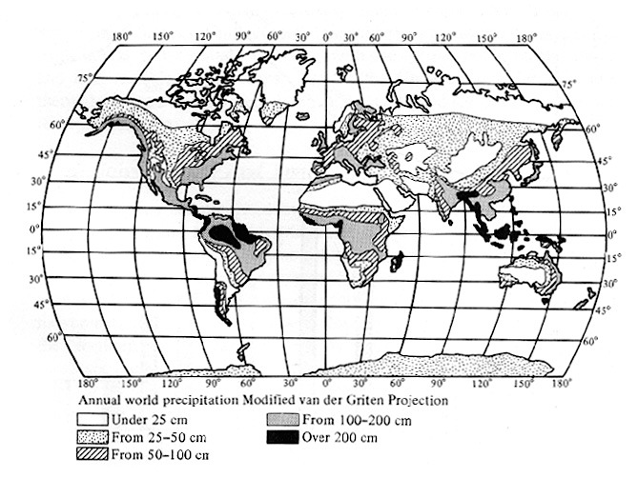
Geographic Distribution of Average Annual Precipitation

Slide 23
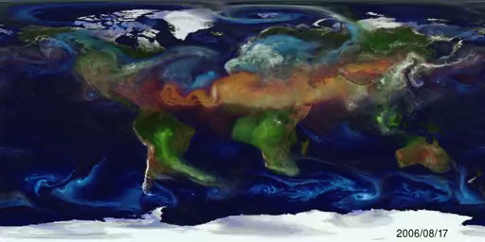
Wind Currents during 2006-2007
Note Westerlies at high latitudes (Blue)

Slide 24
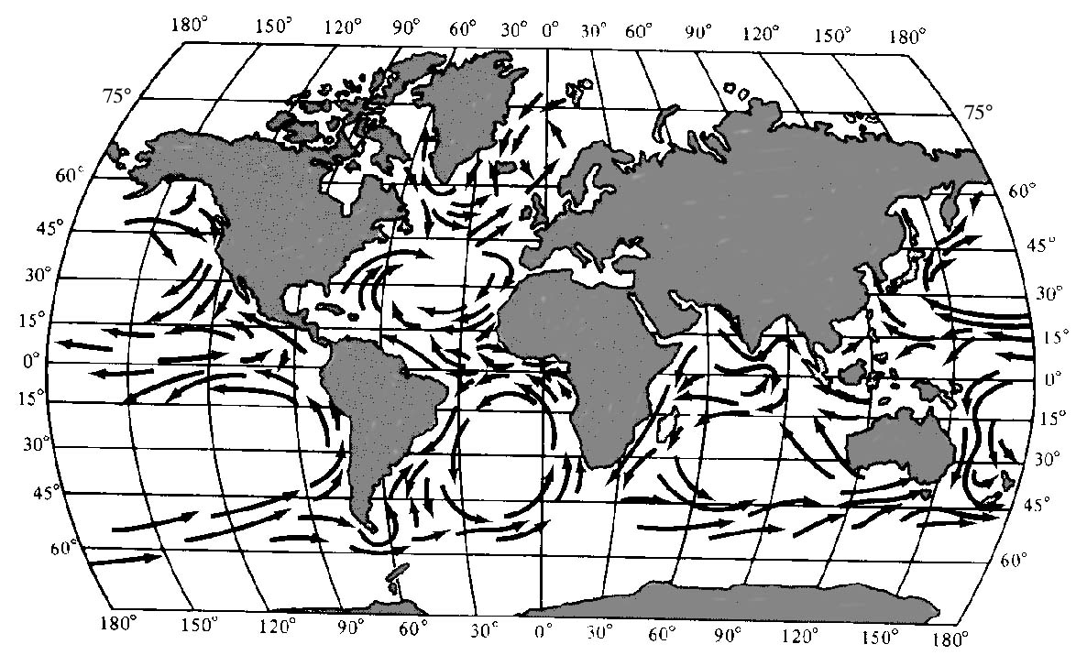
Ocean currents move heat to higher latitudes on east coasts, and cold polar water towards the equator on west coasts.

Slide 25
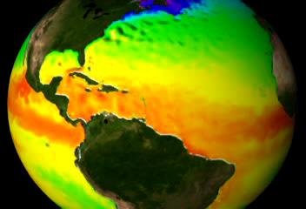
El Nino Ocean Currents move heat

Slide 26
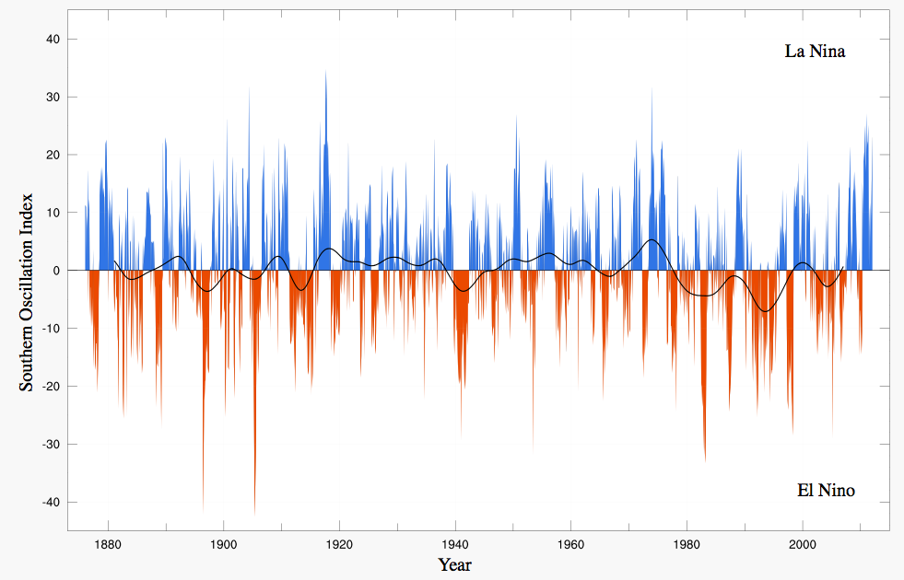

Slide 27
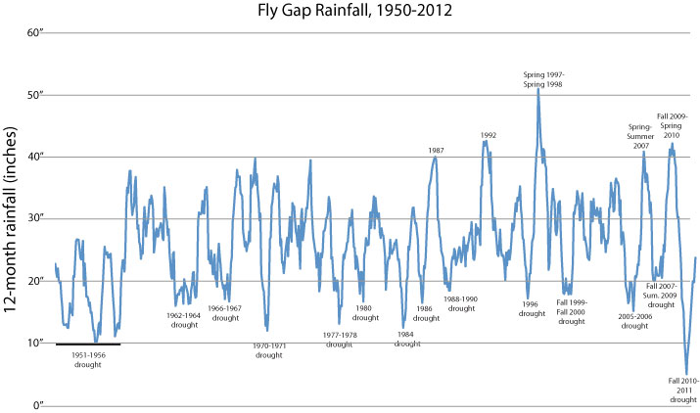

Slide 28
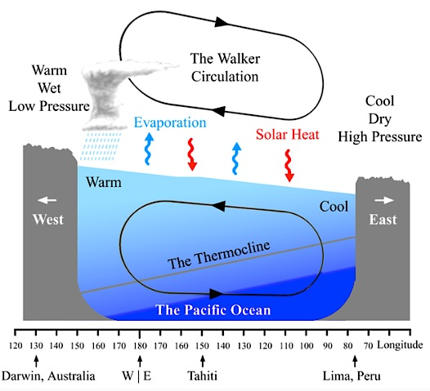
La Nina

Slide 29
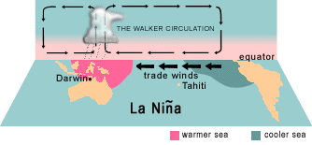
Walker Circulation: El Nino-La Nina

Slide 30
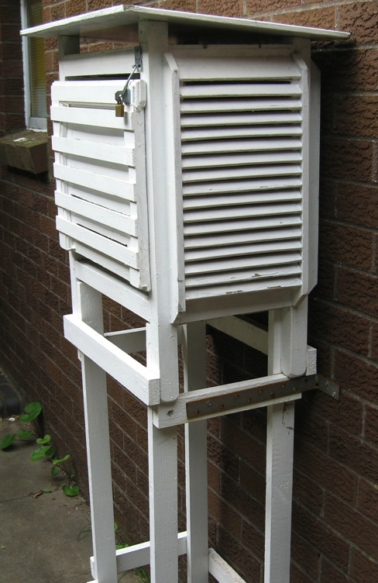
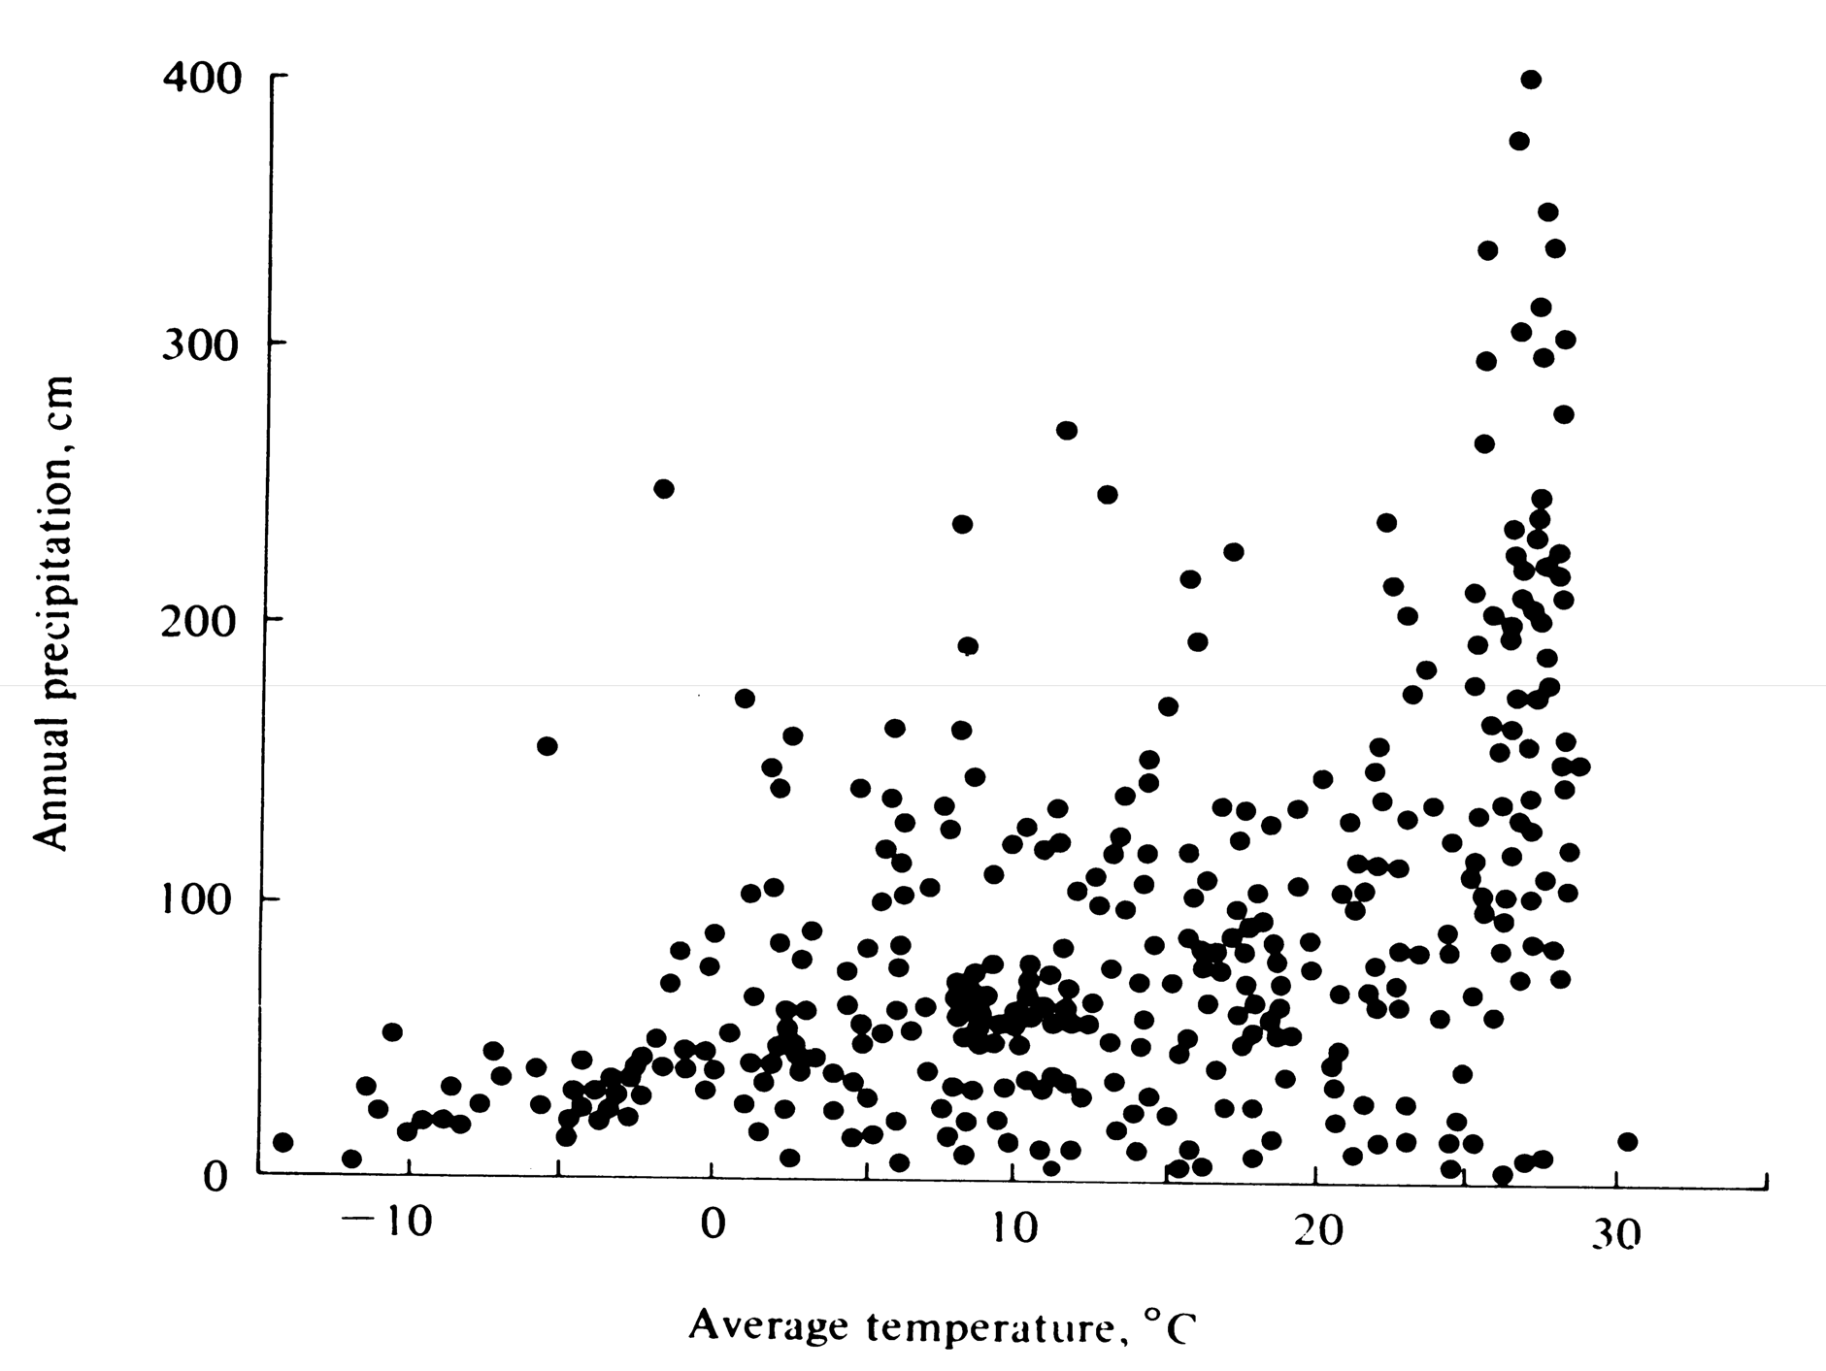
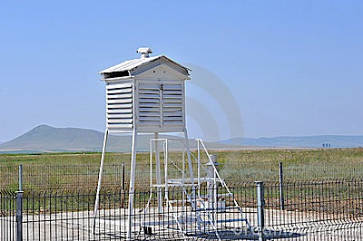
World Net of Weather Stations

Slide 31
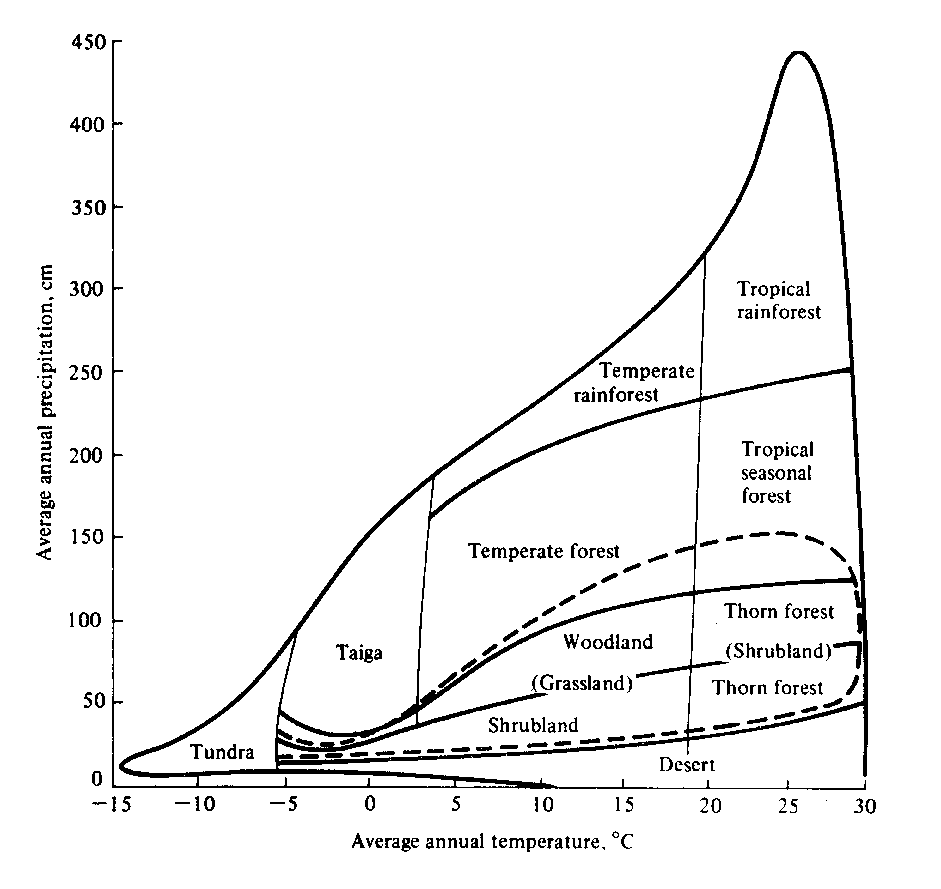
The Interface between Climate and Vegetation

Slide 32
The Interface between Climate and Vegetation
Plant Life Forms and Biomes
Tundra
Taiga (northern coniferous forest, spruce forest)
Temperate Deciduous forest
Temperate Rain forest
Tropical Rain forest
Tropical Deciduous forest
Tropical Scrub forest
Temperate grassland and savanna
Chaparral (“Mediteranean”)
Desert (warm, cold)
Mountains (complex zonation)

Slide 33
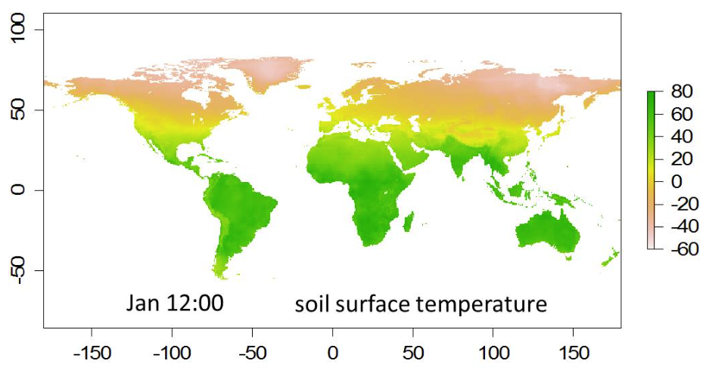

Slide 34
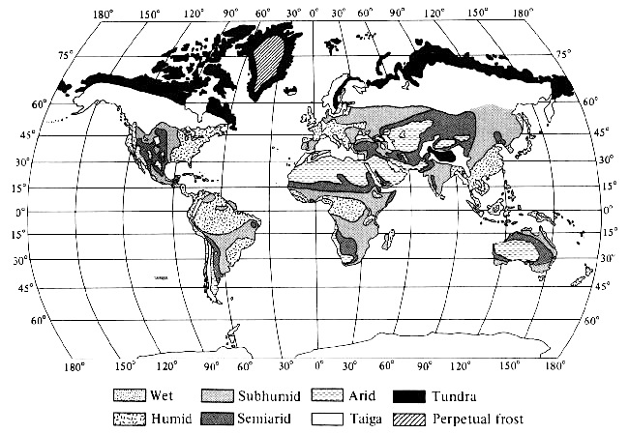
Geographic Distribution of Climates

Slide 35
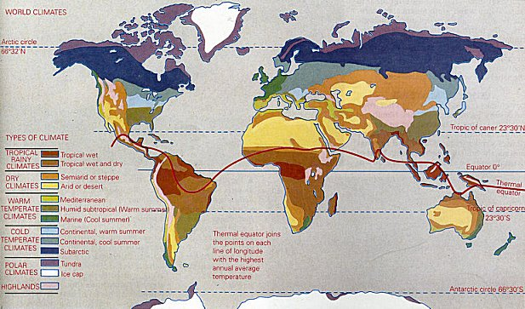
Geographic Distribution of Climates

Slide 36
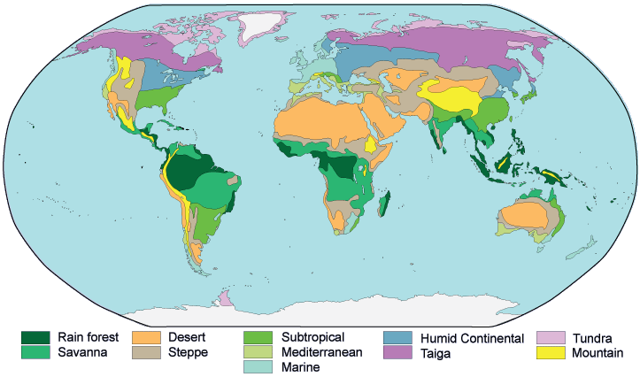
Distribution of Major Vegetation Types

Slide 37
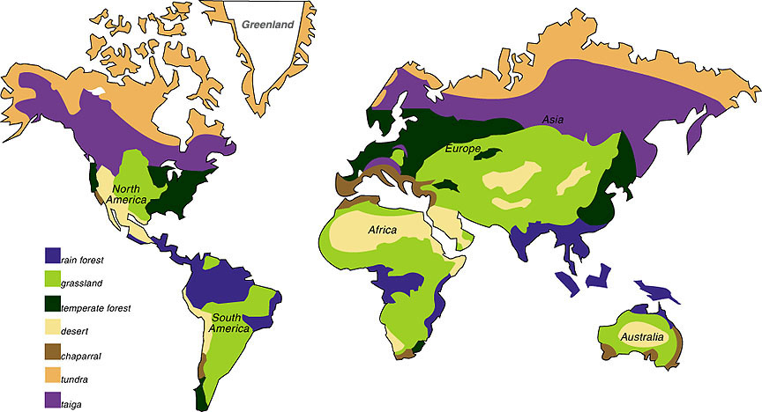
Biomes of the World
Distribution of Major Vegetation Types

Slide 38
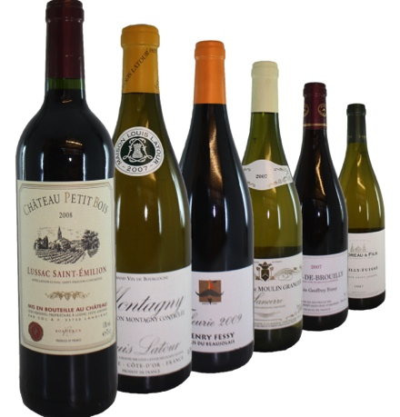
Chaparral
Chaparral
Chaparral
Chaparral
Chaparral

Slide 39
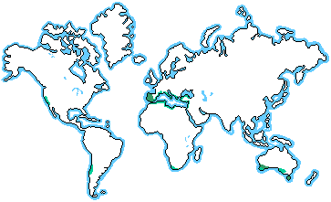
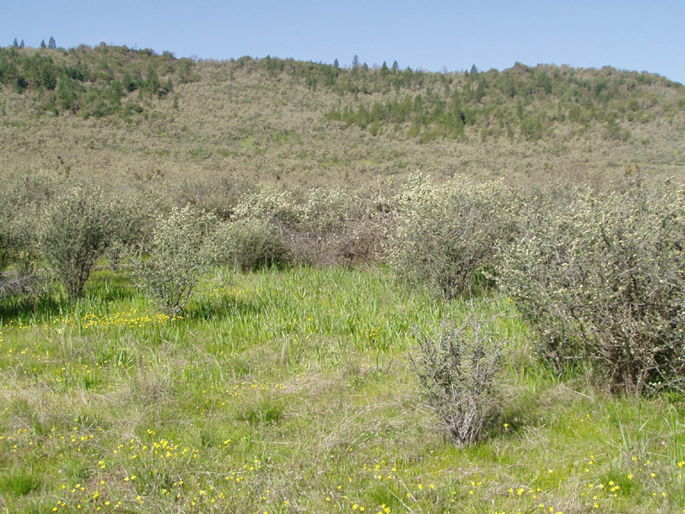
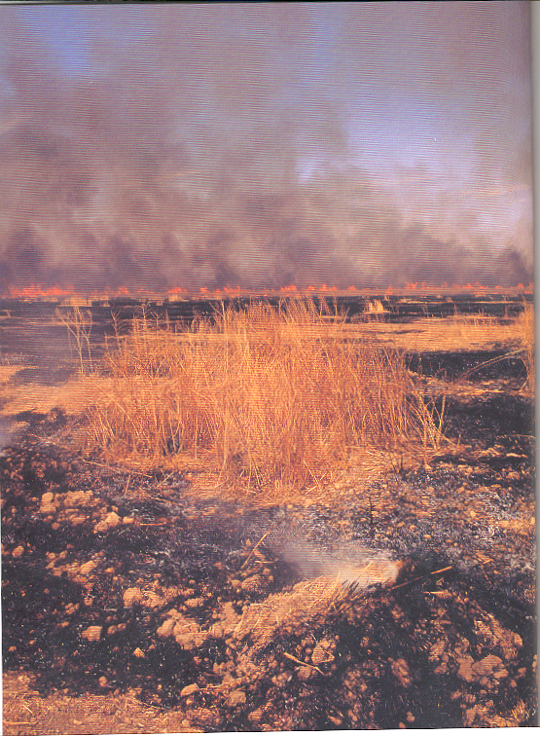
Chaparral

Slide 40
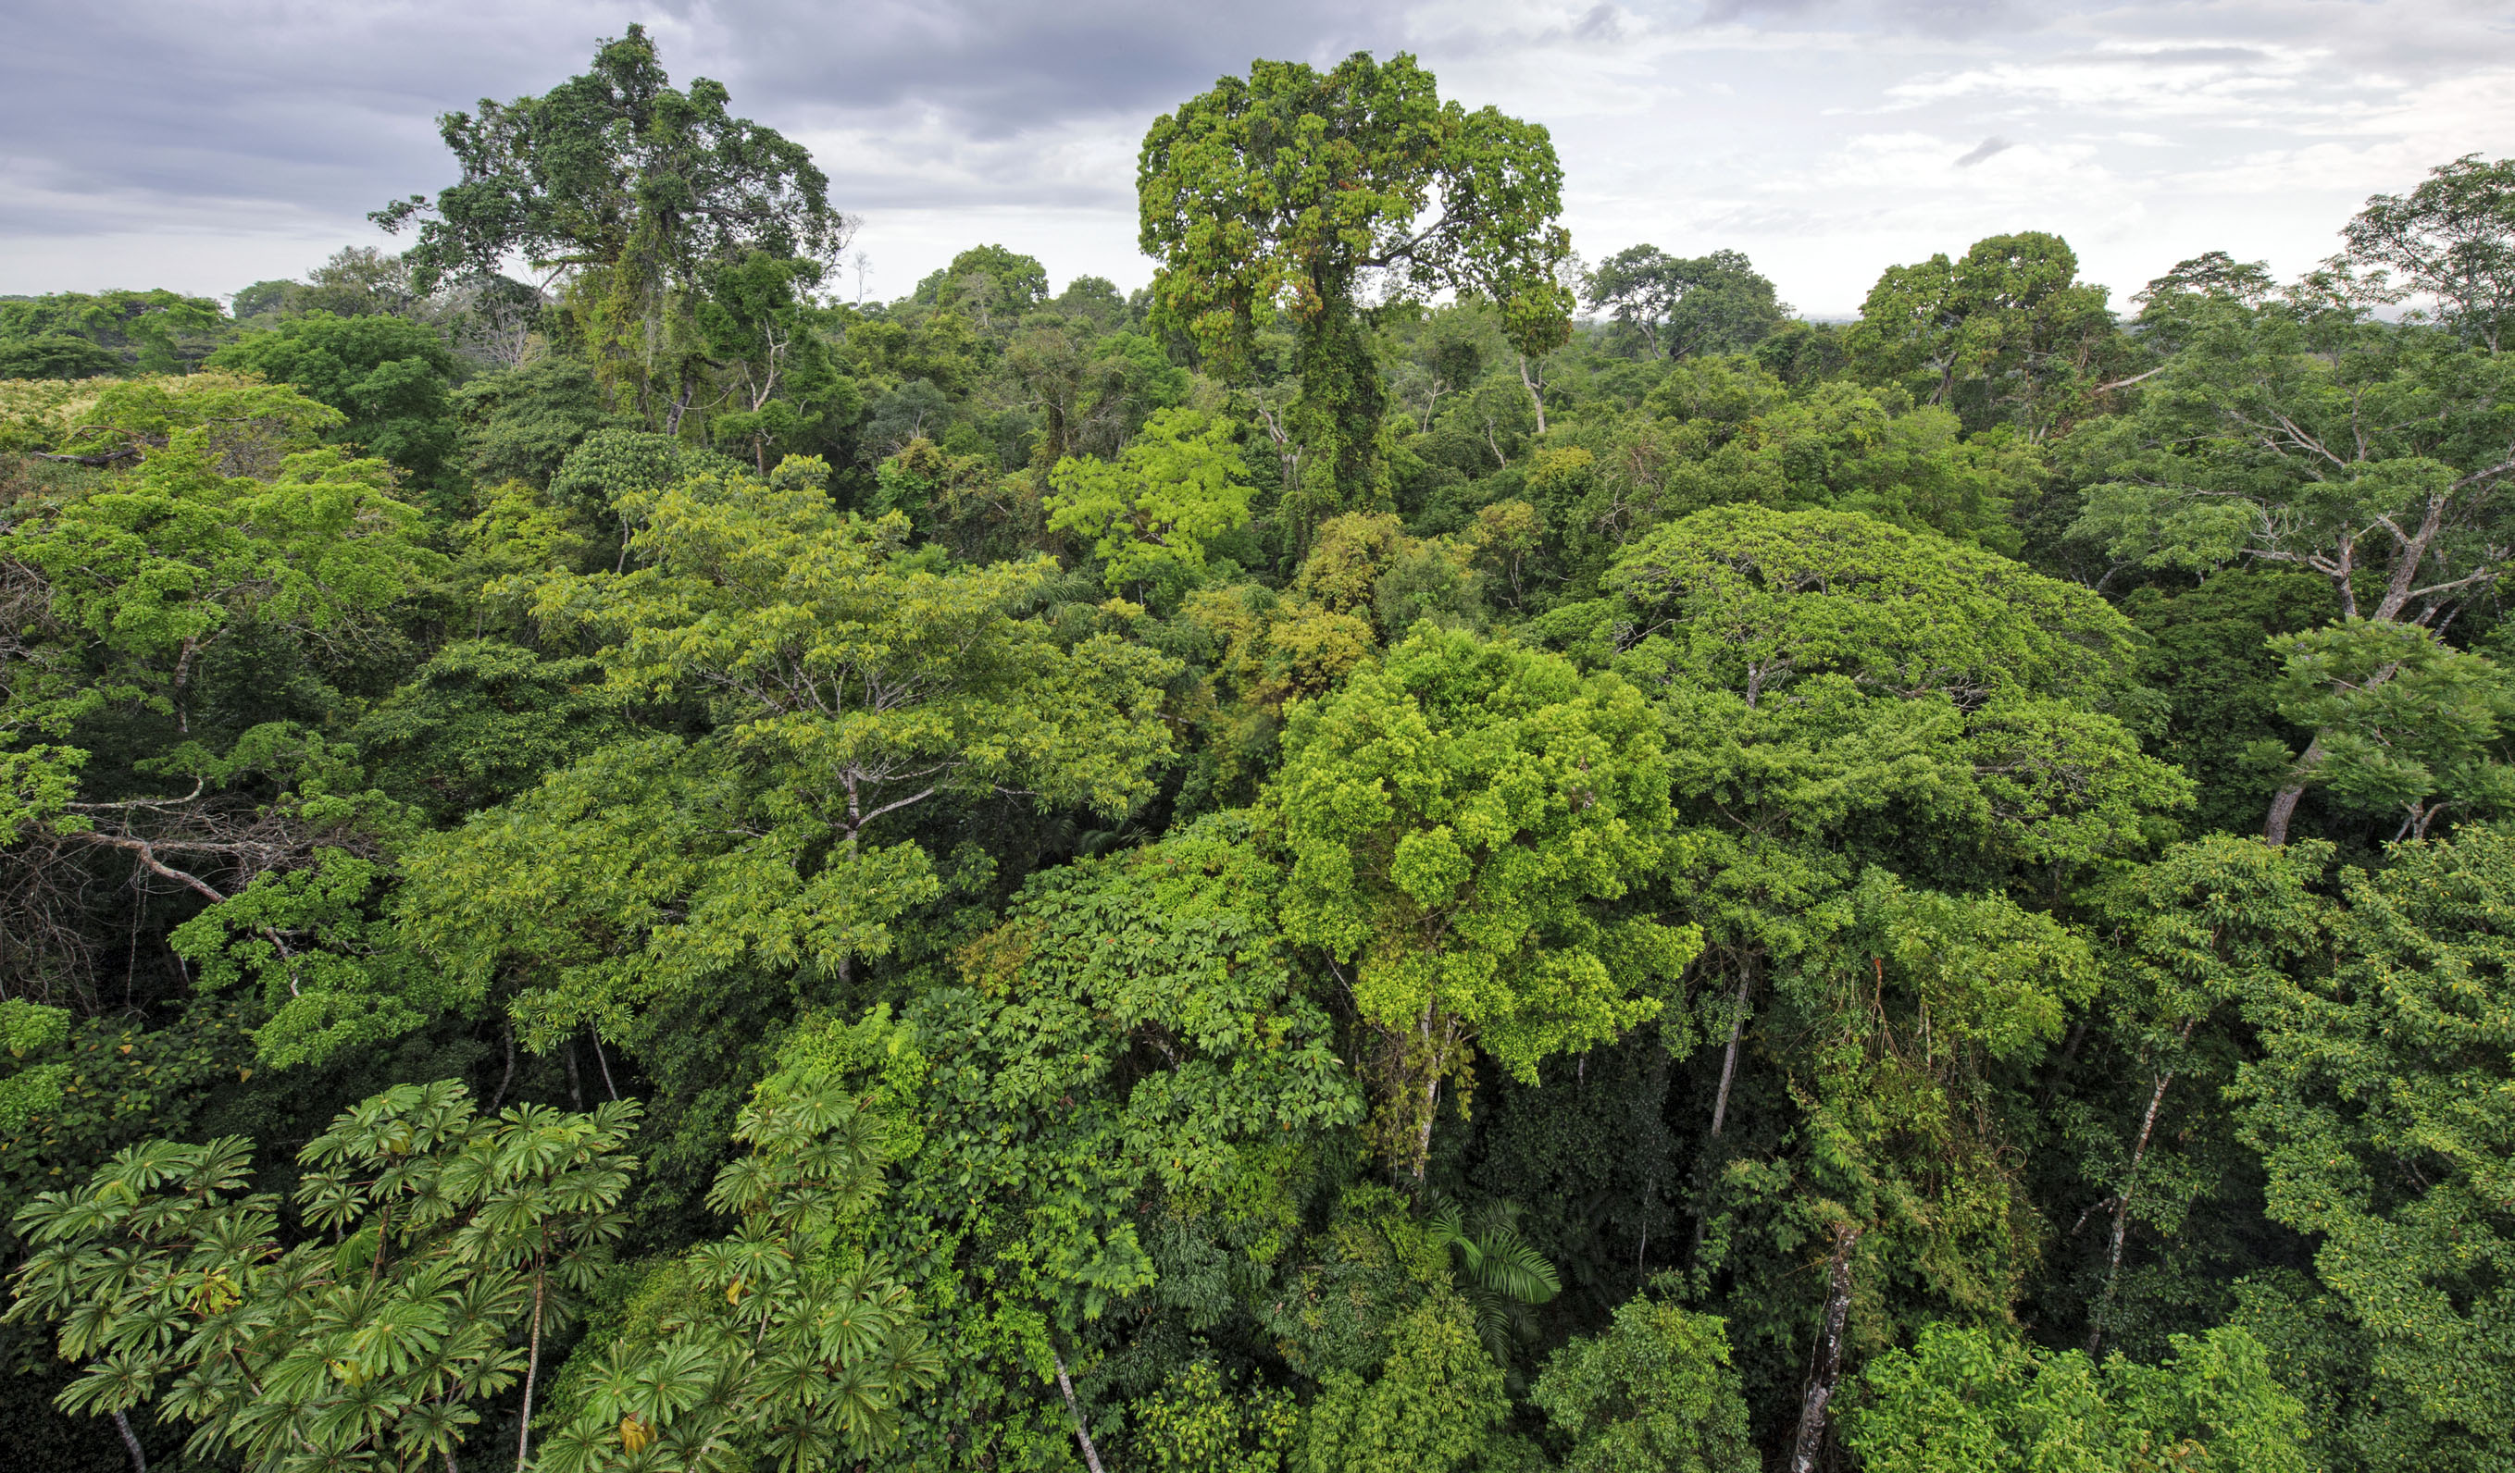
Rainforest

Slide 41
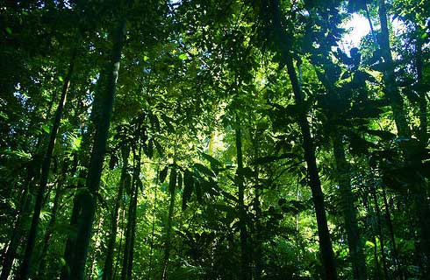
Rainforest
Rainforest

Slide 42
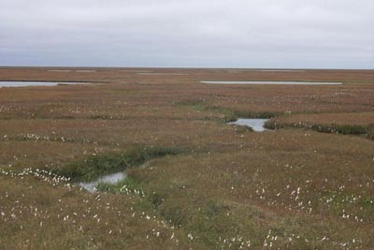
Tundra

Slide 43
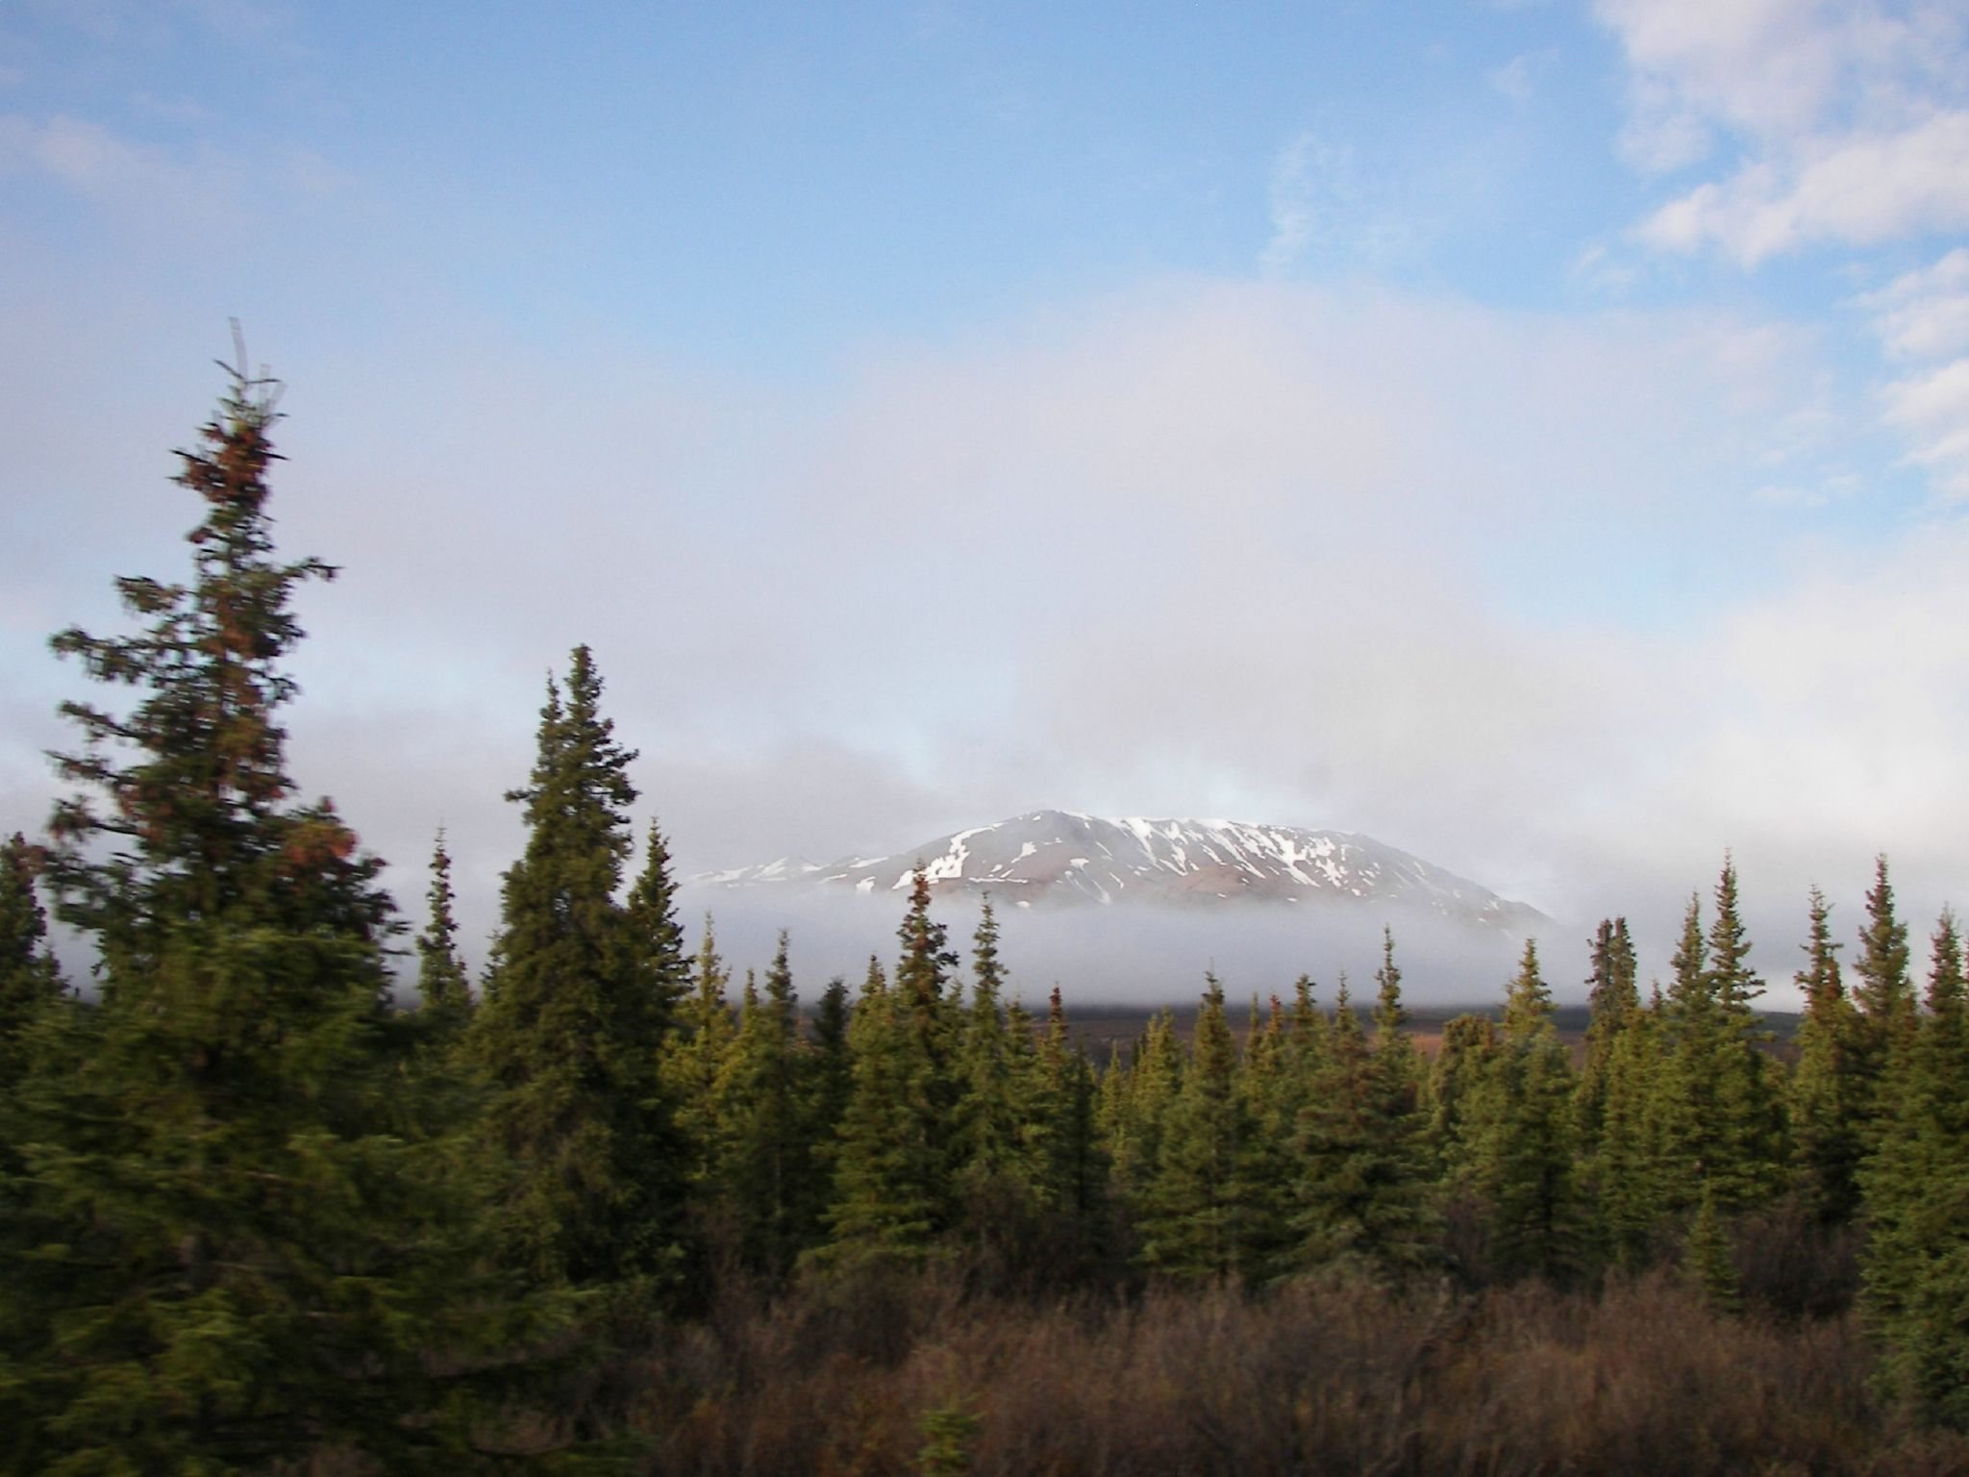
Taiga

Slide 44
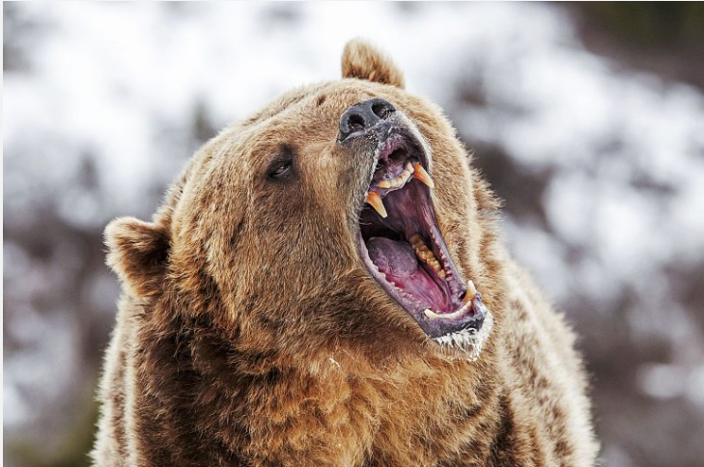

Slide 45

Temperate
Forest

Slide 46

Temperate
Deciduous
Forest

Slide 47

Grassland

Slide 48


Slide 49


Slide 50

Grassland

Slide 51

Grassland
“Prairie”
Grassland

Slide 52

Deserts of the World

Slide 53
Atacama Desert

Slide 54

Namib Desert

Slide 55

Sahara Desert

Slide 56
Gobi Desert

Slide 57
Kalahari Desert

Slide 58
Kalahari Desert

Slide 59
Great Basin Desert

Slide 60
Chihuahuan Desert

Slide 61

Sonoran Desert

Slide 62

Great Victoria Desert, Australia

Slide 63
History and Biogeography
Self-replicating molecular assemblages
Geological Past
Shrinking, buckling Earth, Polarity Reversals Paleoclimatology: Milankovitch cycles
Eustatic (world wide) sea level changes
Palynology (fossil pollen profiles)
Radioisotope dating (half life, C₁₄ carbon 14)
Geological time scale
Boundaries marked by extinctions
Asteroid impact, Chicxulub crater (iridium layer, 65 mya)
Pleistocene Megafauna“Overkill” hypothesis

Slide 64

https://www.nytimes.com/interactive/2018/12/18/
climate/galapagos-islands-ocean-warming.html

Slide 65


Slide 66
The Geological Time Scale
__________________________________________________________________
Years in millions
since beginning of
Eras Periods Epochs period or epoch
__________________________________________________________________
Quaternary Recent 0.1
Pleistocene 1.6
Cenozoic Pliocene 5
Miocene 22
Tertiary Oligocene 36
Eocene 55
Paleocene 65
__________________________________________________________________
Cretaceous 144
Mesozoic Jurassic 192
Triassic 245
_________________________________________________________________
Permian 290
Carboniferous 360
Devonian 408
Paleozoic Silurian 435
Ordivician 485
Cambrian 570
__________________________________________________________________
Precambrian 4600
____________________________________________________________

Slide 67


____________________________________________________________

Slide 68

Ward, P. D. 2006. Impact from the deep. Scientific American 295, 64–71.

Slide 69







Slide 70
History and Biogeography
Self-replicating molecular assemblages
Geological Past
Shrinking, buckling Earth, Polarity Reversals
Paleoclimatology
Eustatic sea level changes
Palynology (fossil pollen profiles)
Radioisotope dating (half life, C₁₄ carbon 14, ~5700 years)
Geological time scale, Boundaries marked by extinctions
Chicxulub Asteroid impact (iridium layer, 65 mya)
Pleistocene Megafauna“Overkill” hypothesis
Classical Biogeography, Wallace’s Line
Continental drift, sea floor spreading
Foraminifera fossil record
Milankovitch Cycles: Precession, Obliquity, and Eccentricity

Slide 71

Classical Biogeography, Biogeographic Realms

Slide 72

Oriental
Realm

Slide 73


Alfred Russel Wallace

Slide 74


Samuel Sweet

Slide 75

Herpestids, Mongoose
Quolls

Slide 76
Currently, 7.7+ billion (that’s 7.7 thousand million)
humans are using half of planet Earth’s land
surface, half of the fresh water, and half of the
solar energy impinging on the surface of the Earth.
Resources are NOT ever expanding. Per capita
shares are falling all the time. About 3 acres per
person.
Growthmania economics is fundamentally flawed

Slide 77


Watch: http://www.upworthy.com/a-smartypants-scientist-makes-an-easy-analogy-about-our-planet-and-now-im-scared
2000 2005 2010
From Proc. Nat. Acad.Sci. (2002), vol.99: 9266-9271

Slide 78


Slide 79


Slide 80


Slide 81


Slide 82


Marine Diatoms
Pliocene Era
5.333 million
to 2.58 million
years BP

Slide 83


Slide 84






Great Auk

Slide 85

Emperor penguin

Slide 86


Slide 87


Slide 88


Slide 89

https://www.nytimes.com/interactive/2017/05/18/climate/antarctica-ice-melt-climate-change.html

Slide 90


Slide 91


Slide 92


Slide 93



