Slide 1
First Exam Thursday 20 February 2020
Covers Chapters 1-4, 6-7 plus Chapter 16
and first 9 lectures, 5 discussions, plus 8 Readings:
Scientific Methods
Natural Selection
On Human Nature
Our Hunter-Gatherer Heritage
Evolution of Uncaring Humanoids
Global Warming
Population Growth
Evolution’s Problem Gamblers
Lecture # 8
13 February 2020

Slide 2
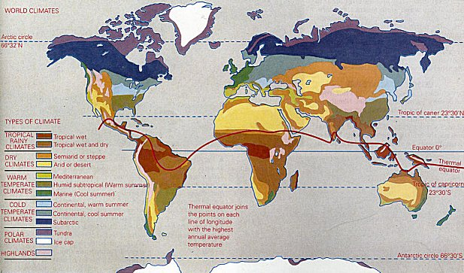
Geographic Distribution of Climates

Slide 3
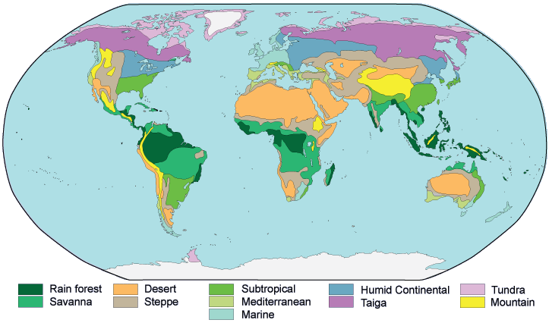
Distribution of Major Vegetation Types

Slide 4
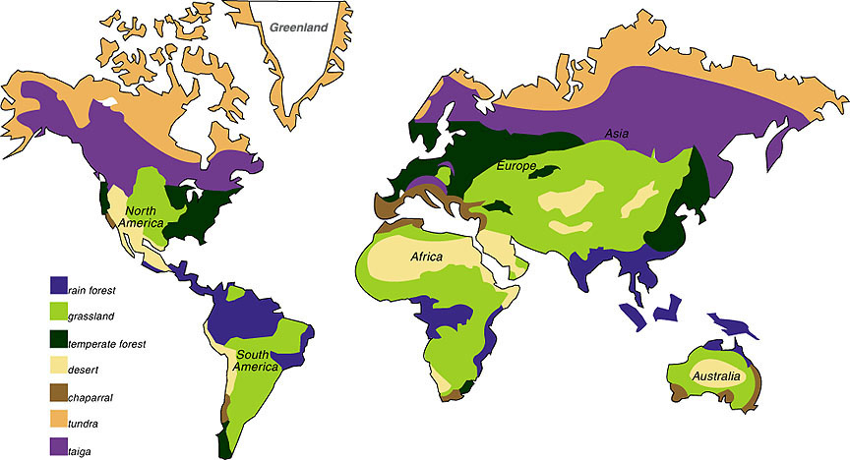
Biomes of the World
Distribution of Major Vegetation Types

Slide 5
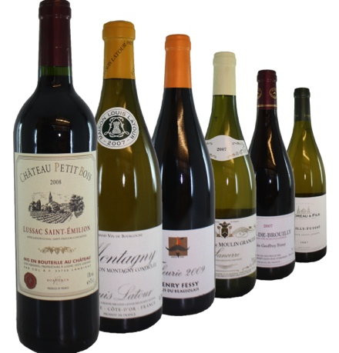
Chaparral
Chaparral
Chaparral
Chaparral
Chaparral

Slide 6
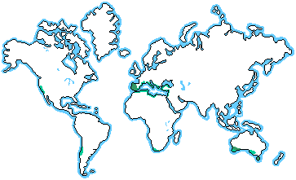
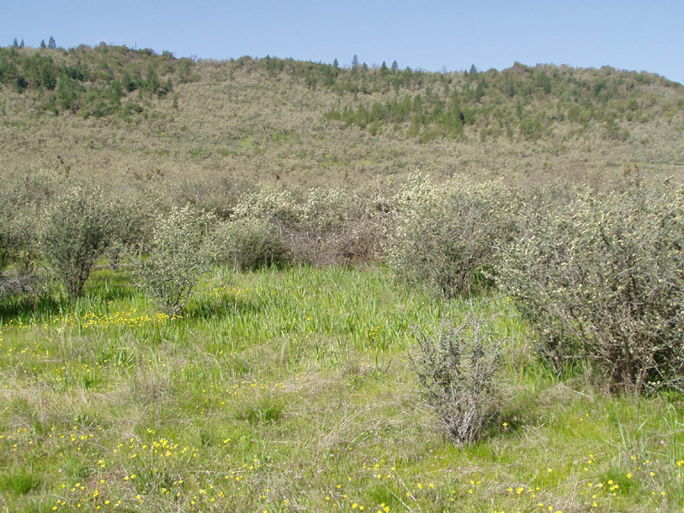
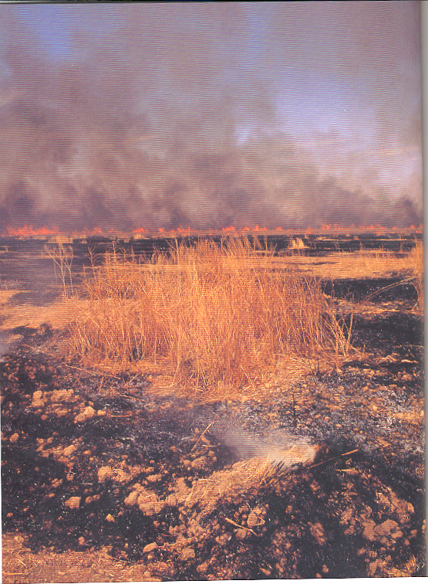
Chaparral

Slide 7
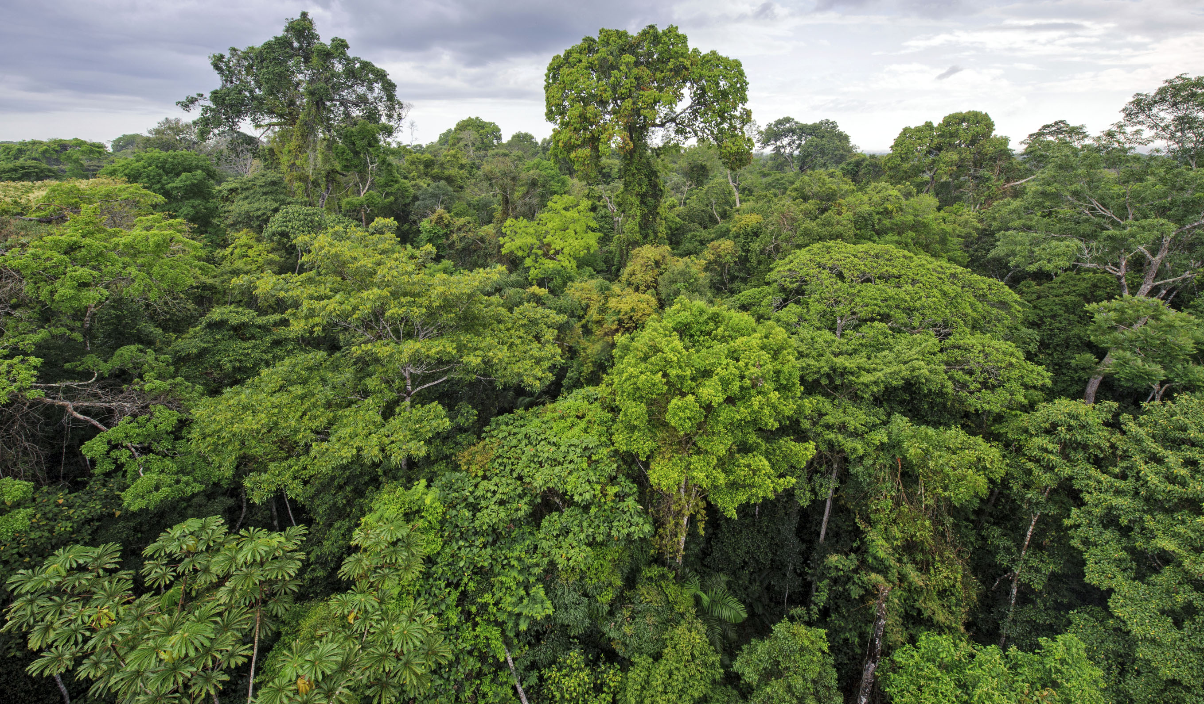
Rainforest

Slide 8
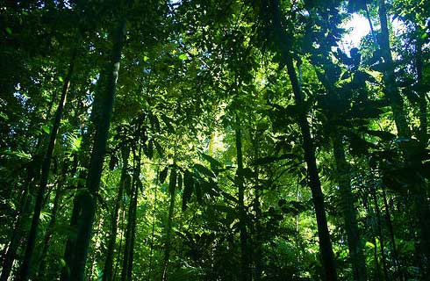
Rainforest
Rainforest

Slide 9
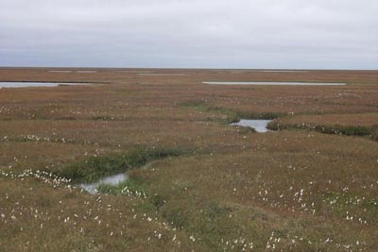
Tundra

Slide 10
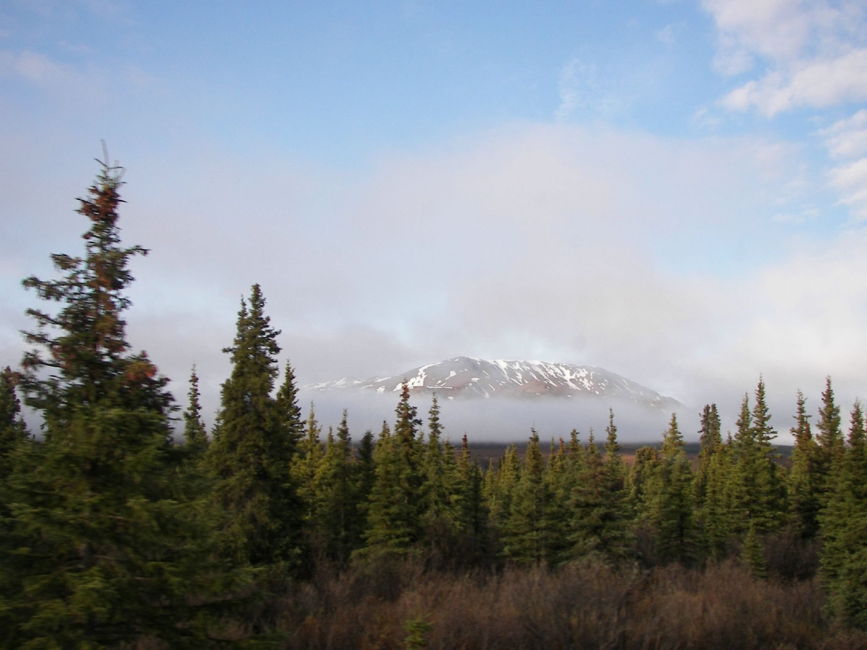
Taiga

Slide 11
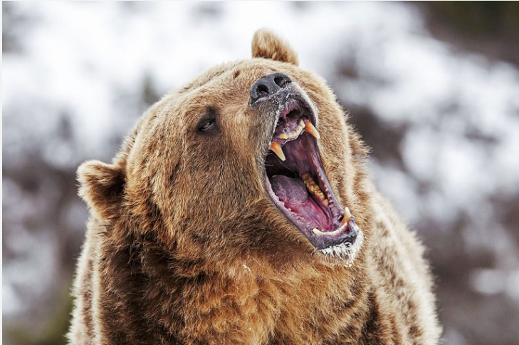

Slide 12
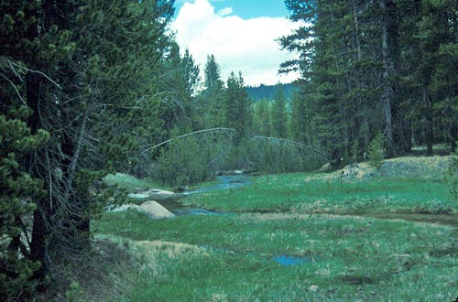
Temperate
Forest

Slide 13
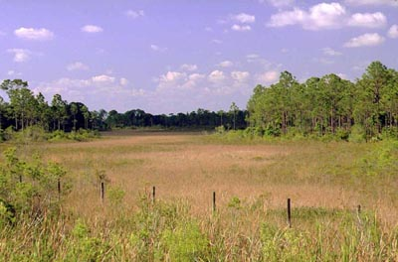
Temperate
Deciduous
Forest

Slide 14
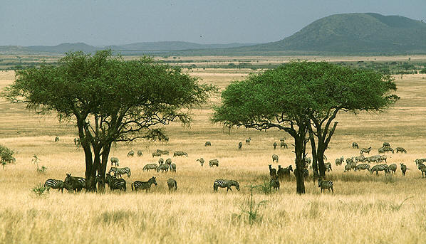
Grassland

Slide 15
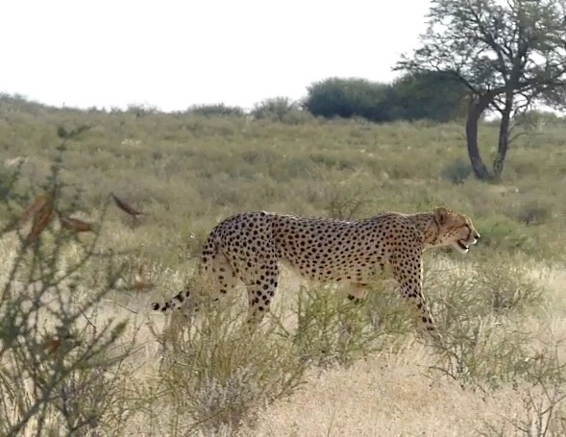

Slide 16
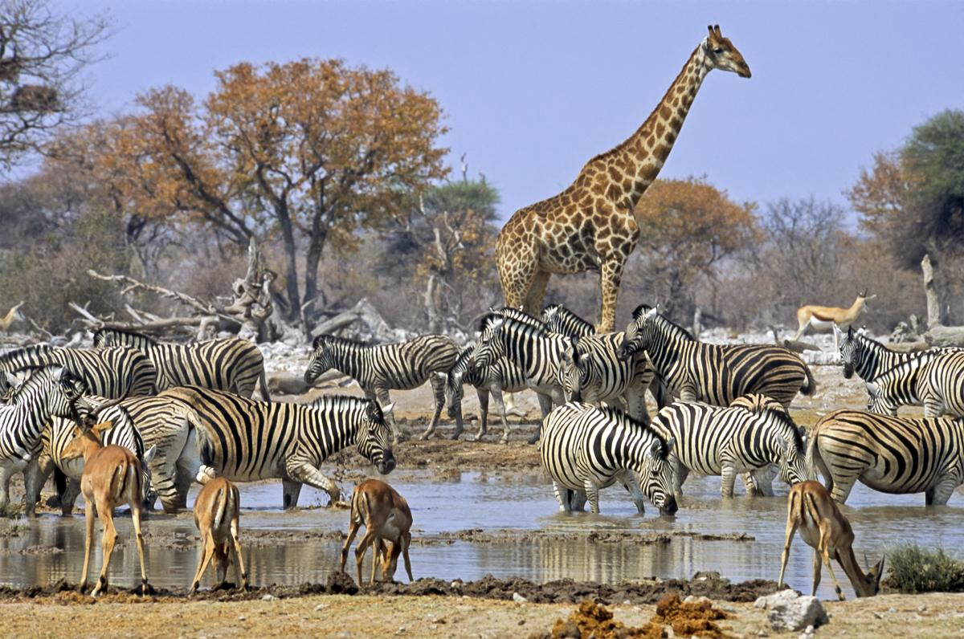

Slide 17
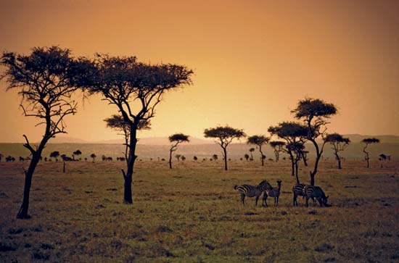
Grassland

Slide 18
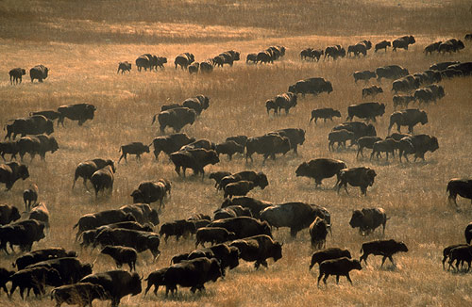
Grassland
“Prairie”
Grassland

Slide 19
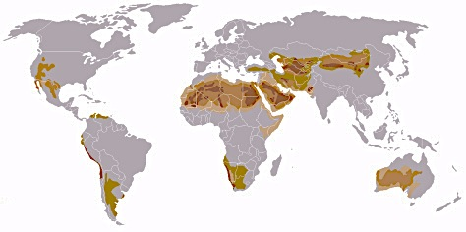
Deserts of the World

Slide 20
Atacama Desert

Slide 21
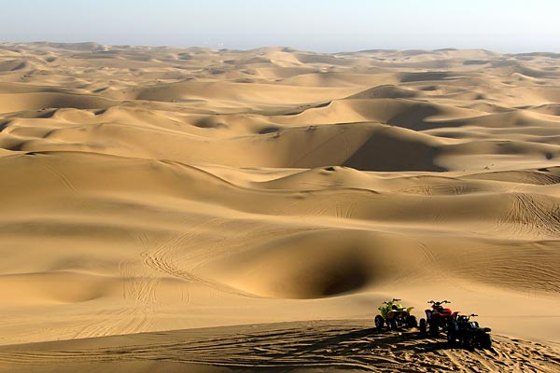
Namib Desert

Slide 22
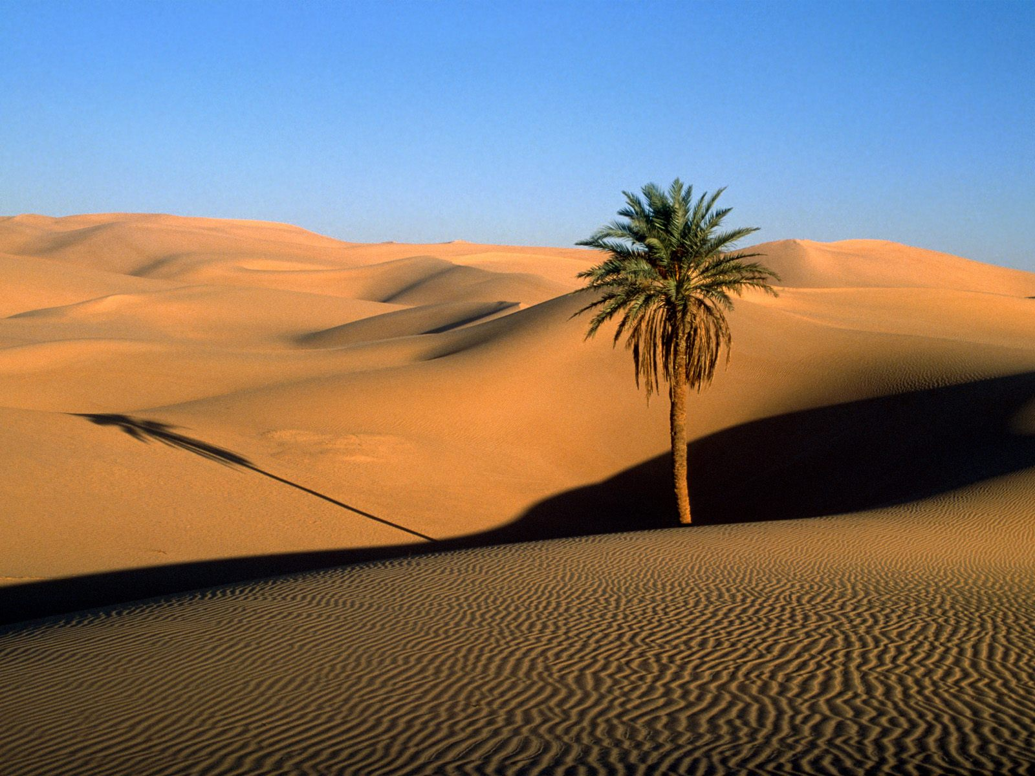
Sahara Desert

Slide 23
Gobi Desert

Slide 24
Kalahari Desert

Slide 25
Kalahari Desert

Slide 26
Great Basin Desert

Slide 27
Chihuahuan Desert

Slide 28
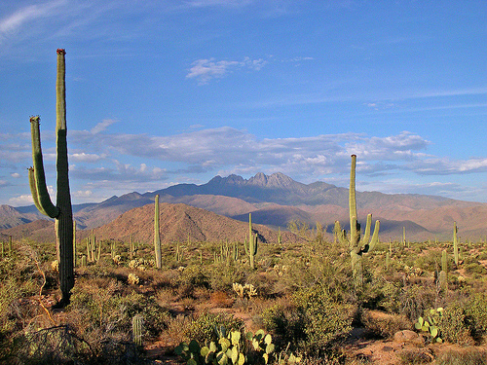
Sonoran Desert

Slide 29
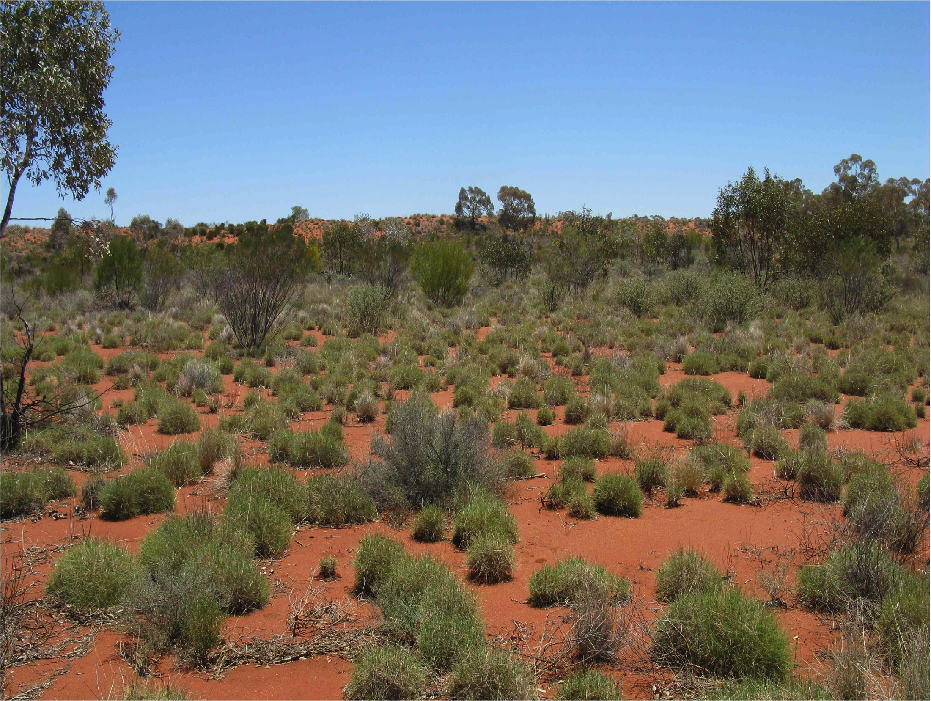
Great Victoria Desert, Australia

Slide 30
History and Biogeography
Self-replicating molecular assemblages
Geological Past
Shrinking, buckling Earth, Polarity Reversals Paleoclimatology: Milankovitch cycles
Eustatic (world wide) sea level changes
Palynology (fossil pollen profiles)
Radioisotope dating (half life, C₁₄ carbon 14)
Geological time scale
Boundaries marked by extinctions
Asteroid impact, Chicxulub crater (iridium layer, 65 mya)
Pleistocene Megafauna“Overkill” hypothesis

Slide 31
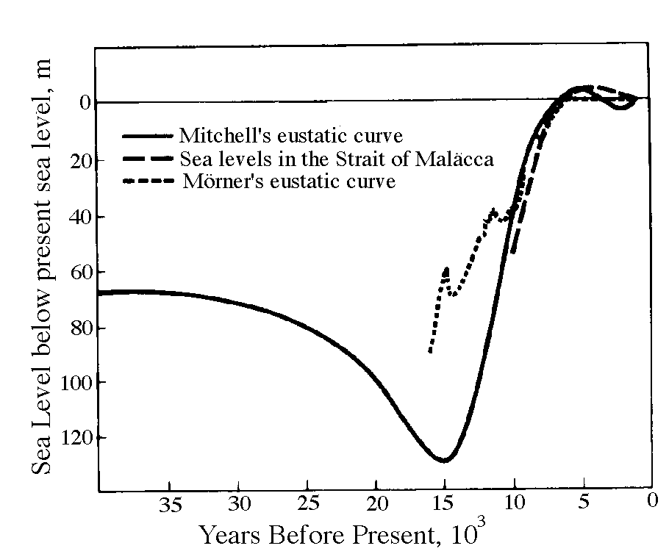
https://www.nytimes.com/interactive/2018/12/18/
climate/galapagos-islands-ocean-warming.html

Slide 32
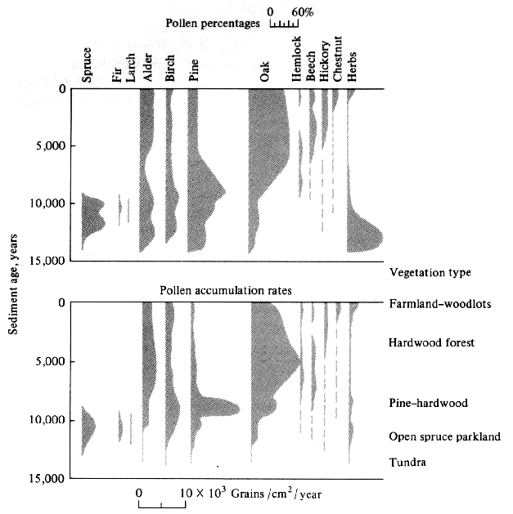

Slide 33
The Geological Time Scale
__________________________________________________________________
Years in millions
since beginning of
Eras Periods Epochs period or epoch
__________________________________________________________________
Quaternary Recent 0.1
Pleistocene 1.6
Cenozoic Pliocene 5
Miocene 22
Tertiary Oligocene 36
Eocene 55
Paleocene 65
__________________________________________________________________
Cretaceous 144
Mesozoic Jurassic 192
Triassic 245
_________________________________________________________________
Permian 290
Carboniferous 360
Devonian 408
Paleozoic Silurian 435
Ordivician 485
Cambrian 570
__________________________________________________________________
Precambrian 4600
____________________________________________________________

Slide 34
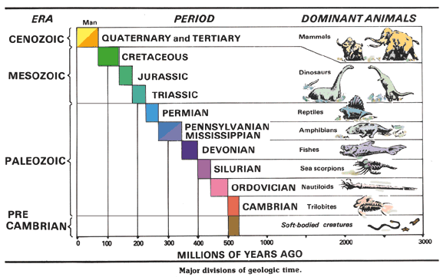

____________________________________________________________

Slide 35
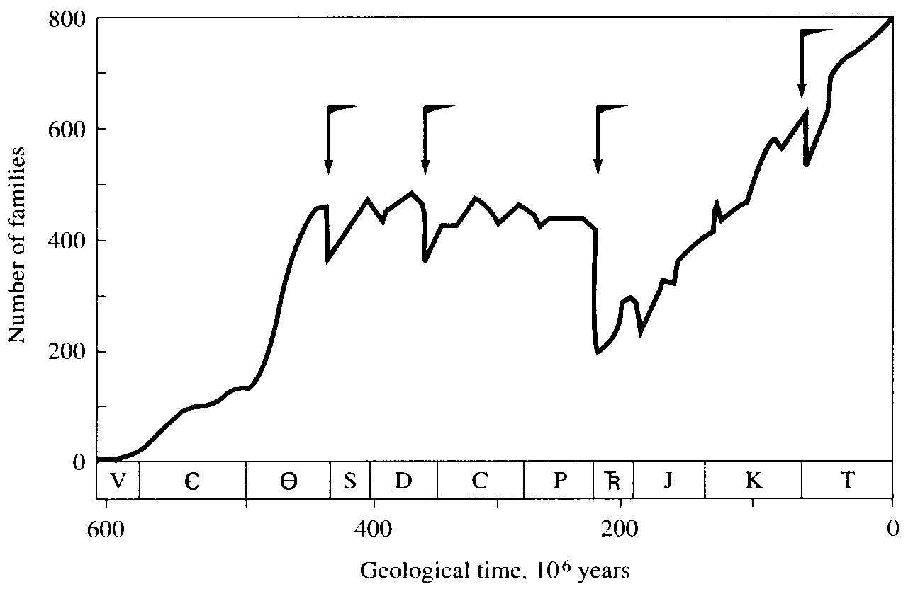
Ward, P. D. 2006. Impact from the deep. Scientific American 295, 64–71.

Slide 36
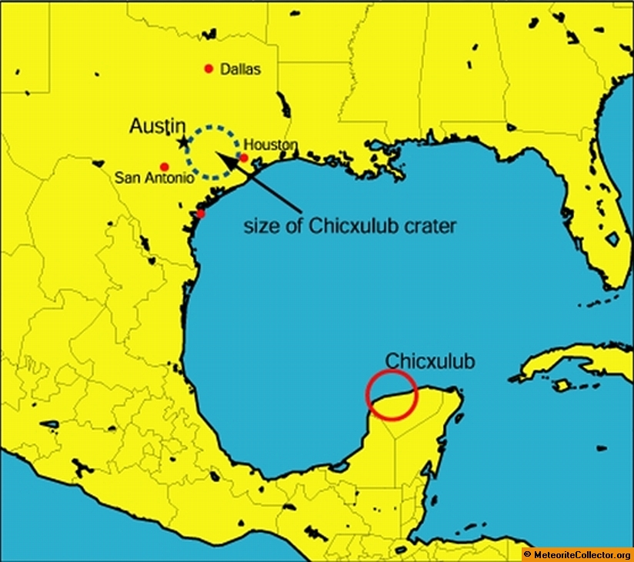
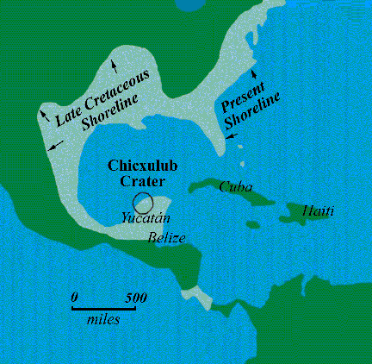
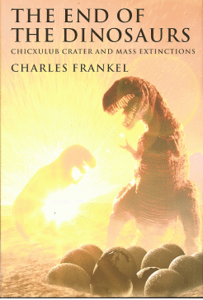

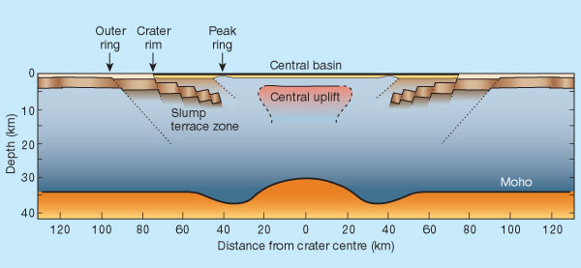
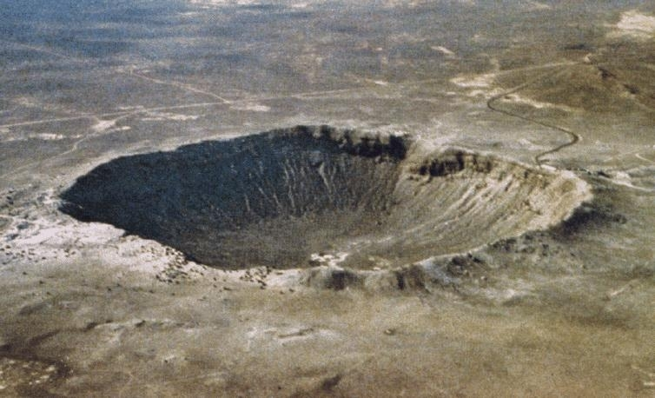

Slide 37
History and Biogeography
Self-replicating molecular assemblages
Geological Past
Shrinking, buckling Earth, Polarity Reversals
Paleoclimatology
Eustatic sea level changes
Palynology (fossil pollen profiles)
Radioisotope dating (half life, C₁₄ carbon 14, ~5700 years)
Geological time scale, Boundaries marked by extinctions
Chicxulub Asteroid impact (iridium layer, 65 mya)
Pleistocene Megafauna“Overkill” hypothesis
Classical Biogeography, Wallace’s Line
Continental drift, sea floor spreading
Foraminifera fossil record
Milankovitch Cycles: Precession, Obliquity, and Eccentricity

Slide 38
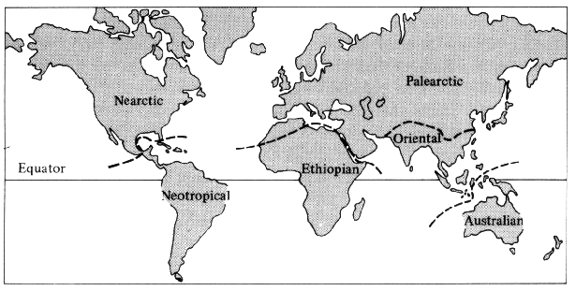
Classical Biogeography, Biogeographic Realms

Slide 39
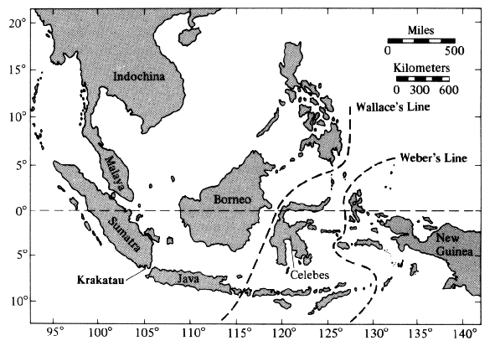
Oriental
Realm

Slide 40
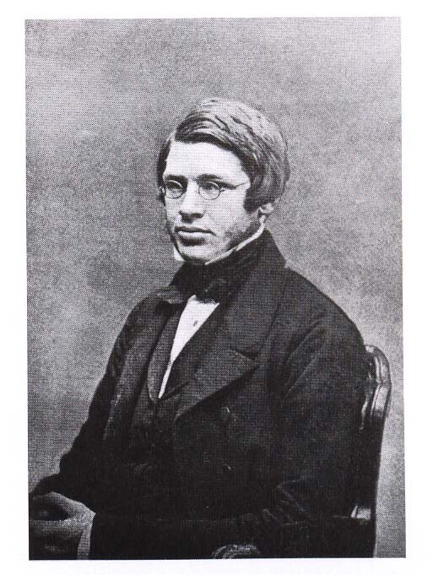
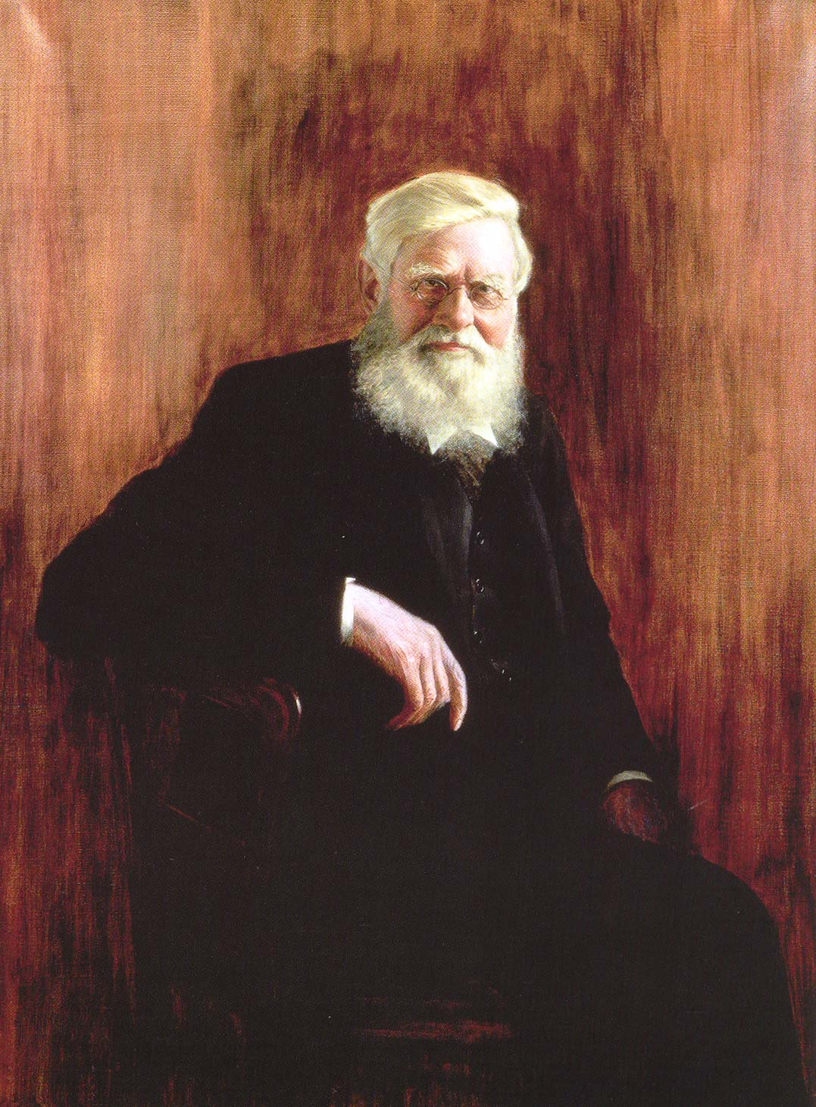
Alfred Russel Wallace

Slide 41
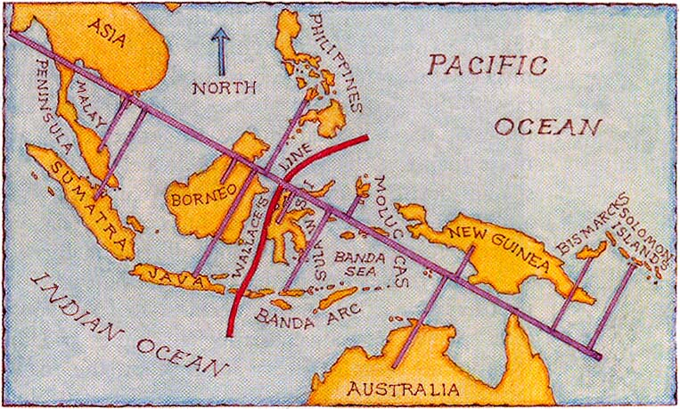
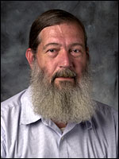
Samuel Sweet

Slide 42
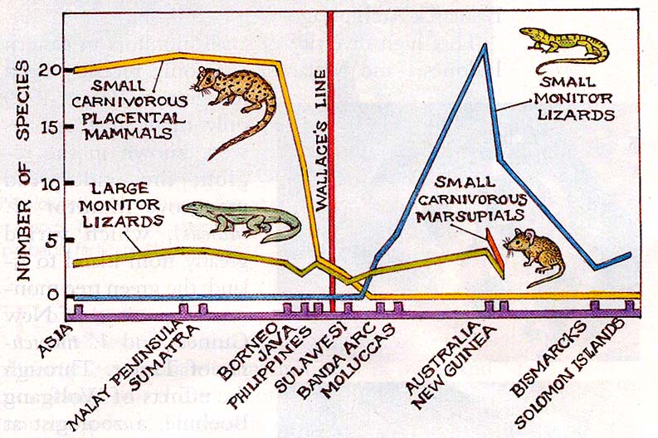
Herpestids, Mongoose
Quolls

Slide 43
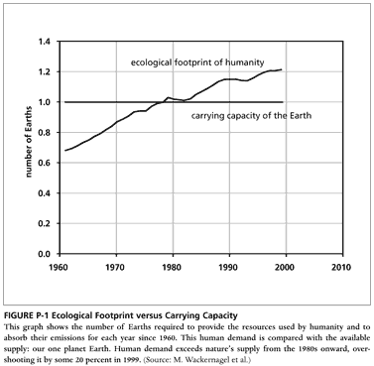
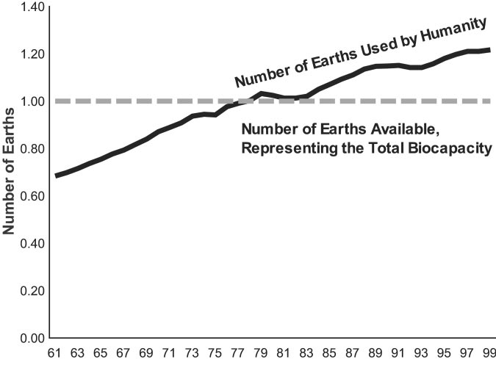
Watch: http://www.upworthy.com/a-smartypants-scientist-makes-an-easy-analogy-about-our-planet-and-now-im-scared
2000 2005 2010
From Proc. Nat. Acad.Sci. (2002), vol.99: 9266-9271

Slide 44
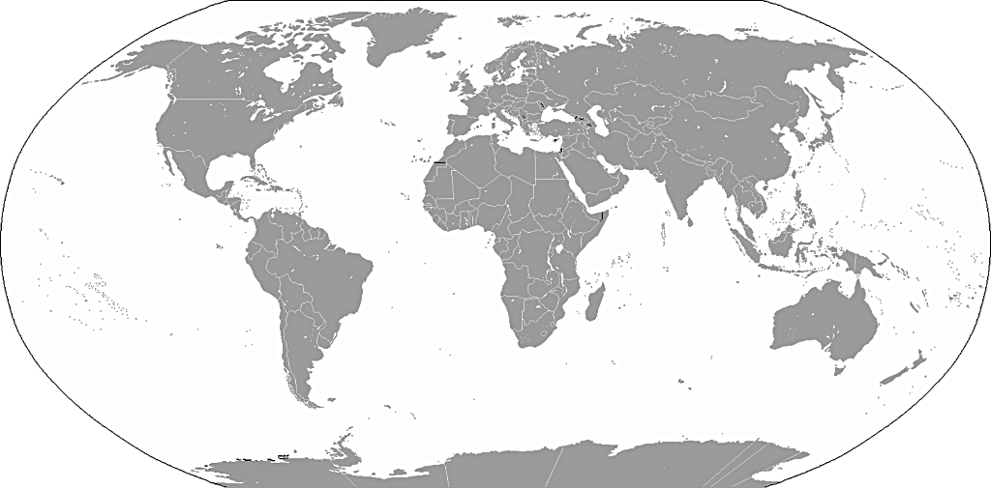
Mercator projection 1569

Slide 45
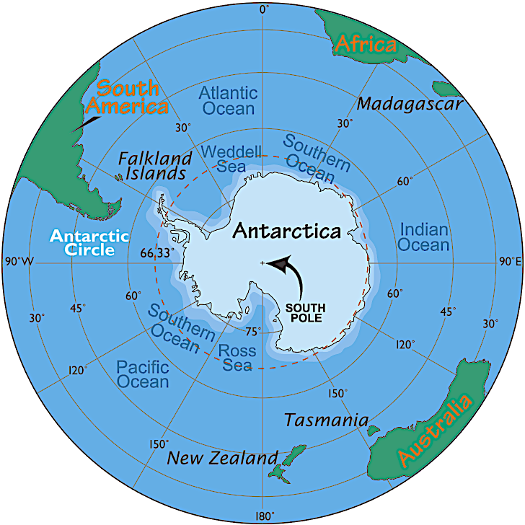

Slide 46
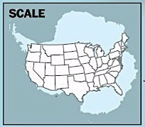

Slide 47
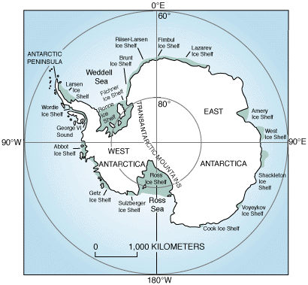

Slide 48
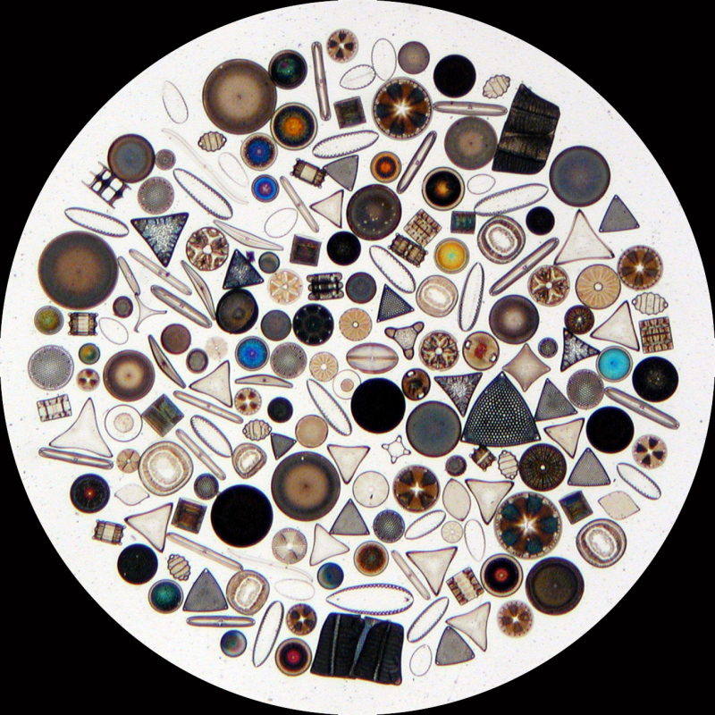
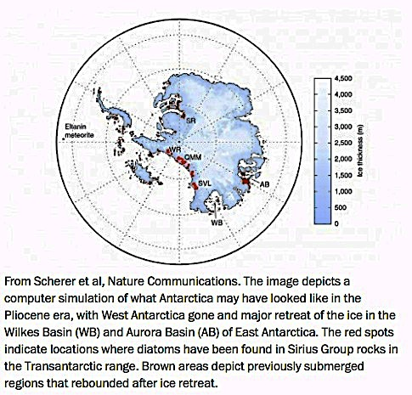
Marine Diatoms
Pliocene Era
5.333 million
to 2.58 million
years BP

Slide 49
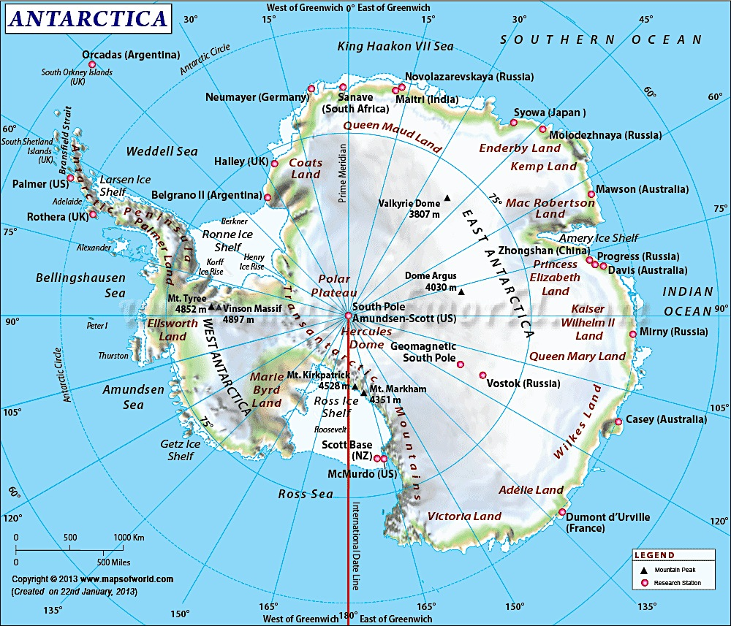

Slide 50
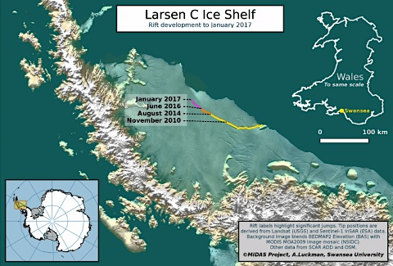

Slide 51

https://www.nytimes.com/interactive/2017/05/18/climate/antarctica-ice-melt-climate-change.html
British Halley Ice Station

Slide 52

British Halley Ice Station

Slide 53


Slide 54

https://www.nytimes.com/interactive/2017/05/18/climate/antarctica-ice-melt-climate-change.html

Slide 55


Slide 56

https://www.nytimes.com/interactive/2017/05/18/climate/antarctica-ice-melt-climate-change.html

Slide 57

https://www.nytimes.com/interactive/2017/05/18/climate/antarctica-ice-melt-climate-change.html

Slide 58


Slide 59



Slide 60






Great Auk

Slide 61

Emperor penguin

Slide 62


Slide 63




Lecture # 8
Lecture # 10
24 September 2019
Daily March of Temperature

Slide 64


Constant Temperature below ground
Idealized Thermal Profile

Slide 65


Temperature profiles in a growing cornfield at midday.

Slide 66


Microhabitats
Leaves droop(wilt) which reduces solar heat load and water loss. Leaves in shade present their full surface to collect
as much incoming solar radiation as possible.

Slide 67


Microhabitats
Similarly, desert lizards position themselves perpendicular to the sun’s rays in early morning, basking when environmental temperatures are low, but during the high temperatures of midday, these same lizards reduce their heat load by climbing up off the ground into cooler air, facing directly into the sun, thereby reducing heat gained.

Slide 68


Microhabitat Selection
Plants buffer temperatures and humidities for animals (also wind). An aphid lives in a 2mm thick microhabitat with 100% humidity.
Soils act similarly: temperature and moisture content are more stable deeper down.
Wind operates to increase thermal exchange (“wind chill” effect) and also has a desiccating effect.

Slide 69


Wind Velocities

Slide 70
Potential Evapotranspiration (PET) theoretical temperature-dependent amount of water that could be “cooked out” of an ecological system, given its input of solar energy and provided that much water fell on the area
Actual Evapotranspiration (AET)
“reverse of rain” — actual amount of water returned to the atmosphere (always less than or equal to PET)

Slide 71


Slide 72


Slide 73
During a period of water surplus, some water may be stored by plants and some may accumulate in the soil as soil moisture, depending on runoff and the capacity of soils to hold water; during a later water deficit, such stored water can be used by plants and released back into the atmosphere. Winter rain is generally much less effective than summer rain because of the reduced activity (or complete inactivity) of plants in winter; indeed, two areas with the same annual march of temperature and total annual precipitation may differ greatly in the types of plants they support and in their productivity as a result of their seasonal patterns of precipitation. An area receiving about 50 cm of precipitation annually supports either a grassland vegetation or chaparral, depending on whether the precipitation falls in summer or winter, respectively.

Slide 74
6 CO₂ + 12 H₂O ——> C₆H₁₂O₆ + 6 O₂ + 6 H₂O
Carbon
Dioxide
CO₂ fairly constant at about 0.03 - 0.04 percent of air
(anthropogenic increase) until recently
(CO₂ seldom limits the rate of photosynthesis, usually it is limited by availability of either light or water)
Light
Light
+ water ——> Glucose + oxygen + water

Slide 75

Net Primary Productivity and World Net Primary Production for Earth’s Major Ecosystems
___________________________________________________________________
_____________________________________________________________________________________
Lake and stream 2 100–1500 500 1.0
Swamp and marsh 2 800–4000 2000 4.0
Tropical forest 20 1000–5000 2000 40.0
Temperate forest 18 600–2500 1300 23.4
Boreal forest 12 400–2000 800 9.6
Woodland and shrubland 7 200–1200 600 4.2
Savanna 15 200–2000 700 10.5
Temperate grassland 9 150–1500 500 4.5
Tundra and alpine 8 10–400 140 1.1
Desert scrub 18 10–250 70 1.3
Extreme desert, rock, ice 24 0–10 3 0.07
Agricultural land 14 100–4000 650 9.1
Total land 149 730 109
Open ocean 332 2–400 125 41.5
Continental shelf 27 200–600 350 9.5
Attached algae, estuaries 2 500–4000 2000 4.0
Total ocean 361 155 55
Total for earth 510 885 164 __________________________________________________________________________________

Slide 76

Limiting Factors

Slide 77

Primary Productivity versus Average Annual Precipitation

Slide 78

~
Log AET ~ Log Productivity

Slide 79


Slide 80

Pedogenic Factors
Climate
Time
Topography
Organisms (especially vegetation)
Parent materials
Vasily V. Dokuchaev

Slide 81

Soil
“Horizons”

Slide 82

From Krohne “Ecology: Evolution, Application, Integration

Slide 83

Tropical soils
Litter fall high, but decomposes rapidly
High rainfall leaches out water soluble nutrients
Nutrient poor soils cannot sustain agriculture
Slash and burn, move on … strategy

Slide 84

Primary succession: soils develop from bare rock Rapidly growing colonizing species eventually give way to slow growing, shade tolerant, climax species

Slide 85

Secondary succession on mature soils
Rapidly growing colonizing species give way to slower growing, shade tolerant, climax species

Slide 86

One to one correspondence between climate, vegetation, and soils

Slide 87
Serpentine soils form over serpentine rock.
Rich in magnesium, chromium, and nickel.
Contain little calcium, nitrogen, or phosphorus.
Support a stunted vegetation (low productivity)
Introduced Mediterranean weeds in California
Primary succession is the development of soils from bare rock, a slow process that takes centuries.

Slide 88


Serpentine Soils
Rich in magnesium, chromium, and nickel, but they contain very little
calcium, molybdenum, nitrogen, and phosphorus.

Slide 89
Serpentine Soils
Yreka, Siskiyou County

Slide 90


Slide 91



Slide 92


Slide 93

Ecotones

Slide 94

Siskiyou County

Slide 95

Limnology
Thermal Stratification

Slide 96


Bathythermographs
High Specific Heat of Water
Heaviest at 4° C ( ice floats )
Eutrophic Lakes
Oligotrophic Lakes
Isothermal at
Spring and Fall Turnover

