Slide 1
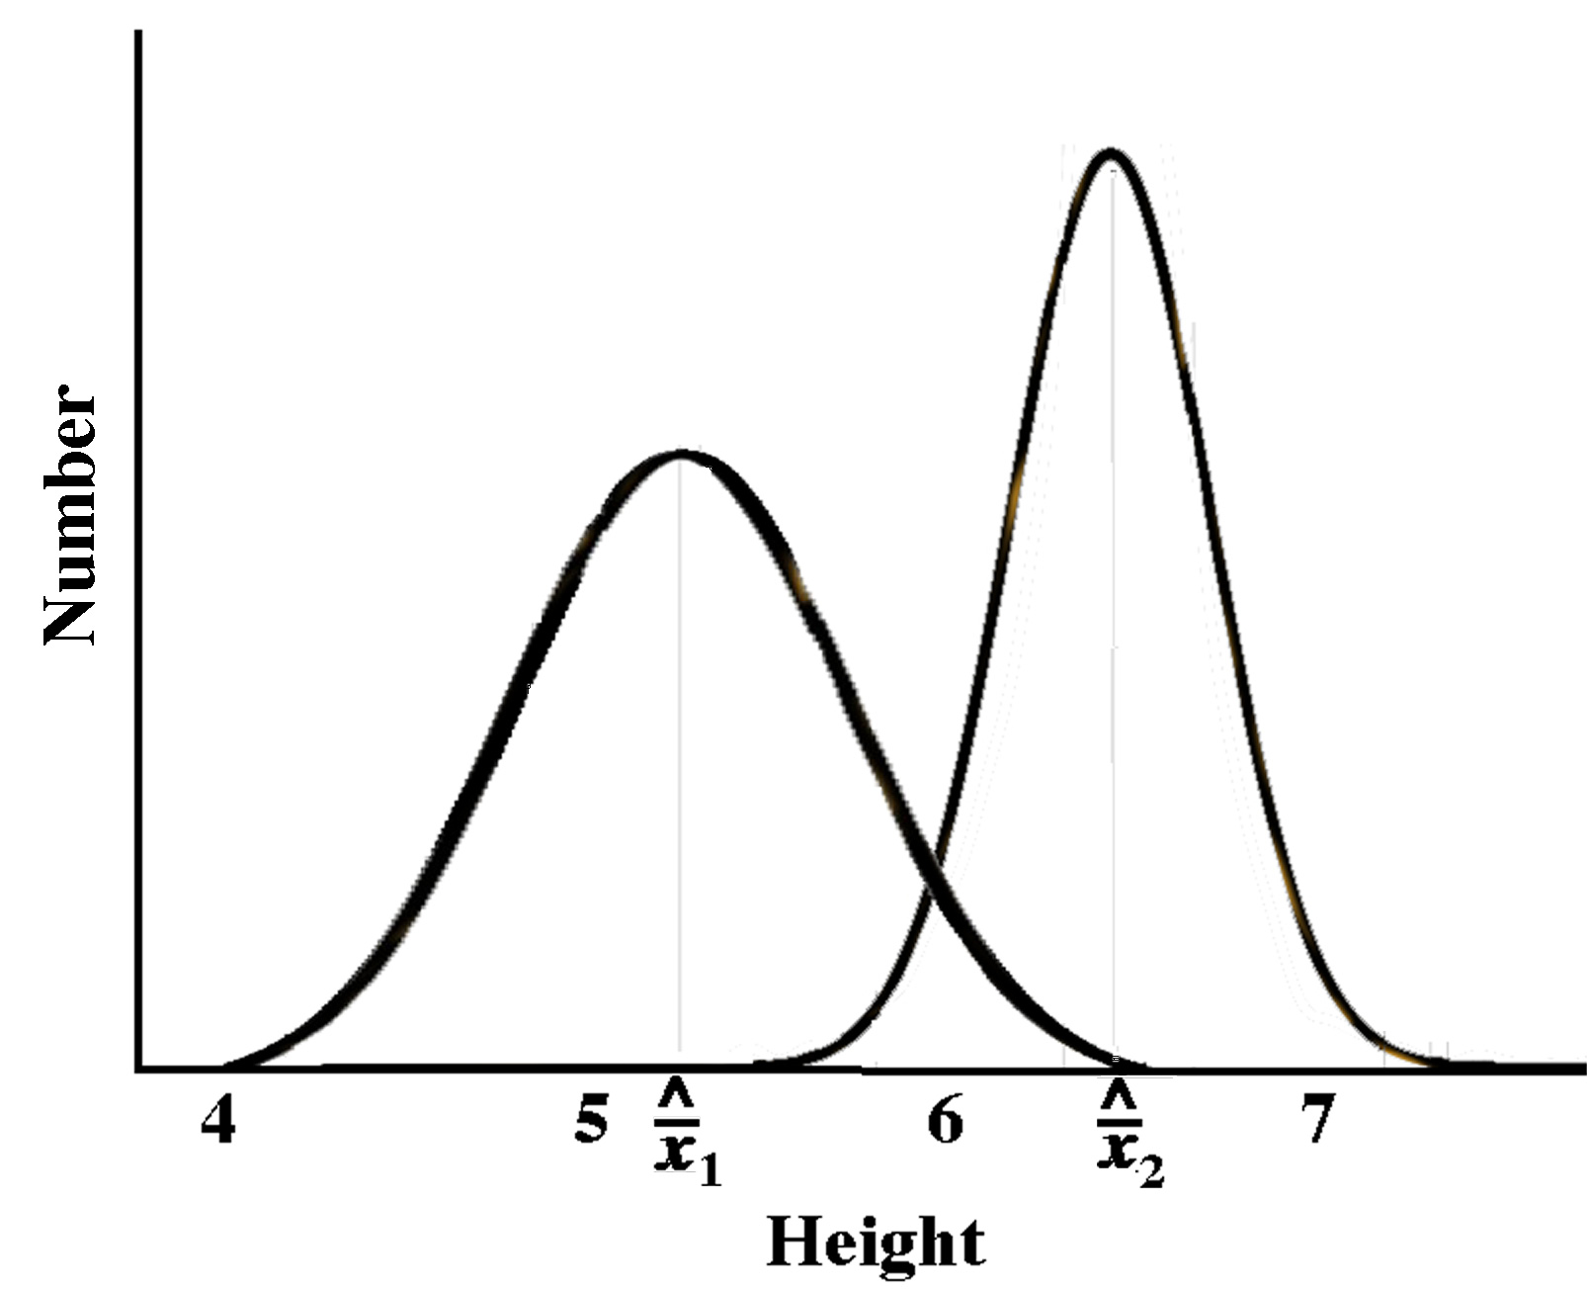
Chapter 8 --Vital Statistics of Populations
Deme (Mendelian Population)
Demography (assume all individuals equal) Population Parameters
(emergent properties)
Mean and Variance
Individual Population
Male or Female Sex Ratio
Has Babies or not Birth Rates
Alive or Dead Death Rates
Given Age Age Structure
Fixed Genotype Gene Frequencies
Growth Rates
Density

Slide 2
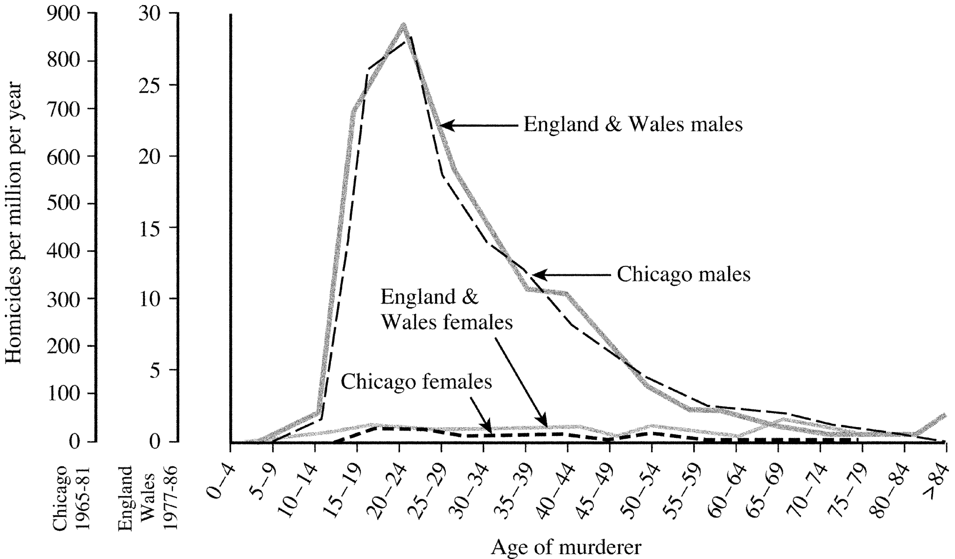

Note 30-fold difference

Slide 3
Note 30-fold difference
Uncanny

Slide 4

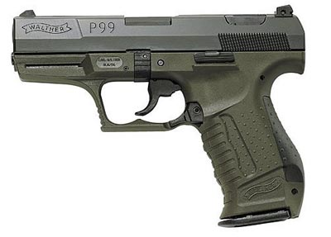
Note 30-fold difference
Saturday
Night Special

Slide 5

More
Personal
(No Guns)
Saturday
Night Special

Slide 6
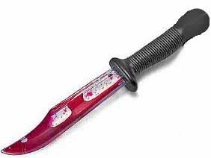
More
Personal
(No Guns)
Saturday
Night Special

Slide 7

More
Personal
(No Guns)
Saturday
Night Special

Slide 8
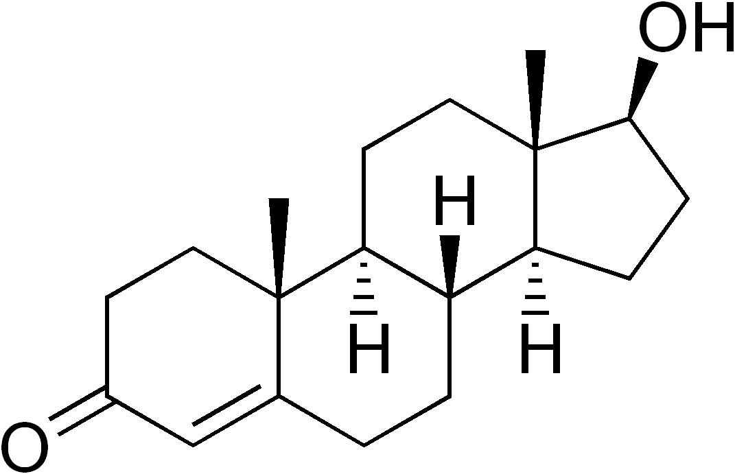
Testosterone
No Guns, More Personal
Saturday Night Special
Lotsa Lead Flying Around

Slide 9
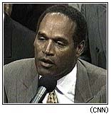
Testosterone
No Guns, More Personal
Saturday Night Special
Lotsa Lead Flying Around

